Slide 1

Easter Sunday
St. Paul’s United Church Sussex, NB
May 11th, 2025
Fourth Sunday of Easter
Welcome

Slide 2
Welcome!
We’re so glad you could join us

Slide 3
Women of the bible
Do you have a favourite woman of the Bible? Write her name on the white board. If there aren’t enough, Jenn will go rogue and select who knows who.

Slide 4
meeting
VBS Craft day is Tuesday, May 13 at 5:30 anyone who wishes to help is welcome.

Slide 5
Luncheon update
Plant sale
The plant sale is May 31st from 9 to noon. Please bring plants on Wed or Thursday of that week, (May 27,28)

Slide 6
Staff Appreciation
M&P Committee would like to acknowledge the contributions of our support staff.
Karen Gallagher, Marty Adair,
Linda McBride, Al Brown.

Slide 7
Grocery cards
You may have seen Shirley or Debbie in the entry way at the table, here’s Shirley to talk about the program.

Slide 8
Introducing---
The chair of the board
Noah gibbons-salib

Slide 9
Volunteers
Thank you to all people who volunteer for events and projects that happen throughout the year.

Slide 10
Creative ideas
There is a box in the entryway where, if you have a creative suggestion, please put it in the box.

Slide 11
Grad Sunday
June 15. Please let us know if you have a family member graduating from high school, college or university. Let Lisa know or sign the sheet in the Narthex.

Slide 12


Slide 13
UCC 100th anniversary
Fun Fact
With Lisa Folkins

Slide 14
Give Us a hand!
Have you drawn your hand outline with a couple of bits of info about you?
Don’t forget to put your name on it.

Slide 15
Take a bottle on Mother’s Day
Return it on Father’s Day.
Put spare change, cash or cheque in the bottle.
Proceeds go to Sussex New Parents and Pregnancy Center.

Slide 16
Good News!

Slide 17

Prelude:
Paul Baloche CCLI

Slide 18
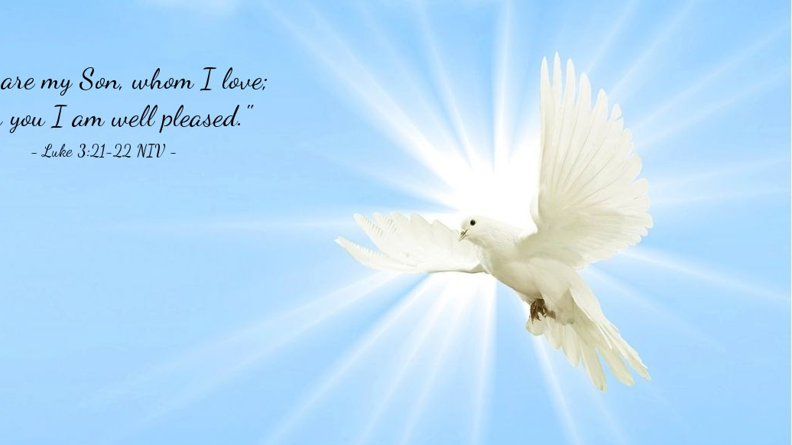
The Peace of Christ.
Sharing the Peace:
Response:
And also with you.
..
Notes:
Hymn Title Page

Slide 19
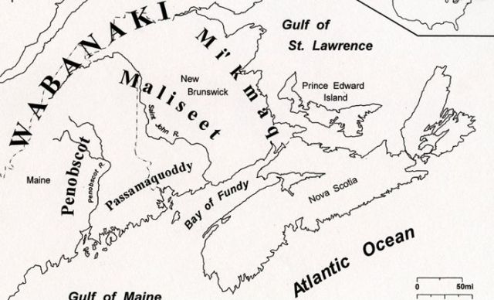
Acknowledging the Territories

Slide 20
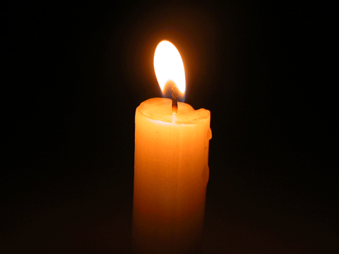
Lighting of the Christ Candle
“Joy is prayer; joy is strength: joy is love; joy is a net of love by which you can catch souls.”
— Mother Teresa

Slide 21
Call to Worship
One: Together with all those in heaven
and on earth, we say:
All: Salvation belongs to our God
who is seated on the throne, and
to the Lamb!
One: Let our hearts be joyful as we
praise:
.

Slide 22
All: We come before the throne of
God to worship day and night.
One: Called together by the Holy
Spirit, let us rejoice and sing:
All: We will hunger and thirst no
more; For Christ brings us eternal
life.

Slide 23
Hymn: VU #187
The Spring Has Come
Words: Shirley Murray Music Colin Gibson ©1990 Reprinted under OneLicense A-725110

Slide 24
The spring has come,
let all the church be part of it!
The world has changed,
and God is at the heart of it!

Slide 25
New light, new day,
new colour after winter grey.
New light, new day,
the spring has come,
let all the church be part of it!

Slide 26
The sun is warm,
let all God's children play in it!
The world expands,
let's spread the Gospel way in it!

Slide 27
New leaf, new thrust,
new greening for the love of Christ.
New leaf, new thrust,
the sun is warm,
Let all God's children play in it!

Slide 28
The spring has come,
new people are the flowers of it.
Through wind and rain,
new life is in the showers of it.

Slide 29
New bud, new shoot,
new hope will bear the Spirit's fruit.
New bud, new shoot,
the spring has come,
New people are the flowers of it!*

Slide 30
Gathering Prayer
God of the ages, God of today,
you are compassion; for our cup
overflows. You are hope; for you
lead us into green pastures. You
are truth; for you lead us beside quiet streams.

Slide 31
You are life; for you restore our
souls. Morning, noon and night, O
God, you are the source of our
joy. We gather to worship you as
one family of your people,
honoring you as our Creator,

Slide 32
trusting you as our Saviour,
celebrating you as the Spirit who
gives us life. Amen.

Slide 33
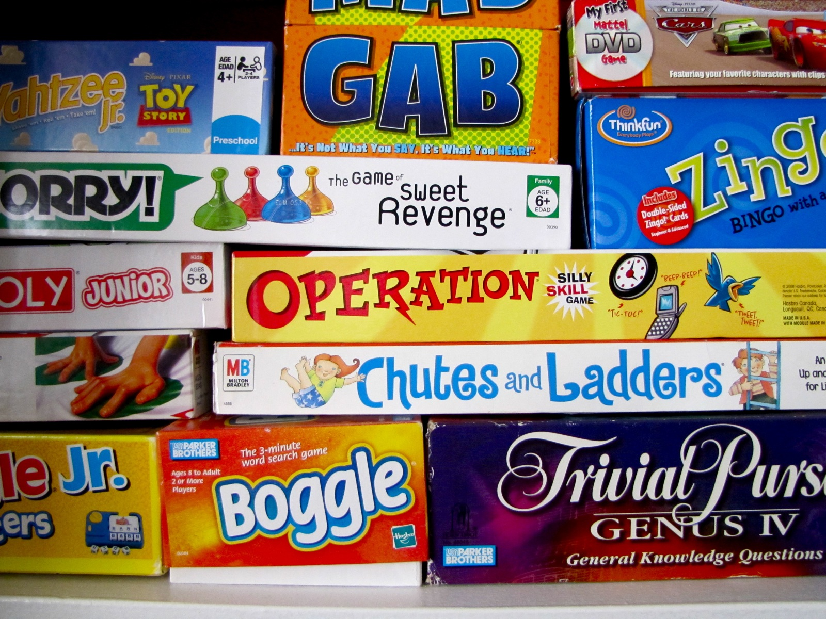
my favourite game…
God style!!!

Slide 34
Hymn: VU #280 Mother and God x2
Miriam Therese Winter 1987 reprinted under OneLicense A-725110

Slide 35
Mother and God,
to you we sing:
Wide is your womb,
warm is your wing.
In you we live, move and are fed
Sweet, flowing milk,
Life giving bread.

Slide 36
Mother and God,
to you we bring
All broken hearts,
all broken wings.

Slide 37
Mother and God,
to you we sing:
Wide is your womb,
warm is your wing.
In you we live, move and are fed
Sweet, flowing milk,
Life giving bread.

Slide 38
Mother and God,
to you we bring
All broken hearts,
all broken wings. *

Slide 39

Prayer for Illumination

Slide 40
Psalm 23:
The LORD is my shepherd; I shall
not want. He makes me lie down in
green pastures; he leads me beside
still waters; he restores my soul. He
leads me in right paths for his name’s
sake

Slide 41
Even though I walk through the
darkest valley, I fear no evil, for
you are with me; your rod and
your staff, they comfort me. You
prepare a table before me in the
presence of my enemies; you
anoint my head with oil; my cup
overflows.

Slide 42
Surely goodness and mercy shall
follow me all the days of my life,
and I shall dwell in the house of
the LORD my whole life long.

Slide 43
Revelation 7: 9-17
After this I looked, and there was a great multitude that no one could count, from every nation, from all tribes and peoples and languages, standing before the throne and before the Lamb, robed in white, with palm
branches in their hands.

Slide 44
They cried out in a loud voice, saying,
“Salvation belongs to our God who is seated on the throne and to the Lamb!” And all the angels stood around
the throne and around the elders and the four living creatures, and they fell on their faces before the throne and worshiped God, singing,

Slide 45
“Amen! Blessing and glory and wisdom and thanksgiving and honor and power and might be to our God forever and ever! Amen.” Then one of the elders addressed me, saying, “Who are these,
robed in white, and where have they come from?” I said to him, “Sir, you are the one who knows.”

Slide 46
Then he said to me, “These are they who have come out of the great ordeal; they have washed their robes and made them white in the blood of the Lamb. For this reason they are before the throne of God and worship
him day and night within his temple,

Slide 47
For this reason they are before the throne of God and worship him day and night within his temple, and the one who is seated on the throne will shelter them. They will hunger no more
and thirst no more; the sun will not strike them, nor any scorching heat, for the Lamb at the center of the throne

Slide 48
will be their shepherd, and he will guide them to springs of the water of
life, and God will wipe away every tear from their eyes.”

Slide 49
John 10:22-30
At that time the Festival of the
Dedication took place in Jerusalem. It was winter, and Jesus was walking in the temple, in the portico of Solomon. So the Jews gathered around him and
said to him, “How long will you keep us in suspense? If you are the Messiah,

Slide 50
tell us plainly.” Jesus answered, “I have told you, and you do not believe. The works that I do in my Father’s name
testify to me, but you do not believe because you do not belong to my sheep. My sheep hear my voice. I know them, and they follow me.

Slide 51
I give them eternal life, and they will
never perish. No one will snatch them out of my hand. My Father, in regard to what he has given me, is greater than all, and no one can snatch them out of the Father’s hand. The Father and I are one.”

Slide 52
Ministry of Music:
The River is Here

Slide 53
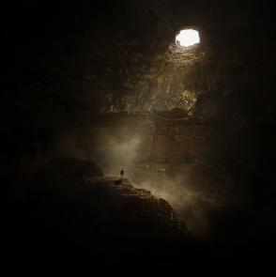
God is searching

Slide 54
Hymn: MV #126 Are You a Shepherd?
Words: copyright Iona Community reprinted under OneLicense A-725110

Slide 55
Are you a shepherd,
good shepherd who leads us
Safely through danger,
while calming our fears?
Are you a father who
Shelters and feeds us,
Shares in our laughter
and wipes away tears?

Slide 56
Yes, you are shepherd,
parent and teacher,
But you are greater
than all that we know.
Holy and living,
loving and giving,
God, you are with us
wherever we go.

Slide 57
Yes, you are shepherd,
parent and teacher,
But you are greater
than all that we know.
Holy and living,
loving and giving,
God, you are with us
wherever we go.

Slide 58
Great, gentle shepherd,
forever beside us,
Lead all your children
in paths that are right.
Great, loving parent,
wise teacher, you guide us.
We want to love you
and bring you delight.

Slide 59
Yes, you are shepherd,
parent and teacher,
But you are greater
than all that we know.
Holy and living,
loving and giving,
God, you are with us
wherever we go. *

Slide 60
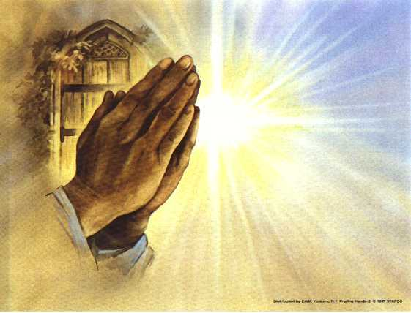
Prayers of the People
One: Lord, in your mercy,
All: Hear our prayers.

Slide 61
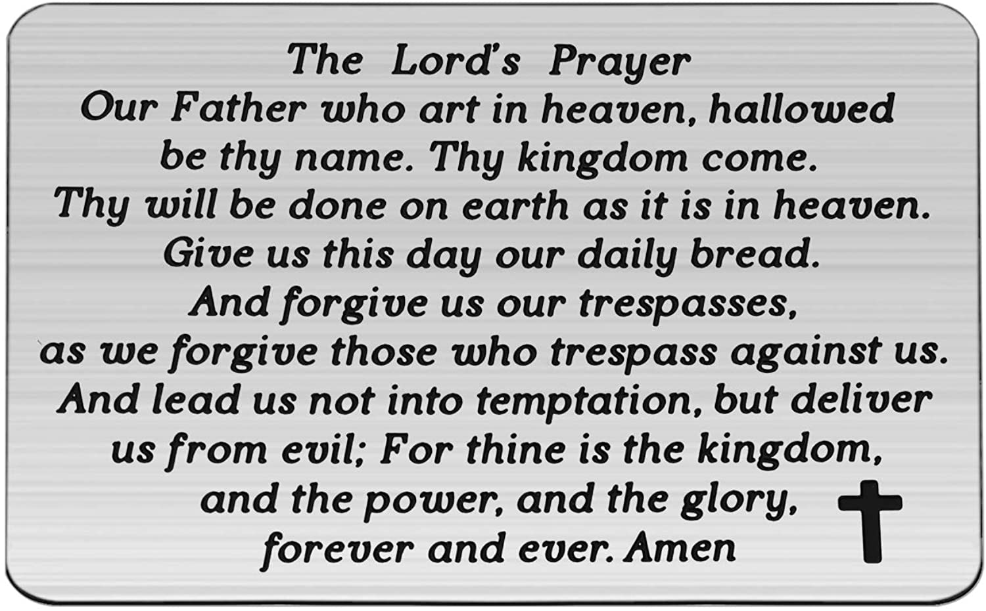

Slide 62
Support the ministry of St. Paul’s :
Through PAR – ask us how to join
via Canada Helps
search for St. Paul’s Sussex
via e-transfer to treasurerstpaulsucc1@gmail.com.
drop in collection plates located in the Narthex and near exit door
by mail to
4 Morrison Avenue, Sussex, N.B. E4E 1P5
during office hours
Notes:
Body text for hymns and prayers

Slide 63
Prayer of Dedication
Generous God, thank you for all
we have received from you in
Christ and in creation; your
generosity to us overflows. Bless
the gifts we bring and use them
and us in the service of your reign
of justice and peace,

Slide 64
in the name of Jesus Christ, our
Saviour and Guide. Amen.

Slide 65
Hymn: VU #556
Would You Bless Our Homes and Families
Words: Walter Farquharson reprinted under OneLicense 725110

Slide 66
Would you bless our homes and families,
Source of life who calls us here;
In our world of stress and tension
Teach us love that conquers fear.

Slide 67
Help us learn to love each other
With a love that constant stays;
Teach us when we face our troubles,
Love's expressed in many ways.

Slide 68
When our way is undemanding,
Let us use the time that's ours
To delight in simple pleasures,
Sharing joys in gentle hours.
When our way is anxious walking
And a heavy path we plod,
Teach us trust in one another
And in you, our gracious God.

Slide 69
From the homes in which we're nurtured,
With the love that shapes us there,
Teach us, God, to claim as family
Every one whose life we share.

Slide 70
And through all that life may offer,
May we in your love remain;
May the love we share in families
Be alive to praise your name.

Slide 71
Let us reach beyond the boundaries
Of our daily thought and care
Till the family you have chosen
Spills its love out everywhere.

Slide 72
Help us learn to love each other
With a love that constant stays;
Teach us when we face our troubles
Love's expressed in many ways. *

Slide 73
Benediction
&
Commission

Slide 74
Sung Benediction:
Giver of New Life
1997 Bruce Harding

Slide 75
O Giver of new life, In Jesus Christ you came.
To bring us peace and joy,
We praise your holy name.
Hallelujah, Praise God Hallelujah.
Hallelujah, Praise God Hallelujah.

Slide 76
Hallelujah, Praise God Hallelujah.
Hallelujah, Praise God Hallelujah.
*

