Slide 1

Easter Sunday
St. Paul’s United Church Sussex, NB
May 18th, 2025
Fifth Sunday of Easter
Welcome

Slide 2
Welcome!
We’re so glad you could join us

Slide 3
Women of the bible
Do you have a favourite woman of the Bible? Write her name on the white board. If there aren’t enough, Jenn will go rogue and select who knows who.

Slide 4
Creative ideas
There is a box in the entryway where, if you have a creative suggestion, you can put it in the box for review.

Slide 5
Creative ideas
We are looking for material that you could donate that looks like the northern lights for a special 100th Anniversary crafty thing.

Slide 6
KNH
St. Paul’s is providing the afternoon service, this afternoon, at Kiwanis Nursing Home. Please consider joining us there at 1:30.

Slide 7
Grad Sunday
June 15. Please let us know if you have a family member graduating from high school, college or university. Let Lisa or the office know.

Slide 8


Slide 9
UCC 100th anniversary
Fun Fact
With Lisa Folkins

Slide 10
Good News!

Slide 11

Prelude:
Paul Baloche CCLI

Slide 12
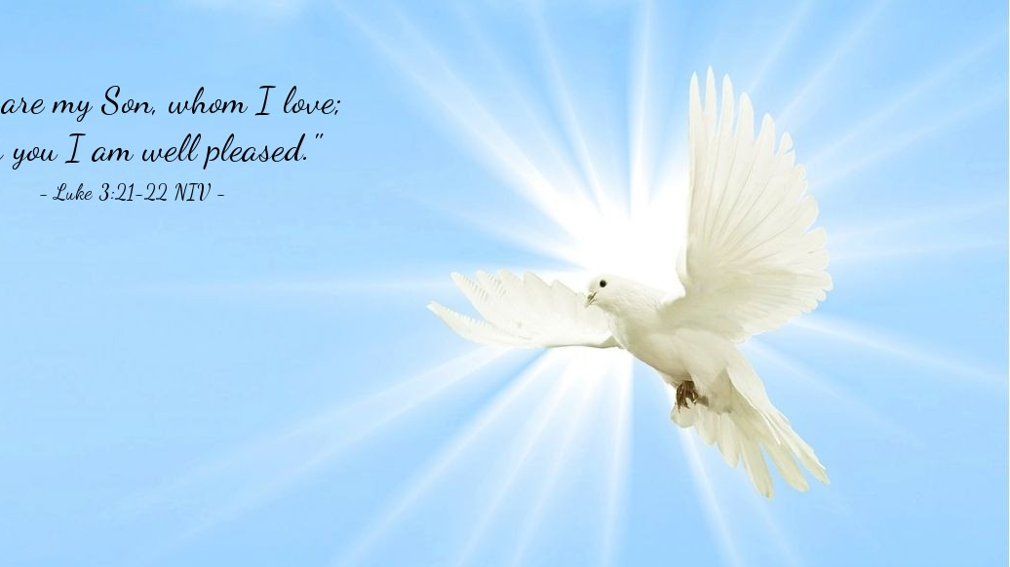
The Peace of Christ.
Sharing the Peace:
Response:
And also with you.
..
Notes:
Hymn Title Page

Slide 13
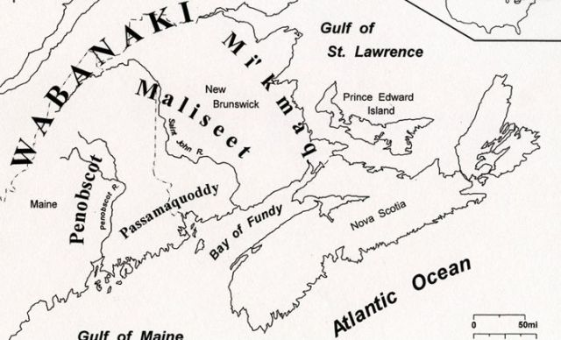
Acknowledging the Territories

Slide 14
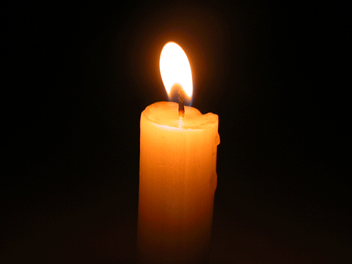
Lighting of the Christ Candle
“The opposite of love is not hate, it’s indifference.”
- Elie Wiesel

Slide 15
Call to Worship (based on Psalm 148)
One: Praise the Lord!
All: Praise God in the heights!
One: Praise God, all you angels; praise God, all creatures high and low!
All: Rulers of the earth and all peoples, praise God’s holy name!

Slide 16
One: Praise God, all of creation, from
hummingbirds to humpback whales,
from mountain tops to valleys!
All: Let all creation, sing out God’s divine glory!
One: Let us praise God, together!
All: With one voice, let us praise the Lord!

Slide 17
Hymn Sing: MV #2, MV #41, MV #30
vs 1,4
Words and Music: WCC, Carolyn McDade, Ruth Duck, Ron Klusmeier Reprinted under OneLicense A-725110

Slide 18
Come All You people,
Come and praise your Maker.
Come All You people,
Come and praise your Maker,
Come All You people,
Come and praise your Maker
Come now and worship the Lord.
1

Slide 19
Come All You people,
Come and praise your Maker.
Come All You people,
Come and praise your Maker,
Come All You people,
Come and praise your Maker
Come now and worship the Lord.
2

Slide 20
O beautiful Gaia,
O Gaia calling us home
O beautiful Gaia,
Calling us on.

Slide 21
Soil yielding its harvest,
O Gaia calling us home
Soil yielding its harvest,
calling us on.
Loon nesting in marshland,
O Gaia calling us home.
Loon nesting in Marshland,
calling us on.

Slide 22
O beautiful Gaia,
O Gaia calling us home
O beautiful Gaia,
Calling us on.

Slide 23
It’s a song of praise to the Maker,
The thrush sings high in the tree.
It’s a song of praise to the Maker
The gray whale sings in the sea.
And by the Spirit, you and I
Can join our voice to the holy cry
And sing, sing,
sing to the Maker too.

Slide 24
It’s the chorus of all creation;
It’s sung by all living things.
It’s the chorus of all creation;
A song the universe sings.
And by the Spirit, you and I
Can join our voice to the holy cry
And sing, sing,
sing to the Maker too. *

Slide 25
Gathering Prayer
Holy God, you are the beginning
and end of all things, and you are
worthy of praise from all your
creation. Sun, moon, and stars
praise you. Earth, sea, and sky
praise you. Every living thing
praises you in its own way.

Slide 26
And so, we praise you in our
human diversity, joining our
varied voices with all your
creatures in heaven and on earth.
You fill our lives with the wonder
of your love in Christ Jesus.

Slide 27
Your Spirit moves throughout the
world to reveal your purposes for
every living thing. Receive our
prayers and praise this day, for
you are the Source of our life and
our hope, Holy God, ever Three
and ever One. Amen.

Slide 28


How do we show our excitement?

Slide 29
Hymn: MV #156
Dance with the Spirit
Words and Music Jim Strathdee © 1995 All right reserved. Reprinted under OneLicense A-725110

Slide 30
Dance with the Spirit
early in the mornin’,
Walk with the Spirit
throughout the long day.
Work and hope
for the new life a-bornin’,
Listen to the Spirit
to show you the way.

Slide 31
Dance with the Spirit
early in the mornin’,
Move with the Spirit
throughout the long day.
Work and hope
for the new life a-bornin’,
Listen to the Spirit
to show you the way.

Slide 32
Dance with the Spirit
early in the mornin’,
Sing with the Spirit
throughout the long day.
Work and hope
for the new life a-bornin’,
Listen to the Spirit
to show you the way. *

Slide 33

Prayer for Illumination

Slide 34
Psalm 148:
Praise the LORD! Praise the LORD from the heavens; praise him in the heights! Praise him, all his angels; praise him, all his host! Praise him, sun and moon; praise him, all you shining stars!

Slide 35
Praise him, you highest heavens and you waters above the heavens! Let them praise the name of the LORD,
for he commanded and they were created. He established them forever and ever; he fixed their bounds, which cannot be passed.

Slide 36
Praise the LORD from the earth, you sea monsters and all deeps, fire and hail, snow and frost, stormy wind fulfilling his command! Mountains and all hills, fruit trees and all cedars! Wild animals and all cattle, creeping things and flying birds!

Slide 37
Kings of the earth and all peoples, princes and all rulers of the earth! Young men and women alike, old and young together! Let them praise the name of the LORD, for his name alone is exalted; his glory is above earth and heaven.

Slide 38
He has raised up a horn for his people, praise for all his faithful, for the people of Israel who are close to him. Praise the LORD!

Slide 39
Revelation 21:1-6
Then I saw a new heaven and a new earth, for the first heaven and the first earth had passed away, and the sea was no more. And I saw the holy city, the new Jerusalem, coming down out of heaven from God, prepared as a bride adorned for her husband.

Slide 40
And I heard a loud voice from the throne saying, “See, the home of God is among mortals. He will dwell with them; they will be his peoples, and God himself will be with them and be their God; he will wipe every tear from their eyes.

Slide 41
Death will be no more; mourning and crying and pain will be no more, for the first things have passed away.” And the one who was seated on the throne said, “See, I am making all things new.” Also he said, “Write this, for these words are trustworthy and true.”

Slide 42
Then he said to me, “It is done! I am the Alpha and the Omega, the Beginning and the End. To the thirsty I will give water as a gift from the spring of the water of life.

Slide 43
John 13:31-35
When he had gone out, Jesus said, “Now the Son of Man has been glorified, and God has been glorified in him. If God has been glorified in him, God will also glorify him in himself and will glorify him at once.

Slide 44
Little children, I am with you only a little longer. You will look for me, and as I said to the Jews so now I say to you, ‘Where I am going, you cannot come.’ I give you a new commandment, that you love one another. Just as I have loved you, you also should love one another.

Slide 45
By this everyone will know that you are my disciples, if you have love for one another.”

Slide 46
Ministry of Music:
Built On the Rock

Slide 47

Looking for Love in all the wrong places…

Slide 48
Hymn: MV #94
Love Knocks and Waits
(Tune – Amazing Grace)
Words & Music: Daniel Charles Damon 1994 reprinted under OneLicense A725110

Slide 49
Love knocks and waits
for us to hear,
To open and invite;
Love longs to quiet every fear,
And seeks to set things right.

Slide 50
Love offers life, in spite of foes
Who threaten and condemn;
Embracing enemies, Love goes
The second mile with them.

Slide 51
Love comes to heal the broken heart,
To ease the troubled mind;
Without a word Love bids us start
To ask and seek and find.

Slide 52
Love knocks and enters at the sound
Of welcome from within;
Love sings and dances all around,
And feels new life begin. *

Slide 53
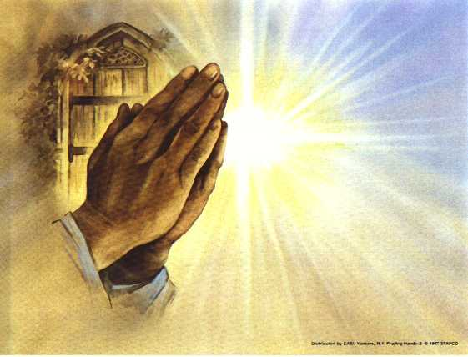
Prayers of the People

Slide 54
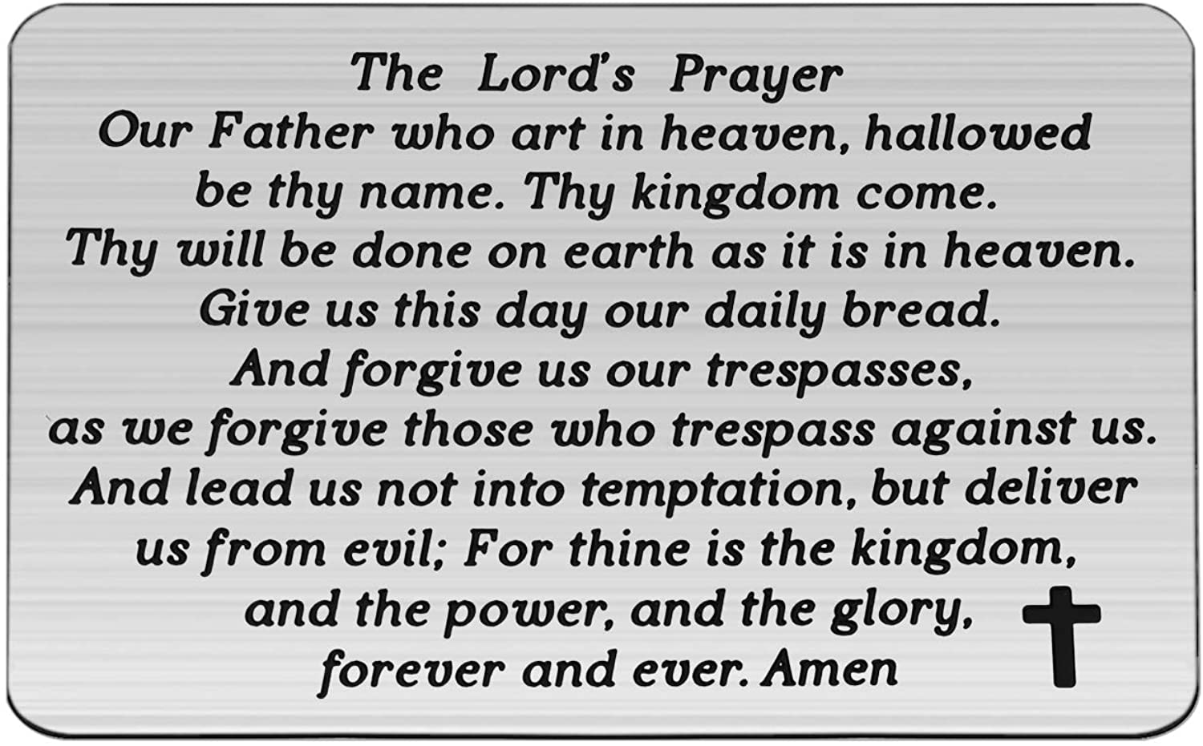

Slide 55
Support the ministry of St. Paul’s :
Through PAR – ask us how to join
via Canada Helps
search for St. Paul’s Sussex
via e-transfer to treasurerstpaulsucc1@gmail.com.
drop in collection plates located in the Narthex and near exit door
by mail to
4 Morrison Avenue, Sussex, N.B. E4E 1P5
during office hours
Notes:
Body text for hymns and prayers

Slide 56
Prayer of Dedication
Generous God, we bless you for
your gift of life renewed through
Christ’s love, and through
springtime growth in fields and
gardens.

Slide 57
Bless the gifts we bring
and make them signs of hope and
renewal in the world we serve in
the name of Jesus Christ, our
Risen Lord. Amen.

Slide 58
Hymn: MV #25
O God Send Out Your Spirit vs 1&2
ICEL, Jesse Manibusan 1996 reprinted under OneLicense 725110

Slide 59
O God, send out your Spirit;
Renew the face of the earth.
O God, send out your Spirit;
Renew the face of the earth.

Slide 60
We bless you O God,
for you are so great.
Your Spirit uncovers
hidden beauty and grace.
Though times we deny,
all the pain and the tears,
Your Spirit empowers us
and soon we face our fears.

Slide 61
O God, send out your Spirit;
Renew the face of the earth.
O God, send out your Spirit;
Renew the face of the earth.

Slide 62
Every prayer we pray,
sacred word, sacred rite,
Is for the ones who
are left waiting outside.
Ev’ry sermon we preach,
ev’ry Spirit filled tune;
Love says, “Remember
why we do the things we do”.

Slide 63
O God, send out your Spirit;
Renew the face of the earth.
O God, send out your Spirit;
Renew the face of the earth. *

Slide 64
Benediction
&
Commission

Slide 65
Sung Benediction:
Giver of New Life
1997 Bruce Harding

Slide 66
O Giver of new life, In Jesus Christ you came.
To bring us peace and joy,
We praise your holy name.
Hallelujah, Praise God Hallelujah.
Hallelujah, Praise God Hallelujah.

Slide 67
Hallelujah, Praise God Hallelujah.
Hallelujah, Praise God Hallelujah.
*

