Slide 1

Easter Sunday
St. Paul’s United Church
Sussex, NB
May 25th, 2025
Sixth Sunday of Easter
Welcome

Slide 2
Welcome!
We’re so glad you could join us

Slide 3
The st. paul’s plant sale
Please bring in your plants this week during office hours for the plant sale. The sale is Saturday, May 31st, 9 - 12

Slide 4
Creative ideas
There is a box in the entryway where, if you have a creative suggestion, you can put it in the box for review.

Slide 5
Creative ideas
We are looking for material that you could donate that looks like the northern lights for a special 100th Anniversary crafty thing.

Slide 6
Grad Sunday
June 15. Please let us know if you have a family member graduating from high school, college or university. Let Lisa or the office know.

Slide 7


Slide 8
UCC 100th anniversary
Fun Fact
With Lisa Folkins

Slide 9
Good News!

Slide 10

Prelude: New Hymn
When Jesus the Healer vs 1
Paul Baloche CCLI

Slide 11
When Jesus the healer
Passed through Galilee,
Heal us, heal us today!
The deaf came to hear
And the blind came to see.
Heal us, Lord Jesus!

Slide 12
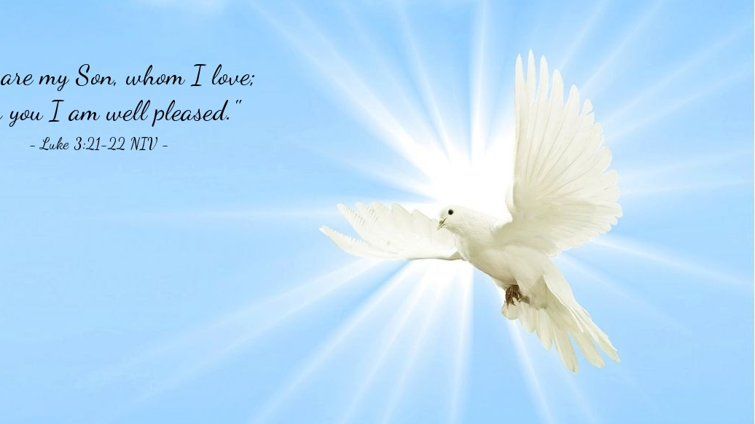
The Peace of Christ.
Sharing the Peace:
Response:
And also with you.
..
Notes:
Hymn Title Page

Slide 13
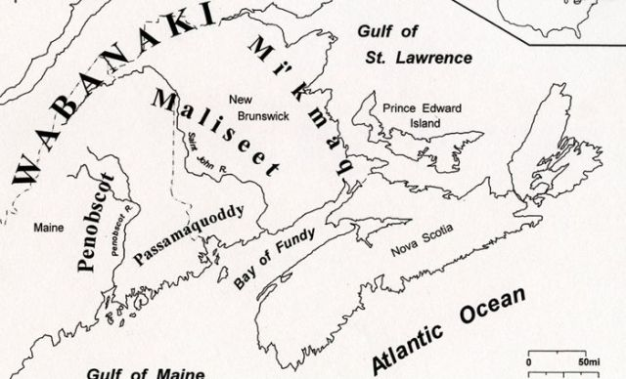
Acknowledging the Territories

Slide 14
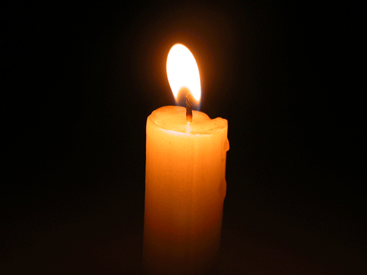
Lighting of the Christ Candle
“Anybody can observe the Sabbath, but making it holy surely takes the rest of the week”
– Alice Walker

Slide 15
Call to Worship
One: Let the peoples praise you, O God;
All: let all the peoples praise you!
One: Let the earth rejoice and be glad,
All: let the heavens declare your
righteousness!

Slide 16
One: May all people see your glory, O God;
All: may your ways be known
throughout the earth.

Slide 17
One: Let us worship the God who loves us;
All: We come to worship with
open hearts, to raise our voices
with thanks and praise.

Slide 18
Hymn Sing: VU# 218 We Praise You, O God
Words: Ruth Duck Music: Ron Klusmeier Reprinted under OneLicense A-725110

Slide 19
We praise you, O God,
our Redeemer, Creator;
In grateful devotion
our tribute we bring.
We lay it before you;
we kneel and adore you;
We bless your holy name,
glad praises we sing.
1

Slide 20
We worship you, God
of our mothers and fathers,
Through trial and tempest,
companion and guide.
When perils o'ertake us,
you will not forsake us,
But faithful to your promise,
you walk by our side.

Slide 21
With voices united
our praises we offer
And gladly our songs
of thanksgiving we raise.
Our sins now confessing,
we pray for your blessing,
To you, our great Redeemer,
forever be praise! *

Slide 22
Gathering Prayer
Generous and Loving God, we
greet you this day with thankful
hearts. Knowing that you shine
your face upon us and instill
within us your ways, we come
offering you our uplifted praises.

Slide 23
In these moments we feel your
presence all around us your world
is full of such variety and detail,
that we stand in awe of your
creative imagination. Draw close
to us in this hour of worship and
show us the promise and purpose
in our own lives.

Slide 24
May we unfurl with your gift of
new life, and move into the
future, renewed by the energy of
your Holy Spirit. Amen

Slide 25


Slide 26
Hymn: MV #119
God Our Protector 2x
Words and Music Steve Bell reprinted under OneLicense A-725110

Slide 27
God our protector,
Keep us in mind,
Always give strength
To your people.
For if we could be with you
One day in time
It is better than a
Thousand without you.

Slide 28
God our protector,
Keep us in mind,
Always give strength
To your people.
For if we could be with you
One day in time
It is better than a
Thousand without you. *

Slide 29

Prayer for Illumination

Slide 30
Psalm 67:
May God be gracious to us and bless
us and make his face to shine upon
us, Selah that your way may be known
upon earth, your saving power among
all nations. Let the peoples praise you,
O God; let all the peoples praise you.

Slide 31
Let the nations be glad and sing for
joy, for you judge the peoples with
equity and guide the nations upon
earth. Selah Let the peoples praise
you, O God; let all the peoples praise
you. The earth has yielded its
increase; God, our God, has blessed
us.

Slide 32
May God continue to bless us; let all
the ends of the earth revere him.

Slide 33
John 14:23-29
Jesus answered him, “Those who love
me will keep my word, and my Father
will love them, and we will come to
them and make our home with them.
Whoever does not love me does not
keep my words,

Slide 34
and the word that you hear is not
mine but is from the Father who sent
me. “I have said these things to you
while I am still with you. But the
Advocate, the Holy Spirit, whom the
Father will send in my name, will teach
you everything and remind you of all
that I have said to you.

Slide 35
Peace I leave with you; my peace I
give to you. I do not give to you as
the world gives. Do not let your hearts
be troubled, and do not let them be
afraid. You heard me say to you, ‘I am
going away, and I am coming to you.’
If you loved me, you would rejoice
that I am going to the Father,

Slide 36
because the Father is greater than I.
And now I have told you this before it
occurs, so that when it does occur you
may believe.

Slide 37
John 5:1-9
After this there was a festival of the
Jews, and Jesus went up to
Jerusalem. Now in Jerusalem by the
Sheep Gate there is a pool, called in
Hebrew Beth-zatha, which has five
porticoes. In these lay many ill, blind,
lame, and paralyzed people.

Slide 38
One man was there who had been ill
for thirty-eight years. When Jesus saw
him lying there and knew that he had
been there a long time, he said to
him, “Do you want to be made well?”
The ill man answered him, “Sir, I have
no one to put me into the pool when
the water is stirred up,

Slide 39
and while I am making my way
someone else steps down ahead of
me.” Jesus said to him, “Stand up,
take your mat and walk.” At once the
man was made well, and he took up
his mat and began to walk. Now that
day was a Sabbath.

Slide 40
Ministry of Music:
Sit Down Servant

Slide 41
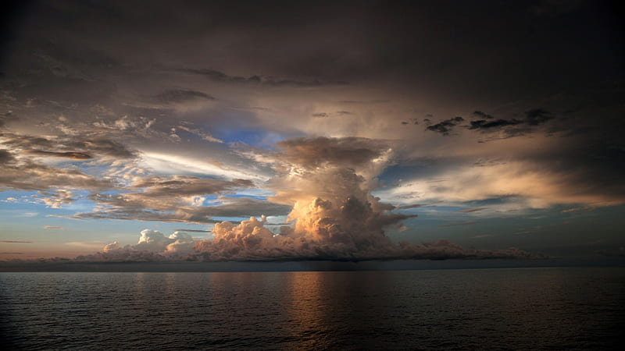
Come What May

Slide 42
Hymn: VU #358 When Jesus the Healer
omit vs 3,6
Words & Music: Peter D. Smith 1978 reprinted under OneLicense A725110

Slide 43
When Jesus the healer
Passed through Galilee,
Heal us, heal us today!
The deaf came to hear
And the blind came to see.
Heal us, Lord Jesus!

Slide 44
A paralyzed man was
Let down through a roof.
Heal us, heal us today!
His sins were forgiven,
His walking the proof
Heal us, Lord Jesus

Slide 45
When blind Bartimaeus
Cried out to the Lord,
Heal us, heal us today!
His faith made him whole
And his sight was restored.
Heal us, Lord Jesus

Slide 46
The lepers were healed
And the demons cast out.
Heal us, heal us today!
A bent woman straightened
To laugh and to shout.
Heal us, Lord Jesus!

Slide 47
There’s still so much sickness
And suffering today.
Heal us, heal us today!
We gather together
For healing and pray:
Heal us, Lord Jesus! *

Slide 48

One: God of mercy,
All: Hear our cry.

Slide 49
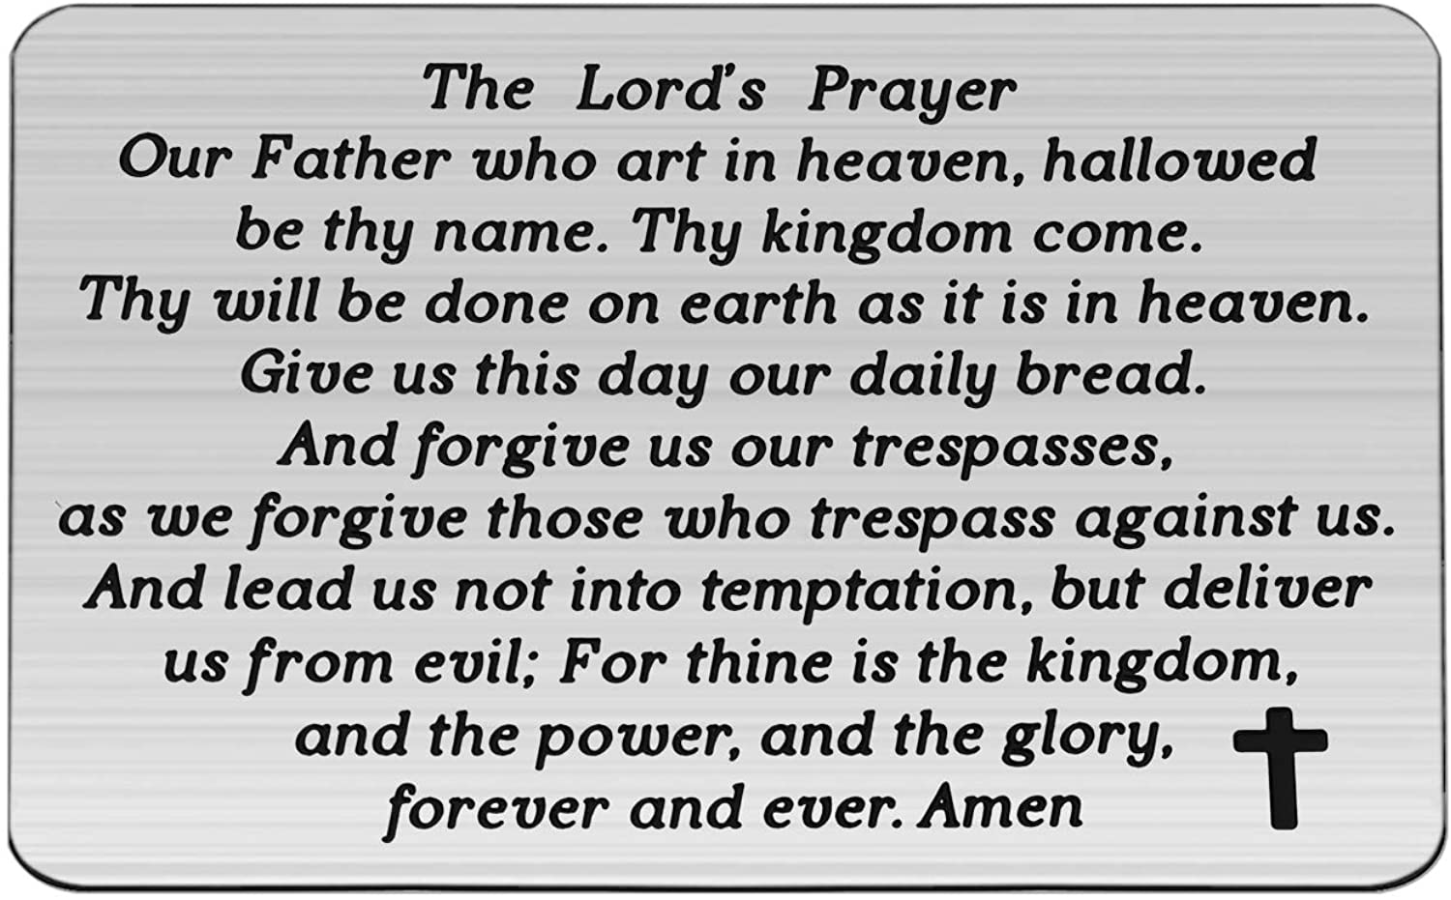

Slide 50
Support the ministry of St. Paul’s :
Through PAR – ask us how to join
via Canada Helps
search for St. Paul’s Sussex
via e-transfer to treasurerstpaulsucc1@gmail.com.
drop in collection plates located in the Narthex and near exit door
by mail to
4 Morrison Avenue, Sussex, N.B. E4E 1P5
during office hours
Notes:
Body text for hymns and prayers

Slide 51
Prayer of Dedication
Generous God, we thank you for
your gift of new life in Christ
Jesus. Receive our gifts this day,
and bless each gift and each
giver.

Slide 52
Use each one to witness to your
purposes through our
congregation and throughout the
world you love, in Jesus’ name.
Amen.

Slide 53
Hymn: VU #420
Go to the World
Words: Sylvia Dunstan Music: Ralph Williams reprinted under OneLicense 725110

Slide 54
Go to the world!
Go into all the earth.
Go preach the cross where
Christ renews life's worth,
Baptising as the sign of our rebirth.
Hallelujah! Hallelujah!

Slide 55
Go to the world!
Go into every place.
Go live the Word
of God's redeeming grace.
Go seek God's presence
in each time and space.
Hallelujah! Hallelujah!

Slide 56
Go to the world!
Go struggle, bless and pray;
The nights of tears
give way to joyous day.
As servant Church,
you follow Christ's own way.
Hallelujah! Hallelujah!

Slide 57
Go to the world!
Go as the ones I send,
For I am with you
'til the age shall end,
When all the hosts of glory cry “Amen!”
Hallelujah! Hallelujah! *

Slide 58
Benediction
&
Commission

Slide 59
Sung Benediction:
MV #32 Hallelujah 2x
Words: Trad. Music: Julian Pattison 2003 reprinted under OneLicense 725110

Slide 60
Halle, hallelujah,
halle, hallelu,
Halle, hallelujah,
Ha-le-lu-jah!

Slide 61
Halle, hallelujah,
halle, hallelu,
Halle, hallelujah,
Ha-le-lu-jah! *

