Slide 1

Easter Sunday
St. Paul’s United Church Sussex, NB
May 4th, 2025
Third Sunday of Easter
Welcome

Slide 2
Welcome!
We’re so glad you could join us

Slide 3
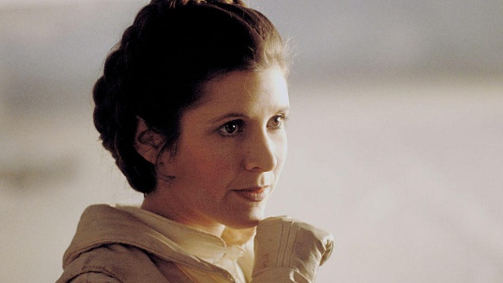
Women of the bible
Do you have a favourite woman of the Bible? Write her name on the white board. This summer we will be talking about the incredible women of the bible.

Slide 4
meeting
The St. Paul’s Ladies will
meet Thursday May 8th at
1:30pm in the Parlour. All
ladies are welcome.

Slide 5
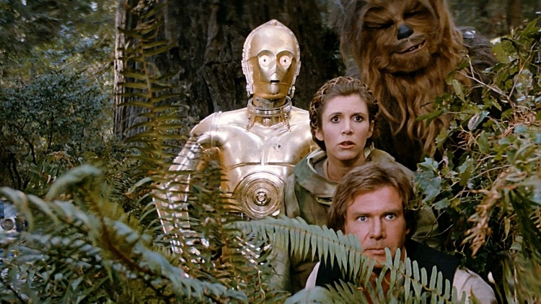
Congratulations
To our volunteer of the year:
Maryanne Verhoeven

Slide 6
Grad Sunday
June 15. Please let us know if you have a family member graduating from high school, college or university. Let Lisa know or sign the sheet in the Narthex.

Slide 7


Slide 8
UCC 100th anniversary
Fun Fact
With Lisa Folkins

Slide 9
Give Us a hand!
Hey Lisa! What’s this about?

Slide 10
Take a bottle on Mother’s Day
Return it on Father’s Day.
Put spare change, cash or cheque in the bottle.
Proceeds go to Sussex New Parents and Pregnancy Center.

Slide 11
Good News!

Slide 12

Prelude:
Paul Baloche CCLI

Slide 13
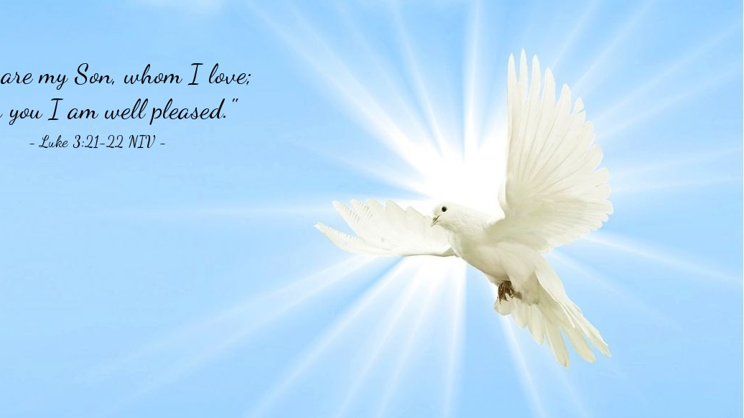
The Peace of Christ.
Sharing the Peace:
Response:
And also with you.
..
Notes:
Hymn Title Page

Slide 14
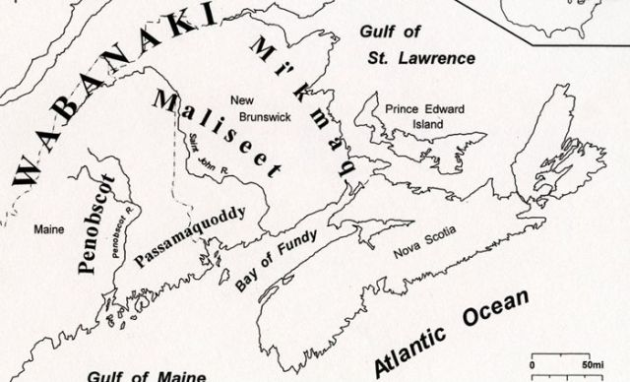
Acknowledging the Territories

Slide 15
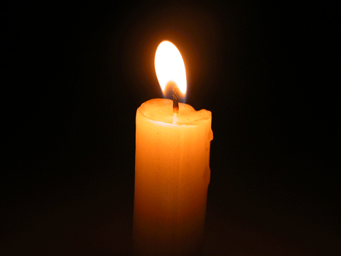
Lighting of the Christ Candle
“May the Force Be With You”
- Obi – Wan - Kenobi

Slide 16
Call to Worship
One: Sing praises to the Lord,
All: We will give thanks to God's holy name.
One: Weeping may linger for the
night, but joy comes with the morning
All: We will give thanks to God's holy name.

Slide 17
One: God has turned our mourning into dancing! Let us praise and not be silent!
All: Lord our God, we will give thanks to your holy name, now and always!

Slide 18
Hymn:
Here I Am to Worship
CCLI reprinted under OneLicense A725110

Slide 19
Light of the world
You stepped down into darkness
Open my eyes let me see.
Beauty that made this heart adore you
Hope of a life spent with me.

Slide 20
So here I am to worship,
Here I am to bow down
Here I am to say
that you’re my God.
And you’re altogether lovely,
Altogether worthy
Altogether wonderful to me.

Slide 21
King of all days oh so highly exalted
Glorious in heaven above.
Humbly You came to the earth You created
All for love’s sake became poor.

Slide 22
So here I am to worship,
Here I am to bow down
Here I am to say
that you’re my God.
And you’re altogether lovely,
Altogether worthy
Altogether wonderful to me.

Slide 23
And I’ll never know how much it cost
To see my sin upon that cross
And I’ll never know how much it cost
To see my sin upon that cross

Slide 24
So here I am to worship,
Here I am to bow down
Here I am to say
that you’re my God.
And you’re altogether lovely,
Altogether worthy
Altogether wonderful to me. *

Slide 25
Gathering Prayer
God of the Risen Christ and the
rising earth, we come giving
thanks for all the wonder in your
creation: for the tiny perfection
revealed in a baby’s fingers
grasping ours,

Slide 26
in each daffodil unzipping its
jacket to greet the spring, and
each rock face worn by wind and
water, bearing its rugged beauty
with your praise. These details lift
our hearts to praise you, too.

Slide 27
So let the details of the story of
the Risen Christ lift our hearts
this day, that we may greet a new
week as an occasion to discover
him in our midst, making all
things new with the springtime of
your Spirit.

Slide 28
Receive our heartfelt worship, O
God, Creator, Christ and Spirit,
ever Three and ever One, now
and evermore. Amen.

Slide 29

Pen or Pencil

Slide 30
Hymn:VU #567
Will You Come and Follow Me vs 1,2,4,5
The Iona Community 1987 reprinted under OneLicense A-725110

Slide 31
Will you come and follow me
if I but call your name?
Will you go where you don't know
and never be the same?
Will you let my love be shown,
will you let my name be known,
Will you let my life be grown
in you and you in me?

Slide 32
Will you leave yourself behind
If I but call your name?
Will you care for cruel and kind
And never be the same?
Will you risk the hostile stare
Should your life attract or scare?
Will you let me answer prayer
In you and you in me?

Slide 33
Will you love the 'you' you hide
if I but call your name?
Will you quell the fear inside
and never be the same?
Will you use the faith you've found
to reshape the world around,
through my sight and touch and sound in you and you in me?

Slide 34
Christ, your summons echoes true
when you but call my name.
Let me turn and follow you
and never be the same.

Slide 35
In your company I'll go
where your love and footsteps show.
Thus I'll move and live and grow
in you and you in me. *

Slide 36

Prayer for Illumination

Slide 37

Psalm 30

Slide 38
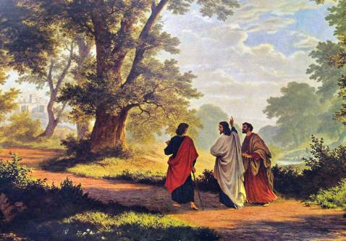
Luke 24: 13-35

Slide 39
Ministry of Music:
You Say

Slide 40
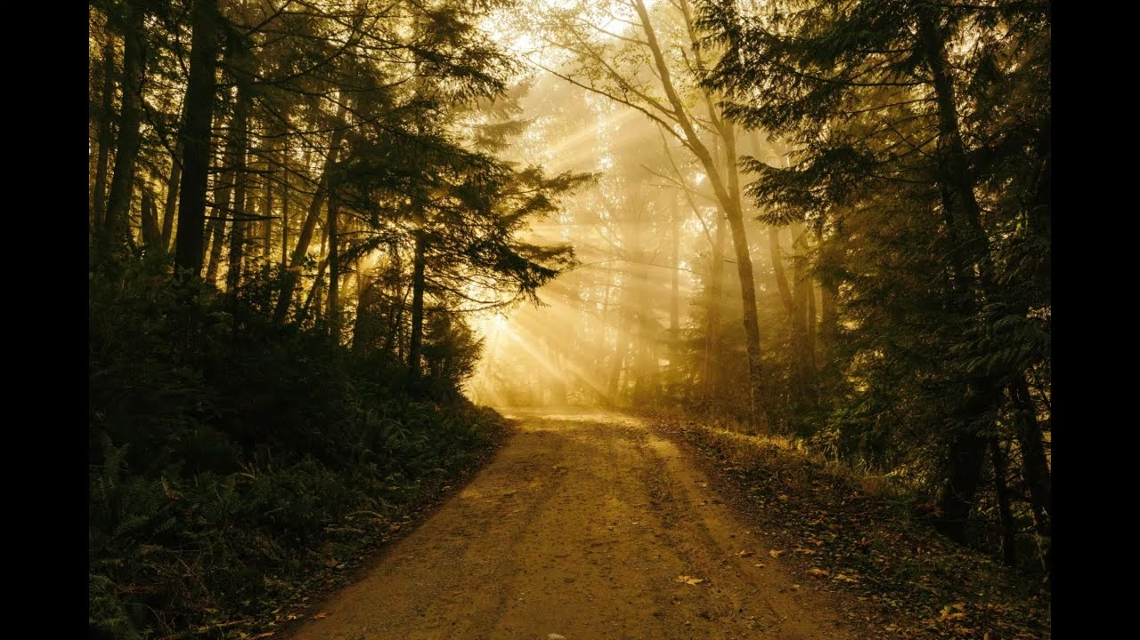
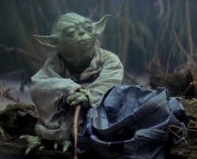
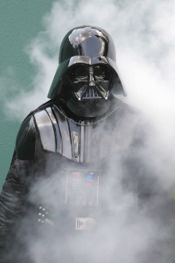
and on this path

Slide 41
Hymn: VU #184
As We Walked Home at Close of Day
Words: copyright Iona Community reprinted under OneLicense A-725110

Slide 42
As we walked home
at close of day,
A stranger joined us on our way.
He heard us speak
of one who’d gone,
And when we stopped,
he carried on.

Slide 43
Why wander further without light?
Please stay with us this troubled night.
We’ve shared the truth of how we feel
And now would like to share a meal.

Slide 44
We sat to eat our simple spread,
Then watched the stranger take the bread;
And, as he said the blessing prayer,
We knew that someone else was there.

Slide 45
No stranger he; it was our eyes
Which failed to see, in stranger’s guise,
The Lord who, risen from the dead,
Met us when ready to be fed.

Slide 46
Hallelujah! Hallelujah!
Hallelujah! Hallelujah!
As Mary and our sisters said,
The Lord is risen from the dead! *

Slide 47
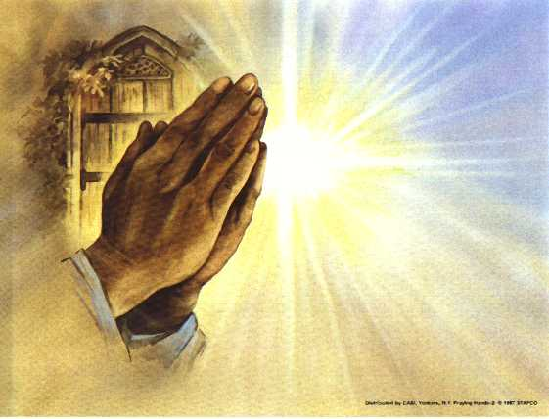
Prayers of the People
One: In your great mercy,
All: Hear our prayers.

Slide 48
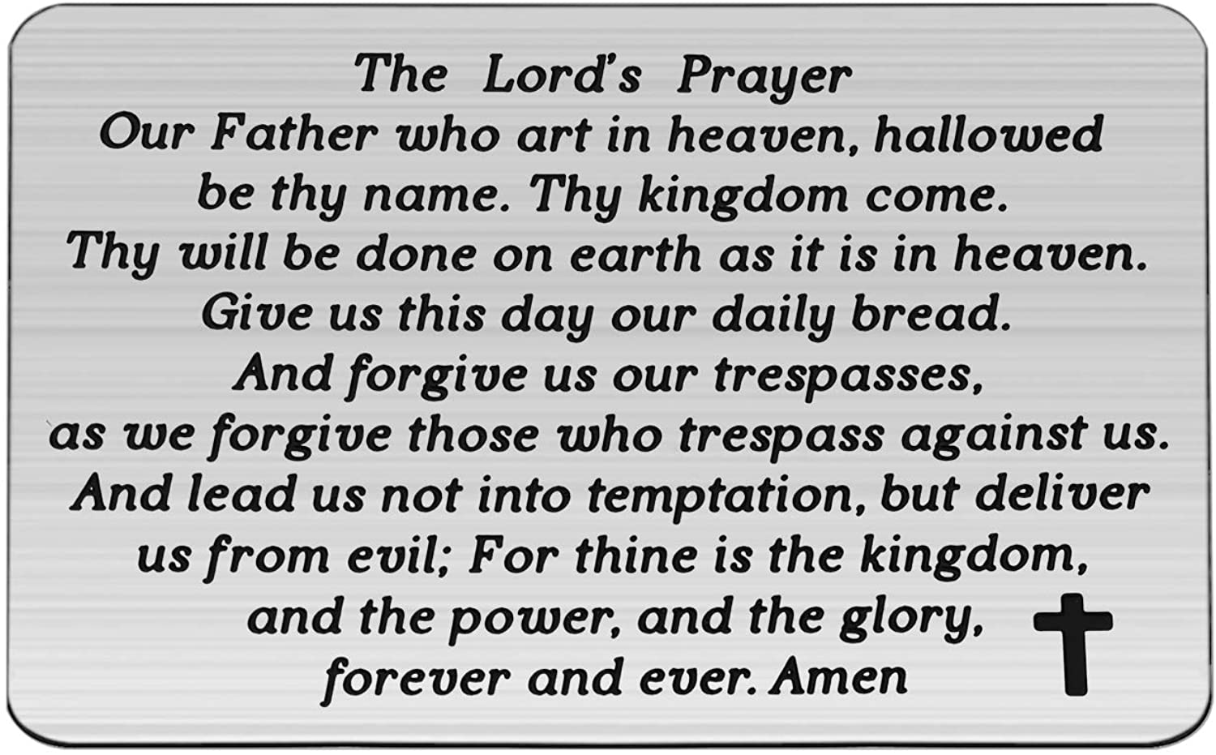

Slide 49
Support the ministry of St. Paul’s :
Through PAR – ask us how to join
via Canada Helps
search for St. Paul’s Sussex
via e-transfer to treasurerstpaulsucc1@gmail.com.
drop in collection plates located in the Narthex and near exit door
by mail to
4 Morrison Avenue, Sussex, N.B. E4E 1P5
during office hours
Notes:
Body text for hymns and prayers

Slide 50
Prayer of Dedication
Gracious God, you have given us
life and furnished it with much
beauty and blessing. In Christ you
have given yourself to us. So we
offer to you a portion of what we
have received to share in the
work of your kin(g)dom.

Slide 51
Use our energy and ability for
your purposes for the sake of
Jesus Christ, our Risen Lord.
Amen.

Slide 52
Hymn: VU #166
Joy Comes with the Dawn
Words, Music: Gordon Light 1985 reprinted under OneLicense 725110

Slide 53
Joy comes with the dawn;
Joy comes with the morning sun;
Joy springs from the tomb
And scatters the night with her song,
Joy comes with the dawn.

Slide 54
Weeping may come;
Weeping may come in the night,
When dark shadows cloud our sight.

Slide 55
Joy comes with the dawn;
Joy comes with the morning sun;
Joy springs from the tomb
And scatters the night with her song,
Joy comes with the dawn.

Slide 56
Sorrow will turn,
sorrow will turn into song,
And God’s laughter make us strong.

Slide 57
Joy comes with the dawn;
Joy comes with the morning sun;
Joy springs from the tomb
And scatters the night with her song,
Joy comes with the dawn.

Slide 58
We will rejoice,
we will rejoice, and give praise,
To the One who brings us grace.

Slide 59
Joy comes with the dawn;
Joy comes with the morning sun;
Joy springs from the tomb
And scatters the night with her song,
Joy comes with the dawn. *

Slide 60
Benediction
&
Commission

Slide 61
Sung Benediction:
Celtic Alleluia
Anon 1987 Reprinted under OneLicense A-725110

Slide 62
Al-le-lu-ia, al-le-lu-ia
Al-le-lu-ia, al-le-lu-ia *

