Slide 1

Palm Sunday
St. Paul’s United Church
Sussex, NB
April 13th, 2025
Welcome

Slide 2
Welcome!
We’re so glad you could join us

Slide 3
Bookmarks
Lenten Bookmarks are available.
A new one each week of Lent and Easter Sunday.

Slide 4
Easter week!
Come upstairs after the
service for sandwiches,
sweets, coffee, tea and meet
the people of Easter Morning.

Slide 5
Easter week!
Maundy Thursday:
Maundy Thursday service is
at 6:00 and will include
communion. It will not be a
pot luck.

Slide 6
Easter week!
Good Friday:
Good Friday service is at 10am

Slide 7
Easter week!
Easter Sunday:
Sonrise service at 7:30am.
Please be aware of the time
change from 8am. At the park next to where the Ultramar used to be. Raining? It will be here at the church.

Slide 8
Easter week!
Easter Sunday:
Breakfast after the Sonrise
service from 8-9ish.

Slide 9
Easter week!
Easter Sunday:
There will be an Easter egg
hunt in the church at 9:30.
Main floor and basement
levels (not including the sanctuary)

Slide 10
Easter week!
Easter Sunday:
Regular Easter Service at 10
with communion.

Slide 11
Spring Luncheon
Spring luncheon takeout is
May 9th. Flowers for donations
can be picked up in the
entryway. See Muriel Gilbert.

Slide 12
Join US!!
Literally: join us.
If you are considering or wanting to transfer your membership from another church to ours, or to be confirmed as a member of St. Paul’s see our delightful minister to discuss the possibilities!

Slide 13
UCC 100th anniversary
Fun Fact
With Lisa Folkins

Slide 14
Good News!

Slide 15

Prelude:
Lift High the Cross

Slide 16
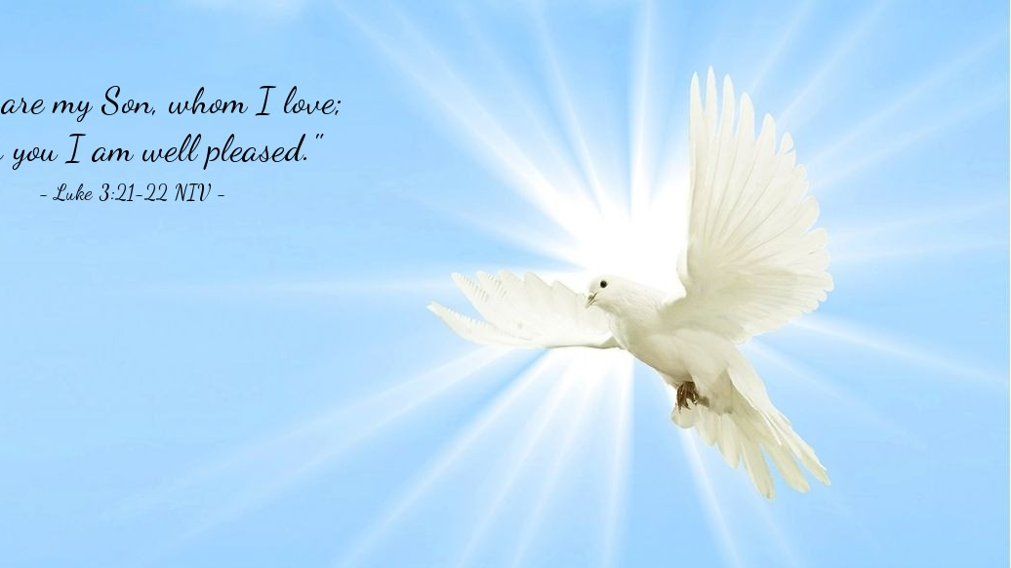
The Peace of Christ.
Sharing the Peace:
Response:
And also with you.
..
Notes:
Hymn Title Page

Slide 17
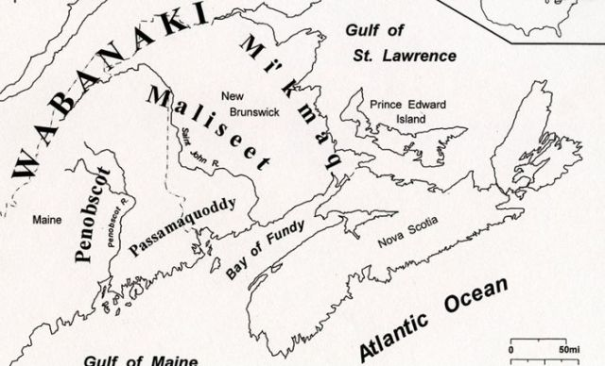
Acknowledging the Territories

Slide 18
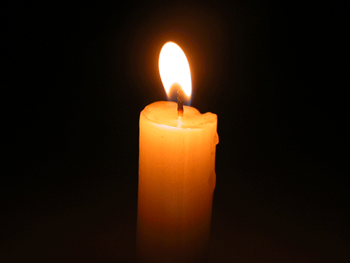
Lighting of the Christ Candle
“Hosanna! Hosanna in the highest!”

Slide 19
Call to Worship
One: People of St. Paul’s, bring your
garments and branches—Jesus is
coming into town! Shout Hosanna!
All: Hosanna! Our deliverer has
come! Let all the hungry be fed!
One: Jesus, the servant king, has
come to show us a new kind of power.

Slide 20
All: Hosanna! Our liberator will set the prisoners free!
One: Let us worship the one who will
save us from corruption. Shout
Hosanna to the King of Kings!

Slide 21
All: Hosanna! Hosanna! The
bread of life has come to sustain
us. Believing this promise, let us
worship together!

Slide 22
Hymn: VU #123 Hosanna, Loud Hosanna
Public Domain. reprinted under OneLicense A725110

Slide 23
Hosanna, loud hosanna
the happy children sang;
Through pillared court and temple
the joyful anthem rang;
To Jesus, who had blessed them
close folded to his breast,
The children sang their praises,
the simplest and the best.

Slide 24
From Olivet they followed
'mid an exultant crowd,
The victory palm branch waving,
and singing clear and loud;
The Lord of earth and heaven
rode on in lowly state,
Content that little children
should on his bidding wait.

Slide 25
'Hosanna in the highest!'
That ancient song we sing,
For Christ is our Redeemer;
earth, let your anthems ring.
O may we ever praise him
with heart and life and voice,
And in his humble presence
eternally rejoice! *

Slide 26
Gathering Prayer
Holy God, we gather on this Palm
Sunday and find ourselves in
solidarity with the crowds who
shouted for salvation. We know
our needs, both individually and
collectively.

Slide 27
Our hunger for righteousness and
justice compels us to proclaim,
“Hosanna! Save us!” two
thousand years later. As we begin
this journey toward the cross,
from admiration to despair, we
know we are well-nourished for
the path ahead.

Slide 28
You have prepared us, fed us
with love and truth, and
refreshed our spirits throughout
the Lenten season. Let us carry
the spirit of Hosanna in our
hearts, ready to serve and love,
knowing the journey continues
toward resurrection and renewal.

Slide 29
May the bread we break, both
physical and spiritual, remind us
of your presence in every step.
Guide us on this path and sustain
us for the work ahead.
Amen.

Slide 30
Lenten Prayer of Confession:
One: Because human beings …
trusting in Jesus.
All: Holy and saving God, we
confess we have sought comfort
in systems of power that promise
salvation through dominance,
control, and division.

Slide 31
We place our hope in the forces
of wealth, status, and self
preservation, rather than in the
humility of Christ. We align
ourselves with the powers of this
world, turning away from the
radical love, justice, and peace embodied in Jesus.

Slide 32
We fail to notice how the cries for
justice of the oppressed mirror
the “Hosannas” of hope. We
ignore the cries of the poor, the
marginalized, and the suffering,
choosing instead the easy path of
complicity.

Slide 33
We turn a blind eye to the earth’s
cries and the injustices so many
endure. Forgive us, O God, for
placing our trust in the powers of
this world rather than in the
power of your love.

Slide 34
Renew our hearts and minds and
lead us back to the path of true
salvation, where love, justice, and
peace reign.

Slide 35

The offering of

Slide 36
The love of Jesus is Good News
We Shout to the World!

Slide 37
Hymn: MV #183 Shout Out Your Love
Words & Music: Bruce Harding reprinted under OneLicense A-725110

Slide 38
I’m gonna shout, shout,
Shout out my love for Jesus,
for Jesus!
I’m gonna shout, shout,
Shout out my love
for God’s most holy child!

Slide 39
For whatever I might do today,
At home, at school, at work, at play,
I’ve Jesus’ love deep down inside of me!

Slide 40
I’m gonna raise, raise,
Raise up my hands for Jesus,
for Jesus!
I’m gonna raise, raise,
Raise up my hands
for God’s most holy child!

Slide 41
For whatever I might do today,
At home, at school, at work, at play,
I’ve Jesus’ love deep down inside of me!

Slide 42
I’m gonna dance, dance,
dance all around for Jesus,
for Jesus!
I’m gonna dance, dance,
dance all around
for God’s most holy child!

Slide 43
For whatever I might do today,
At home, at school, at work, at play,
I’ve Jesus’ love deep down inside of me! *

Slide 44

Prayer for Illumination

Slide 45
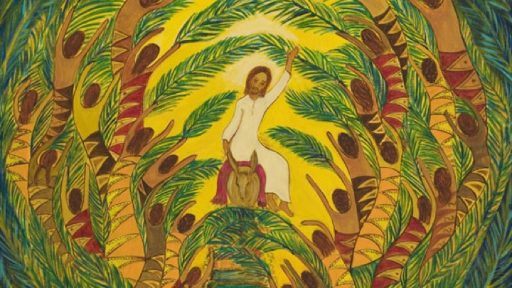
John 12: 12-16

Slide 46
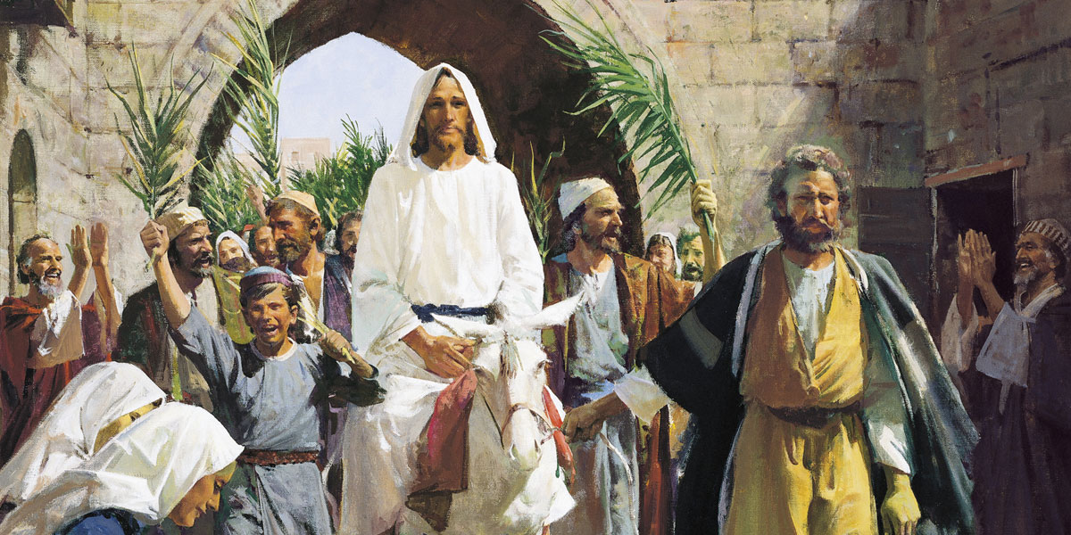
Luke 19: 28- 40

Slide 47
Ministry of Music:
Lay Down

Slide 48
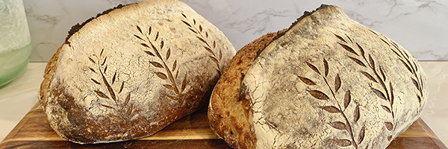
Bread for the Road

Slide 49
Hymn: MV #202 Bread For The Journey 2x
Bruce Harding. reprinted under OneLicense A-725110

Slide 50
Bread for the journey,
Food for the way.
Cup of God’s blessing,
Tomorrow, today.

Slide 51
Bread for the journey,
Food for the way.
Cup of God’s blessing,
Tomorrow, today. *

Slide 52
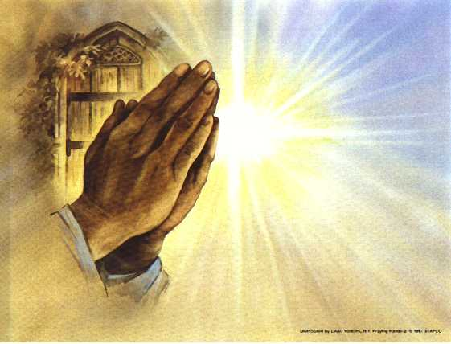
Prayers of
the People
One: Bread of life,
All: Hosanna, save us.

Slide 53
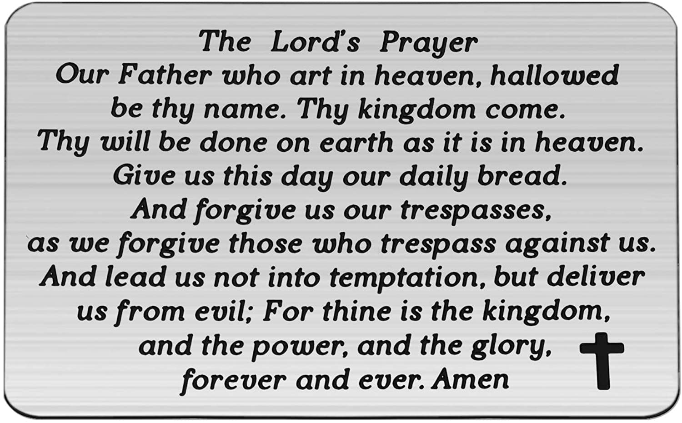

Slide 54
Support the ministry of St. Paul’s :
Through PAR – ask us how to join
via Canada Helps
search for St. Paul’s Sussex
via e-transfer to treasurerstpaulsucc1@gmail.com.
drop in collection plates located in the Narthex and near exit door
by mail to
4 Morrison Avenue, Sussex, N.B. E4E 1P5
during office hours
Notes:
Body text for hymns and prayers

Slide 55
Prayer of Dedication
Gracious God who saves, we bring our gifts to you. We offer
our time, talents, and resources
for your work in the world.

Slide 56
May these gifts be a sign of our
trust in you, and may they
nourish your mission of love,
justice, and hope for all. In
Christ’s name, we pray.
Amen.

Slide 57
Hymn: MV #8
And On This Path
Words: Lynn Bauman 2000, Music: Linnea Good 2003 reprinted under OneLicense A-725110

Slide 58
And on this path,
the gates of holiness
are open wide,
And on this path,
the gates of holiness
are open wide,

Slide 59
And of this path,
the gates of holiness
are open wide!
Open wide! Open wide!
Open wide!
The gates are open wide!

Slide 60
So enter in
the gates of holiness
are open wide,
So enter in
the gates of holiness
are open wide,

Slide 61
So enter in the gates
of holiness are open wide!
Open wide! Open wide!
Open wide!
The gates are open wide! *

Slide 62
Affirmation of Faith
We believe in Jesus Christ, who
rode into Jerusalem not on a
warhorse but on a humble
donkey, proclaiming peace
instead of domination.

Slide 63
We believe in the way of the
servant leader, where greatness
is found in humility, and power is
made perfect in love. We believe
in choosing integrity over bluster,
faithfulness over greed, and
justice over the empty promises
of empire.

Slide 64
We believe God’s kin(g)dom is
not built by violence, but by the
transformative power of grace,
mercy, and sacrifice. We believe
salvation is not found in the halls
of the mighty, but in the heart of
Christ, who calls us to walk the
road of love and courage.

Slide 65
We believe in shouting “Hosanna”
to the one who brings true peace,
trusting not in the powers of this
world, but in the reign of God that
has no end.
Amen.

Slide 66
Benediction
&
Commission

Slide 67
Sung Benediction:
Hosanna 2x’s
Carl Tuttle reprinted under OneLicense A-725110

Slide 68
Hosanna, hosanna,
hosanna in the highest.
Hosanna, hosanna,
hosanna in the highest.

Slide 69
Lord we lift up your name,
With hearts full of praise,
Be exalted O Lord, my God,
Hosanna in the highest.

Slide 70
Glory, glory,
glory to the King of Kings.
Glory, glory,
glory to the King of Kings.

Slide 71
Lord we lift up your name,
With hearts full of praise,
Be exalted O Lord, my God,
Glory to the King of kings.

Slide 72
Hosanna, hosanna,
hosanna in the highest.
Hosanna, hosanna,
hosanna in the highest.

Slide 73
Lord we lift up your name,
With hearts full of praise,
Be exalted O Lord, my God,
Hosanna in the highest.

Slide 74
Glory, glory,
glory to the King of Kings.
Glory, glory,
glory to the King of Kings.

Slide 75
Lord we lift up your name,
With hearts full of praise,
Be exalted O Lord, my God,
Glory to the King of kings. *

