Slide 1

Easter Sunday
St. Paul’s United Church Sussex, NB
April 20th, 2025
Welcome

Slide 2
Welcome!
We’re so glad you could join us

Slide 3
The Gardens!
Would you like to take care of
one of the garden beds? Bob
doesn’t want to be a box pig.
So, if you want one, please let him know or else he will do it.

Slide 4
Spring Luncheon
Spring luncheon takeout is
May 9th. Orders can be place
by calling the office this week
or next T,W,Th 9:30 – 3:00
Cost is $10.

Slide 5
Spring Luncheon
If you are paying by e-transfer
please do so by May 1st and
include what you are ordering
in the information.

Slide 6
Plant sale
This year, the plant sale will be held on Saturday, May 31. If you have any 6”, 8” or ½ gallon pots to spare, please drop them off over the next couple of weeks. Thank you.

Slide 7
Join US!!
If you are considering or wanting to transfer your membership from another church to ours, or to be confirmed as a member of St. Paul’s see our delightful minister to discuss the possibilities!

Slide 8
UCC 100th anniversary
Fun Fact
With Lisa Folkins

Slide 9
Good News!

Slide 10

Prelude:

Slide 11
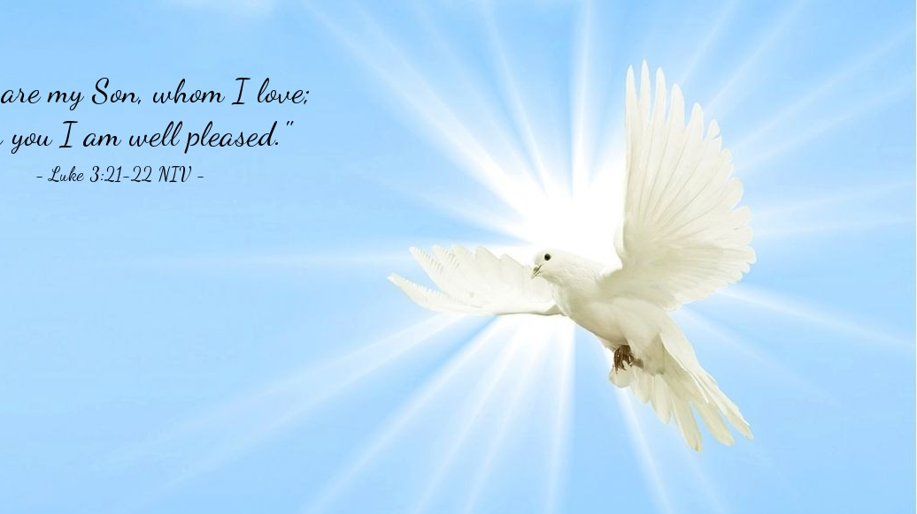
The Peace of Christ.
Sharing the Peace:
Response:
And also with you.
..
Notes:
Hymn Title Page

Slide 12
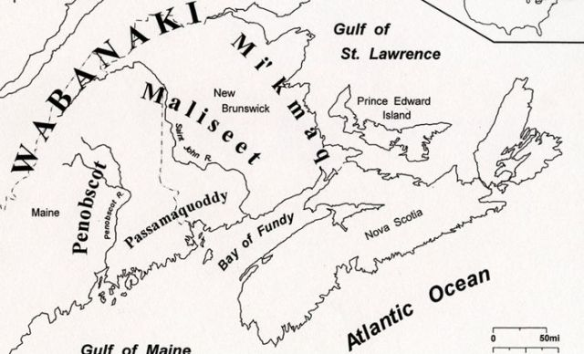
Acknowledging the Territories

Slide 13
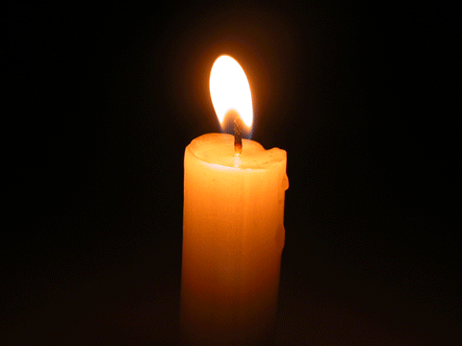
Lighting of the Christ Candle
“Christ is Risen! Christ is Risen Indeed! Hallelujah!”

Slide 14
Call to Worship
One: Christ is risen!
All: Christ is risen, indeed!
One: The bread of life has broken the
power of death! Let no one go hungry
again!
All: Alleluia! Jesus is alive! Let all
creation rejoice!

Slide 15
One: Christ is risen, conquering hate
and violence! Let the people of God
find wholeness and healing.
All: Alleluia! Let restoration begin!
The kin(g)dom of God is at hand!
One: Let us join in the eternal feast,
where hope overflows and the despair
of this life is vanquished by love.

Slide 16
All: The bread of life is risen and
alive. Let us worship the one who
leads us now in compassion and
justice!

Slide 17
Hymn: VU #155 Jesus Christ Is risen Today vs 1,2,4
Public Domain. reprinted under OneLicense A725110

Slide 18
Jesus Christ is risen today,
hallelujah!
our triumphant holy day,
hallelujah!
who did once, upon the cross,
hallelujah!
suffer to redeem our loss.
Hallelujah!

Slide 19
Hymns of praise then let us sing
hallelujah!
unto Christ, our heavenly King,
hallelujah!
who endured the cross and grave,
hallelujah!
sinners to redeem and save.
Hallelujah!

Slide 20
But the pains which he endured,
hallelujah!
our salvation have procured;
hallelujah!
now above the sky he's King,
hallelujah!
where the angels ever sing.
Hallelujah!

Slide 21
Sing we to our God above,
hallelujah!
praise eternal as God's love;
hallelujah!
praise our God, ye heavenly host,
hallelujah!
praise the Son and Holy Ghost.
Hallelujah! *

Slide 22
Gathering Prayer
Spirit of the risen Christ, you
dwell among us as we sing, pray,
and rejoice in your victory.
Because you have conquered
death, nothing can separate us
from your presence.

Slide 23
So, with full hearts and nourished
souls, we celebrate this day of
extravagant love. Let our worship
be a reflection of the feast you
have prepared, where no one is
left hungry, and all are made
whole.

Slide 24
May our work in this
world bring the table of heaven to
earth. We pray this in the name of
the bread of life, who was born in
a town called House of Bread.
Alleluia! Amen!

Slide 25
Lenten Prayer of Confession:
One: Often … we have limited God’s
work in this world.
All: Resurrected Christ, you faced
the depths of death and suffering
and emerged victorious. You were
broken yet made whole, for the
love of God’s good world.

Slide 26
Yet, we confess that we forget
love has the final victory. You
prove your love for us by taking
our small efforts and magnifying
them into dramatic change. You
challenge our limited potential
and expand our reach into new
horizons of love and justice.

Slide 27
You are a good teacher, showing
us how to take what little we
have and trust in your abundance.
Yet we cling to our scarcity,
doubting that what we offer could
ever be enough.

Slide 28
Forgive us when we think too
small, failing to believe you can
use our efforts for the good of
your world. Forgive us, bread of
life, for underestimating your
power and ignoring the call to
join in your work.

Slide 29
Inspire us to dream boldly, give
generously, and act faithfully,
trusting that your love can
transform even the smallest
offering into a feast of justice
and grace.

Slide 30

The offering of

Slide 31
Come and Have Breakfast

Slide 32
Hymn: MV #121
Hey Now Singing Alleluia vs 1,2,5
Words & Music: Bruce Harding reprinted under OneLicense A-725110

Slide 33
Hey now! Singing hallelujah
Hey now! The morning has come!
Hey now! Singing hallelujah
The tomb was empty at the rising sun.

Slide 34
Jesus loved people
and he made them friends
Hey now, the tomb was empty
He called to the children
and the women and men.
Hey now, the tomb was empty

Slide 35
Hey now! Singing hallelujah
Hey now! The morning has come!
Hey now! Singing hallelujah
The tomb was empty at the rising sun.

Slide 36
Jesus healed people and
he helped them be well.
Hey now, the tomb was empty.
He taught about God
in the stories he’d tell.
Hey now, the tomb was empty.

Slide 37
Hey now! Singing hallelujah
Hey now! The morning has come!
Hey now! Singing hallelujah
The tomb was empty at the rising sun.

Slide 38
Jesus loves people
and he lives a-gain!
Hey now, the tomb was empty
Calls us disciples and
he calls us his friends.
Hey now, the tomb was empty

Slide 39
Hey now! Singing hallelujah
Hey now! The morning has come!
Hey now! Singing hallelujah
The tomb was empty at the rising sun. *

Slide 40

Prayer for Illumination

Slide 41
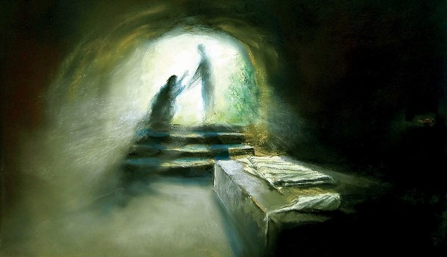
John 20:11-18, 21: 1-17

Slide 42
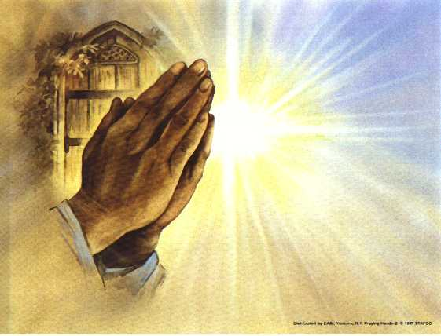
Prayers of the People
One: Alleluia!
All: Let creation be healed by the bread of life.
One: …together we pray
All: Alleluia! Amen.

Slide 43
Ministry of Music:
Sing A Joyous Alleluia

Slide 44
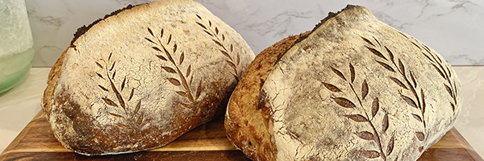
Bread for feasting

Slide 45
Hymn: MV #48 Jump For Joy
Bruce Harding. reprinted under OneLicense A-725110

Slide 46
I can feel you near me God,
I can feel you near
Yes I know you’re with me God,
I feel you here
I can feel you near me God,
I can feel you near
Yes I know you’re with me God
Heaven is here.

Slide 47
And I’ll jump for joy
I’m singing Al-le-lu-ia
Jump for joy for you
I will jump for joy
I’m singing Al-le-lu-ia
Jump for joy for you.

Slide 48
I can feel you loving me,
Yes I know you care God
I know you’re loving me
Always everywhere
I can feel you loving me,
Yes I know you care God
I know you’re loving me
I know you’re there.

Slide 49
And I’ll jump for joy
I’m singing Al-le-lu-ia
Jump for joy for you
I will jump for joy
I’m singing Al-le-lu-ia
Jump for joy for you. *

Slide 50
COMMUNION
Invitation to the Table:
The Great Thanksgiving
One: God be with you.
All: And also with you.
One: Lift up your hearts.
All: We lift them to God.

Slide 51
One: Let us give thanks to God.
All: It is good to give God thanks
and praise.
One: Risen Christ, bread of life… Let
us proclaim the mystery of faith:
All: Christ has died, Christ is risen
Christ will come again.
One: Holy God, you nourish … Amen.

Slide 52
Ministry of Music:
The Lord’s Prayer solo by Claire Turner

Slide 53
Words of Remembrance:
Distribution of the Elements:

Slide 54
Hymn: VU #466
Eat This Bread
Bruce Harding. reprinted under OneLicense A-725110

Slide 55
Eat this bread, drink this cup;
Come to me and never be hungry.
Eat this bread, drink this cup;
Trust in me and you will not thirst. *

Slide 56
Hymn: VU #467 One Bread One Body. Refrain only.
Bruce Harding. reprinted under OneLicense A-725110

Slide 57
One bread, one body,
one Lord of all,
One cup of blessing
which we bless;
And we, through many,
throughout the earth,
We are one body
in this one Lord. *

Slide 58
Prayer Following Communion:
Loving and faithful God, we thank
you for this sacred meal that
reminds us of the bread of life,
broken for the whole world. You
have fed us and filled us with the
hope of resurrection. Alleluia!

Slide 59
As we leave this table, may we
carry the bread of life into the
world, bringing comfort to the
hurting, food to the hungry, and
hope to the hopeless.

Slide 60
Strengthen us to serve as your
faithful disciples, proclaiming
justice, mercy, and peace to every
soul we encounter. Amen.

Slide 61
Support the ministry of St. Paul’s :
Through PAR – ask us how to join
via Canada Helps
search for St. Paul’s Sussex
via e-transfer to treasurerstpaulsucc1@gmail.com.
drop in collection plates located in the Narthex and near exit door
by mail to
4 Morrison Avenue, Sussex, N.B. E4E 1P5
during office hours
Notes:
Body text for hymns and prayers

Slide 62
Prayer of Dedication
Holy God, we bring to you our
gifts and offerings with the same
spirit of abandon that inspired
Peter to jump into the sea to
greet Jesus.

Slide 63
Let our generosity
flow from the joy of knowing that
the bread of life has come to heal
us and restore us to wholeness.
Use our gifts to nourish our
communities and satisfy the
hunger of our world. Amen.

Slide 64
Hymn: VU #175
This Is The Day That God Has Made
Words: Lynn Bauman 2000, Music: Linnea Good 2003 reprinted under OneLicense A-725110

Slide 65
This is the day that God has made!
Rejoice! Rejoice, and be
exceeding glad!
This is the day that God has made!
Rejoice! Rejoice! Hallelujah!

Slide 66
Christ has conquered death at last,
left the tomb that held him fast!
Gone the sorrow, gone the night,
dawns the morning clear and bright!

Slide 67
This is the day that God has made!
Rejoice! Rejoice, and be
exceeding glad!
This is the day that God has made!
Rejoice! Rejoice! Hallelujah!

Slide 68
Jesus lives who once was dead,
lives forever, as he said!
Risen now our Saviour, King;
songs of gladness let us sing!

Slide 69
This is the day that God has made!
Rejoice! Rejoice, and be
exceeding glad!
This is the day that God has made!
Rejoice! Rejoice! Hallelujah! *

Slide 70
Affirmation of Faith
From the manger in a town called
House of Bread, Jesus came to
show us God’s love. We believe
Jesus lived a fully human life. He
chose to take on our weakness
and remained faithful until the very end.

Slide 71
We believe Jesus was and is the
bread of life, broken for all, and
made whole in resurrection. We
believe the table is set for all
people, and there will always be
enough. We believe the bread of
life compels us to seek justice so
all might have the spiritual,

Slide 72
emotional, and physical
nourishment they need. We
believe Christ is risen, death is
defeated, and no one can
separate us from the love and joy
that surround us today and every
day. We believe in the renewal of
all things.

Slide 73
Even now, the bread of life is at
work, healing and restoring all
that was broken. We believe
one day we will all gather around
God’s table, united in peace, joy,
and justice for all people. Alleluia!
Amen.

Slide 74
Benediction
&
Commission

Slide 75
Sung Benediction: VU #958 Halle Halle Halle
Anon 1987 Reprinted under OneLicense A-725110

Slide 76
Halle, halle, halle – lujah
Halle, halle, halle – lujah
Halle, halle, halle – lujah
Hallelujah, hallelujah. *

