Slide 1

5th Sunday of Lent
St. Paul’s United Church Sussex, NB
April 6th, 2025
Welcome

Slide 2
Welcome!
We’re so glad you could join us

Slide 3
Bookmarks
Lenten Bookmarks are available.
A new one each week of Lent and Easter Sunday.

Slide 4
the Board of St. Paul’s
Chair: Noah Gibbons Salib
Secretary: Sue Ness
Treasurer: Linda McBride
Finance and Property: John Gilbert
Congregational Life and Faith
Formation: Pattie Northrup

Slide 5
Worship and Outreach: Tom Belyea
Two members at Large: Kevin
Darbyson and Daniel Carmichael
M&P: Shirley Keith
Regional Representatives: Lisa
Folkins, Wanda Northrup, Nelson
Ball (one vote on the board)

Slide 6
Meeting
CFMT meets Tuesday 6:30
Fundraising meets Tuesday 7:00
St. Paul’s Ladies Thursday 1:30
(all ladies welcome)
Youth Group is Thursday 6:30

Slide 7
Easter week!
Palm Sunday: there will be a
chance to meet with the
people of Easter Morning after
the service on Palm Sunday
(next week).

Slide 8
Easter week!
There is a sign up sheet in the
narthex for sandwiches and
sweets for the Palm Sunday
meet and greet.

Slide 9
Easter week!
Maundy Thursday:
Maundy Thursday service is
at 6:00 and will include
communion. It will not be a
pot luck.

Slide 10
Easter week!
Good Friday:
Good Friday service is at 10am

Slide 11
Easter week!
Easter Sunday:
Sonrise service at 7:30am.
Please be aware of the time
change from 8am. At the park next to where the Ultramar used to be. Raining? It will be here at the church.

Slide 12
Easter week!
Easter Sunday:
Breakfast after the Sonrise
service from 8-9ish.

Slide 13
Easter week!
Easter Sunday:
There will be an Easter egg
hunt in the church at 9:30. Main floor and basement levels

Slide 14
Easter week!
Easter Sunday:
Regular Easter Service at 10
with communion.

Slide 15
Fun Fact
With Lisa Folkins

Slide 16
Good News!

Slide 17

Prelude:
Let It Be

Slide 18
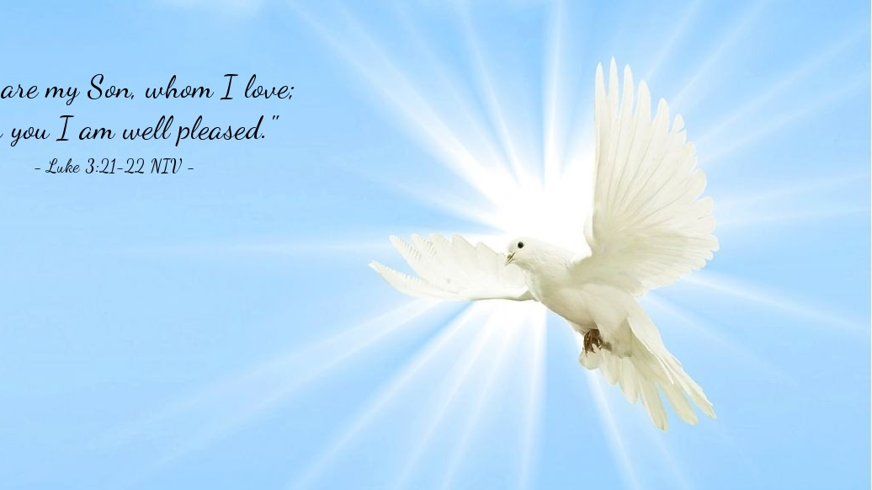
The Peace of Christ.
Sharing the Peace:
Response:
And also with you.
..
Notes:
Hymn Title Page

Slide 19
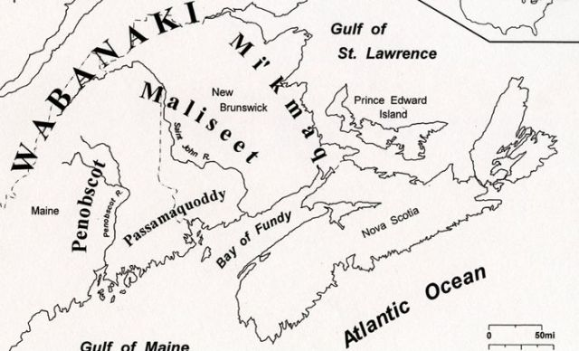
Acknowledging the Territories

Slide 20
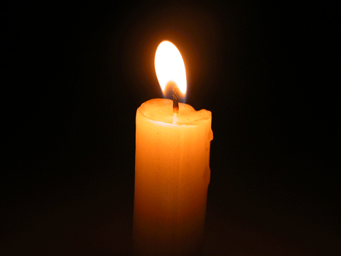
Lighting of the Christ Candle
“You pray for the hungry, then you feed them. That is how prayer works.” – Pope Francis

Slide 21
Call to Worship
One: Come down from the tree,
Zacchaeus and friends. Come and
worship together!
All: The bread of life satisfies our
hunger and thirst.

Slide 22
One: You are witnessed, worthy, and
welcomed today by Jesus, the bread
of life.
All: The bread of life loves us and
knows our needs.
One: Let us feast at the table of love
and justice, where no one dines alone.

Slide 23
All: The bread of life has come to
sustain us. Believing this promise,
let us worship together!

Slide 24
Hymn: MV #178 Who is My Mother
Words: Shirley Erena Murray 1992, Music: Ron Klusimeier, 2002 reprinted under OneLicense A725110

Slide 25
Who is my mother,
who is my brother?
All those who gathered
round Jesus Christ:
Spirit blown people
born from the Gospel
Sit at the table,
round Jesus Christ.

Slide 26
Differently abled,
differently labelled,
Widen the circle round
Jesus Christ:
Crutches and stigmas,
culture’s enigmas,
All are accepted
round Jesus Christ.

Slide 27
Love will relate us
colour or status
Can’t segregate us
round Jesus Christ:
Family failings,
human derailing,
All are accepted
round Jesus Christ.

Slide 28
Bound by one vision,
met for one mission
We claim each other,
round Jesus Christ:
Here is my mother,
here is my brother,
Kindred in Spirit,
through Jesus Christ. Amen. *

Slide 29
Gathering Prayer
Gracious God, as we gather in this
season of reflection and
repentance, you call us from our
hiding places and invite us to the
table of grace. You see us in our
brokenness and meet us with
mercy.

Slide 30
You offer us the bread of life that
nourishes our souls, heals our
wounds, and strengthens us for
the journey of faith. In this time
of worship, open our hearts to
your transforming love and lead
us to greater humility and justice.

Slide 31
May this sacred time draw us
nearer to you and to one another.
Amen.

Slide 32
Lenten Prayer of Confession:
One: Often, … we have missed
opportunities to honor our neighbors.
All: God of righteousness and
justice, you know our hearts and
minds.

Slide 33
While we center and glorify
people who are talented, famous,
conventionally beautiful, or
wealthy, you see beauty in places
we tend to ignore or neglect. We
confess we have judged people
by their ability to fit into social norms, win awards,

Slide 34
accumulate wealth, and perform
with power. We miss the
Zacchaeuses of our times because
we have overlooked the value of
those who don't fit our standards,
who struggle to be seen, or who
are dismissed by society.

Slide 35
We have neglected to honor the
dignity of those unlike us or
displaced from their homelands
and have allowed our biases to
shape our actions and choices.
Forgive us, God, for the times we
have failed to reflect your
inclusive love and justice.

Slide 36
Open our eyes to see the worth of
every person, and teach us to
honor all your creation with the
respect it deserves.

Slide 37

The offering of

Slide 38

Jesus told us to pray

Slide 39
Opening Prayer:
Presentation of the Candidates:
Brooklyn Mae and Emma Rose
daughters of Stephanie and
Matthew Douthwright.
Profession of Faith and Promises:
Commitment of Parents:
Commitment of Grandparents:

Slide 40
Congregational Commitment:
One: Will you support this family with
constant love, wholesome example,
Christian teaching and faith prayer?
All: We will, God being our helper.

Slide 41
The United Church Creed VU 918
We are not alone,
we live in God’s world.
We believe in God:
who has created and is creating,

Slide 42
who has come in Jesus,
the Word made flesh,
to reconcile and make new,
who works in us and others
by the Spirit
We trust in God.

Slide 43
We are called to be the Church:
to celebrate God’s presence,
to live with respect in Creation,
to love and serve others,
to seek justice and resist evil,

Slide 44
to proclaim Jesus,
crucified and risen,
our judge and our hope.
In life, in death,
in life beyond death,
God is with us.
We are not alone.
Thanks be to God.

Slide 45
Prayer of Thanksgiving and the Pouring of the Water:
One: God be with you.
All: And also with you.
One: Lift up your hearts.
All: We lift them to God.

Slide 46
One: Let us give thanks to God.
All: It is good to give God thanks
and praise.
One: Gracious and Holy God,…

Slide 47
Act of Baptism:
Brooklyn Mae Douthwright:
Act of Baptism:
Emma Rose Douthwright

Slide 48
Declaration and
Congregational Welcome:
One: Into the household of faith, we
welcome you with joy and
thanksgiving.
All: We are members of the Body
of Christ. We are inheritors of God’s promise.
In the name of Christ, we
welcome you.
Blessing:

Slide 49
In the name of Christ, we
welcome you.
Blessing:

Slide 50
Hymn: MV #201
I am the Bread of Life x2
Words & Music: Tom Kacemarek 2005 reprinted under OneLicense A-725110

Slide 51
I am the bread of life
Broken for the world,
I am the cup poured out for all.
Those who believe in me
Will never die.
I am the life of the world.

Slide 52
I am the bread of life
Broken for the world,
I am the cup poured out for all.
Those who believe in me
Will never die.
I am the life of the world. *

Slide 53

Prayer for Illumination

Slide 54
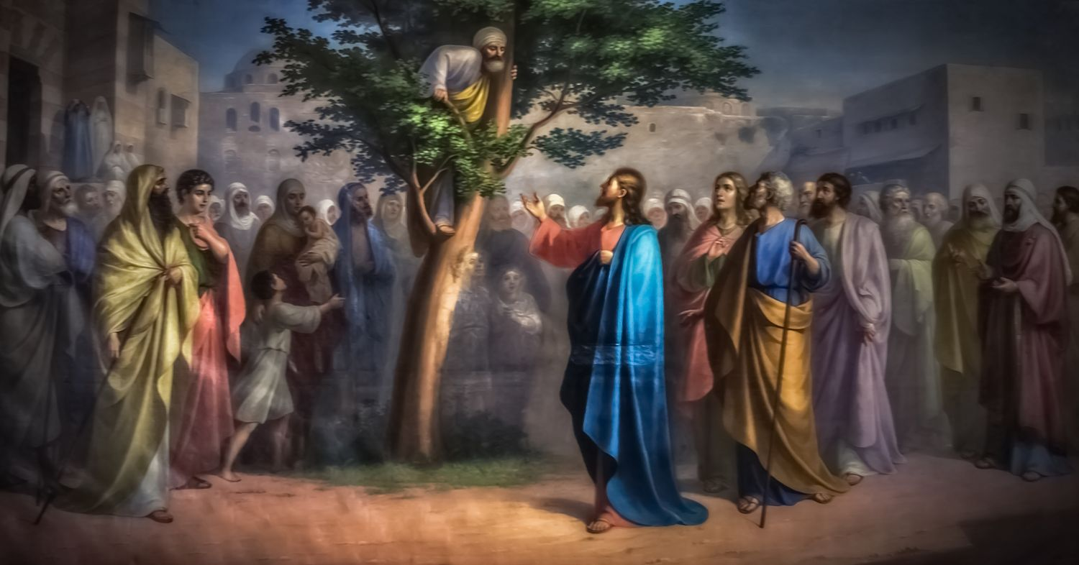
Luke 19: 1-10

Slide 55
Ministry of Music:
You Are My All in All

Slide 56
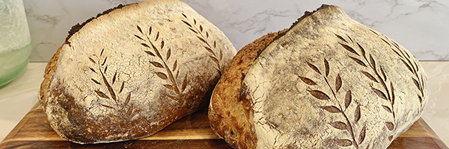
Bread for Community

Slide 57
Hymn: MV #198 When we Gather at the Table
Word: Walter Farquharson 1995 Music: Ron Klusmeier 2006. reprinted under OneLicense A-725110

Slide 58
When we gather at the table
Wine is poured and Bread is broken.
Then love claims us offering healing
We hear welcome gently spoken.

Slide 59
Jesus offers our thanksgiving
Blessing God for life we’re given
From the earth comes grain to feed us
Watered by the rains of heaven.

Slide 60
Word of promise claims attention
Earth renewed by God’s designing.
All the creatures join in praises
God’s intended wholeness finding.

Slide 61
Come, invited, now draw nearer,
Join this holy celebration.
Here be strengthened, called to justice,
Living now God’s new creation.

Slide 62
Christ, your coming and your hosting
Gives us place at widening table
Now embracing world and neighbour
Spirit strong, by love enabled. *

Slide 63
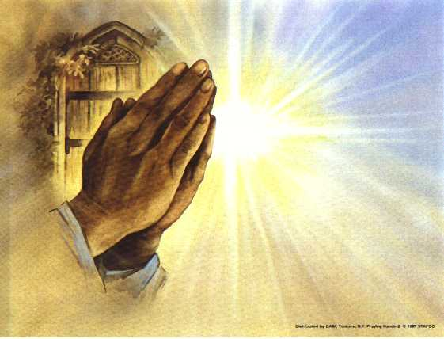
Prayers of
the People
One: Bread of life,
All: Help us come down from our hiding places and welcome you.

Slide 64
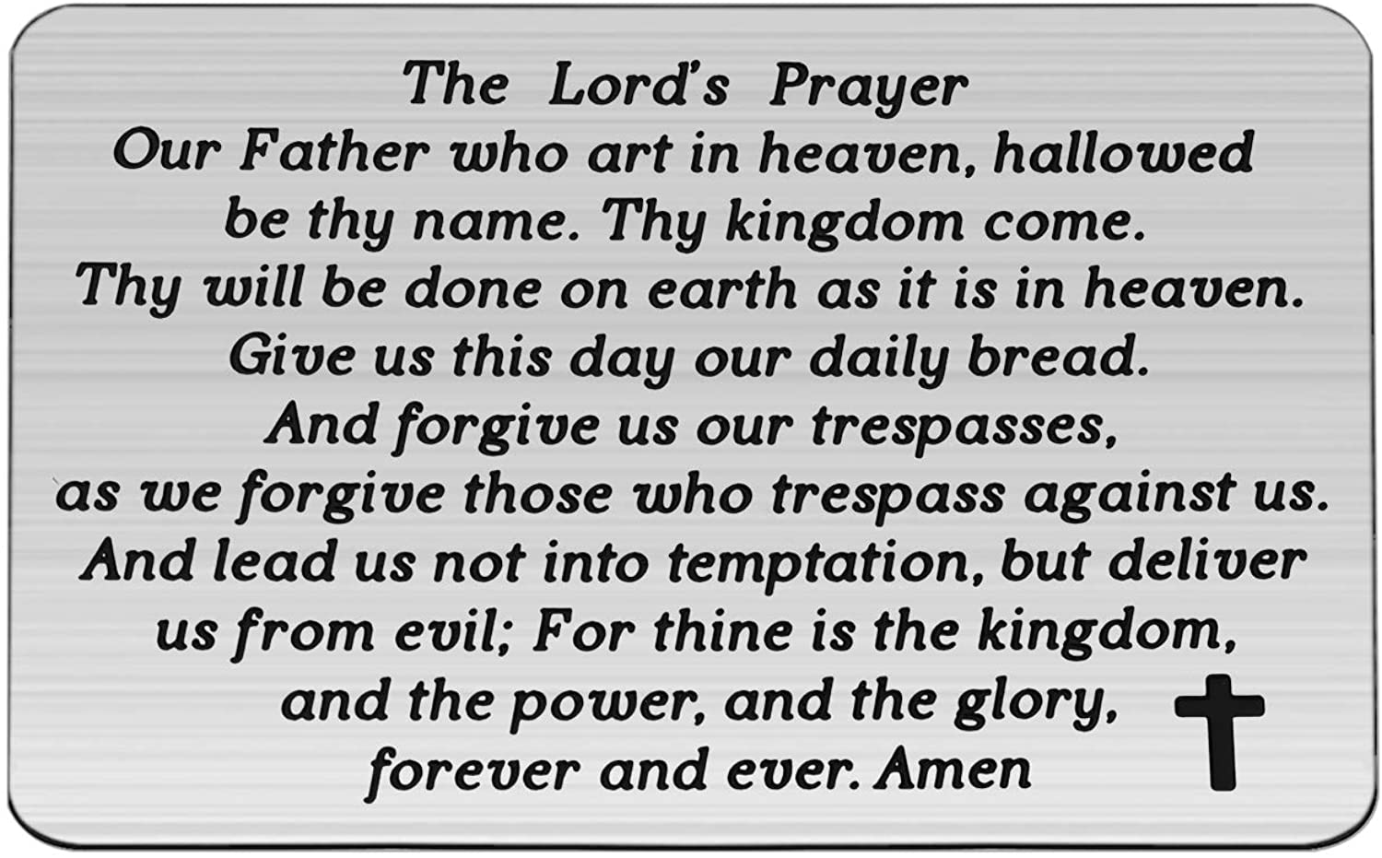

Slide 65
Support the ministry of St. Paul’s :
Through PAR – ask us how to join
via Canada Helps
search for St. Paul’s Sussex
via e-transfer to treasurerstpaulsucc1@gmail.com.
drop in collection plates located in the Narthex and near exit door
by mail to
4 Morrison Avenue, Sussex, N.B. E4E 1P5
during office hours
Notes:
Body text for hymns and prayers

Slide 66
Prayer of Dedication
Gracious God, we offer these gifts
as a sign of our gratitude for the
bread of life that sustains us. May
these offerings be used to feed
the hungry, welcome our
neighbors, and spread your love
and justice throughout the world.

Slide 67
Bless both the giver and the gift,
that they may bear fruit for your
kin(g)dom.
Amen.

Slide 68
Hymn: MV #182 Grateful
Words & Music Tom Tomaszek © 2003 reprinted under OneLicense A-725110

Slide 69
Grateful for the life your give us,
thankful for your Holy Son,
Joyful in your Spirit flowing
over all, O God of Love,
Grateful for the Bread of Heaven,
Thankful for your Holy Word,
Joyful in your mercy flowing,
we will praise you.

Slide 70
You are more than we imagine,
Ancient, Holy, living Lord.
Even when we doubt your presence
You are faithful to your word

Slide 71
Grateful for the life your give us,
thankful for your Holy Son,
Joyful in your Spirit flowing
over all, O God of Love,
Grateful for the Bread of Heaven,
Thankful for your Holy Word,
Joyful in your mercy flowing,
we will praise you.

Slide 72
May our lives proclaim your justice,
May our voices sing your praise.
May our hands work in your service
To the glory of your name.

Slide 73
Grateful for the life your give us,
thankful for your Holy Son,
Joyful in your Spirit flowing
over all, O God of Love,
Grateful for the Bread of Heaven,
Thankful for your Holy Word,
Joyful in your mercy flowing,
we will praise you. *

Slide 74
Affirmation of Faith
We believe all people, regardless
of their past or position, are
worthy of community and
belonging.

Slide 75
We believe Jesus calls us to break
down barriers, share generously,
and restore dignity to all, just as
he did with Zacchaeus. We
believe when we come together
around a table, the
transformative power of food and fellowship can heal divisions

Slide 76
and create justice. We believe in
sharing resources, lifting each
other up, and ensuring everyone
has enough. We believe all people
are also worthy of safety and
healthy boundaries around the
table of Christ.

Slide 77
May our actions reflect the
abundance of God's love, creating
a world where all are welcomed,
safe, and have enough.
Amen.

Slide 78
Benediction
&
Commission

Slide 79
Sung Benediction:
The Lord Bless You
Words and music: Pedro Rubalcava 2002 reprinted under OneLicense A-725110

Slide 80
The Lord bless you
The Lord keep you
May his love ever,
Always surround you,
Protect you and guide you,
In all that you do.
Our prayer for you. Amen. *

