Slide 1

St. Paul’s United Church
Sussex, NB
August 10th, 2025
Ninth Sunday
after
Pentecost

Slide 2
Welcome!
We’re so glad you could join us

Slide 3
Just a reminder that if you know of someone who would like a card from the caring corner, or a visit from the minister, please let Jenn or the office know.
Thanks.

Slide 4
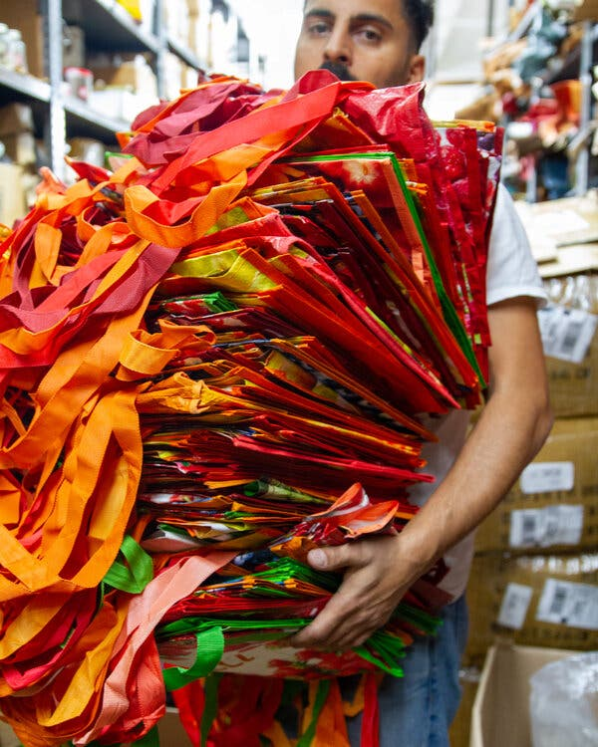
Wondering What to do with those excess reusable bags?
Donate them to the Salvation Army.

Slide 5
Good News!

Slide 6

Prelude: VU #316
Praise our Maker
Paul Baloche CCLI

Slide 7
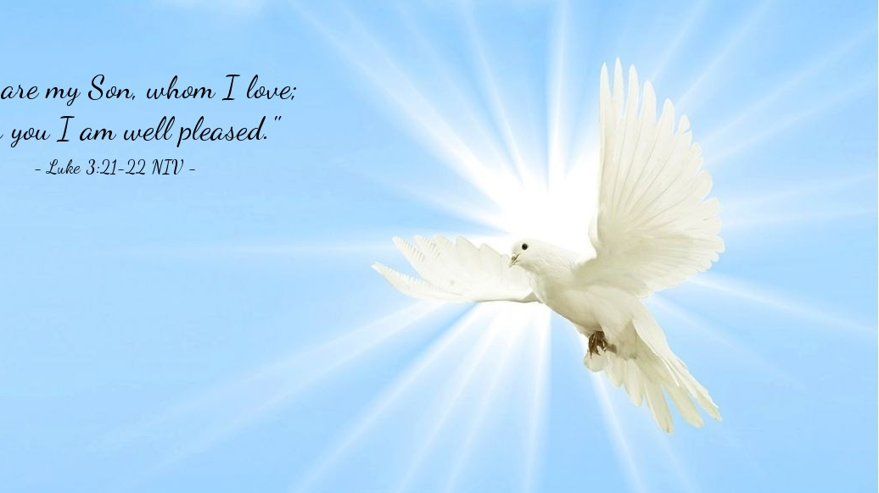
The Peace of Christ.
Sharing the Peace:
One: May the peace of Christ be with you.
Response: and also with you.
Response:
And also with you.
..
Notes:
Hymn Title Page

Slide 8
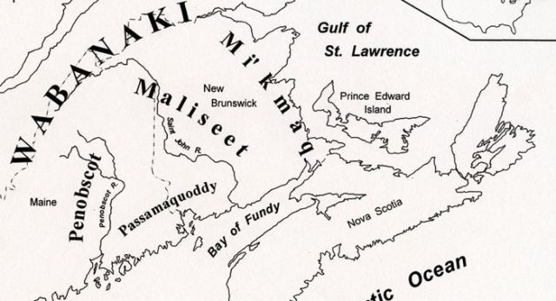
Acknowledging the Territories

Slide 9
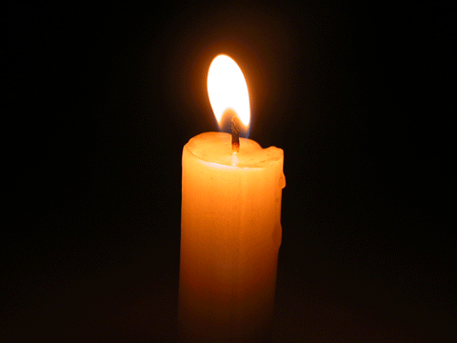
Lighting of the Christ Candle
.
If I perish, I perish. - Queen Esther

Slide 10
Call to Worship:
One: Let us come before God with a thankful heart.
All: We lift up our hearts with
gratitude, and our voices with
praise for all that God has done.

Slide 11
One: Wait upon the Lord who is our
help and shield.
All: We trust in God’s holy name
and so we come to worship.

Slide 12
Hymn: MV #131 You, Creator God, Have Searched Me
Words & Music George Mulrain Arr 2007 reprinted under OneLicense A-725110

Slide 13
You, Creator God,
have searched me
and you know my ways
You perfectly understand me;
it’s my cause of praise.

Slide 14
I cannot escape your presence
in air, land or sea.
Your arms of love and protection
are always with me.

Slide 15
You know me, O God,
you have made me,
I am proud I’m the work of your hand.
In my waking and sleeping moments,
With my being I will praise your name.

Slide 16
You created light and darkness
and you love them both.
You blessed the womb of my mother,
you brought me to birth.

Slide 17
In your image and your likeness,
wonderfully made.
I will lift my voice to praise you,
you are God indeed.

Slide 18
You know me, O God,
you have made me,
I am proud I’m the work of your hand.
In my waking and sleeping moments,
With my being I will praise your name. *

Slide 19
Gathering Prayer
God of promise and purpose, you
have called us to be your people
and given us a purpose for our
lives each day. You created the
world and all that is in in it and
you work for reconciliation and
renewal among us.

Slide 20
We gather to worship and adore
you, and to be renewed to live out
your purpose in the week ahead.
We seek your wisdom and
guidance to lead us through the
choices we face and the
challenges that surround us.

Slide 21
You are our God and we offer you
our faithfulness and praise, so the
world will see that we belong to
you. Amen.

Slide 22

It’s Okay to be Afraid

Slide 23
Hymn:
O Great Earth
Words and Music: Linnea Good reprinted under OneLicense A-725110

Slide 24
O Great Earth so green and blue,
This is the promise that I’ll make to you:
To care for your _____
For _____ can hear
The rhythm of your heartbeat. *

Slide 25

Prayer for Illumination

Slide 26
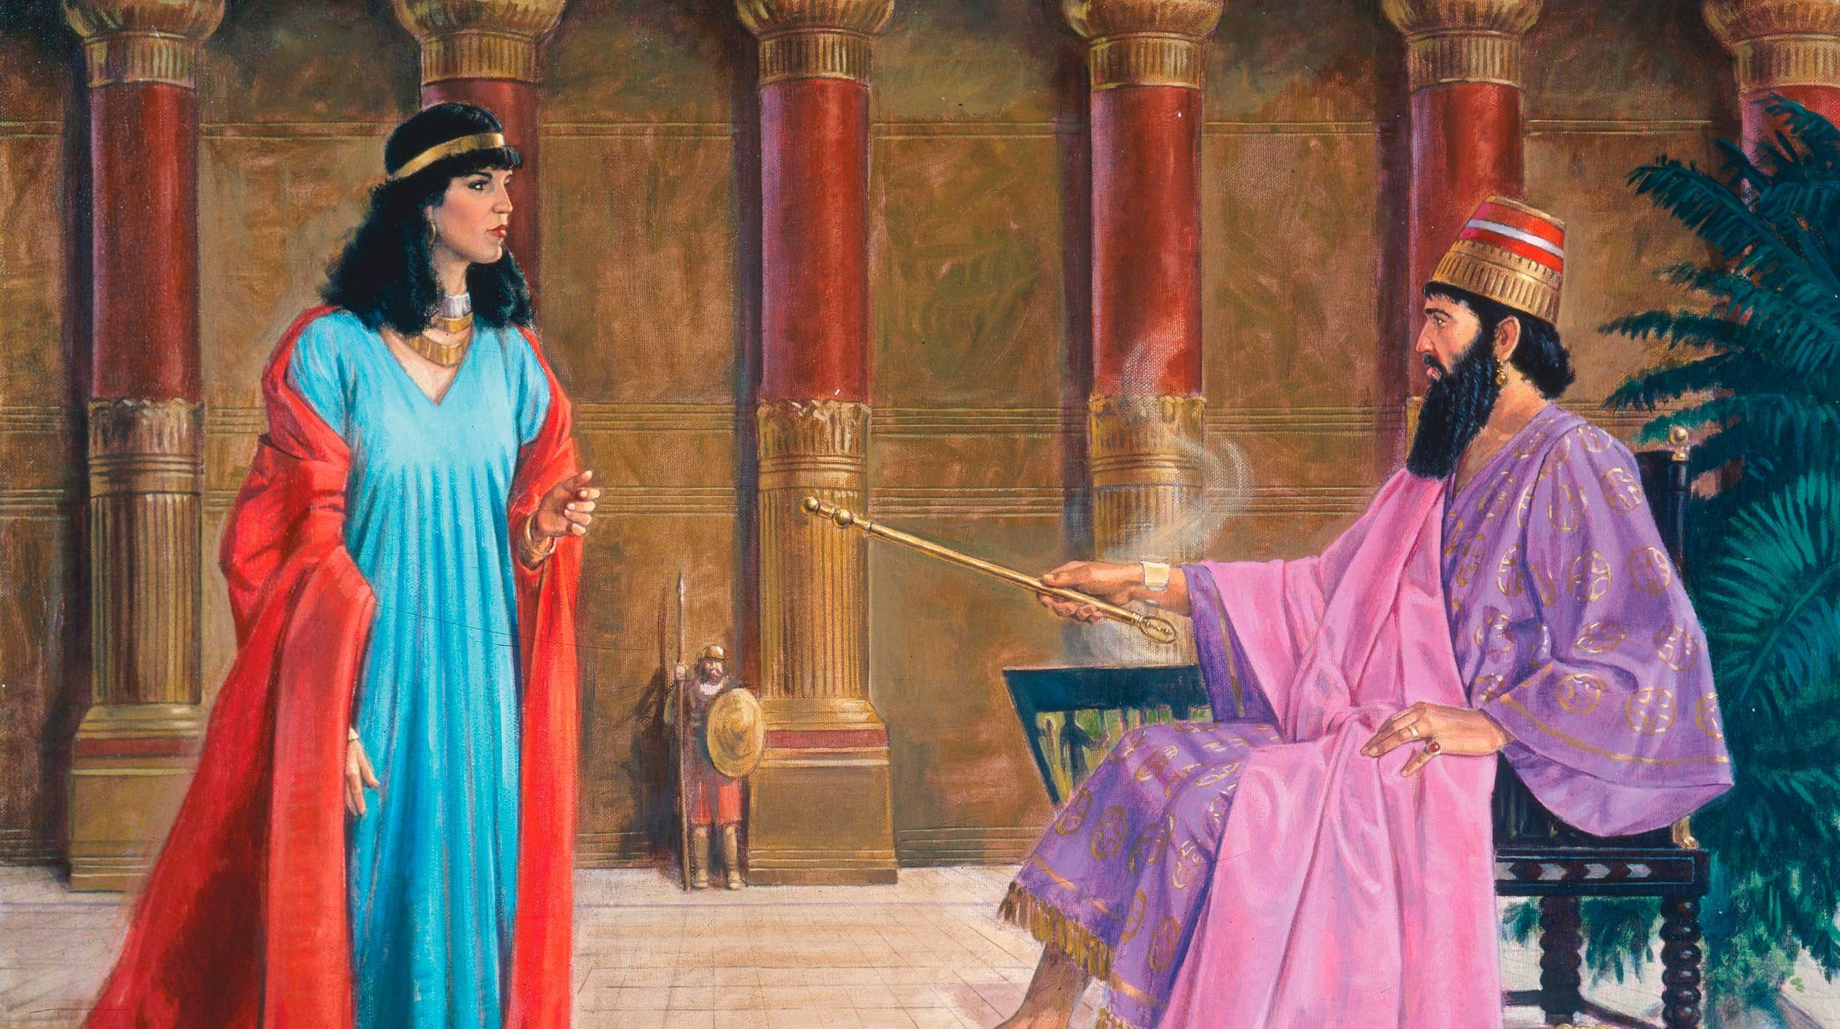
Esther 2: 17-20
Esther 4: 1-7
Esther 7: 1-10

Slide 27
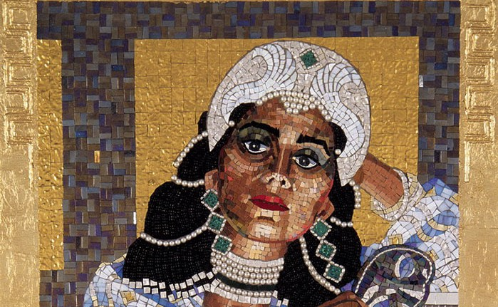
Long live the Queen

Slide 28
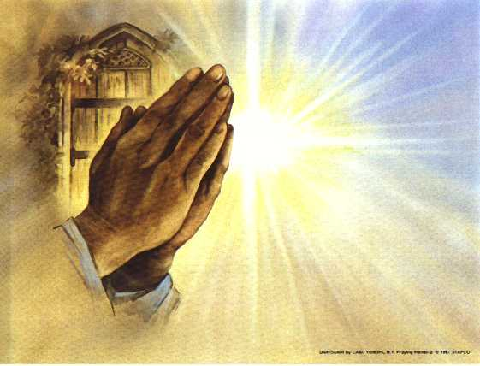
Prayers of
the People

Slide 29
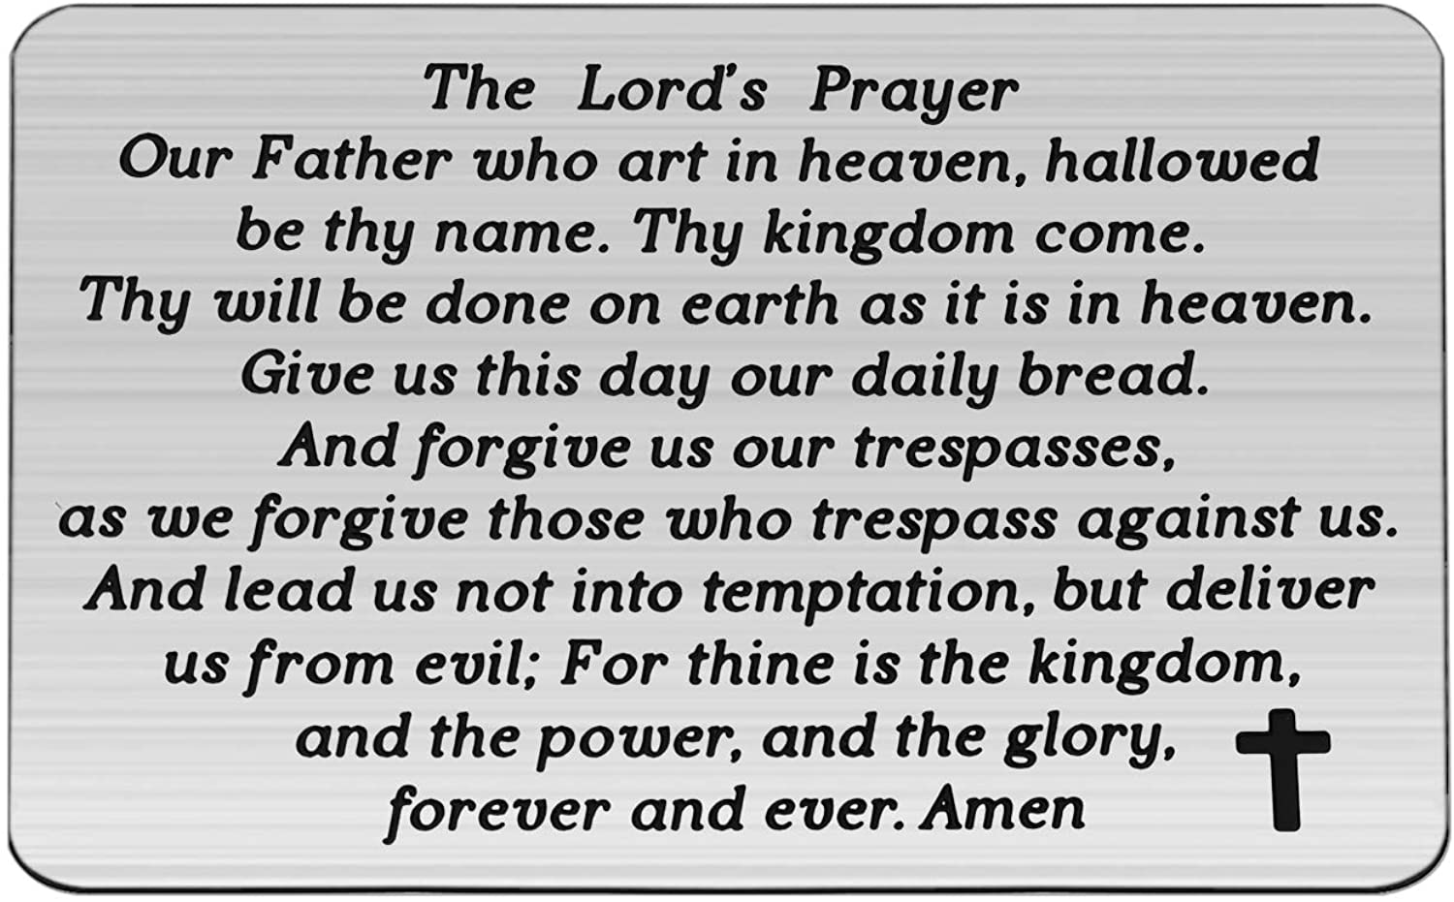

Slide 30
Support the ministry of St. Paul’s :
Through PAR – ask us how to join
via Canada Helps
search for St. Paul’s Sussex
via e-transfer to treasurerstpaulsucc1@gmail.com.
drop in collection plates located in the Narthex and near exit door
by mail to
4 Morrison Avenue, Sussex, N.B. E4E 1P5
during office hours
Notes:
Body text for hymns and prayers

Slide 31
Prayer of Dedication
Blessed are you, God of all
creation. Through your goodness
we have these gifts to share.
Bless what we offer for your
purposes.

Slide 32
Give us courage to offer ourselves
more fully to you, so that our
lives bring you honour and glory
through Christ our Lord. Amen.

Slide 33
Hymn: VU #316 Praise our Maker
Arranged Ruth Watson Henderson 1995 reprinted under OneLicense A-725110

Slide 34
Praise our Maker,
peoples of one family:
God is love, God is love!
Praise our Maker,
peoples of one family:
God is love, God is love!

Slide 35
Love our Saviour,
followers of Jesus:
God is love, God is love!
Love our Saviour,
followers of Jesus:
God is love, God is love!

Slide 36
Care for others,
children of the Spirit:
God is love, God is love!
Care for others,
children of the Spirit:
God is love, God is love! *

Slide 37
Benediction
&
Commissioning

Slide 38
Sung Benediction:
My Peace
Words: Michael A. Perry reprinted under OneLicense A-725110

Slide 39
My peace I give unto you.
It’s a peace that the world cannot give.
It’s a peace that the world cannot understand.
Peace to know, Peace to live.
My peace I give unto you.

Slide 40
My love I give unto you.
It’s a love that the world cannot give.
It’s a love that the world cannot understand.
Love to know, Love to live.
My love I give unto you. *

