Slide 1

St. Paul’s United Church Sussex, NB
August 17th, 2025
Tenth Sunday
after
Pentecost

Slide 2
Welcome!
We’re so glad you could join us

Slide 3
Good News!

Slide 4

Prelude: VU #414
God Be Praised at Early Morn
Paul Baloche CCLI

Slide 5
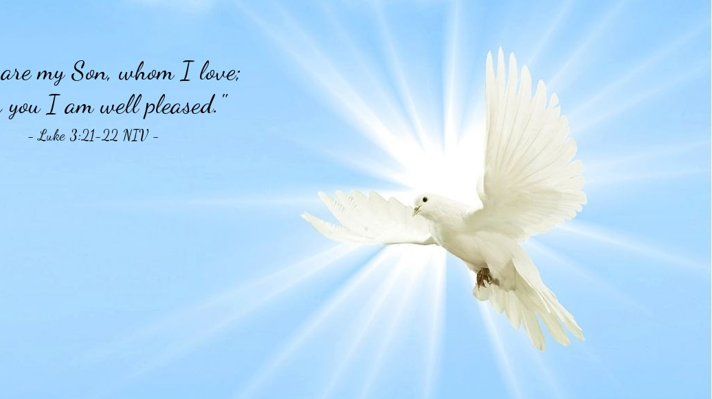
The Peace of Christ.
Sharing the Peace:
One: May the peace of Christ be with you.
Response: and also with you.
Response:
And also with you.
..
Notes:
Hymn Title Page

Slide 6
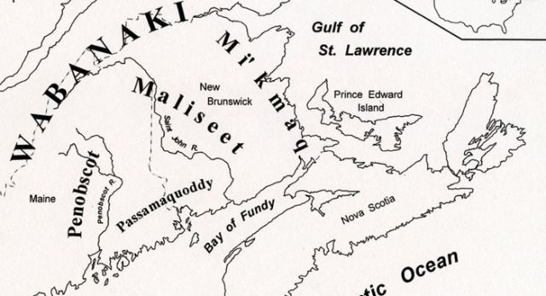
Acknowledging the Territories

Slide 7
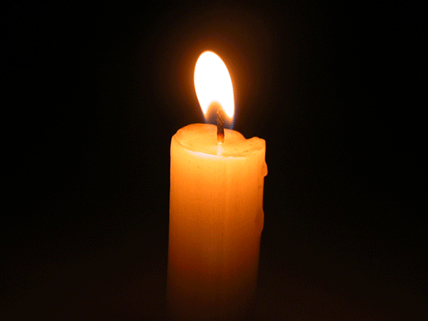
Lighting of the Christ Candle
.
The Lord your God is indeed God in heaven above and on earth below. - Joshua 2:11

Slide 8
Call to Worship:
One: The One who led the people out of their 40-year wandering;
All: calls us to be open to the
spirit in our own wanderings.
One: Like Rahab, let us be determined
and courageous people of faith.

Slide 9
All: Let us trust in the One who
shows mercy and hope.
One: May righteousness and justice be
our constant companions.
All: May we be a true blessing to
the world around us.

Slide 10
Hymn: VU #395 Come In, Come In and Sit Down vs 2,3,4
Words & Music James K Manley 1984 reprinted under OneLicense A-725110

Slide 11
Come in, come in and sit down,
You are a part of the family.
We are lost and we are found,
And we are a part of the family.

Slide 12
God is with us in this place,
Like a mother's warm embrace.
We're all forgiven by God's grace,
For we are a part of the family.

Slide 13
Come in, come in and sit down,
You are a part of the family.
We are lost and we are found,
And we are a part of the family.

Slide 14
There’s life to be shared
in the bread and the wine;
We are the branches,
Christ is the vine.
This is God’s temple,
it’s not your or mine,
but we are a part of the family.

Slide 15
Come in, come in and sit down,
You are a part of the family.
We are lost and we are found,
And we are a part of the family.

Slide 16
There's rest for the weary
and health for us all;
There's a yoke that is easy,
and a burden that's small.
So come in and worship
and answer the call,
For we are a part of the family.

Slide 17
Come in, come in and sit down,
You are a part of the family.
We are lost and we are found,
And we are a part of the family.*

Slide 18
Gathering Prayer
God of the Wandering, open our
hearts and minds, so that your
Spirit can guide us, to lead lives
seeking justice and offering
compassion.

Slide 19
We praise you for your great love
and mercy, revealed in the people
who surround us, offering us
encouragement and strength for
all we do in your love. May we too
be people who uplift and care for
all your creation. Amen.

Slide 20

Liliana Eve Green-Huestis
Jesus told us to pray

Slide 21
Opening Prayer:
Presentation of the Candidates:
Profession of Faith and Promises:
(to be answered for Eve by her parents)
Commitment of Parents:
Commitment of Godparents:
Commitment of Grandparents:

Slide 22
Congregational Commitment:
One: We have heard the will… Will
you support this family with constant
love, wholesome example, Christian
teaching and faith prayer?
All: We will, God being our helper.

Slide 23
The United Church Creed #VU 918
We are not alone,
we live in God’s world.
We believe in God:
who has created and is creating,

Slide 24
who has come in Jesus,
the Word made flesh,
to reconcile and make new,
who works in us and others
by the Spirit
We trust in God.
We are called to be the Church:

Slide 25
to celebrate God’s presence,
to live with respect in Creation,
to love and serve others,
to seek justice and resist evil,
to proclaim Jesus,
crucified and risen,
our judge and our hope.

Slide 26
In life, in death,
in life beyond death,
God is with us.
We are not alone.
Thanks be to God.

Slide 27
Prayer of Thanksgiving and the Pouring of the Water
One: God be with you.
All: And also with you.
One: Lift up your hearts.
All: We lift them to God.
One: Let us give thanks to God.

Slide 28
All: It is good to give God thanks
and praise.
One: Gracious and Holy God, we bless
you for the gift of life,… Amen.
[pouring of the water]

Slide 29
Act of Baptism:
Blessing:
Marking of the sign of the Cross:
Lighting a candle:

Slide 30
Congregational Welcome:
One: Into the household of faith, we
welcome you with joy and
thanksgiving.
All: We are members of the Body
of Christ. We are inheritors of
God’s promise. In the name of
Christ, we welcome you.

Slide 31
Hymn:
O Great Earth
Words and Music: Linnea Good reprinted under OneLicense A-725110

Slide 32
O Great Earth
so green and so blue,
This is the promise that I’ll make to you:
To care for your _____
For _____ can hear
The rhythm of your heartbeat. *

Slide 33

Prayer for Illumination

Slide 34
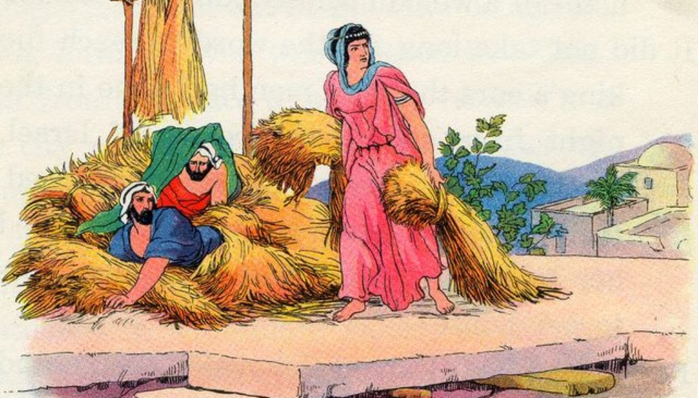
Joshua 2:1,3-16

Slide 35
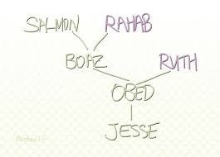
Matthew 1:5

Slide 36

James 2: 23-26

Slide 37
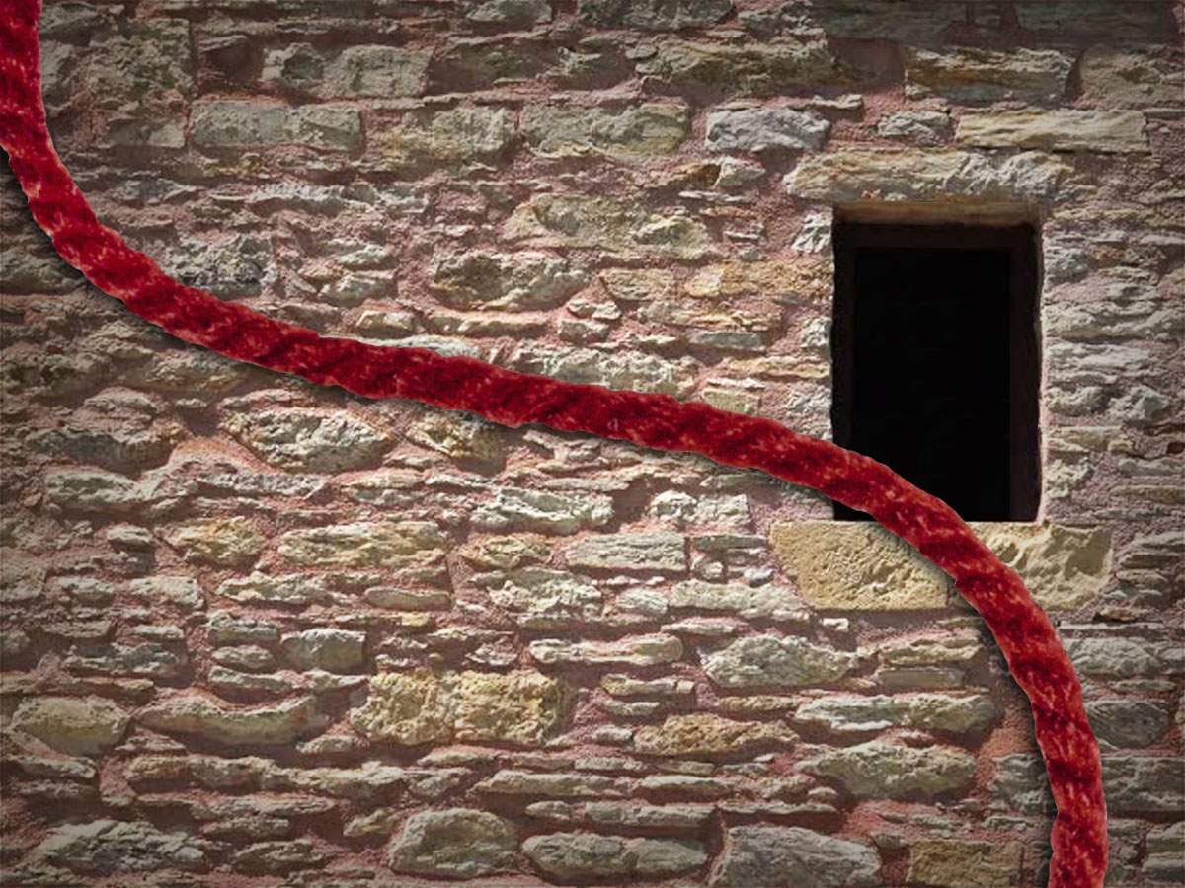
The Scarlet Cord

Slide 38
Hymn: VU #663
My Faith Looks Up to Thee
Public Domain

Slide 39
My faith looks up to thee,
Thou Lamb of Calvary,
Saviour divine.
Now hear me while I pray;
Take all my guilt away.
O let me from this day be
Wholly thine.

Slide 40
While life’s dark maze I tread,
And griefs around me spread,
Be thou my guide,
Bid darkness turn to day;
Wipe sorrow’s tears away;
Nor let me ever stray from
Thee aside.

Slide 41
May thy rich grace impart
Strength to my fainting heart,
My zeal inspire.
As thou hast died for me,
O may my love to thee
Pure, warm, and changeless be,
A living fire. *

Slide 42
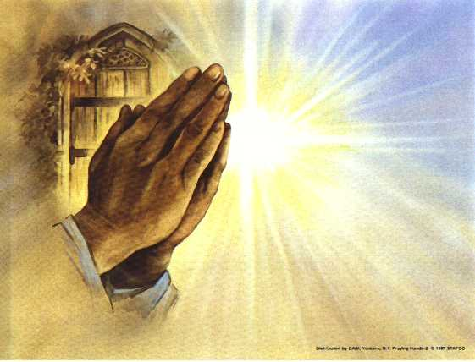
Prayers of
the People
One: Faithful God, hear our prayer,
All: And renew our faithfulness.

Slide 43
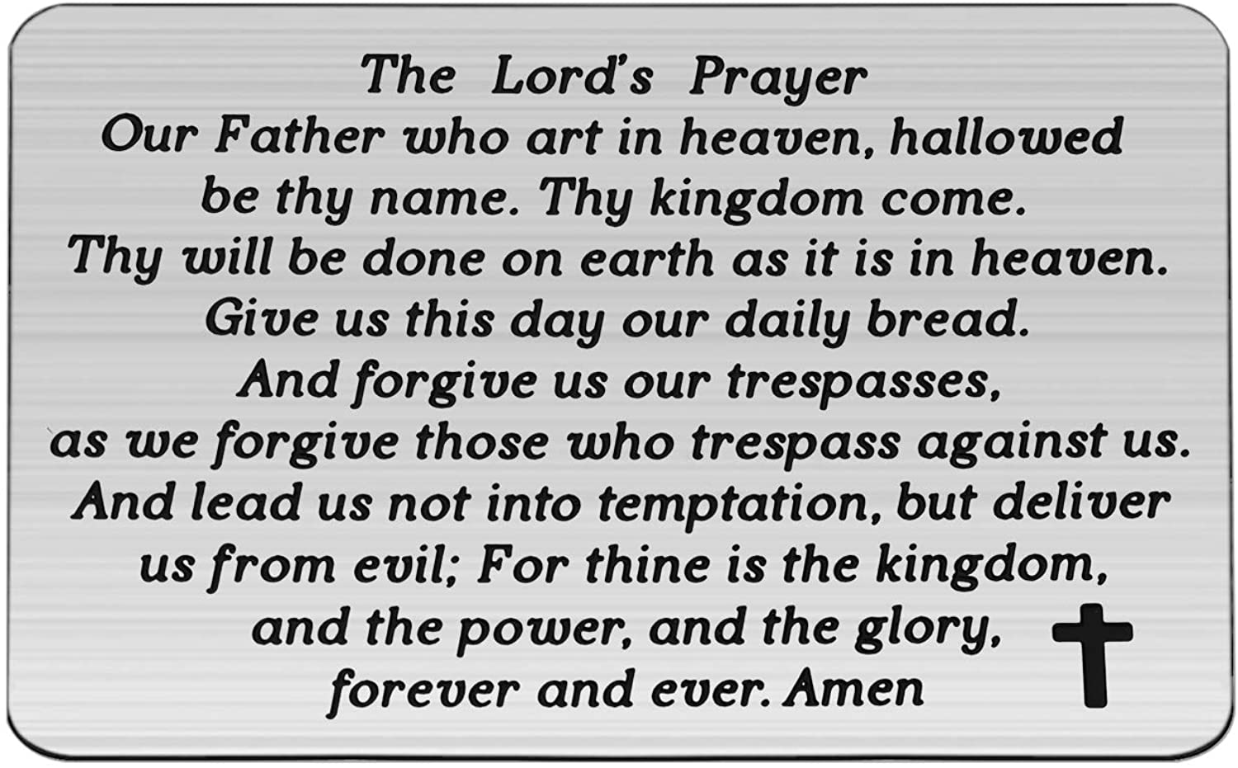

Slide 44
Support the ministry of St. Paul’s :
Through PAR – ask us how to join
via Canada Helps
search for St. Paul’s Sussex
via e-transfer to treasurerstpaulsucc1@gmail.com.
drop in collection plates located in the Narthex and near exit door
by mail to
4 Morrison Avenue, Sussex, N.B. E4E 1P5
during office hours
Notes:
Body text for hymns and prayers

Slide 45
Prayer of Dedication
Faithful God, bless the gifts we
offer to you today. Use them to
plant seeds of faith, hope and
love in the world, so that your
goodness will grow among your
people, and your name be
honoured for Christ’s sake. Amen.

Slide 46
Hymn: VU #414 God Be Praised at Early Morn
Words and music Dawei Wang 1981 reprinted under OneLicense A-725110

Slide 47
God be praised at early morn
For protection through the night;
Blessing still I need this day,
In my work, a steadfast heart

Slide 48
Everywhere your glorious light,
Splendour fills the universe;
True light, shine upon my heart
Always praising your deep love.*

Slide 49
Benediction
&
Commissioning

Slide 50
Sung Benediction:
My Peace
Words: Michael A. Perry reprinted under OneLicense A-725110

Slide 51
My peace I give unto you.
It’s a peace that the world cannot give.
It’s a peace that the world cannot understand.
Peace to know, Peace to live.
My peace I give unto you.

Slide 52
My love I give unto you.
It’s a love that the world cannot give.
It’s a love that the world cannot understand.
Love to know, Love to live.
My love I give unto you. *

