Slide 1

St. Paul’s United Church Sussex, NB
August 24th, 2025
Eleventh Sunday
after
Pentecost

Slide 2
Welcome!
We’re so glad you could join us

Slide 3
Next Sunday:
There will be a service at the Kiwanis Nursing Home at 1:30. All are welcome.

Slide 4
Family ministries
There is a planning meeting on Tuesday, Aug 26 @ 6:30 if anyone will like to help plan for our fall activities.

Slide 5
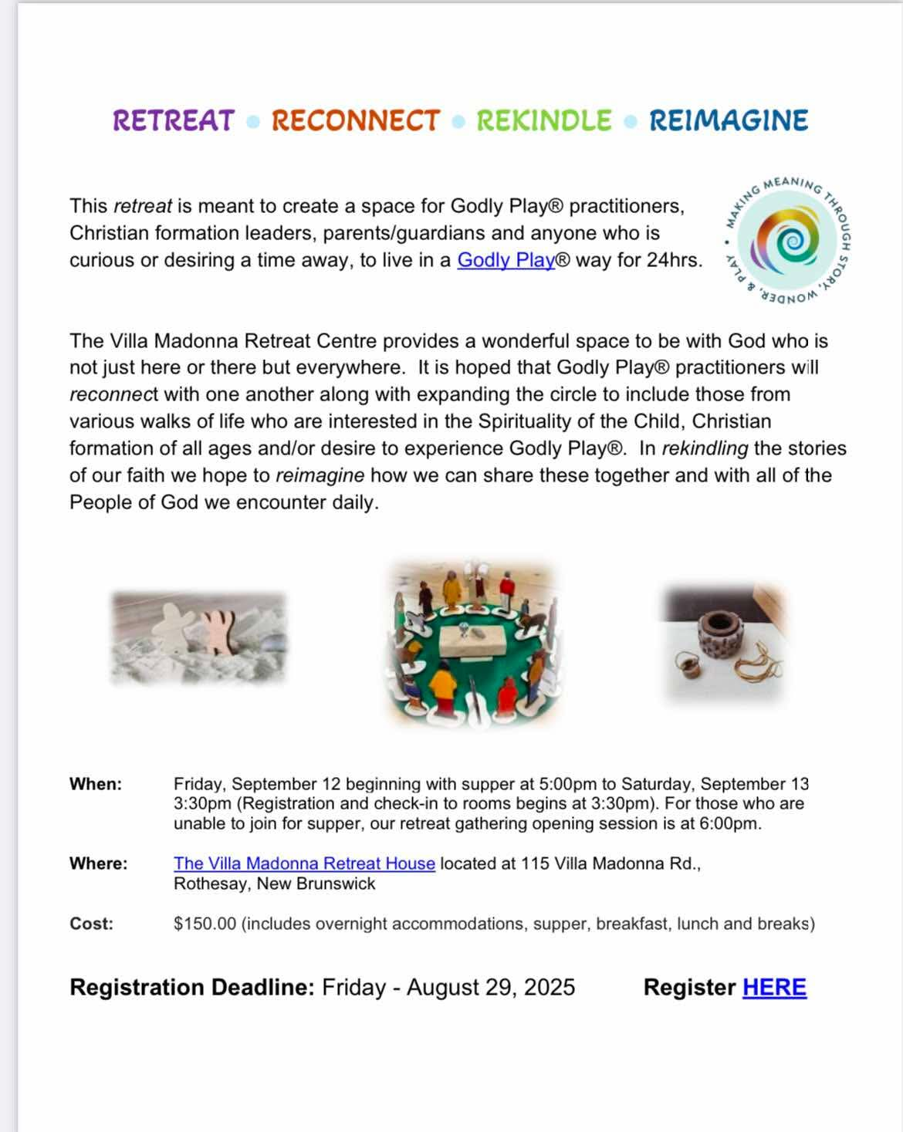
.

Slide 6
Good News!

Slide 7

Prelude: VU #414
God Be Praised at Early Morn
Paul Baloche CCLI

Slide 8
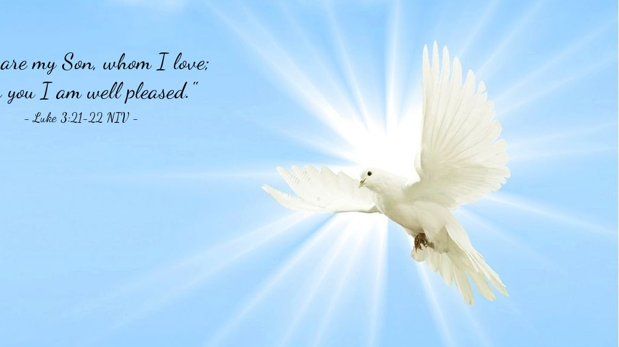
The Peace of Christ.
Sharing the Peace:
One: May the peace of Christ be with you.
Response: and also with you.
Response:
And also with you.
..
Notes:
Hymn Title Page

Slide 9
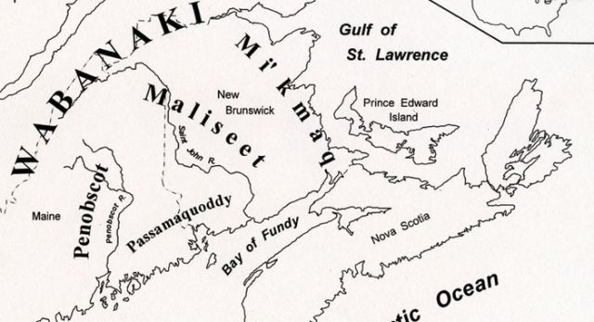
Acknowledging the Territories

Slide 10
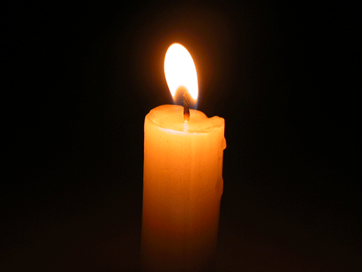
Lighting of the Christ Candle
.
Contribute to the needs of the saints; pursue hospitality to strangers. - Romans 12:13

Slide 11
Call to Worship:
One: Welcome to a time of wonder
All: and music that calls us home
One: Welcome to hear God’s words
that inspire and challenge
All: and to reminders that we are
offered holy hospitality -

Slide 12
One: Hospitality, like Lydia’s that
teaches us how to open our lives to
others
All: leading us to fully live open
minds, open hearts, open doors.

Slide 13
Hymn: TLUS #35 Bless the Lord, O My Soul
Words & Music Jonas Myrin, Matt Redman reprinted under OneLicense A-725110

Slide 14
Bless the Lord, O my soul.
O my soul, worship your holy name.
Sing like never before, O my soul;
I’ll worship your holy name.

Slide 15
The sun comes up,
It’s a new day dawning;
It’s time to sing your song again.
Whatever may pass,
And whatever lies before me,
Let me be singing
when the evening comes.

Slide 16
Bless the Lord, O my soul.
O my soul, worship your holy name.
Sing like never before, O my soul;
I’ll worship your holy name.

Slide 17
You’re rich in love,
And you’re slow to anger.
Your name is great
and your heart is kind.
For all your goodness,
I will keep on singing
Ten thousand reasons
For my heart to find.

Slide 18
Bless the Lord, O my soul.
O my soul, worship your holy name.
Sing like never before, O my soul;
I’ll worship your holy name.

Slide 19
And on that day
When my strength is failing,
The end draws near
And my time has come,
Still, my soul will
Sing your praise unending
Ten thousand years
And then forever more!

Slide 20
Bless the Lord, O my soul.
O my soul, worship your holy name.
Sing like never before, O my soul;
I’ll worship your holy name.
Worship your holy name;
Worship your holy name. *

Slide 21
Gathering Prayer
Eternal God, who gives good gifts
to all people, and who grants the
spirit of generosity: Give us, we
pray you, hearts always open to
hear your word, that, following
the example of your servant
Lydia,

Slide 22
we may show hospitality to those who are in any need or trouble;
through Jesus Christ our Lord
who lives and reigns with you and
the Holy Spirit, one God, now and
for ever. Amen.

Slide 23
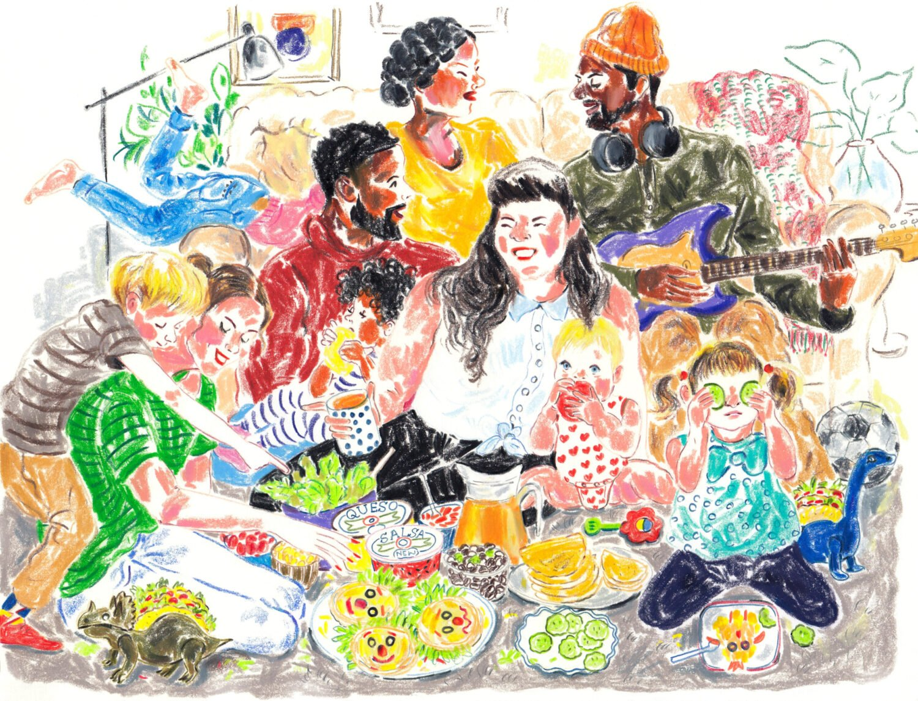
Visitors!

Slide 24
Hymn:
O Great Earth
Words and Music: Linnea Good reprinted under OneLicense A-725110

Slide 25
O Great Earth
so green and so blue,
This is the promise that I’ll make to you:
To care for your _____
For _____ can hear
The rhythm of your heartbeat.

Slide 26
O Great Earth
so green and so blue,
This is the promise that I’ll make to you:
To care for your _____
For _____ can hear
The rhythm of your heartbeat. *

Slide 27

Prayer for Illumination

Slide 28
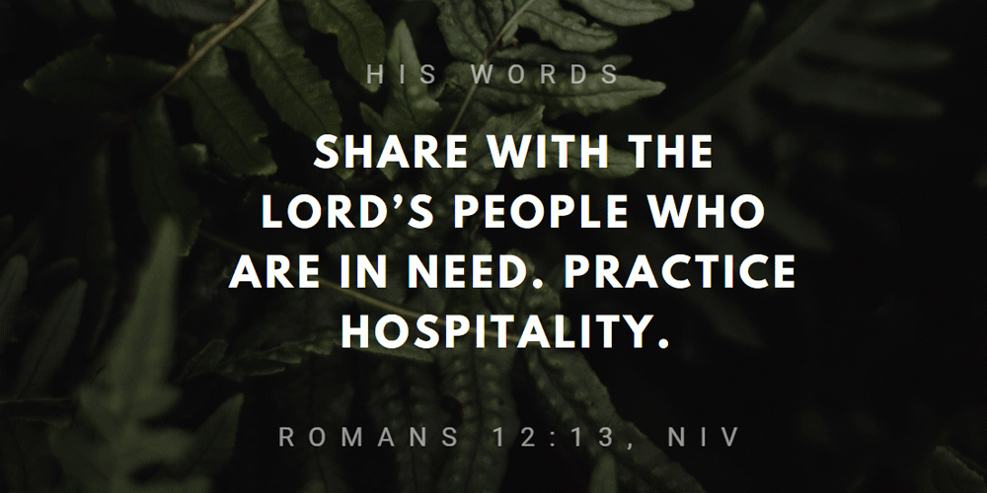
Romans 12:13

Slide 29
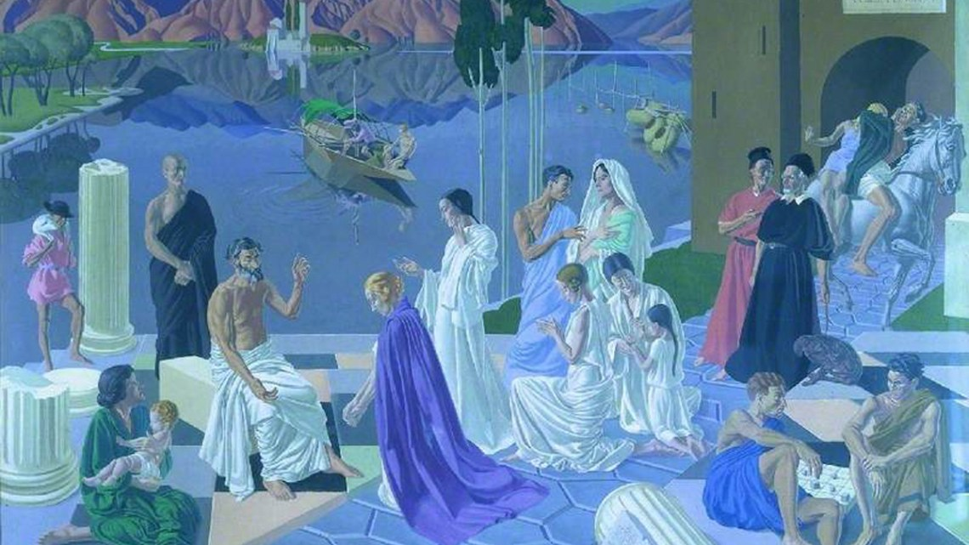
Acts 16: 11-40

Slide 30

Ephesians 5:15-16

Slide 31
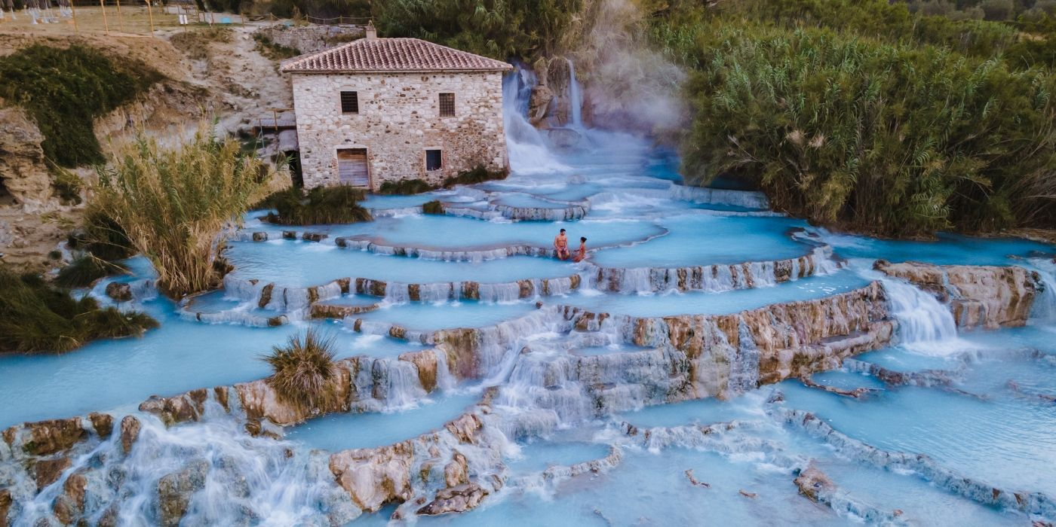
Open Heart, Open House

Slide 32
Hymn: VU# 371 Open My Eyes, That I May See
Public Domain

Slide 33
Open my eyes, that I may see
Glimpses of truth thou hast for me;
Place in my hands the wonderful key
That shall unclasp and set me
free.

Slide 34
Silently now I wait for thee,
Ready, my God, thy will to see.
Open my eyes, illumine me,
Spirit divine!

Slide 35
Open my ears, that I may hear
Voices of truth thou sendest clear;
And while the wavenotes fall on my ear,
Everything false will disappear.

Slide 36
Silently now I wait for thee,
Ready, my God, thy will to see.
Open my ears, illumine me,
Spirit divine!

Slide 37
Open my mouth, and let me bear
Gladly the warm truth everywhere;
Open my heart and let me prepare
Love with thy children thus to share.

Slide 38
Silently now I wait for thee,
Ready, my God, thy will to see.
Open my mouth, illumine me,
Spirit divine! *

Slide 39
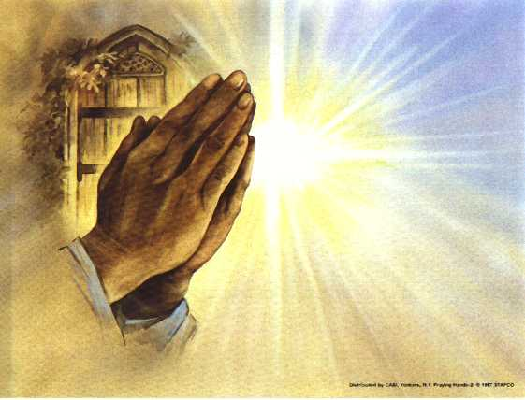
Prayers of
the People

Slide 40
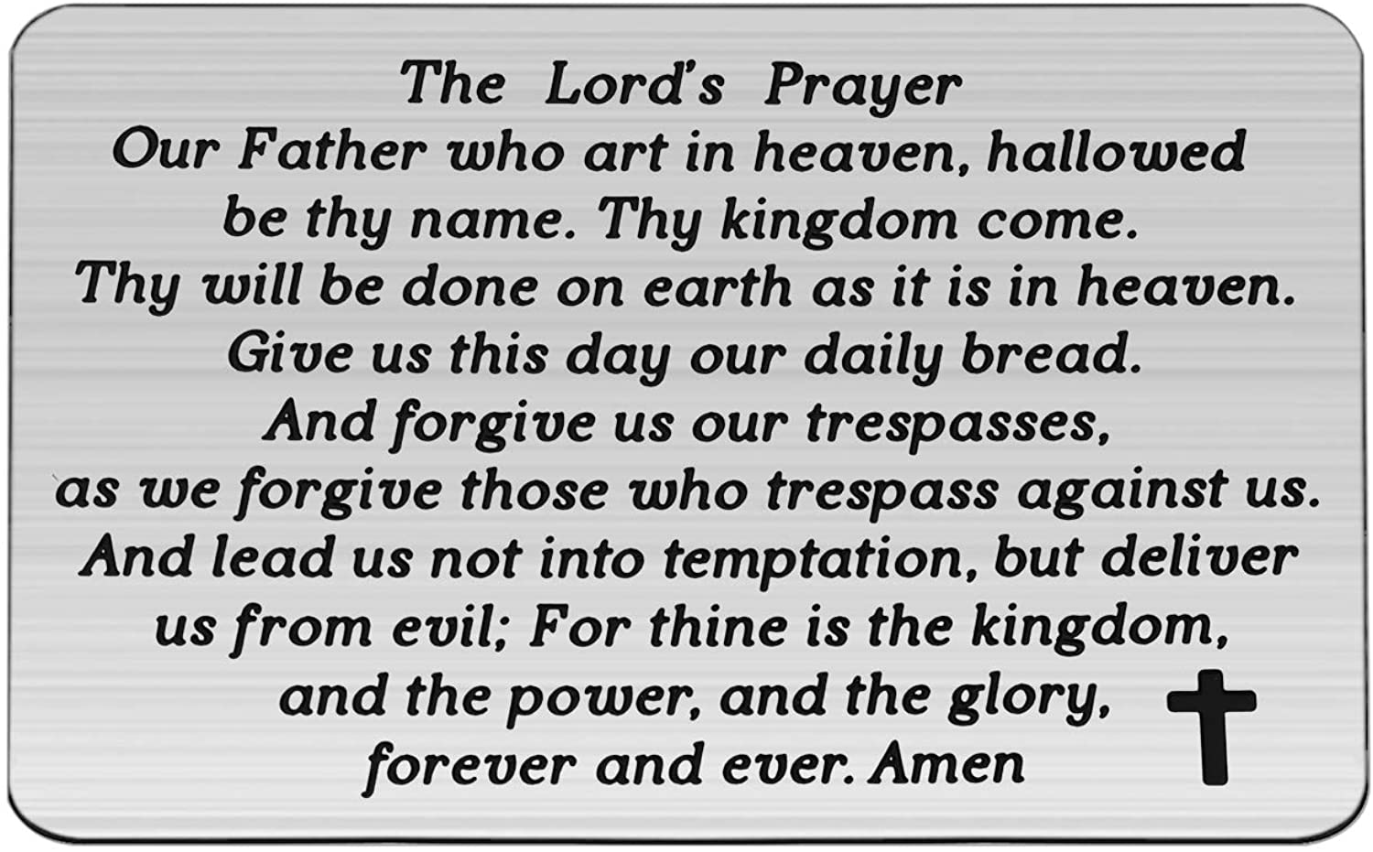

Slide 41
Support the ministry of St. Paul’s :
Through PAR – ask us how to join
via Canada Helps
search for St. Paul’s Sussex
via e-transfer to treasurerstpaulsucc1@gmail.com.
drop in collection plates located in the Narthex and near exit door
by mail to
4 Morrison Avenue, Sussex, N.B. E4E 1P5
during office hours
Notes:
Body text for hymns and prayers

Slide 42
Prayer of Dedication
Here, God, we give our gifts to
the work of your church, for the
encouragement of your people,
and with the love of Christ in our
hearts. Bless our offerings as a
sign of our faith.

Slide 43
With these gifts, encourage our
service as a sign of your love, we
pray in Christ’s name. Amen.

Slide 44
Hymn: TLUS #30 We Are a Rainbow
Words and Music: David Kai, 2017 reprinted under OneLicense A-725110

Slide 45
We’re the light of all the world,
We are a city on a hill,
We’re a candle on
a stand proclaiming light,
We will not hide our lamp
Beneath a bushel anymore,
We will shine a ray of hope
That’s burning bright.

Slide 46
We are a rainbow,
Sign of covenant and peace
For the flood of tears
Will finally cease to be,
Come shine your rainbow,
Splash your hues across the sky,
Paint the world in colours
Proud and bold and free.

Slide 47
We’re a coat of many colours,
Sewn from many diff’rent threads
Cov’ring all in warmth,
In welcome and in grace,
God said “Let there be light”,
Created every varied shade,
In the rainbow each of us
Can find a place.

Slide 48
We are a rainbow,
Sign of covenant and peace
For the flood of tears
Will finally cease to be,
Come shine your rainbow,
Splash your hues across the sky,
Paint the world in colours
Proud and bold and free.

Slide 49
We are hope to still believe
In tomorrow’s better day,
We are peace in
a world that’s torn apart,
we are joy that will last
in all the struggles that we face
we are love that blooms and
grows in every heart.

Slide 50
We are a rainbow,
Sign of covenant and peace
For the flood of tears
Will finally cease to be,
Come shine your rainbow,
Splash your hues across the sky,
Paint the world in colours
Proud and bold and free.

Slide 51
When we face the storms of life,
We will never be alone,
For our God will
Be with us on the way,
Here we are, side by side,
We won’t be frightened anymore,
As the mourning night of tears
Breaks into day.

Slide 52
We are a rainbow,
Sign of covenant and peace
For the flood of tears
Will finally cease to be,
Come shine your rainbow,

Slide 53
Splash your hues across the sky,
Paint the world in colours
Proud and bold and free.
Paint the world in colours
Proud and bold and free. *

Slide 54
Benediction
&
Commissioning

Slide 55
Sung Benediction:
My Peace
Words: Michael A. Perry reprinted under OneLicense A-725110

Slide 56
My peace I give unto you.
It’s a peace that the world cannot give.
It’s a peace that the world cannot understand.
Peace to know, Peace to live.
My peace I give unto you.

Slide 57
My love I give unto you.
It’s a love that the world cannot give.
It’s a love that the world cannot understand.
Love to know, Love to live.
My love I give unto you. *

