Slide 1

St. Paul’s United Church
Sussex, NB
August 3rd, 2025
Eighth Sunday
after
Pentecost

Slide 2
Welcome!
We’re so glad you could join us

Slide 3
A weekend with Linnea:
Unfortunately, due to logistical issues, this event has been cancelled.
Hampton United, along with Linnea Good, wish to express their apologies for this.

Slide 4
Just a reminder that if you know of someone who would like a card from the caring corner, or a visit from the minister, please let Jenn or the office know.
Thanks.

Slide 5
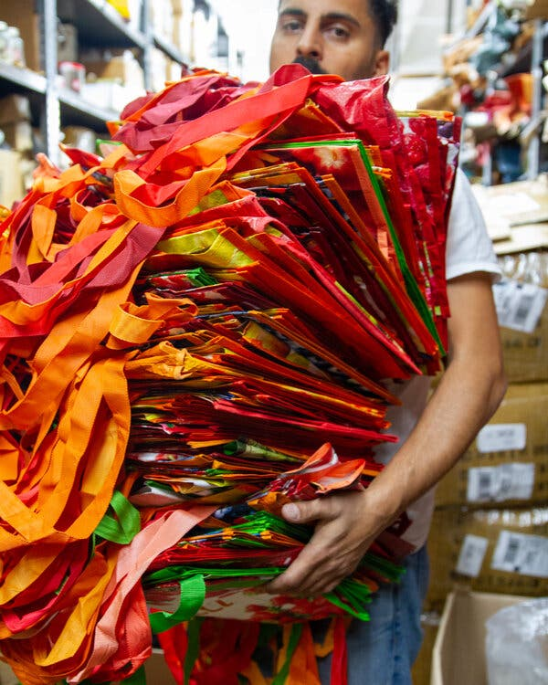
Wondering What to do with those excess reusable bags?
Donate them to the Salvation Army.

Slide 6
Good News!

Slide 7
We are sending 3 members to general council in Calgary this year.

Slide 8
Good News!

Slide 9

Prelude: MV #169 When Hands Reach Out Beyond Divides
Paul Baloche CCLI

Slide 10
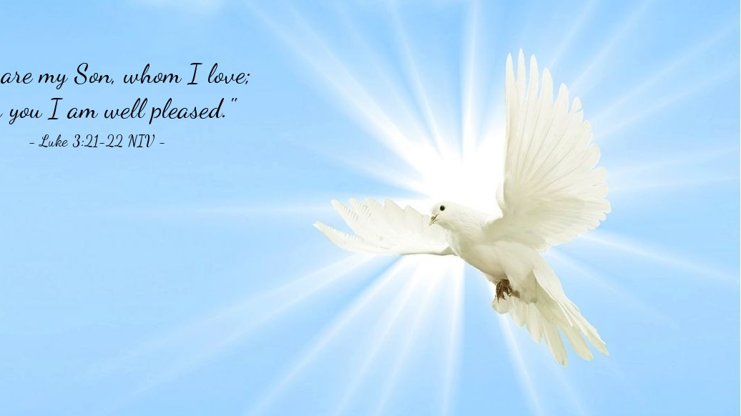
The Peace of Christ.
Sharing the Peace:
One: May the peace of Christ be with you.
Response: and also with you.
Response:
And also with you.
..
Notes:
Hymn Title Page

Slide 11
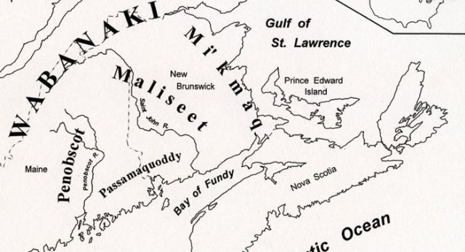
Acknowledging the Territories

Slide 12
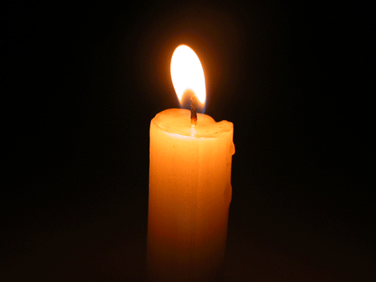
Lighting of the Christ Candle
.
Then David said to Abigail… I have heeded your voice, and I have granted your petition.
- 1 Samuel 25: 35

Slide 13
Call to Worship:
One: Give thanks to the Lord, for God
is good!
All: God’s faithful love endures
forever.
One: God gives us the gifts and
people we need to help us on our
journey.

Slide 14
All: God has blessed us in ways
too numerous to count.
One: Praise the Lord for God’s
steadfast love is great!
All: Let us praise the Lord! Let us
worship God.

Slide 15
Hymn: MV #221
I Am Walking a Path of Peace
Words & Music Janet Bauman Tissandier reprinted under OneLicense A-725110

Slide 16
I am walking a path of peace,
I am walking a path of peace,
I am walking a path of peace,
Lead me home, Lead me home.

Slide 17
I am walking a path of faith,
I am walking a path of faith,
I am walking a path of faith,
Lead me home, Lead me home. *

Slide 18
Gathering Prayer
God of justice and joy, as we
gather to worship, may we join
our spirits, together to praise
your faithful love and many
blessings in our lives.

Slide 19
Help us find within us a growing
sense of courage and compassion
to meet the challenges that life
brings to us. Fill us with your love
and encourage us to live faithfully
and with a sense of true
hospitality towards all your
children and wider creation.Amen

Slide 20
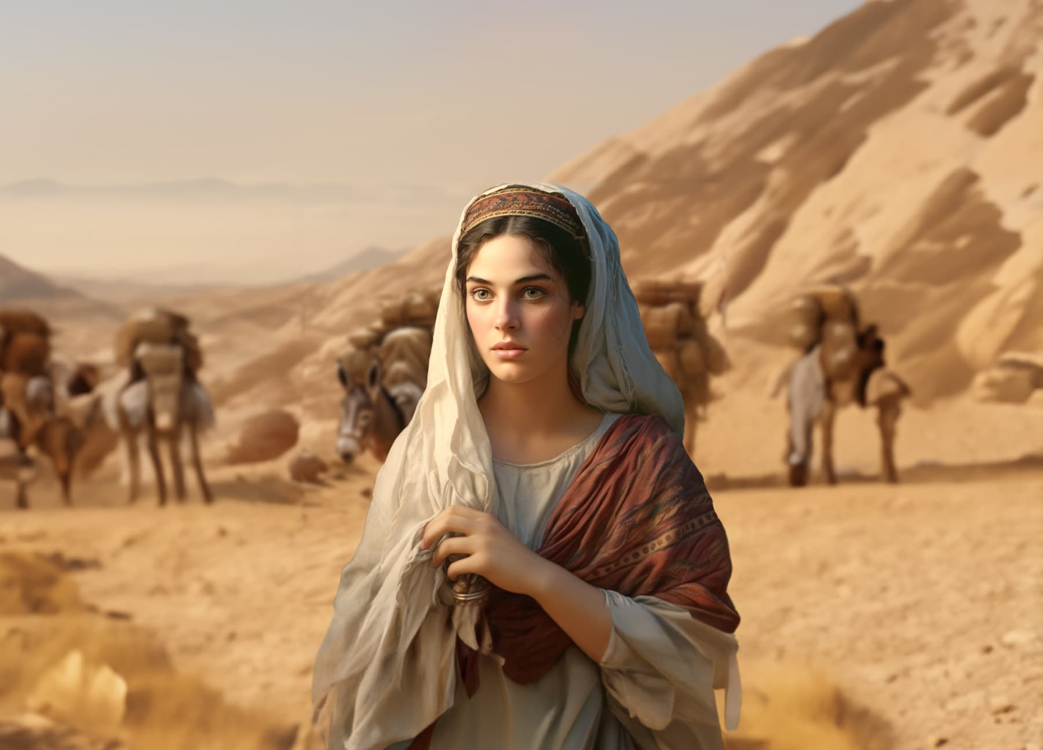
More than just a pretty face

Slide 21
A blessing offered:
Our members attending the General Council:
Samantha Corcoran
Daniel Carmichael
Lisa Folkins

Slide 22
Hymn:
O Great Earth
Words and Music: Linnea Good reprinted under OneLicense A-725110

Slide 23
O Great Earth so green and blue,
This is the promise that I’ll make to you:
To care for your _____
For _____ can hear
The rhythm of your heartbeat. *

Slide 24

Prayer for Illumination

Slide 25
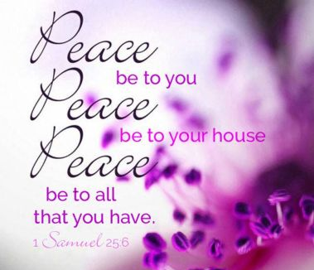
1 Samuel 25: 2-6

Slide 26
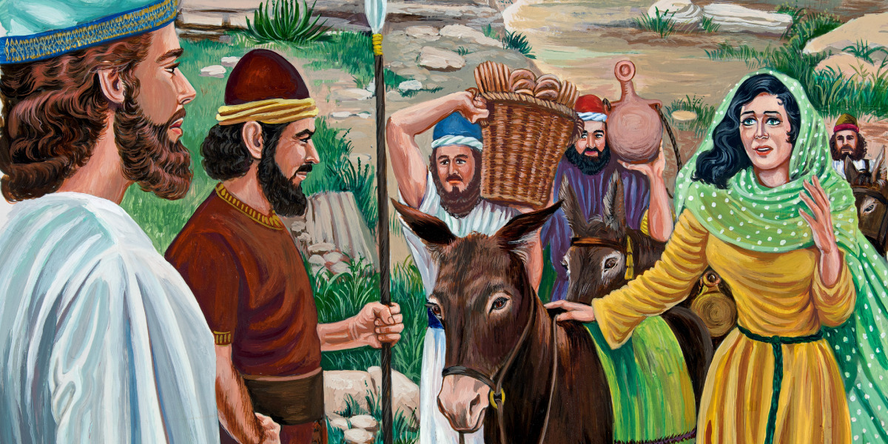
1 Samuel 25: 14-42

Slide 27
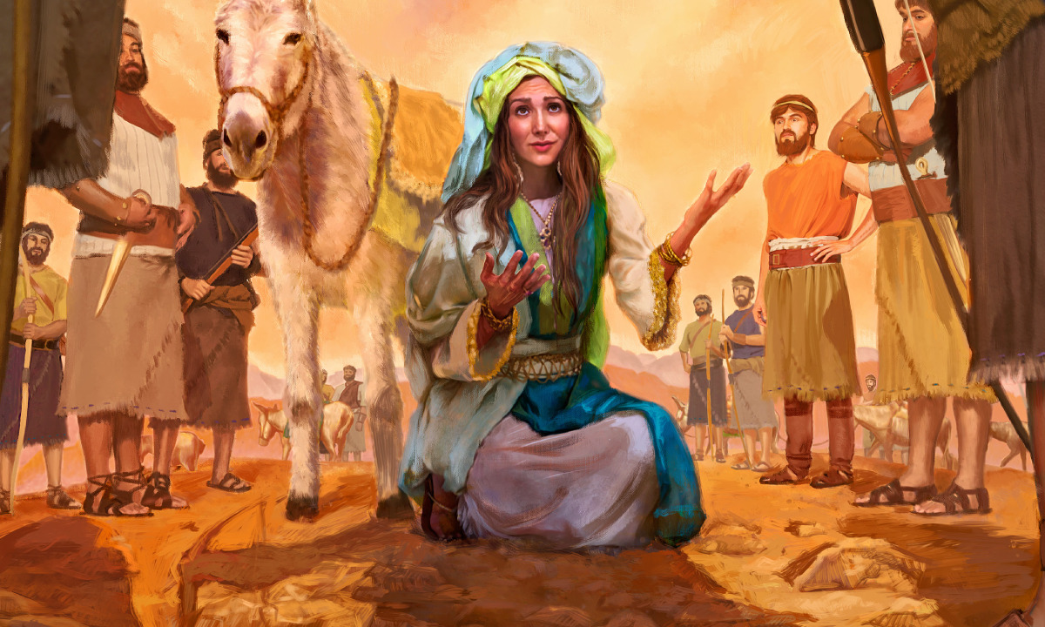
Abigail: definitely more than a pretty face

Slide 28
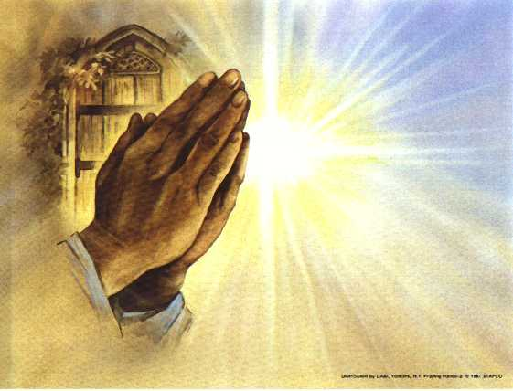
Prayers of
the People

Slide 29
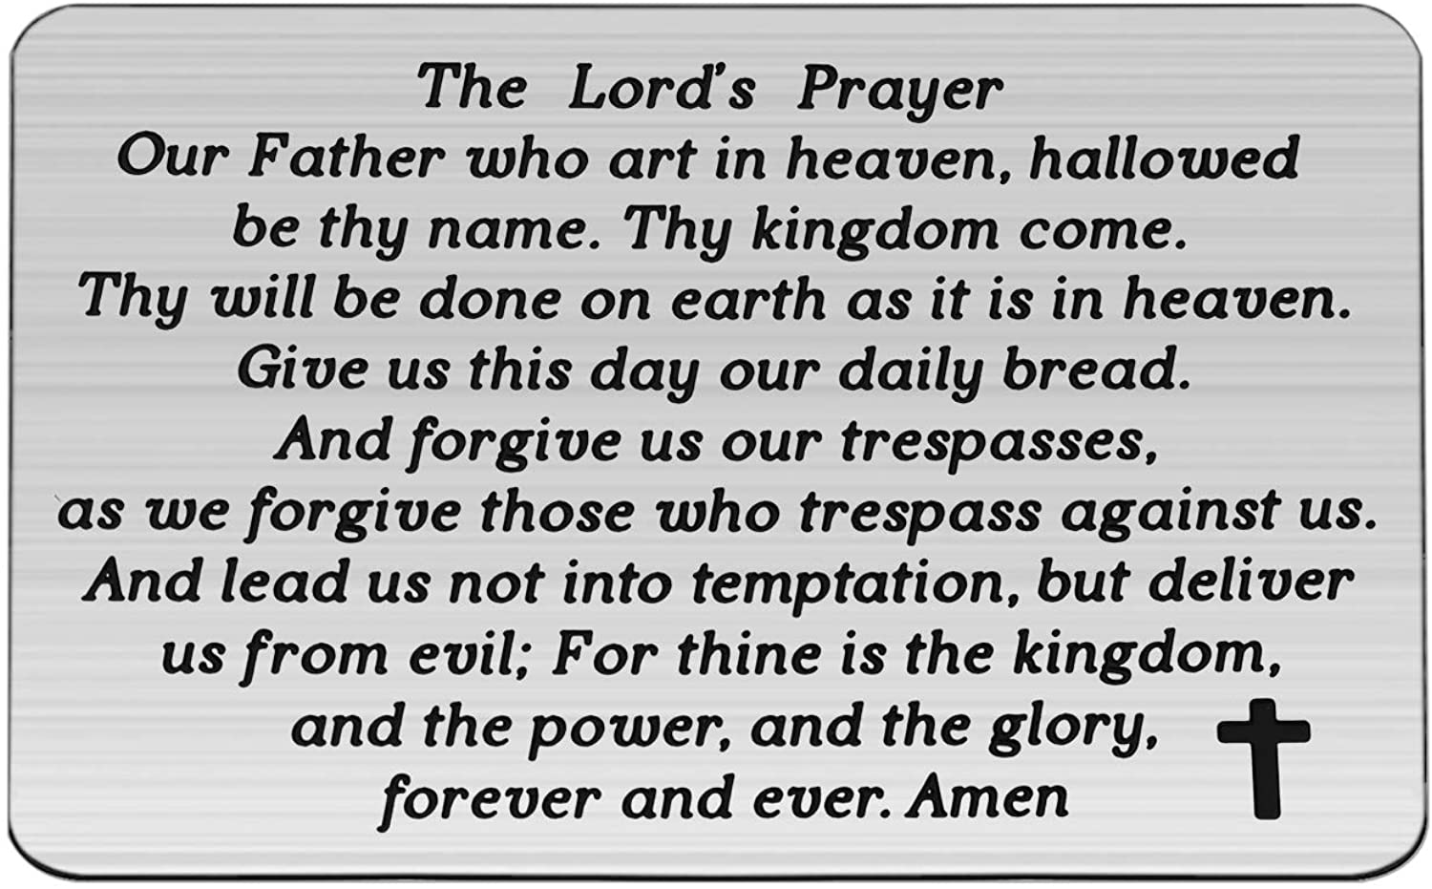

Slide 30
Support the ministry of St. Paul’s :
Through PAR – ask us how to join
via Canada Helps
search for St. Paul’s Sussex
via e-transfer to treasurerstpaulsucc1@gmail.com.
drop in collection plates located in the Narthex and near exit door
by mail to
4 Morrison Avenue, Sussex, N.B. E4E 1P5
during office hours
Notes:
Body text for hymns and prayers

Slide 31
Prayer of Dedication
God of Abundant love, we bring
you our gifts in gratitude for your
generosity. Bless and multiply
these gifts, so that they can
spread your goodness in the
world and touch lives of those in
need. Amen.

Slide 32
Hymn: MV #169 When Hands Reach Out Beyond Divides
Words: Ken K. Wehlander, 2005 Music: unknown composer reprinted under OneLicense A-725110

Slide 33
When hands reach out beyond divides
And hope is truly found,
Each chain of hate will fall away
And bells of peace shall sound,

Slide 34
And bells of peace, of peace shall sound
And bells of peace shall sound
Each chain of hate will fall away
And bells of peace shall sound.

Slide 35
When fear no longer guides our steps
And days of war are done,
God’s dream for all shall live anew;
Our hearts will heal as one

Slide 36
Our hearts will heal, will heal as one,
God’s dream for all shall live anew
Our hearts will heal as one.

Slide 37
When race and creed blind us no more,
A neighbour’s face we’ll see,
And we shall dance the whole world round,
For love will set us free,

Slide 38
For love, yes love will set us free,
For love will set us free,
And we shall dance the whole world round,
For love will set us free. *

Slide 39
Benediction
&
Commissioning

Slide 40
Sung Benediction:
My Peace
Words: Michael A. Perry reprinted under OneLicense A-725110

Slide 41
My peace I give unto you.
It’s a peace that the world cannot give.
It’s a peace that the world cannot understand.
Peace to know, Peace to live.
My peace I give unto you.

Slide 42
My love I give unto you.
It’s a love that the world cannot give.
It’s a love that the world cannot understand.
Love to know, Love to live.
My love I give unto you. *

