Slide 1
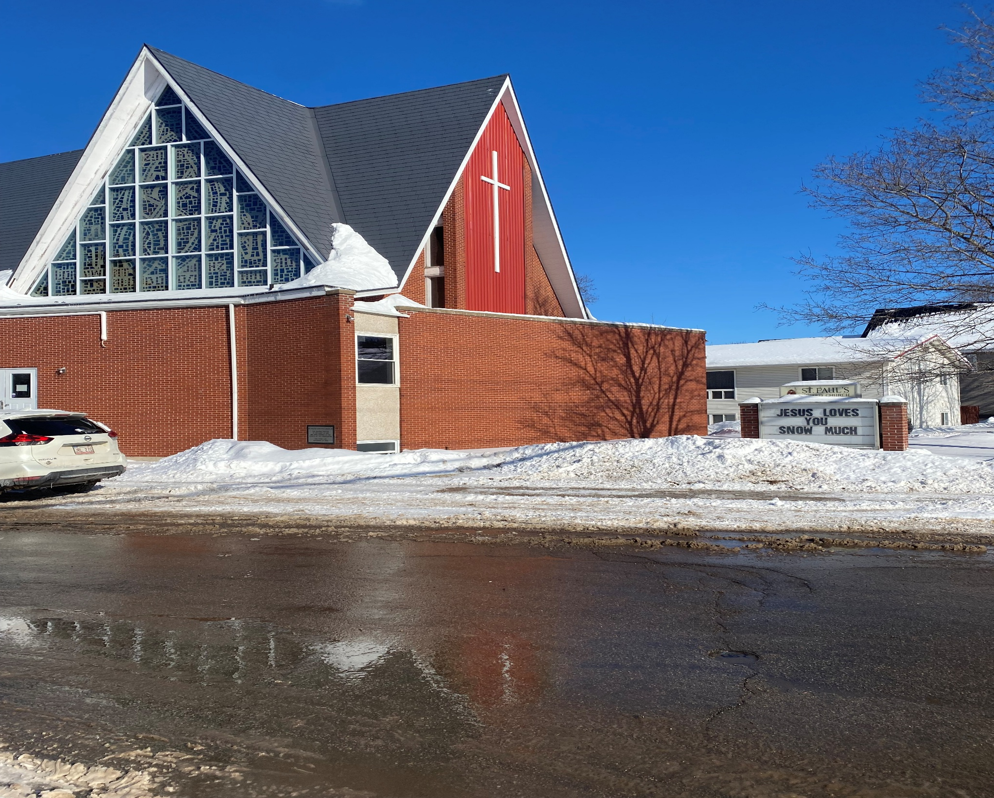
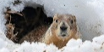
6th after Epiphany
St. Paul’s United Church
Sussex, NB
February 16, 2025
Welcome

Slide 2
In sanctuary passing of the peace.

Slide 3

Prelude:

Slide 4
Welcome!
We’re so glad you could join us

Slide 5
Coldest night
It has been determined that there will not be an entry from St. Paul’s for this year’s coldest night event.

Slide 6
Lenten practices
A 31 short spiritual practices program is available.
If you want a copy, please contact the office. Email, phone or stop in. You can get it printed or in digital format.

Slide 7
Good News!

Slide 8
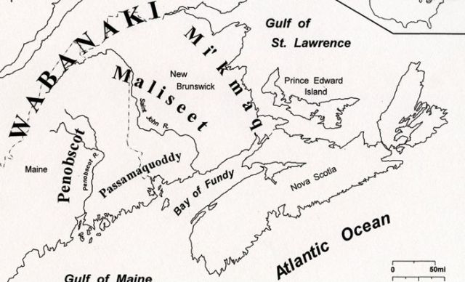
Acknowledging the Territories

Slide 9

Leader: May the Peace of Christ be with you.
Response:
And also with you.
..
Notes:
Hymn Title Page

Slide 10
Call to Worship
One: Sing to the Lord a new song!
All: Let us join in song before our
God!
One: Let everything that breathes
praise the Lord!
All: Let us sing praises to God’s
holy name together.

Slide 11
One: How good it is to sing praises to
our God;
All: For God is gracious and
steadfast in mercy.
One: A song of praise is always fitting,
All: For God heals the broken
hearted and binds up our wounds.

Slide 12
Hymn: VU #222 Come let Us Sing
words and music: Jim Strathdee, © 1977, Desert Flower Music reprinted under OneLicense A725110

Slide 13
Come, let us sing
to the Lord our song,
we have stood silently too long;
surely the Lord
deserves our praise,
so joyfully thank God
for our days.

Slide 14
O thirsty soul,
come drink at the well;
God's living waters will never fail.
Surely the Lord
will help you to stand,
strengthened and comforted
by God's hand.

Slide 15
You dwell among us
and cause us to pray,
and walk with each other following your way;
our precious brothers
and sisters will grow
in the fulfilling love they know.

Slide 16
Deserts shall bloom
and mountains shall sing
to the desire of all living things.
Come, all you creatures,
high and low,
let your praises endlessly flow. *

Slide 17
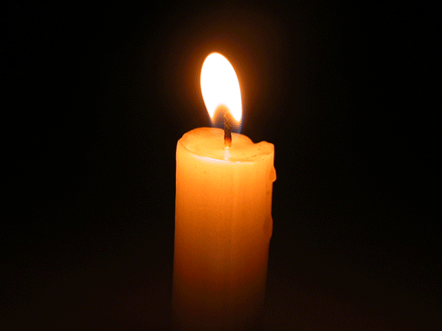
Lighting of the Christ Candle
“. . . when it comes down to it, that’s what life is all about: showing up for the people you love, again and again, until you can’t show up anymore.” — Rebecca Walker

Slide 18
Gathering Prayer
Loving God, you created us to live
in community and uphold one
another in love. May we seek your
presence in each and every day
and learn to recognize you in the
sound and feel of our own breath

Slide 19
and in the movement or noise of
those around us. Enliven our faith
so that it leads us to trust in you
and to follow the path of
abundance, compassion, and
connection.

Slide 20
Let our worship in song and
prayer be a foreshadowing of our
worship in action and witness.
Transform us from despair to
hope, complacency to courage,
and indifference to love in your
name. Amen.

Slide 21
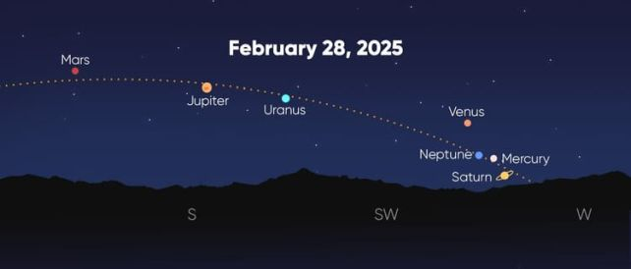
And on the 4th day *******

Slide 22
Hymn: MV #13
O Let The Power Fall on Me vs 1,2,1
Words: Birchfield Aymer music: trad Caribbean reprinted under OneLicense A-725110

Slide 23
O let the power
Fall on me, my Lord,
Let the power
Fall on me;
O let the power from heaven
Fall on me, let the power
Fall on me.

Slide 24
For we want justice
And truth and love, my Lord,
We want justice
And truth and love;
For we want justice and truth
And love, my Lord,
we want justice
And truth and love.

Slide 25
O let the power
Fall on me, my Lord,
Let the power
Fall on me;
O let the power from heaven
Fall on me, let the power
Fall on me. *

Slide 26

Prayer for Illumination

Slide 27
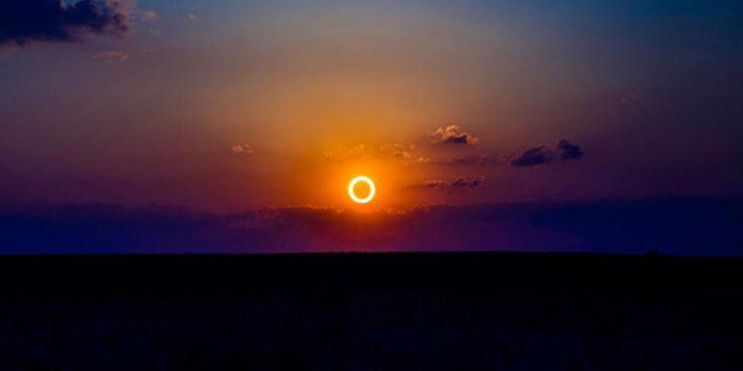
Genesis 1: 14-19

Slide 28
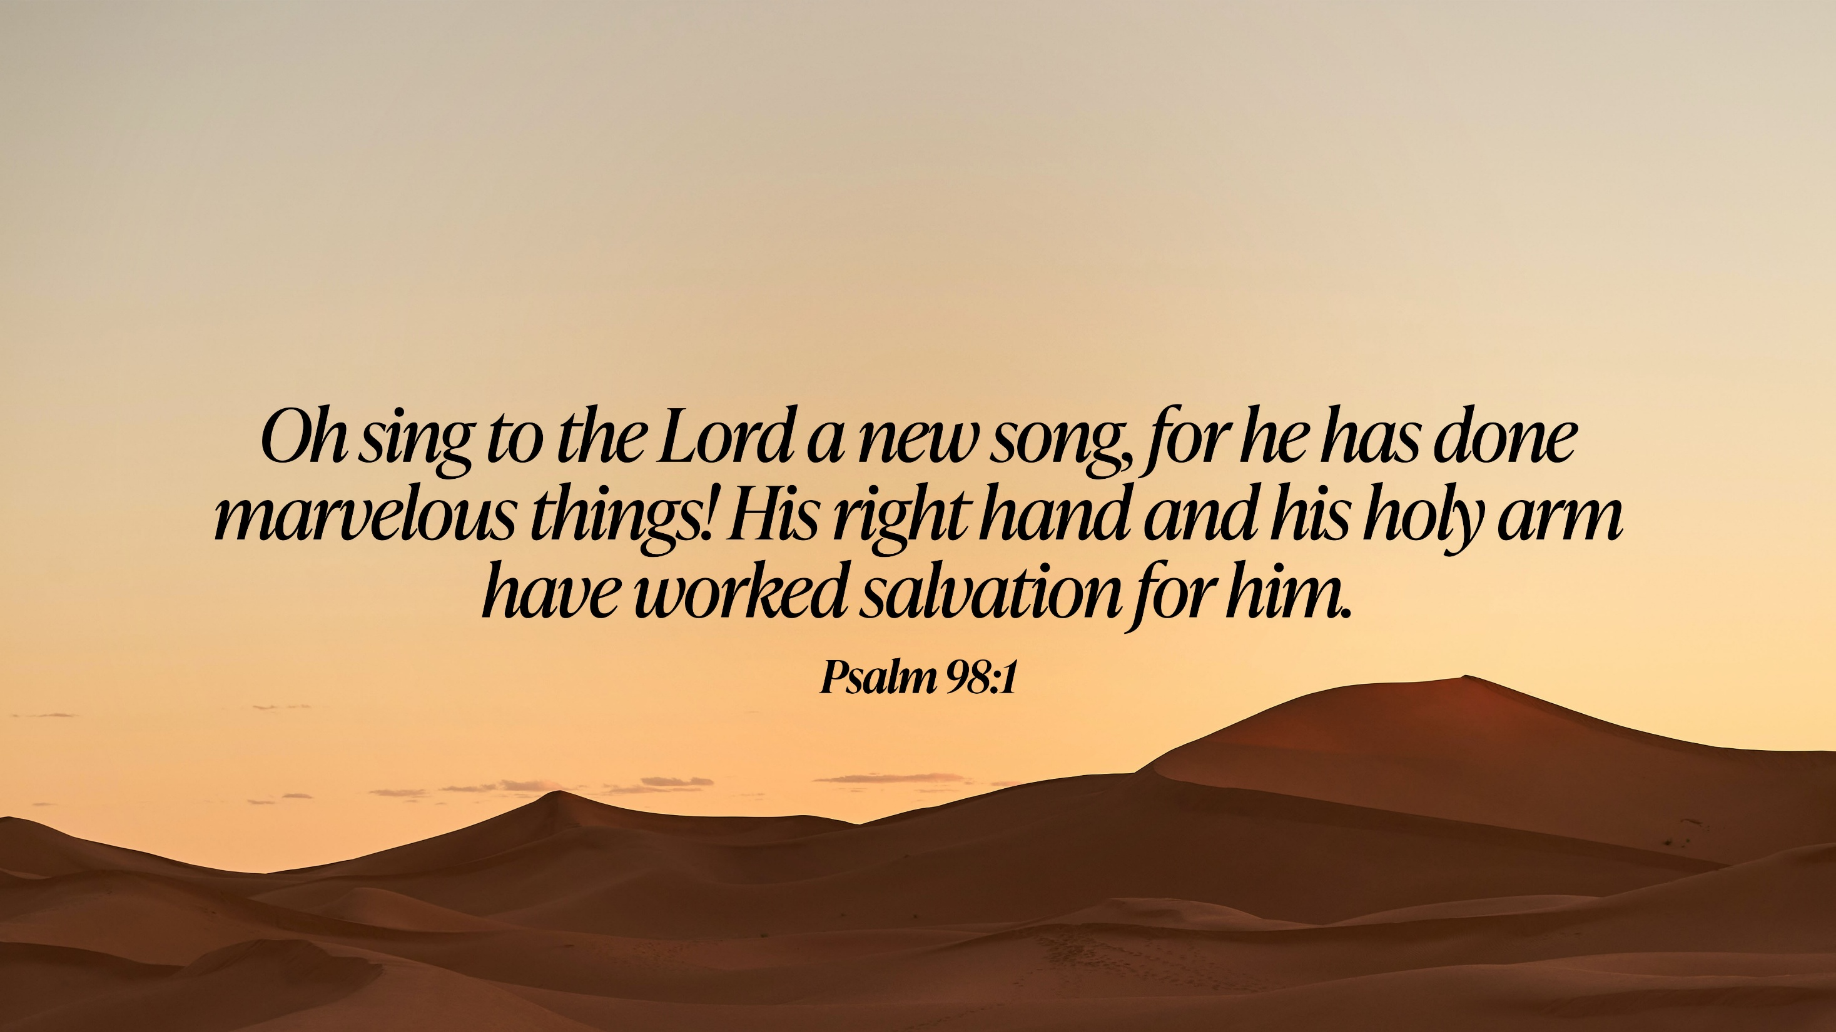
Psalm 98

Slide 29
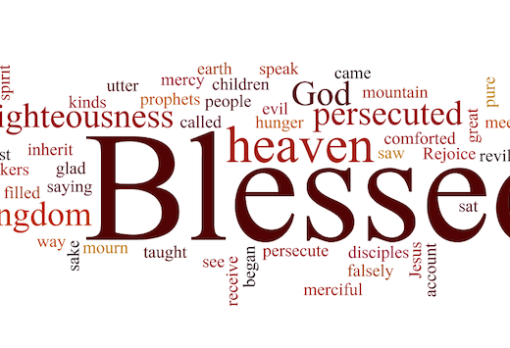
Luke 6:17-26

Slide 30
Ministry of Music:
Look to the Light

Slide 31
To Suffer together............

Slide 32
Hymn: VU #701
What does The Lord Require of You
Words & Music Jim Strathdee ©1986 reprinted under OneLicense A725110

Slide 33
What does the Lord
require of you?
What does the Lord
require of you?
What does the Lord
require of you?
What does the Lord
require of you?

Slide 34
Justice, kindness,
walk humbly with your God.
Justice, kindness,
walk humbly with your God.

Slide 35
What does the Lord
require of you?
What does the Lord
require of you?
What does the Lord
require of you?
What does the Lord
require of you?

Slide 36
To seek justice,
and love kindness,
And walk humbly with your God.
To seek justice,
and love kindness,
And walk humbly with your God.

Slide 37
What does the Lord
require of you?
What does the Lord
require of you?
What does the Lord
require of you?
What does the Lord
require of you? *

Slide 38
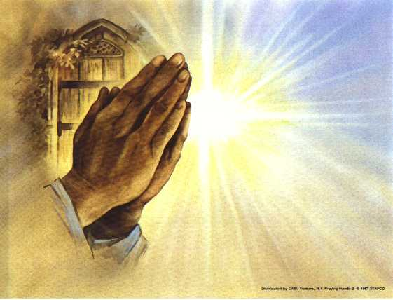
Prayers of
The People
One: Faithful God,
All: Hear our prayer.

Slide 39
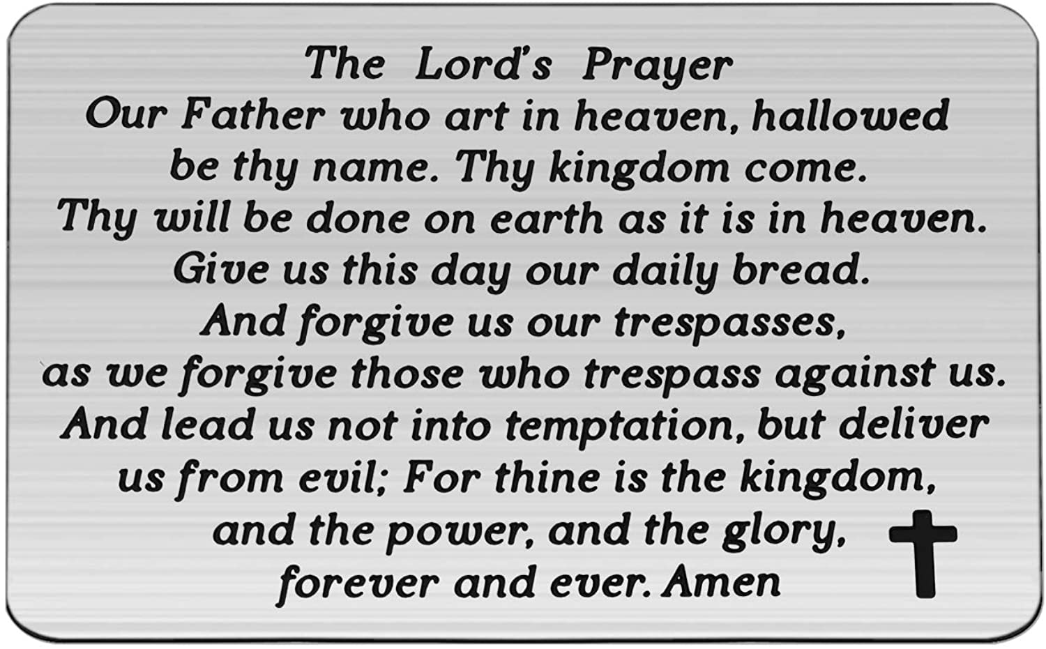

Slide 40
Support the ministry of St. Paul’s :
Through PAR – ask us how to join
via Canada Helps
search for St. Paul’s Sussex
via e-transfer to treasurerstpaulsucc1@gmail.com.
drop in collection plates located in the Narthex and near exit door
by mail to
4 Morrison Avenue, Sussex, N.B. E4E 1P5
during office hours
Notes:
Body text for hymns and prayers

Slide 41
Prayer of Dedication
Loving God, you are the Source of
all that is good. For it is from you,
that loving kindness, justice and
mercy flows into the world. Bless
these gifts so that acts of
kindness, justice and mercy may
flow through them, too.

Slide 42
And bless our lives so our words
and actions show your Spirit at
work in us and through us, in the
name of Jesus Christ, our friend
and Saviour. Amen.

Slide 43
Hymn: VU #242
Let All Things Now Living
Words Katherine K. Davis, Music:. Welsh Melody. ©1939 reprinted under OneLicense A725110

Slide 44
Let all things now living
a song of thanksgiving
To God our Creator triumphantly raise;
Who fashioned and made us,
protected and stayed us,
By guiding us on to the end of our days.

Slide 45
God's banners are o'er us,
pure light goes before us,
A pillar of fire
shining forth in the night;
Till shadows have vanished
and darkness is banished,
As forward we travel
from light into Light.

Slide 46
By law God enforces,
the stars in their courses
And sun in its orbit
obediently shine
The hills and the mountains,
the rivers and fountains,
The depths of the ocean
proclaim God divine.

Slide 47
We, too, should be voicing
our love and rejoicing;
With glad adoration
a song let us raise:
Till all things now living
unite in thanksgiving,
To God in the highest,
hosanna and praise. *

Slide 48
Benediction
&
Commission

Slide 49
Sung Benediction: MV #211
Go Now in Peace
Guided by the Light
Words and music: Pedro Rubalcava 2002 reprinted under OneLicense A-725110

Slide 50
Go now in peace
guided by the light of Christ,
so you may be nourished
by the Word of life.

Slide 51
Go now in peace
guided by the light of Christ,
so you may be nourished
by the Word of life. *

