Slide 1
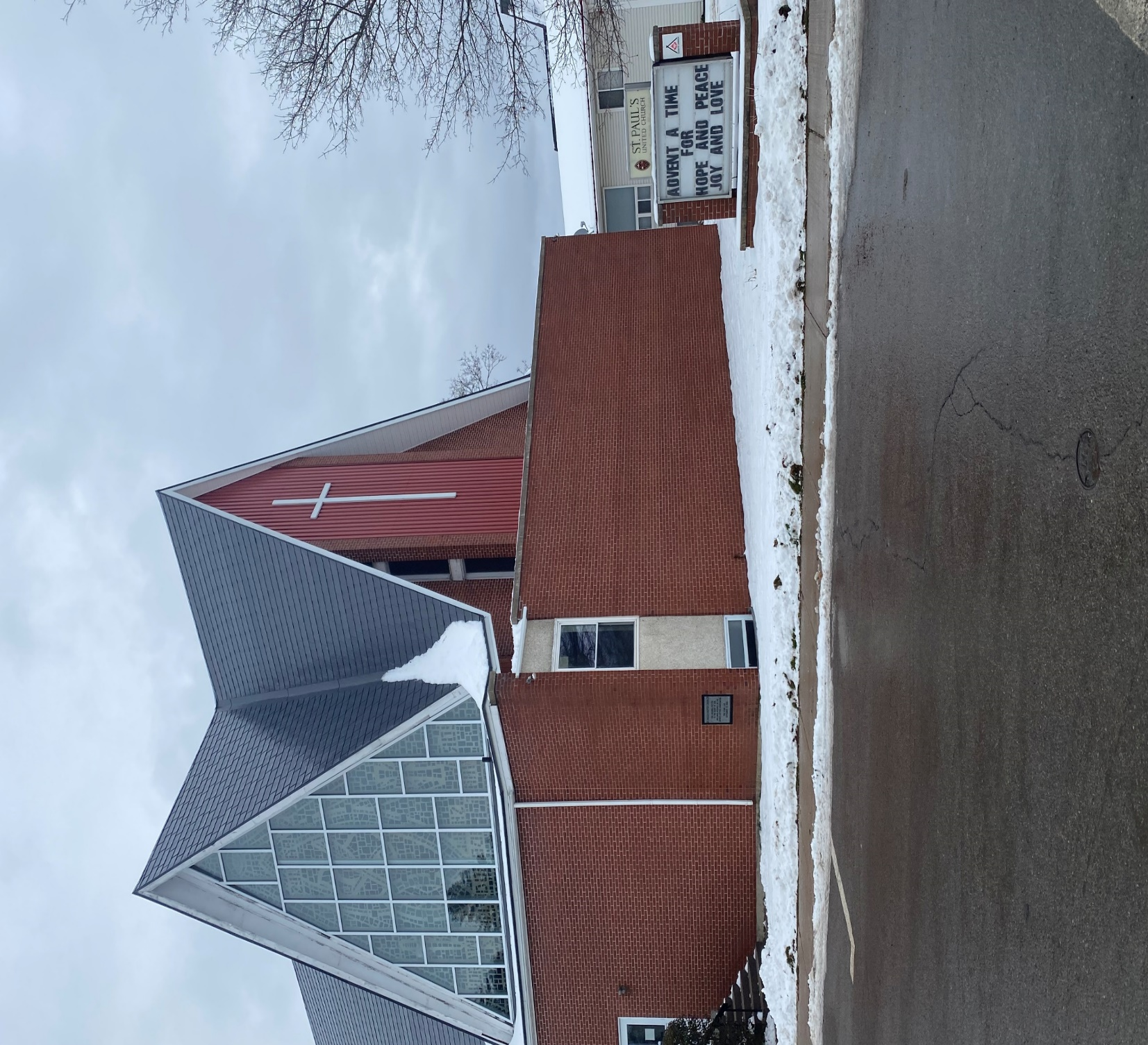
Third after Epiphany
St. Paul’s United Church Sussex, NB
January 26, 2025
Welcome

Slide 2
In sanctuary passing of the peace.

Slide 3

Prelude:
My Life Is in You Lord (For all to sing)

Slide 4
My life is in You, Lord,
my strength is in You Lord.
My hope is in You, Lord, in You, it's in You.
My life is in You, Lord,
my strength is in You Lord.
My hope is in You, Lord, in You, it's in You.

Slide 5
I will praise You with all of my life
I will praise You with all of my strength
With all of my life, with all of my strength.
All of my hope is in You.

Slide 6
My life is in You, Lord,
my strength is in You Lord
My hope is in You, Lord, in You, it's in You.
In You, in You, in You, in You. *

Slide 7
Welcome!
We’re so glad you could join us

Slide 8
Meetings
The Board will meet Tuesday, Feb 4th at 6:30
GPS Starts back up on Wed. the 5th
Circle of Friendship meets Thursday, Feb 6th in the parlour at 2

Slide 9
Speaking of the Board
Here’s Lloyd speaking for the board

Slide 10
Valentine Social
Next Week.
After the service, come upstairs and enjoy fellowship, music, socializing and dessert!
Get your valentine photo taken, celebrate Valentine Day.

Slide 11
Coldest night of the year
Support the sharing club
If you are interested in forming a team to represent St. Paul’s, there is a sign up sheet with more info in the narthex.

Slide 12
Shrove Tuesday pancake supper
If you are interested in forming a team to help prepare a pancake supper for Shrove Tuesday please sign up on the sheet in the narthex.

Slide 13
Good News!

Slide 14
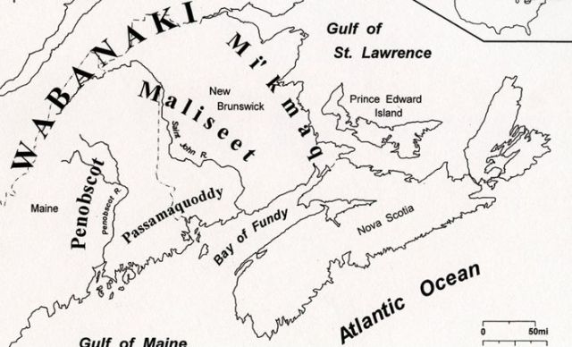
Acknowledging the Territories

Slide 15

Leader: May the Peace of Christ be with you.
Response:
And also with you.
..
Notes:
Hymn Title Page

Slide 16
Call to Worship
One: Love is not an emotion.
All: Love is a decision, made
continually.
One: Love had the first word, in
creating all things,

Slide 17
All: And love will have the last
word, in fulfilling all things. We
praise the power of God’s love
today!

Slide 18
Hymn: MV #1
Let Us Build a House
Words and Music: Marty Haugen 1994 reprinted under OneLicense A725110

Slide 19
Let us build a house where love can dwell
And all can safely live,
A place where saints and children tell
How hearts learn to forgive.

Slide 20
Built of hopes and dreams and visions,
Rock of faith and vault of grace;
Here the love of Christ shall end divisions:

Slide 21
All are welcome,
All are welcome,
All are welcome in this place.

Slide 22
Let us build a house where prophets speak,
And words are strong and true,
Where all God’s children dare to seek
To dream God’s reign anew.

Slide 23
Here the cross shall stand as witness
And as symbol of God’s grace;
Here as one we claim the faith of Jesus:

Slide 24
All are welcome,
All are welcome,
All are welcome in this place.

Slide 25
Let us build a house where love is found
In water, wine and wheat:
A banquet hall on holy ground,
Where peace and justice meet.

Slide 26
Here the love of God through Jesus,
Is revealed in time and space;
As we share in Christ the feast that frees us:

Slide 27
All are welcome,
All are welcome,
All are welcome in this place.

Slide 28
Let us build a house where hands will reach
Beyond the wood and stone
To heal and strengthen, serve and teach,
And live the Word they’ve known.

Slide 29
Here the outcast and the stranger
Bear the image of God’s face;
Let us bring an end to fear and danger:

Slide 30
All are welcome,
All are welcome,
All are welcome in this place.

Slide 31
Let us build a house where all are named,
Their songs and visions heard
And loved and treasured,
taught and claimed as words within the Word.

Slide 32
Built of tears and cries and laughter,
Prayers of faith and songs of grace;
Let this house proclaim from floor to rafter:

Slide 33
All are welcome,
All are welcome,
All are welcome in this place. *

Slide 34
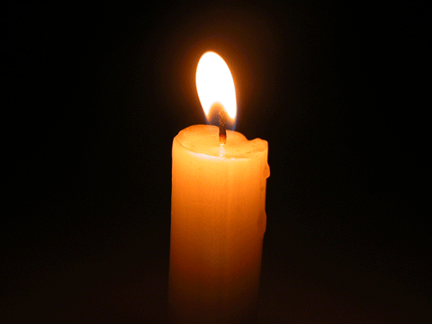
Lighting of the Christ Candle
"“As the light grows longer the cold grows stronger
If Candlemas be fair and bright Winter will have another flight
If Candlemas be cloud and snow Winter will be gone and not come again”
-Scottish poem precursor to Groundhog day tradition.

Slide 35
Gathering Prayer
God of light and life, your light
shines into our lives through
your Son, Jesus. In the warmth of
that light, we feel Your Spirit
strengthen us to face whatever
this year will bring to us.

Slide 36
And so we come to praise you for
your love and grace which
transforms our days and our lives,
and for your wisdom which
enlightens truth for our times.
Shine through us, we pray, so
that we may bear the light of
Love in this world. Amen

Slide 37
We pray for your help on our
journey so that we become more
faith filled through your
continued gifts to us. Amen.

Slide 38
Sam, Phil, Chuck, and Jimmy

Slide 39
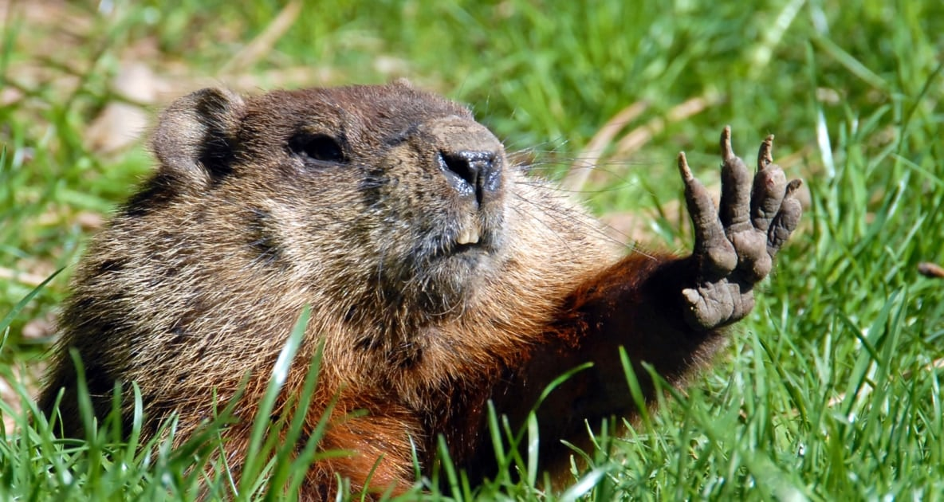
Coffee and conversation
There will be coffee and conversation after the service
today in the fellowship hall.

Slide 40

What’s on Your Shoulder

Slide 41
Hymn: VU #595
We Are Pilgrims
Words and Music: Richard Gillard 1977 reprinted under OneLicense A725110

Slide 42
We are pilgrims on a journey,
Fellow travelers on the road;
We are here to help each other
Walk the mile and bear the load.

Slide 43
Sister, let me be your servant,
Let me be as Christ to you;
Pray that I may have the grace to
Let you be my servant too.

Slide 44
I will hold the Christ-light for you
In the night-time of your fear;
I will hold my hand out to you,
Speak the peace you long to hear.

Slide 45
I will weep when you are weeping,
When you laugh I'll laugh with you;
I will share your joy and sorrow,
Till we've seen this journey through.

Slide 46
When we sing to God in heaven,
We shall find such harmony,
Born of all we've known together
Of Christ's love and agony.

Slide 47
Brother, let me be your servant,
Let me be as Christ to you;
Pray that I may have the grace to
Let you be my servant too. *

Slide 48

Prayer for Illumination

Slide 49

Jeremiah 1:4-10

Slide 50
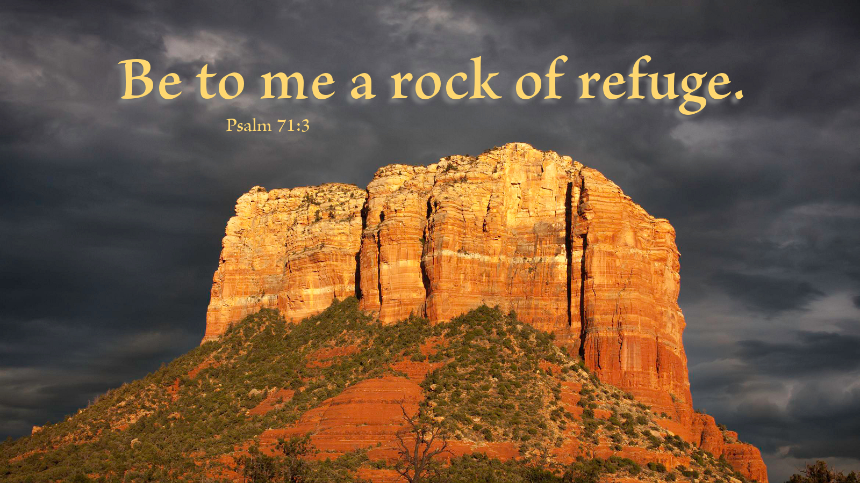
Psalm 71:1-6

Slide 51

1 Corinthians 13:1–13

Slide 52
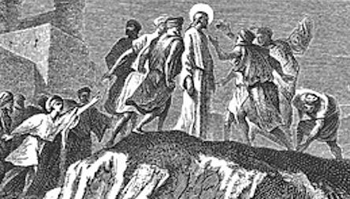
Luke 4:21-30

Slide 53
Ministry of Music:
Let Your Light Shine

Slide 54
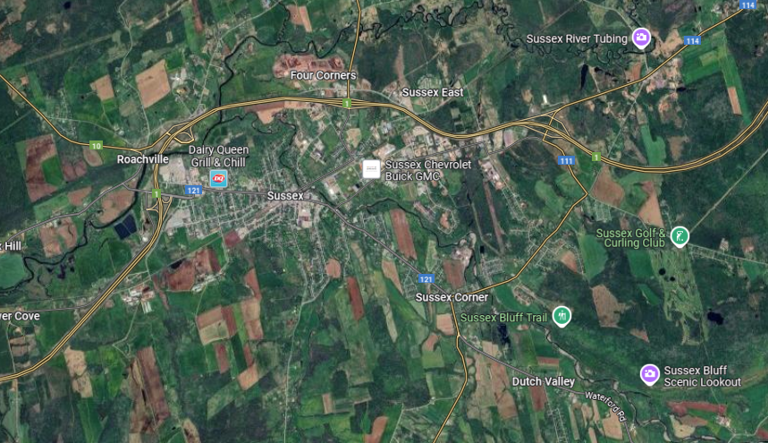
From Here?

Slide 55
Hymn: VU #670 Precious Lord, Take My Hand
Words: Thomas A. Dorsey 1932 reprinted under OneLicense A725110

Slide 56
Precious Lord, take my hand,
Lead me on, let me stand,
I am tired, I am weak, I am worn;
Through the storm, through the night,
Lead me on to the light:

Slide 57
Take my hand, precious Lord,
lead me home.

Slide 58
When my way grows drear,
Precious Lord, linger near,
When my life is almost gone,
Hear my cry, hear my call,
Hold my hand lest I fall:

Slide 59
Take my hand, precious Lord,
lead me home.

Slide 60
When the darkness appears,
And the night draws near,
And the day is past and gone,
At the river I stand,
Guide my feet, hold my hand:

Slide 61
Take my hand, precious Lord,
lead me home. *

Slide 62
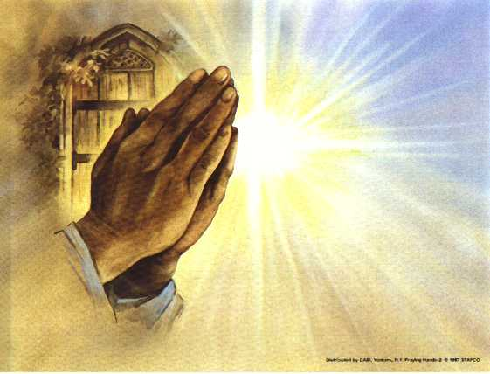
Prayers of
The People

Slide 63
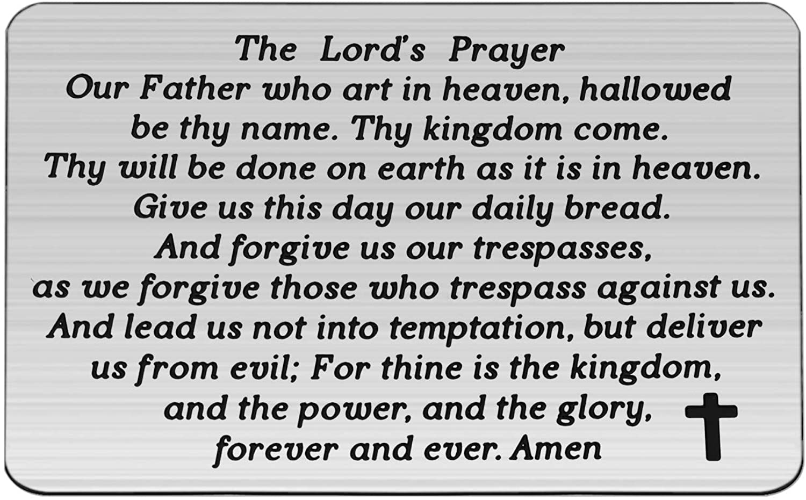

Slide 64
Support the ministry of St. Paul’s :
Through PAR – ask us how to join
via Canada Helps
search for St. Paul’s Sussex
via e-transfer to treasurerstpaulsucc1@gmail.com.
drop in collection plates located in the Narthex and near exit door
by mail to
4 Morrison Avenue, Sussex, N.B. E4E 1P5
during office hours
Notes:
Body text for hymns and prayers

Slide 65
Prayer of Dedication
Gracious and loving God, receive
our gifts of self and substance.
They have belonged to you since
our very beginning. We give them
freely, joyfully, prayerfully. With
them we praise you.

Slide 66
With them we celebrate the great
power that is love— a love that
abides always, a love that
makes us whole. Amen.

Slide 67
Hymn: VU# 675
Will Your Anchor Hold
Public Domain reprinted under OneLicense A725110

Slide 68
Will your anchor hold
in the storms of life?
When the clouds unfold
their wings of strife,
When the strong tides lift
and the cables strain,
Will your anchor drift or firm remain?

Slide 69
We have an anchor that keeps the soul
Steadfast and sure
while the billows roll,
Fastened to the rock
which cannot move,
Grounded firm and deep
in the Saviour's love!

Slide 70
It will surely hold in the straits of fear,
When the breakers tell
that the reef is near;
Though the tempest rave
and the wild winds blow,
Not an angry wave
shall our bark o'erflow.

Slide 71
We have an anchor that keeps the soul
Steadfast and sure
while the billows roll,
Fastened to the rock
which cannot move,
Grounded firm and deep
in the Saviour's love!

Slide 72
It will surely hold
in the floods of death,
When the waters cold
chill our latest breath;
On the rising tide it can never fail
While our hopes abide within the veil.

Slide 73
We have an anchor that keeps the soul
Steadfast and sure
while the billows roll,
Fastened to the rock
which cannot move,
Grounded firm and deep
in the Saviour's love!

Slide 74
When our eyes behold,
through the gathering night,
The city of gold, our harbour bright,
We shall anchor fast
by the heavenly shore,
With the storms all past for evermore.

Slide 75
We have an anchor that keeps the soul
Steadfast and sure
while the billows roll,
Fastened to the rock
which cannot move,
Grounded firm and deep
in the Saviour's love! *

Slide 76
Benediction
&
Commission

Slide 77
Sung Benediction: MV #211
Go Now in Peace
Guided by the Light
Words and music: Pedro Rubalcava 2002 reprinted under OneLicense A-725110

Slide 78
Go now in peace
guided by the light of Christ,
so you may be nourished
by the Word of life.

Slide 79
Go now in peace
guided by the light of Christ,
so you may be nourished
by the Word of life. *

