Slide 1
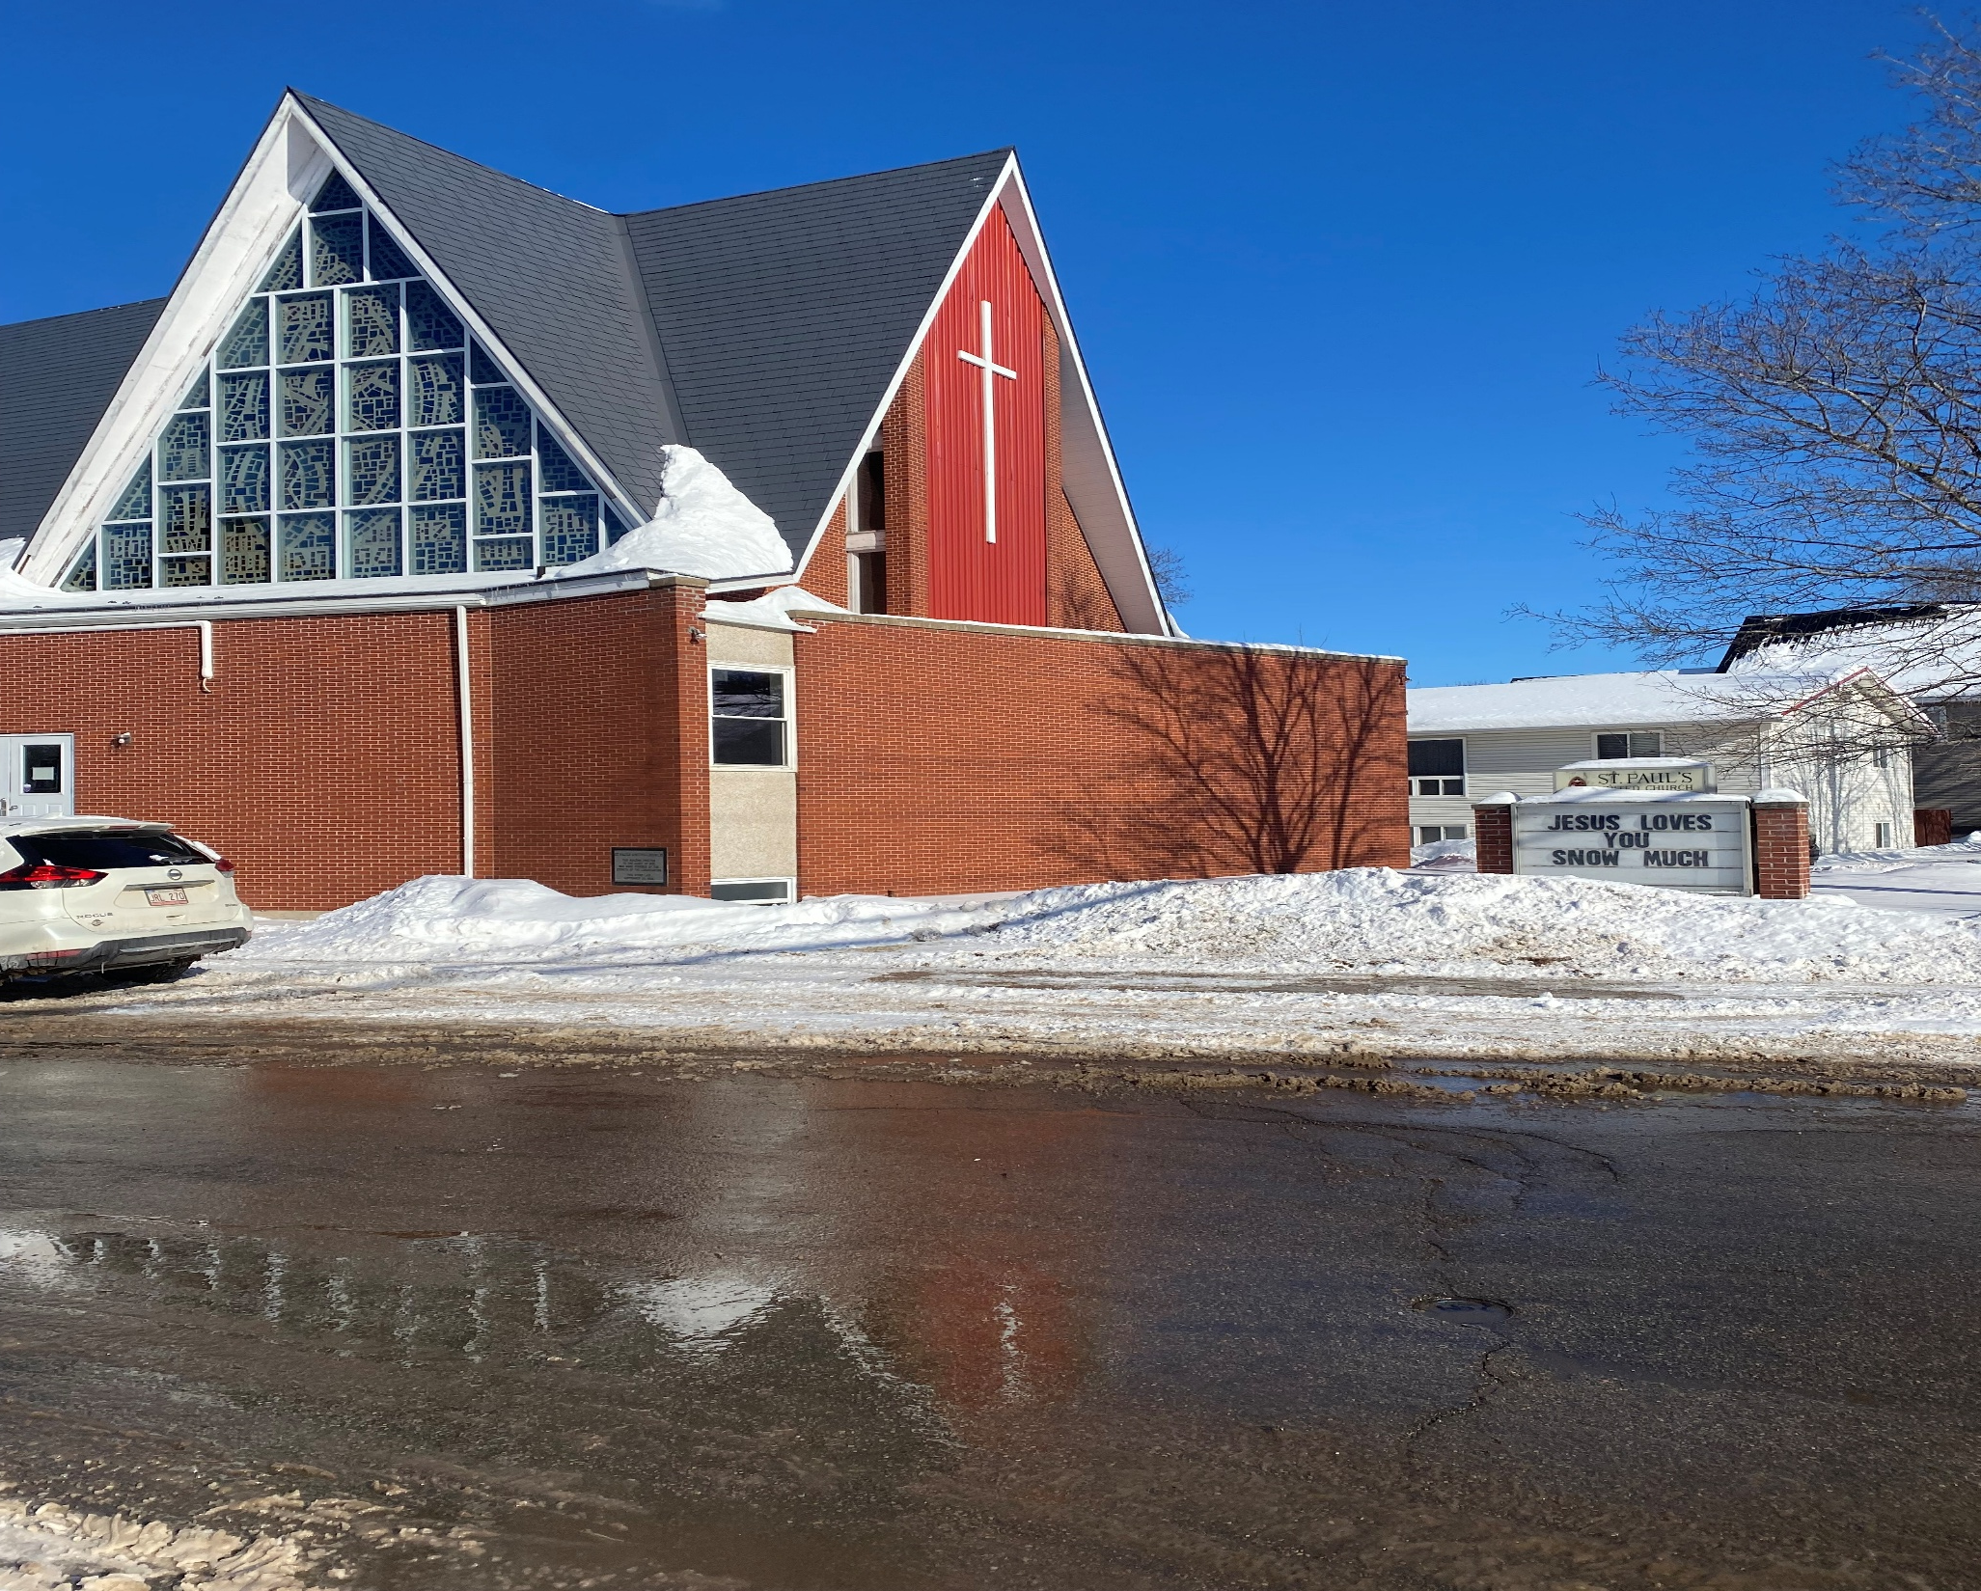
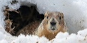
7th after Epiphany
St. Paul’s United Church
Sussex, NB
February 23, 2025
Welcome

Slide 2
In sanctuary passing of the peace.

Slide 3

Prelude:

Slide 4
Welcome!
We’re so glad you could join us

Slide 5
Lenten practices
A 31 short spiritual practices program is available.
If you want a copy, please contact the office. Email, phone or stop in. You can get it printed or in digital format.

Slide 6
The Choice has been made
And it wasn’t the Stay-Puft Marshmallow man.
The AGM will be held after the service. The date will be confirmed in the next couple of weeks.

Slide 7
Radon
It’s time to return the test units.
Here’s Al with some points to remember:
Where, When, Survey.
Again?

Slide 8
Game night
Join us for Game Night in the fellowship hall.
Thursday March 6th
starting at 6:30.

Slide 9
Good News!

Slide 10
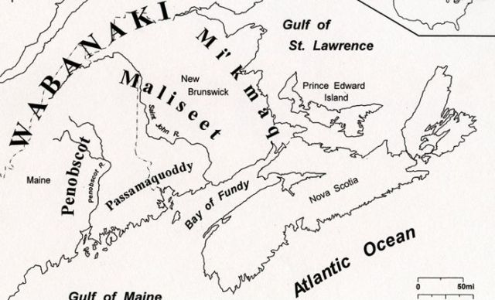
Acknowledging the Territories

Slide 11

Leader: May the Peace of Christ be with you.
Response:
And also with you.
..
Notes:
Hymn Title Page

Slide 12
Call to Worship
One: Come, Beloved, and release the anxiety and fear you carry.
All: We come seeking to hear the
enduring promises of the Holy
One.
One: Let meekness rise as strength of soul.

Slide 13
All: May our promised inheritance
of love shine brightly all around.
One: May it strengthen us in our waiting and our working.
All: May all that is evil wither, and
all that is good grow to fullness.
One: May the grace of God rest on us all as we gather.

Slide 14
Hymn: VU #296 This Is God’s Wondrous World
Public Domain reprinted under OneLicense A725110

Slide 15
This is God's wondrous world,
and to my listening ears
all nature sings,
and round me rings
the music of the spheres.

Slide 16
This is God's wondrous world;
I rest me in the thought
of rocks and trees,
of skies and seas,
God's hand the wonders wrought.

Slide 17
This is God's wondrous world:
the birds their carols raise;
the morning light, the lily white,
declare their Maker's praise.

Slide 18
This is God's wondrous world:
God shines in all that's fair;
in the rustling grass
or mountain pass,
God's voice speaks everywhere.

Slide 19
This is God's wondrous world:
O let me ne'er forget
that though the wrong
seems oft so strong,
God is the ruler yet.

Slide 20
This is God's wondrous world:
why should my heart be sad?
Let voices sing,
let the heavens ring:
God reigns, let earth be glad! *

Slide 21
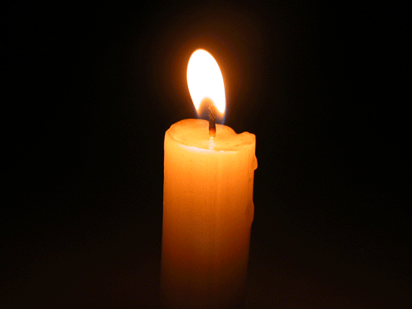
Lighting of the Christ Candle
“It is no matter of health to be well
adjusted to a profoundly sick society.”
- J. Krishnamurti

Slide 22
Gathering Prayer
Beloved God, help us seek a new
beginning. Soften our hearts and
still our minds as you gather us
into Your gracious embrace. Hold
the anxieties and wanderings of
our lives, allow us to rest in You.

Slide 23
May we feel the Holy Spirit
gifting us with renewed energy
for our journeys. Let it meet
our fatigue and form in us a
deepened commitment to Your
vision of Your beloved creation.

Slide 24
May we become agents of Your
blessing, for the good of the
world. May our lives run over with
love and energy to live out Your
desire for our lives. In Your Holy
name, we pray. Amen.

Slide 25

Not Everyone will like us

Slide 26
Hymn: VU #703
In The Bulb There Is a Flower
Words & Music: Natalie Sleeth 1986 reprinted under OneLicense A-725110

Slide 27
In the bulb there is a flower;
In the seed, an apple tree;
In cocoons, a hidden promise:
Butterflies will soon be free!
In the cold and snow of winter
There's a spring that waits to be,
Unrevealed until its season,
Something God alone can see.

Slide 28
There's a song in every silence,
Seeking word and melody;
There's a dawn in every darkness,
Bringing hope to you and me.

Slide 29
From the past will come the future;
What it holds, a mystery,
Unrevealed until its season,
Something God alone can see.

Slide 30
In our end is our beginning;
In our time, infinity;
In our doubt there is believing;
In our life, eternity.
In our death, a resurrection;
At the last, a victory,
Unrevealed until its season,
Something God alone can see. *

Slide 31

Prayer for Illumination

Slide 32
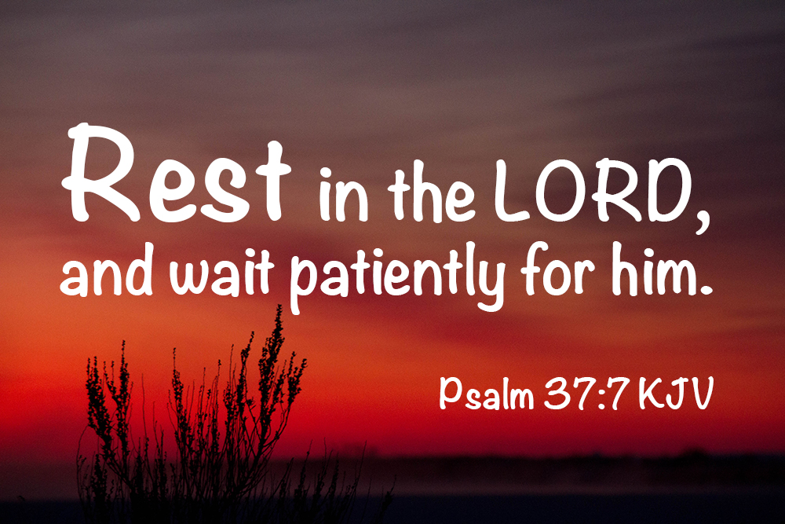
Psalm 37:1–11, 39–40

Slide 33
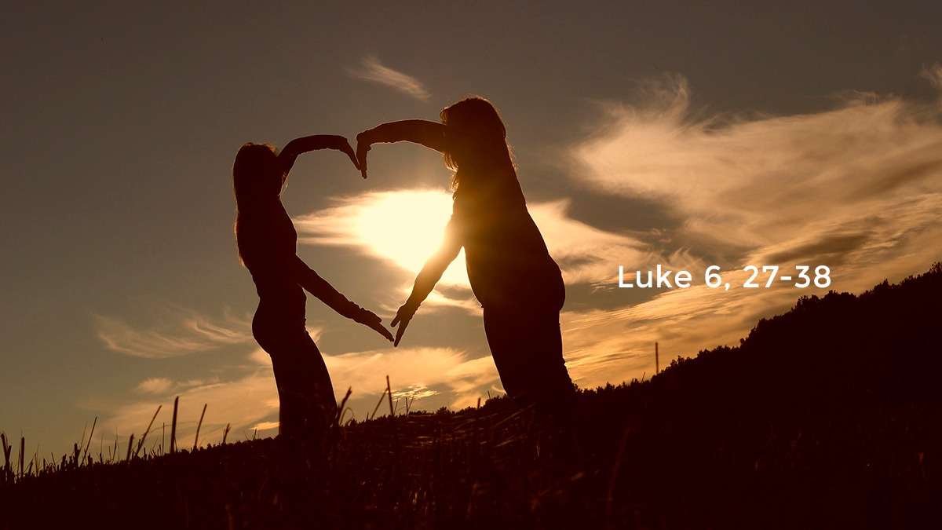
Luke 6:27–38

Slide 34
Ministry of Music:
Jesus Strong and Kind

Slide 35

Seriously?!

Slide 36
Hymn: MV #169 When Hands Reach Out Beyond Divides
Words: Ken K. Wehlander, 2005 Music: unknown composer reprinted under OneLicense A-725110

Slide 37
When hands reach out beyond divides
And hope is truly found,
Each chain of hate will fall away
And bells of peace shall sound,

Slide 38
And bells of peace, of peace shall sound
And bells of peace shall sound
Each chain of hate will fall away
And bells of peace shall sound.

Slide 39
When fear no longer guides our steps
And days of war are done,
God’s dream for all shall live anew;
Our hearts will heal as one

Slide 40
Our hearts will heal, will heal as one,
God’s dream for all shall live anew
Our hearts will heal as one.

Slide 41
When race and creed blind us no more,
A neighbour’s face we’ll see,
And we shall dance the whole world round,
For love will set us free,

Slide 42
For love, yes love will set us free,
For love will set us free,
And we shall dance the whole world round,
For love will set us free. *

Slide 43
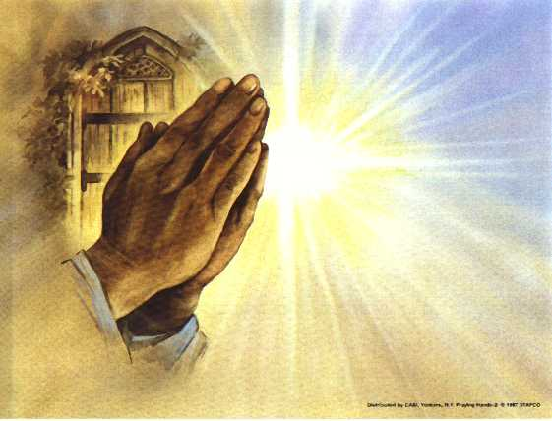
Prayers of
The People
One: God of -----
All: Hear our prayers for your world.

Slide 44
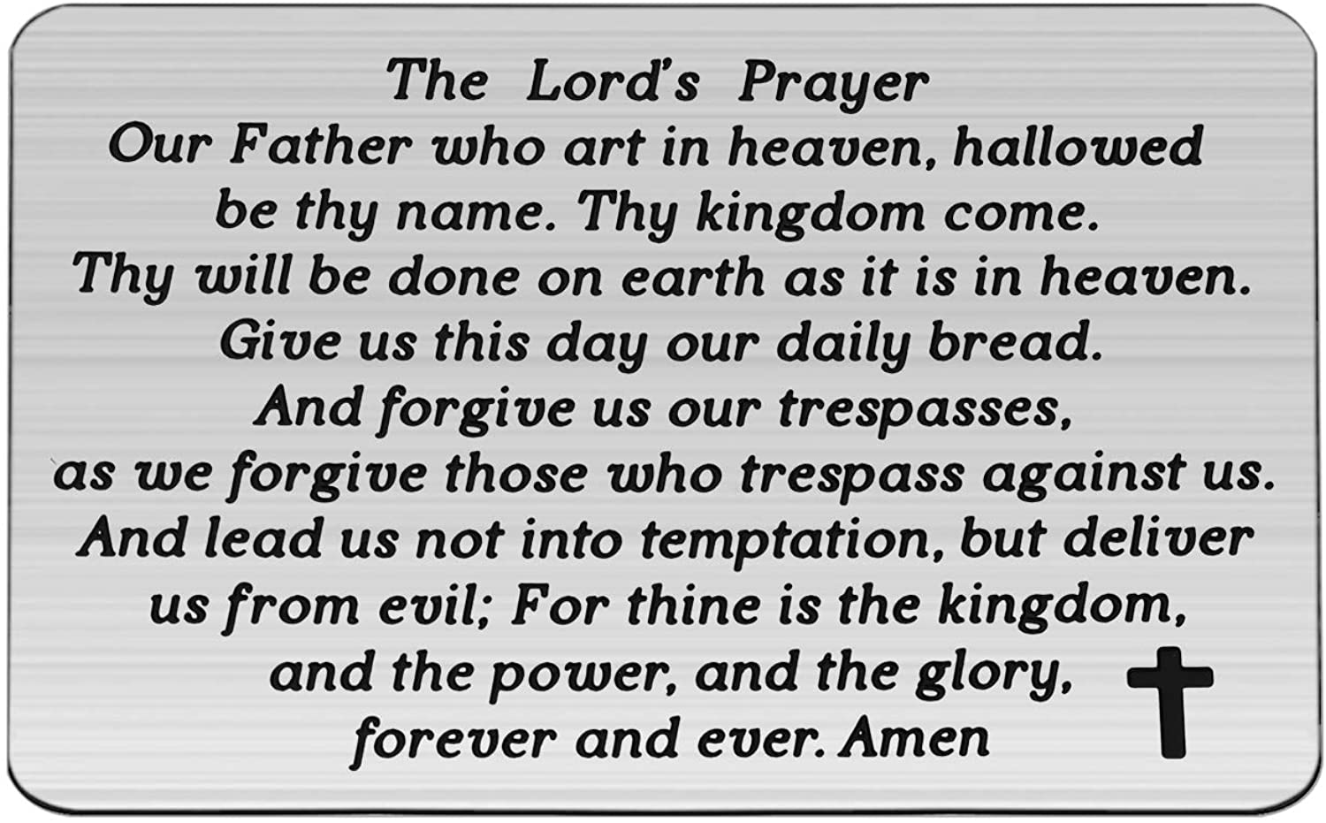

Slide 45
Support the ministry of St. Paul’s :
Through PAR – ask us how to join
via Canada Helps
search for St. Paul’s Sussex
via e-transfer to treasurerstpaulsucc1@gmail.com.
drop in collection plates located in the Narthex and near exit door
by mail to
4 Morrison Avenue, Sussex, N.B. E4E 1P5
during office hours
Notes:
Body text for hymns and prayers

Slide 46
Prayer of Dedication
Beloved God of New Beginnings,
we bring our gifts with grateful
hearts, for we have received so
much through your kindness.

Slide 47
Bless our gifts, and use them to
touch lives in situations we
cannot even imagine with your
love. Make us a blessing in our
community for the sake of Christ,
our Friend and Saviour. Amen.

Slide 48
Hymn: VU #289
It Only Takes A Spark
Words and music: Kurt Kaiser reprinted under OneLicense A725110

Slide 49
It only takes a spark
to get a fire going,
and soon all those around
can warm up in its glowing:

Slide 50
that's how it is with God's love,
once you've experienced it:
you spread God's love to
everyone,
you want to pass it on.

Slide 51
What a wondrous time is spring
when all the trees are budding,
the birds begin to sing,
the flowers start their blooming;

Slide 52
that's how it is with God's love,
once you've experienced it:
you want to sing,
it's fresh like spring,
you want to pass it on.

Slide 53
I wish for you, my friend,
this happiness that I've found -
on God you can depend,
it matters not where you're bound;
:

Slide 54
I'll shout it from the mountain
top;
I want my world to know
the Lord of love has come to me,
I want to pass it on. *

Slide 55
Benediction
&
Commission

Slide 56
Sung Benediction: MV #211
Go Now in Peace
Guided by the Light
Words and music: Pedro Rubalcava 2002 reprinted under OneLicense A-725110

Slide 57
Go now in peace
guided by the light of Christ,
so you may be nourished
by the Word of life.

Slide 58
Go now in peace
guided by the light of Christ,
so you may be nourished
by the Word of life. *

