Slide 1
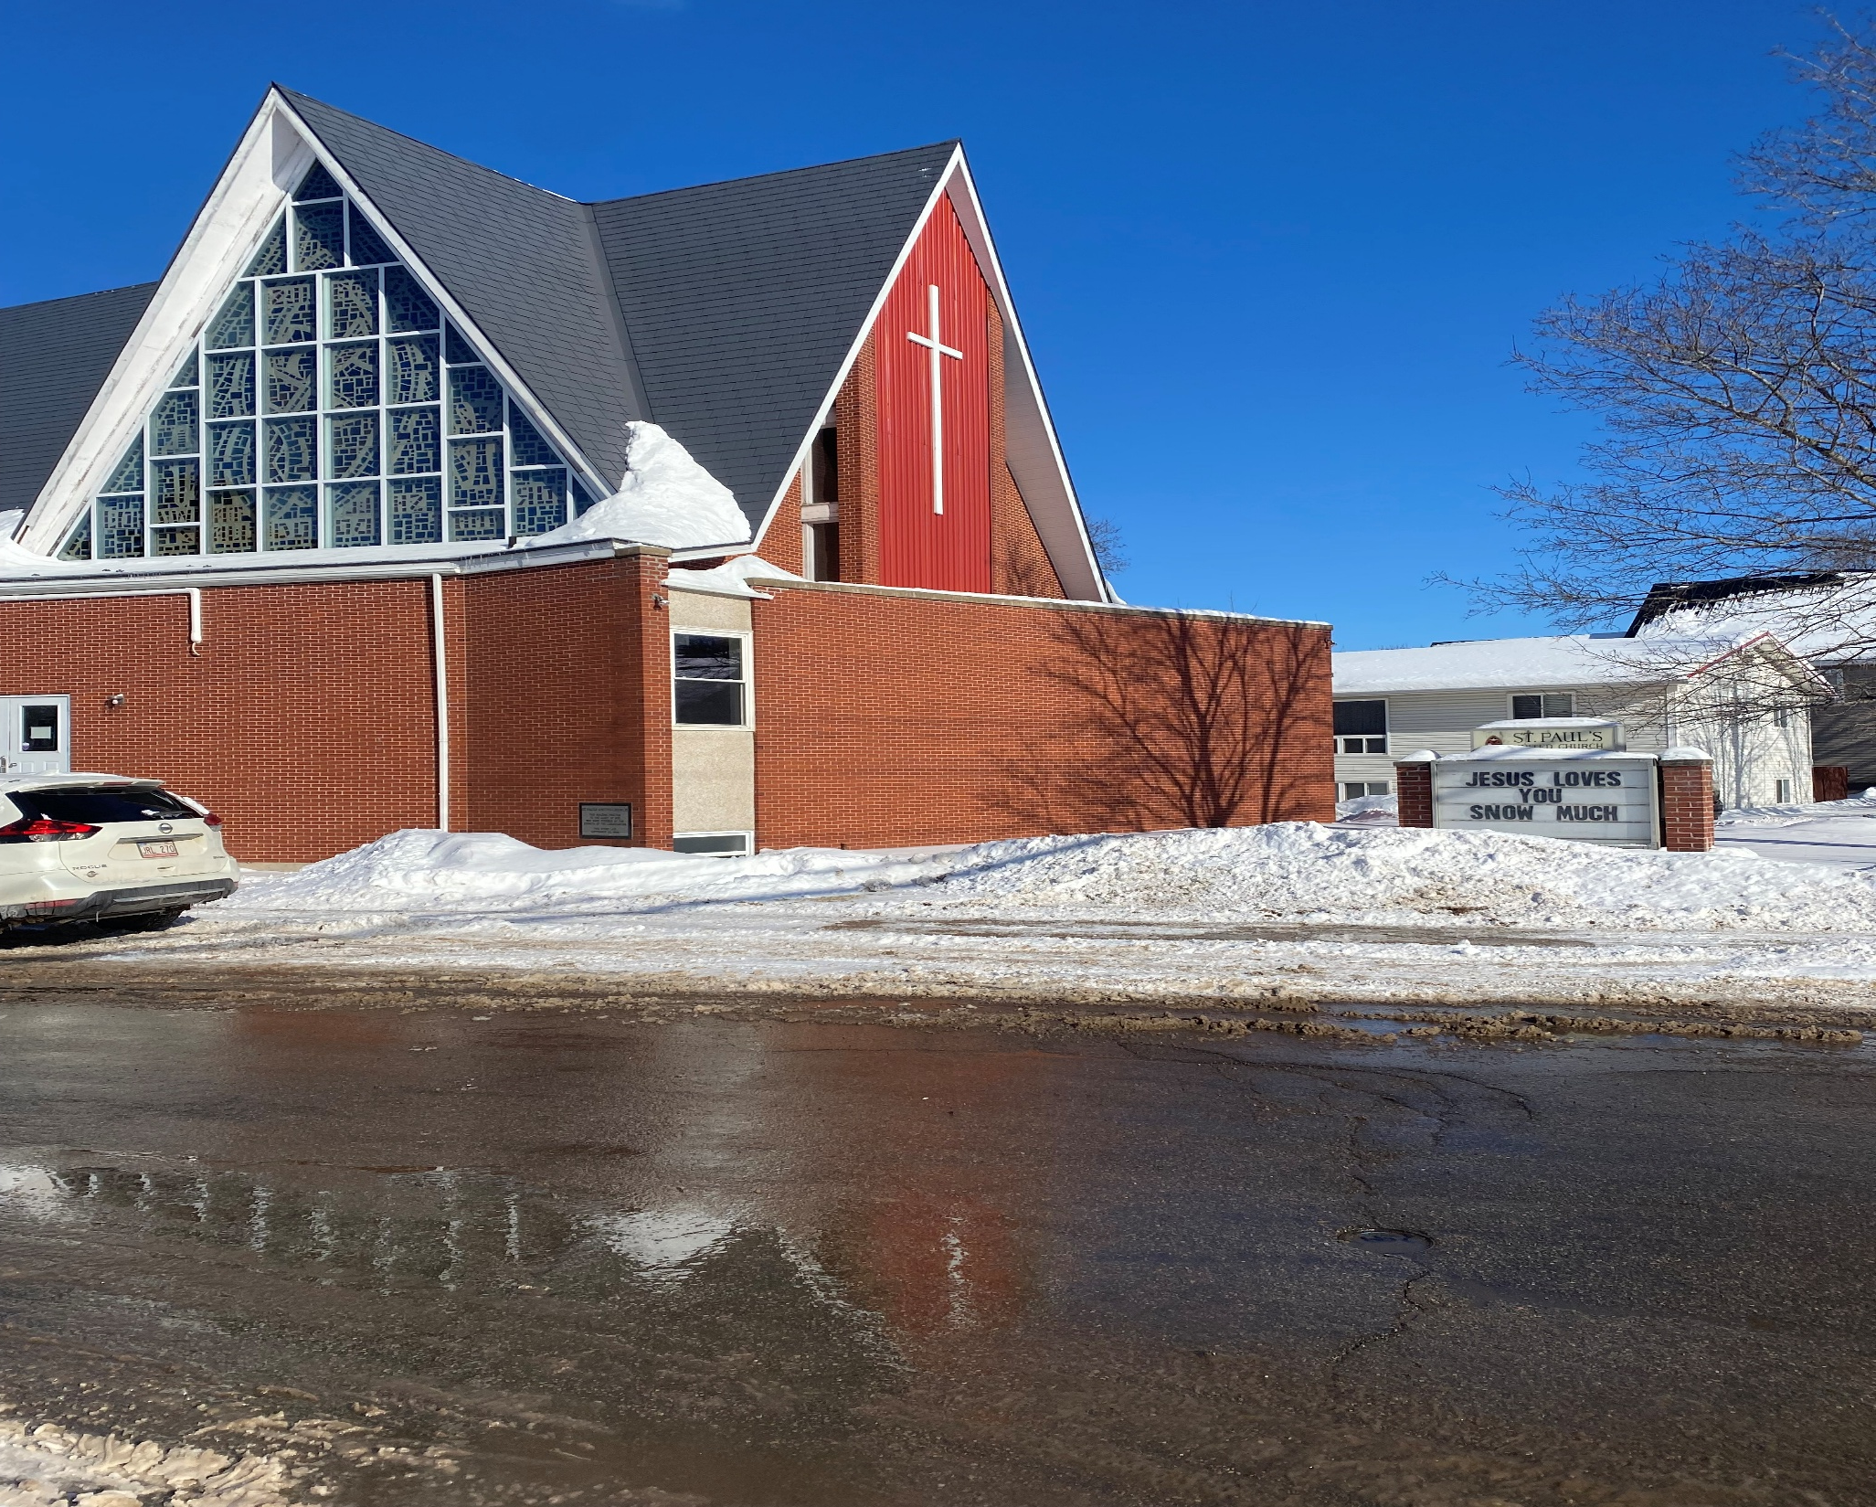
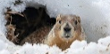
Fifth after Epiphany
St. Paul’s United Church Sussex, NB
February 9, 2025
Welcome

Slide 2
In sanctuary passing of the peace.

Slide 3

Prelude:

Slide 4
Welcome!
We’re so glad you could join us

Slide 5
Meetings
CFMT will meet Tuesday, Feb 11 at 5:30 pm
St. Paul’s Ladies meet Thursday, Feb 13 at 1:30
Youth Group meets Thursday at 6:30

Slide 6
Broadview magazine
Did you receive or do you want to receive the Broadview Magazine? We have an opportunity to renew and subscribe people at a reduced rate of $31.
Please notify the office by end of week.

Slide 7
Lenten practices
A 31 short spiritual practices program is available.
If you want a copy, please contact the office. Email, phone or stop in. You can get it printed or in digital format.

Slide 8
VOTE on the agm
There are three options for the format the AGM will take. We are conducting a strawless poll.
Please put a mark on the board in the narthex under the option you would like to see used.

Slide 9
Good News!

Slide 10
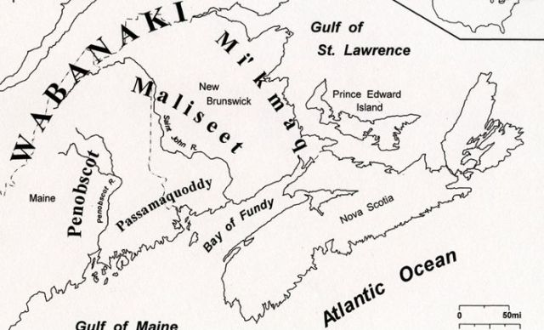
Acknowledging the Territories

Slide 11

Leader: May the Peace of Christ be with you.
Response:
And also with you.
..
Notes:
Hymn Title Page

Slide 12
Call to Worship
One: We have gathered here in God’s
presence.
All: Praise be to God!
One: We acknowledge that in God’s
love all has come into being and it is
good.
All: Praise be to God!

Slide 13
One: We celebrate that through Christ
we know of God’s deep love for us.
All: Praise be to God!
One: We proclaim that the Holy Spirit
is at work in the world, calling us to
live in God’s love.
All: Praise be to God!

Slide 14
Hymn: MV #26
Your Love Is Amazing
Words and Music: Marty Haugen 1994 reprinted under OneLicense A725110

Slide 15
Your love is amazing, steady and unchanging
Your love is a mountain, firm beneath my feet.
Your love is a mystery, how you gently lift me
When I am surrounded your love carries me.

Slide 16
Hallelujah, Hallelujah , Hallelujah
Your love makes me sing.
Hallelujah, Hallelujah , Hallelujah
Your love makes me sing.

Slide 17
Your love is surprising,
I can feel it rising
All the joy that’s growing
Deep inside of me.
Every time I see you,
All your goodness shines through
I can feel this God song rising up in me.

Slide 18
Hallelujah, Hallelujah , Hallelujah
Your love makes me sing.
Hallelujah, Hallelujah , Hallelujah
Your love makes me sing.

Slide 19
Yes, you make me sing
Lord, you make me sing, sing, sing
How you make me sing

Slide 20
Hallelujah, Hallelujah, Hallelujah
Your love makes me sing.
Hallelujah, Hallelujah , Hallelujah
Your love makes me sing.
How you make me sing.
Hallelujah. *

Slide 21

Lighting of the Christ Candle
“Sometimes, I think, I need a spare heart to feel all the things I feel.” ― Sanober Khan

Slide 22
Gathering Prayer
Loving God, gather us into your
wide net of love. Interrupt
whatever overwhelms us with the
gift of your renewing grace.
Search every depth and reveal
Your holy abundance.

Slide 23
Let it awaken us to what you
make possible when we risk
answering your invitation to
begin again. Gift us with the
courage to trust the command of
Christ to put out into the deep,
even when it doesn’t seem to
make sense.

Slide 24
Answer our trust with Your
promised presence, which reveals
an ever-new rising. Bless us as
we gather in the name of Jesus.
Amen.

Slide 25
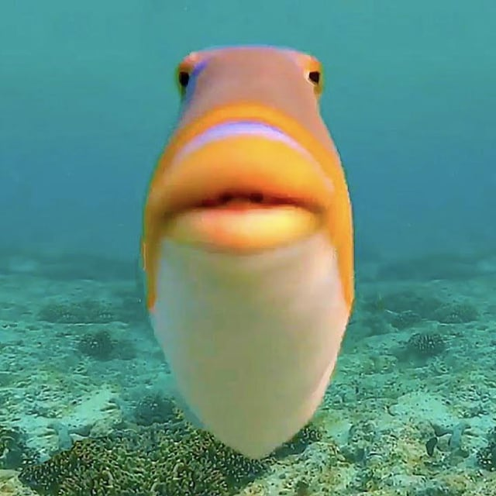
Fishing is fun for everyone but the fish

Slide 26
Ministry of Music:
Sing unto the Lord a New Song

Slide 27

Prayer for Illumination

Slide 28
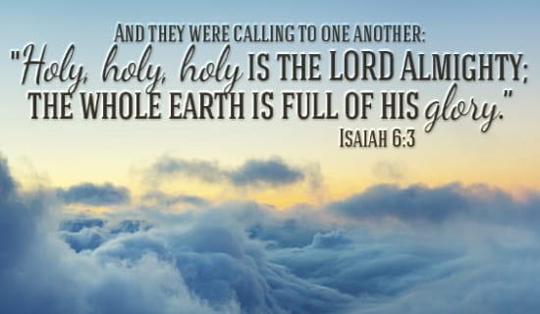
Isaiah 6:1-6, 9-13

Slide 29
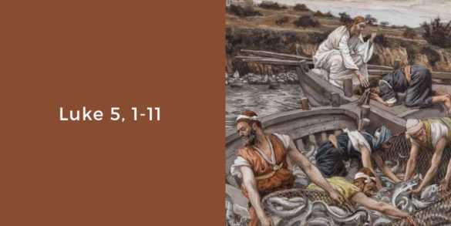
Luke 5:1-11

Slide 30
Ministry of Music:
The Goodness of God

Slide 31
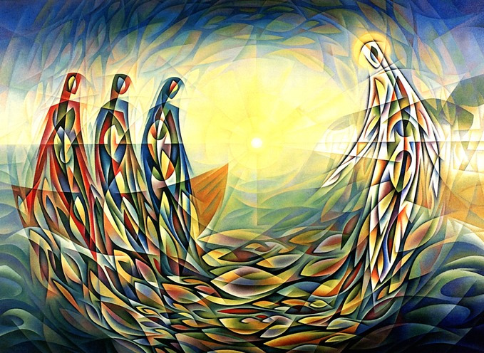
What we gather in

Slide 32
Hymn: MV #113 Jesus Saw Them Fishing
Words & Music © 2002 Ken Canedo reprinted under OneLicense A725110

Slide 33
Jesus saw them fishing
by the shore of Galilee,
Casting out their nets into the sea.
Simon Peter, Andrew
and the sons of Zebedee,
Waiting in their boats so patiently.

Slide 34
And Jesus said,
“Oh, come and follow me.
Oh, leave behind your nets.
I call you. Oh, come and fish with me,
And your life will never
be the same again.”

Slide 35
A rich young person came to
Jesus looking for advice.
“How can I obtain eternal life?”
Jesus told him, “Honour the
commandments of the Lord.
Then sell off all your riches for the poor.”

Slide 36
And Jesus said,
“Oh, come and follow me.
Oh, leave behind your nets.
I call you. Oh, come and fish with me,
And your life will never
be the same again.”

Slide 37
“If you want to follow me,
deny your very self.
Take up your cross
and walk the walk with me.
This might seem a hardship,
an impossibility,
But nothing is impossible with God.”

Slide 38
And Jesus said,
“Oh, come and follow me.
Oh, leave behind your nets.
I call you. Oh, come and fish with me,
And your life will never
be the same again.” *

Slide 39
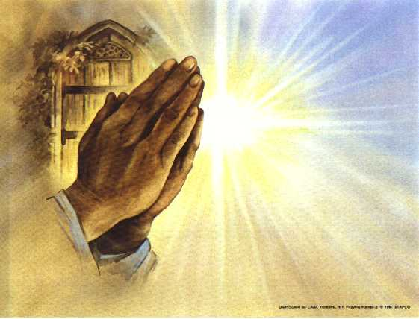
Prayers of
The People

Slide 40
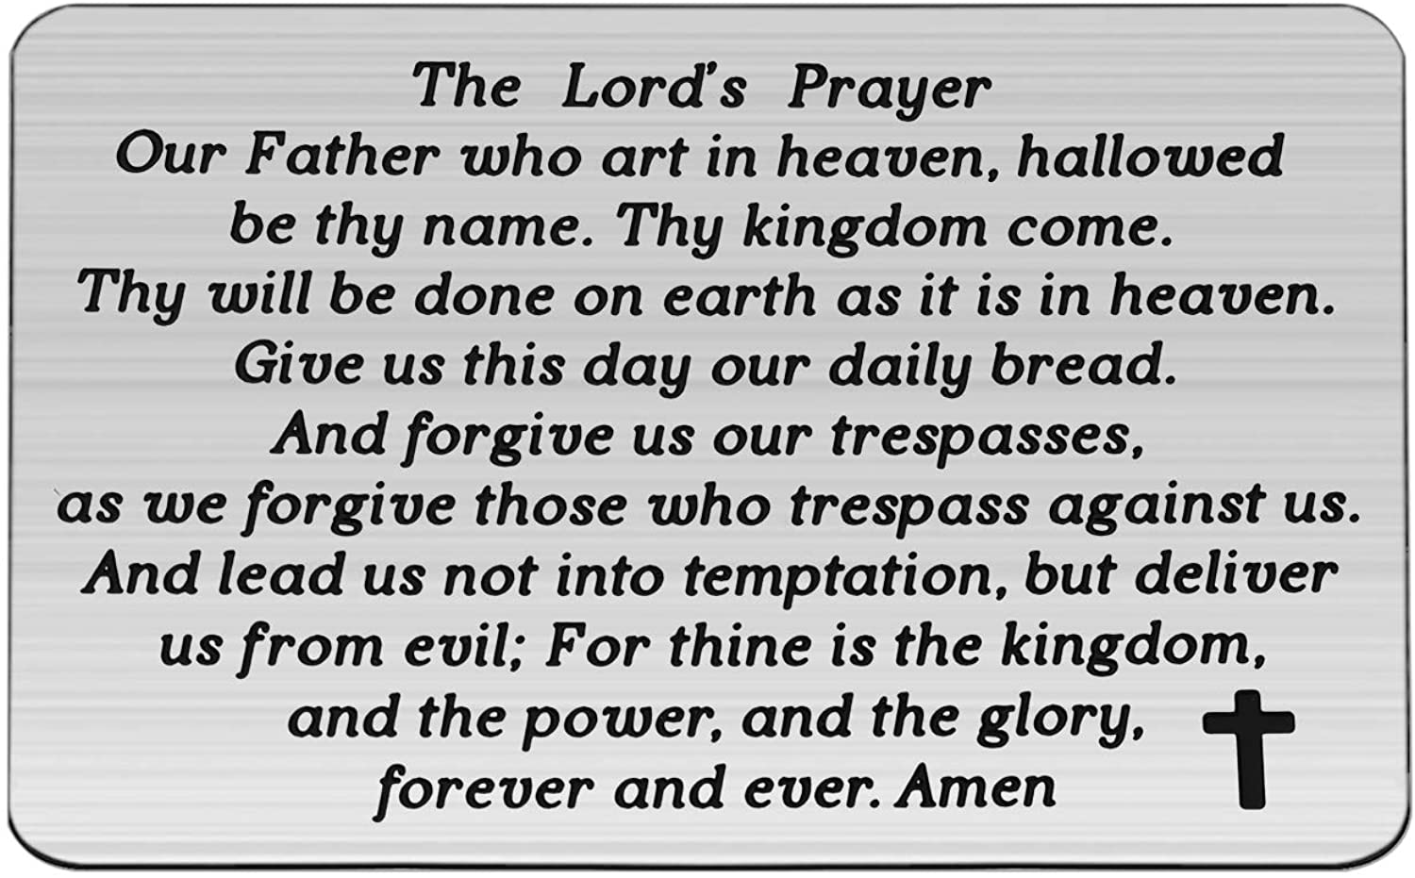

Slide 41
Support the ministry of St. Paul’s :
Through PAR – ask us how to join
via Canada Helps
search for St. Paul’s Sussex
via e-transfer to treasurerstpaulsucc1@gmail.com.
drop in collection plates located in the Narthex and near exit door
by mail to
4 Morrison Avenue, Sussex, N.B. E4E 1P5
during office hours
Notes:
Body text for hymns and prayers

Slide 42
Prayer of Dedication
God of the bursting nets, we
thank you for your abundant
blessings rising up at every turn.
Multiply these gifts and our faith
that your good news of life-giving
love may stretch wider still.

Slide 43
Yes, form us deep in Your heart
for this good and gracious work.
Amen.

Slide 44
Hymn:MV #94
Love Knocks and Waits (Tune – Amazing Grace)
Words & Music: Daniel Charles Damon 1994 reprinted under OneLicense A725110

Slide 45
Love knocks and waits for us to hear,
To open and invite;
Love longs to quiet every fear,
And seeks to set things right.

Slide 46
Love offers life, in spite of foes
Who threaten and condemn;
Embracing enemies, Love goes
The second mile with them.

Slide 47
Love comes to heal the broken heart,
To ease the troubled mind;
Without a word Love bids us start
To ask and seek and find.

Slide 48
Love knocks and enters at the sound
Of welcome from within;
Love sings and dances all around,
And feels new life begin. *

Slide 49
Benediction
&
Commission

Slide 50
Sung Benediction: MV #211
Go Now in Peace
Guided by the Light
Words and music: Pedro Rubalcava 2002 reprinted under OneLicense A-725110

Slide 51
Go now in peace
guided by the light of Christ,
so you may be nourished
by the Word of life.

Slide 52
Go now in peace
guided by the light of Christ,
so you may be nourished
by the Word of life. *

