Slide 1
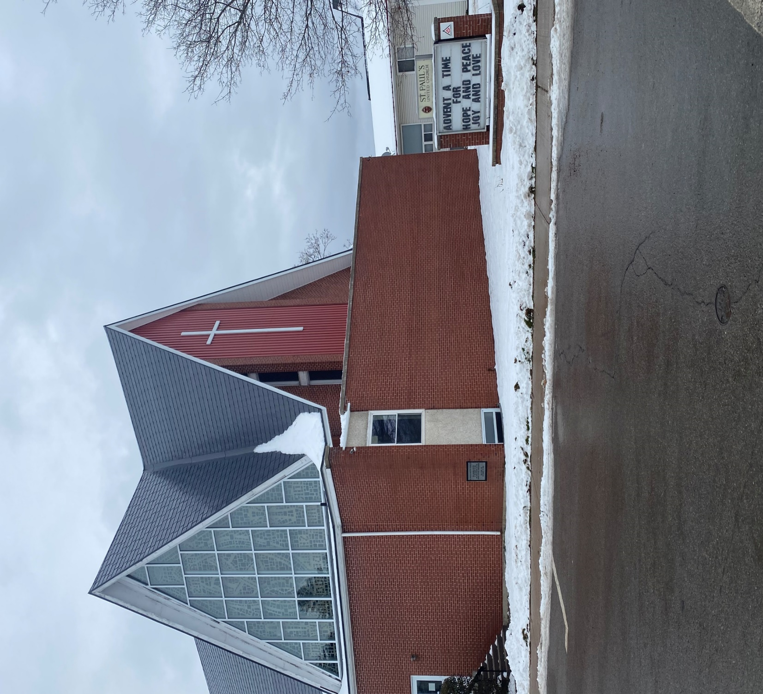
Third after Epiphany
St. Paul’s United Church Sussex, NB
January 26, 2025
Welcome

Slide 2
In sanctuary passing of the peace.

Slide 3

Prelude:
Angels Among Us

Slide 4
Welcome!
We’re so glad you could join us

Slide 5
Coffee and conversation
There will be coffee and conversation after the service
today in the fellowship hall.

Slide 6
Valentine Social
Sunday, February 9th
After the service, come upstairs and enjoy fellowship, music, socializing and dessert!
Get your valentine photo taken, celebrate Valentine Day.

Slide 7
Coldest night of the year
Support the sharing club
If you are interested in forming a team to represent St. Paul’s, there is a sign up sheet with more info in the narthex.

Slide 8
Shrove Tuesday pancake supper
If you are interested in forming a team to help prepare a pancake supper for Shrove Tuesday please sign up on the sheet in the narthex.

Slide 9
Good News!

Slide 10
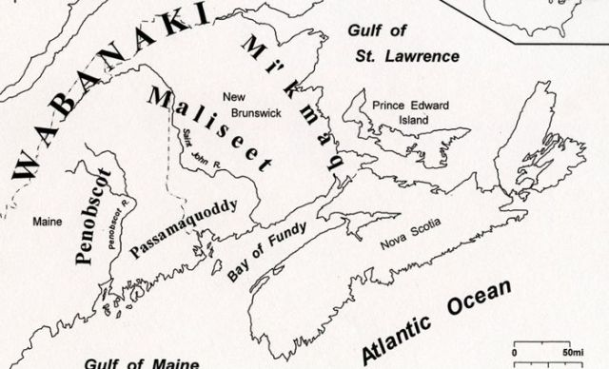
Acknowledging the Territories

Slide 11

Leader: May the Peace of Christ be with you.
Response:
And also with you.
..
Notes:
Hymn Title Page

Slide 12
Call to Worship
One: We live and breathe, laugh and
grieve.
All: God, thank you for the angels
that walk among us.
One: We hurt, we fear, we worry, we
stress.

Slide 13
All: God, thank you for the angels
that walk among us.
One: We struggle sometimes with
relationships.
All: God, thank you for the Angels
that walk among us.

Slide 14
One: We are your children, learning
and growing each day.
All: Thank you, God, for the
angels that walk among us.
Amen.

Slide 15
Hymn: MV# 142
Oh A Song Must Rise
Words and Music: Paul B. Svenson 1995 reprinted under OneLicense A725110

Slide 16
Oh a song must rise
for the spirit to descend
Oh a song must rise once again
Singing out God’s
praises and glory,
the faithful voices blend,
Oh a song must rise
for the spirit to descend

Slide 17
From the mountains
to the valleys,
from the desert to the sea,
a song must rise once again.
From the voices of our leaders,
the voice of you and me,
a song must rise
for the spirit to descend.

Slide 18
Oh a song must rise
for the spirit to descend
Oh a song must rise once again
Singing out God’s
praises and glory,
the faithful voices blend,
Oh a song must rise
for the spirit to descend

Slide 19
From poverty and riches,
from the voice of young and old,
a song must rise once again.
From the free
and the imprisoned,
the timid and the bold,
a song must rise
for the spirit to descend.

Slide 20
Oh a song must rise
for the spirit to descend
Oh a song must rise once again
Singing out God’s
praises and glory,
the faithful voices blend,
Oh a song must rise
for the spirit to descend

Slide 21
From ev’ry house of worship,
in ev’ry faith and tongue,
a song must rise once again.
From the villages and cities
a new song must be sung,
a song must rise
for the spirit to descend.

Slide 22
Oh a song must rise
for the spirit to descend
Oh a song must rise once again
Singing out God’s
praises and glory,
the faithful voices blend,
Oh a song must rise
for the spirit to descend. *

Slide 23
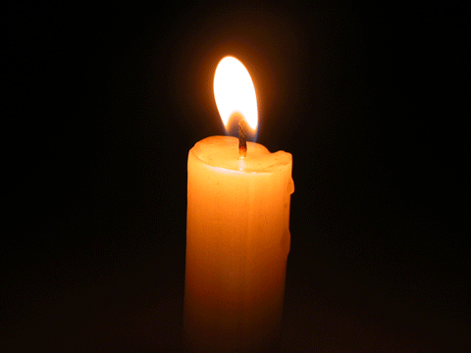
Lighting of the Christ Candle
"Angels are the invisible hand that lifts us up when we are ready to give up on ourselves"

Slide 24
Gathering Prayer
God we are here this morning to
praise you. We awake every
morning to Praise you. We revere
you. We cannot imagine what our
lives would look like without you
God.

Slide 25
Your love, your grace, your
guidance, your wisdom, your Son,
the Holy Spirit and the Angels
who walk among us are all gifts
and we give Thanks to you for
them. These gifts mold us. Inspire
us this morning so that we may
be a Blessing to others this week.

Slide 26
We pray for your help on our
journey so that we become more
faith filled through your
continued gifts to us. Amen.

Slide 27
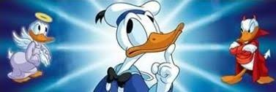
What’s on Your Shoulder

Slide 28
Hymn: MV #92
Like A Rock
Words: Keri K. Wehlander, 1999 reprinted under OneLicense A725110

Slide 29
Like a rock, like a rock,
God is under our feet.
Like the starry night sky,
God is over our head.
Like the sun on the horizon,
God is ever before.
Like the river runs to ocean,
Our home is in God ever more. *

Slide 30

Prayer for Illumination

Slide 31
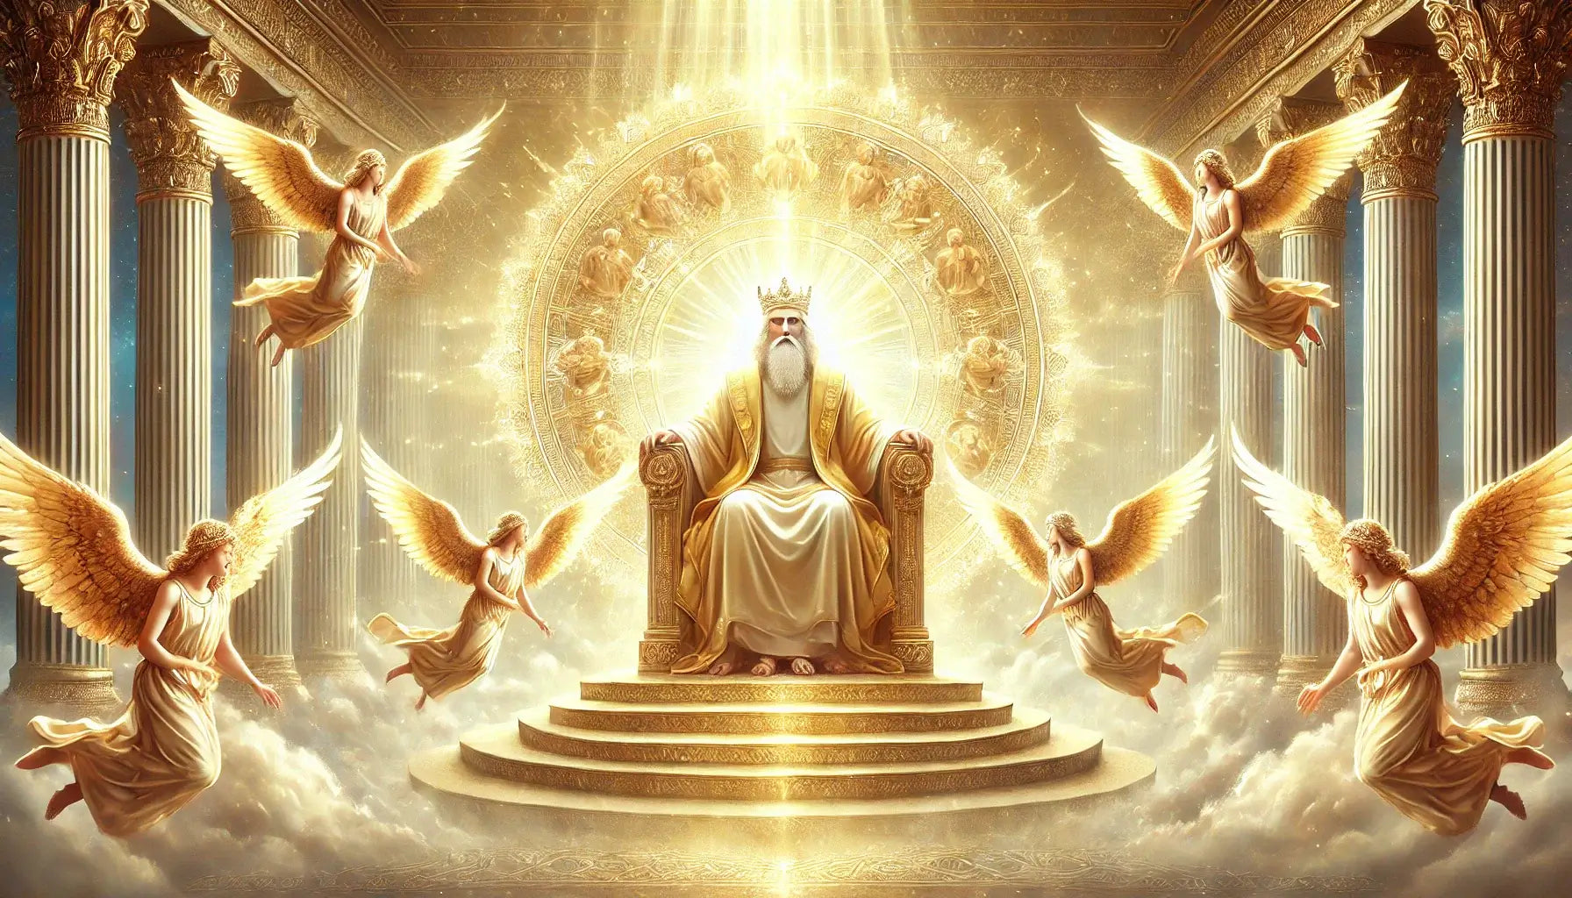
Isaiah 6: 1-4

Slide 32
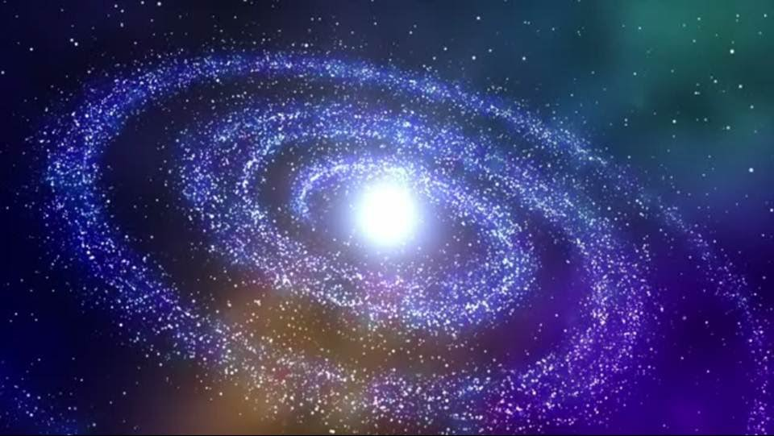
Psalm 148: 1-6

Slide 33

Revelations 22: 1-5

Slide 34

Matthew 26: 47-54

Slide 35
Ministry of Music:
Light of the World
(Sing Hallelujah)

Slide 36
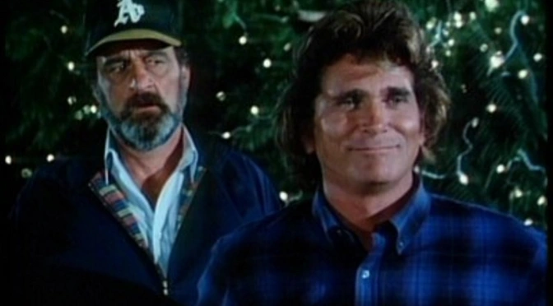
Angels who walk among us

Slide 37
Hymn: VU #388
Spirit Dancing
Words: Walter Farquharson Music: Lori Erhardt reprinted under OneLicense A725110

Slide 38
Spirit dancing on the waters,
sun reflecting song of grace
calling life to all the creatures,
giving life to human race.

Slide 39
Spirit dancing on the waters,
naming moment they should part,
giving freedom to the peoples,
signed for all in dancer’s art.

Slide 40
Spirit dancing on the waters,
paradox of womb and grave,
welcome now the Word child’s coming,
no one prisoner, no one slave.

Slide 41
Spirit dancing on the waters,
can the dance by cross be stilled?
Earth be shaken! Dead awaken!
What was emptied shall be filled.

Slide 42
Spirit dancing on the waters,
give your people their new birth,
healing, loving one another
in community with earth.

Slide 43
Spirit dancing on the waters,
we would come and dance with you
‘til our world is filled with music
and in Christ all things are new.*

Slide 44
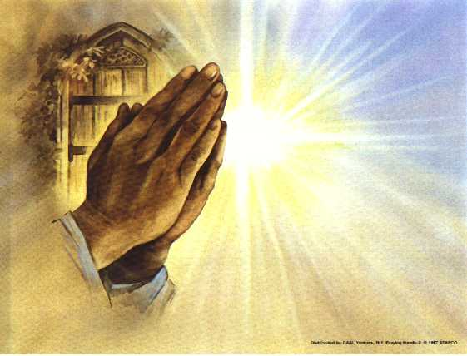
Prayers of
The People

Slide 45
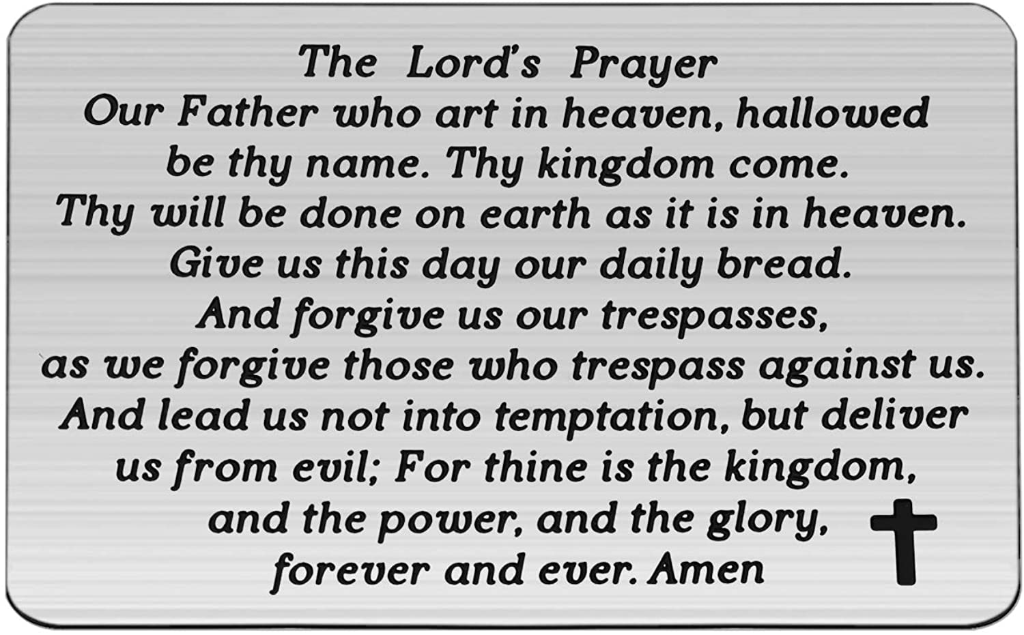

Slide 46
Support the ministry of St. Paul’s :
Through PAR – ask us how to join
via Canada Helps
search for St. Paul’s Sussex
via e-transfer to treasurerstpaulsucc1@gmail.com.
drop in collection plates located in the Narthex and near exit door
by mail to
4 Morrison Avenue, Sussex, N.B. E4E 1P5
during office hours
Notes:
Body text for hymns and prayers

Slide 47
Prayer of Dedication
God, to you we dedicate these
gifts this day. May this act of
giving inspire other ways that we
may help others and help St.
Paul’s help others so that your
love may be revealed on earth as
it is in heaven. Amen.

Slide 48
Hymn: VU #238 vs 1,2,4
O Lord My God
Public Domain reprinted under OneLicense A725110

Slide 49
O Lord my God,
when I in awesome wonder
Consider all
the works thy hand hath made,
I see the stars,
I hear the mighty thunder,
Thy power throughout
the universe displayed.

Slide 50
Then sings my soul,
my Saviour God, to thee,
How great thou art!
How great thou art!
Then sings my soul,
my Saviour God, to thee,
How great thou art!
How great thou art!

Slide 51
When through the woods
and forest glades I wander,
I hear the birds
sing sweetly in the trees;
When I look down
from lofty mountain grandeur
And hear the brook
and feel the gentle breeze.

Slide 52
Then sings my soul,
my Saviour God, to thee,
How great thou art!
How great thou art!
Then sings my soul,
my Saviour God, to thee,
How great thou art!
How great thou art!

Slide 53
When Christ shall come
with shout of acclamation
And take me home,
what joy shall fill my heart!
Then I shall bow in humble adoration
And there proclaim,
'My God, how great thou art!'

Slide 54
Then sings my soul,
my Saviour God, to thee,
How great thou art!
How great thou art!
Then sings my soul,
my Saviour God, to thee,
How great thou art!
How great thou art! *

Slide 55
Benediction
&
Commission

Slide 56
Sung Benediction: MV #211
Go Now in Peace
Guided by the Light
Words and music: Pedro Rubalcava 2002 reprinted under OneLicense A-725110

Slide 57
Go now in peace
guided by the light of Christ,
so you may be nourished
by the Word of life.

Slide 58
Go now in peace
guided by the light of Christ,
so you may be nourished
by the Word of life. *

