Slide 1

St. Paul’s United Church
Sussex, NB
July 13th, 2025
Fifth Sunday
after
Pentecost

Slide 2
Welcome!
We’re so glad you could join us

Slide 3
Strawberry Festival:
At Salisbury United Church. July 16th from 6:00-8:00PM. Take out only. Choose from the following: strawberries, strawberry shortcake, strawberries and cake, cake. Gluten free options available.
$8.00

Slide 4
See lisa run
Run lisa, run:
Lisa will be running a 5K while at General Council in Calgary in support of the Alvin Dixon Memorial Bursary Fund. Lisa is looking for folks to donate $1 per km. Thank you!

Slide 5
Rev. Jenn will be on vacation for the next week.
The July 20th service will be led by Lisa Folkins featuring Cindy Hatt on the piano.

Slide 6
Good News!

Slide 7
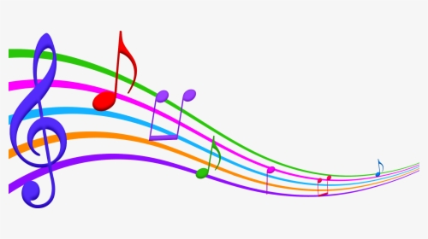
Prelude:
Heart and Soul
Paul Baloche CCLI

Slide 8
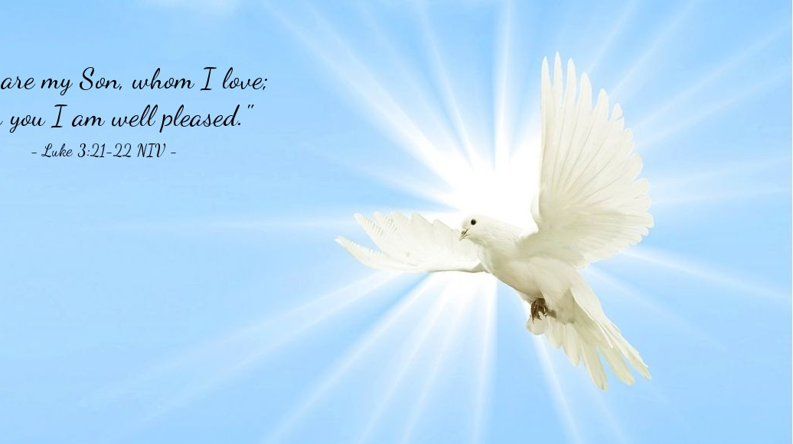
The Peace of Christ.
Sharing the Peace:
Response:
And also with you.
..
Notes:
Hymn Title Page

Slide 9
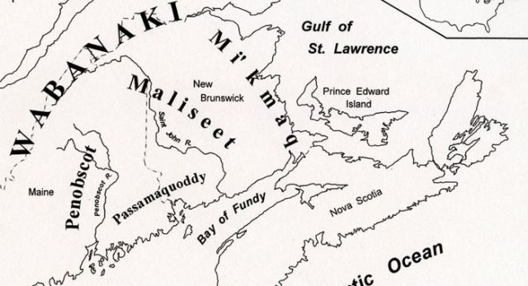
Acknowledging the Territories

Slide 10
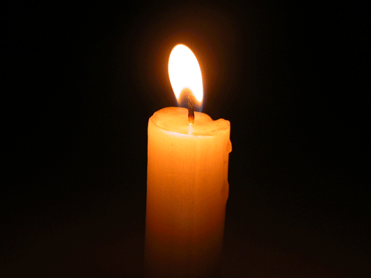
Lighting of the Christ Candle
.
Mary Magdalene went and announced to the disciples, ‘I have seen the Lord’; and she told them that he had said these things to her. - John 20: 18

Slide 11
Call to Worship:
One: As we gather this day, each of us
brings something different to worship
All: We bring the joys and
burdens of the week.
One: We bring prayers of hope, and
prayers of anguish.

Slide 12
All: We bring our voices, and our
offerings, and our questions.
One: We bring our faith, tattered or
whole as it may be.
All: We bring all this to each other
and to God, whom we worship
today.

Slide 13
Hymn: SOG #76 Leaning on the Everlasting Arms
Words and Music: David Kai 2017 Reprinted under OneLicense A-725110

Slide 14
What a fellowship,
what a joy divine,
Leaning on the Everlasting Arms!
What a blessedness,
what a peace is mine
Leaning on the Everlasting Arms!

Slide 15
Leaning, leaning,
Safe and secure from all alarms;
Leaning, leaning,
Leaning on the Everlasting Arms.

Slide 16
O how sweet
to walk in this pilgrim way,
Leaning on the Everlasting Arms!
O how bright the path grows
from day to day,
Leaning on the Everlasting Arms!

Slide 17
Leaning, leaning,
Safe and secure from all alarms;
Leaning, leaning,
Leaning on the Everlasting Arms.

Slide 18
What have I to dread,
what have I to fear,
Leaning on the Everlasting Arms!
I have peace complete
with my Lord so near,
Leaning on the Everlasting Arms!

Slide 19
Leaning, leaning,
Safe and secure from all alarms;
Leaning, leaning,
Leaning on the Everlasting Arms.
*

Slide 20
Gathering Prayer
(inspired by Colossians 1: 1-14)
Loving and Gracious God, in you we find our hope for new
beginnings and new paths. We
seek out your wisdom, praying it
will bear abundant fruit in our
lives.

Slide 21
As we grow in faith, help us truly
comprehend the grace you offer
us, as we seek to lead lives
worthy of you, O Lord. In Jesus‘
name, we pray.
Amen.

Slide 22
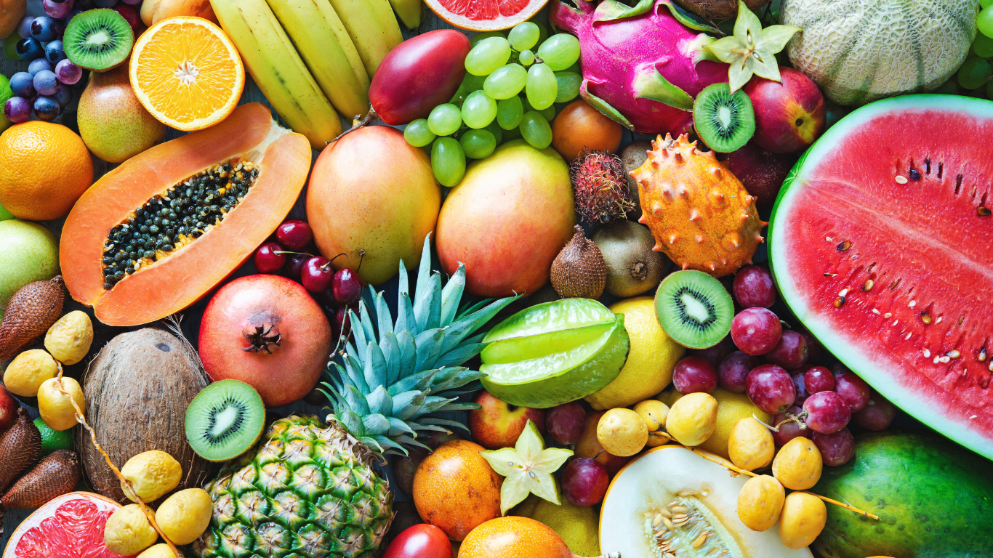
What is the Best Way to Eat Fruit?

Slide 23
Hymn: SOG #27 What a Friend
Words & Music Jonas Myrin and Matt Redman Reprinted under OneLicense A725110

Slide 24
What a friend we have in Jesus,
All our sins and griefs to bear!
What a privilege to carry
Ev’rything to God in pray’r
O what peace we often forfeit,
O what needless pain we bear,
All because we do not carry
Ev’rything to God in pray’r

Slide 25
Have we trials and temptations?
Is there trouble anywhere?
We should never be discouraged,
Take it to the Lord in pray’r.
Can we find a friend so faithful
Who will all our sorrows share?
Jesus knows our ev’ry weakness,
Take it to the Lord in pray’r.

Slide 26
Are we weak and heavy laden,
Cumbered with a load of care?
Precious Saviour, still our refuge,
Take it to the Lord in pray’r.

Slide 27
Do thy friends despise, forsake thee?
Take it to the Lord in pray’r.
In His arms He’ll take and shield thee,
Thou wilt find a solace there. *

Slide 28

Prayer for Illumination

Slide 29
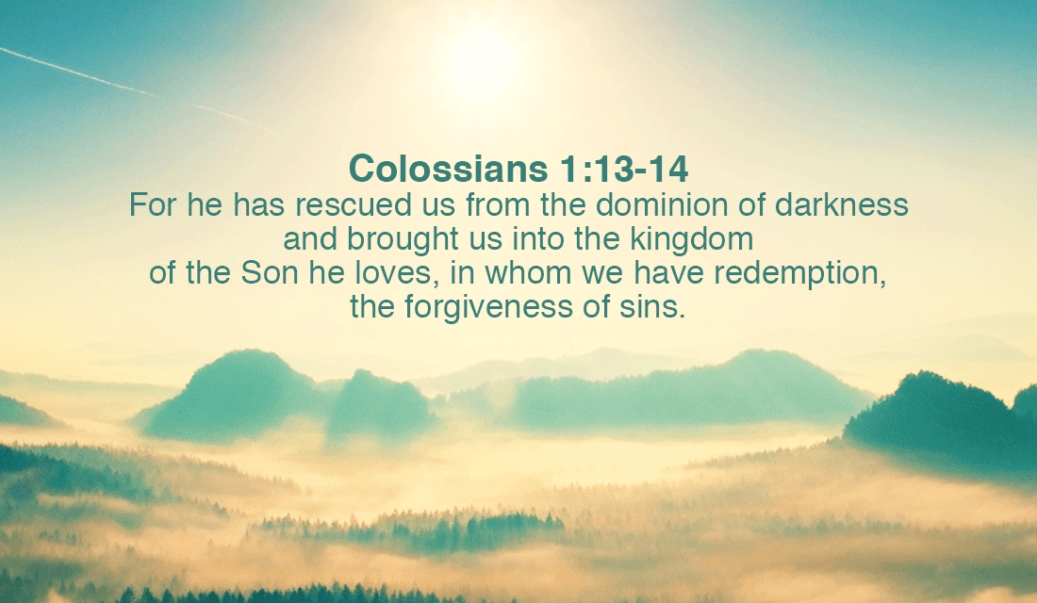
Colossians 1: 1-14

Slide 30
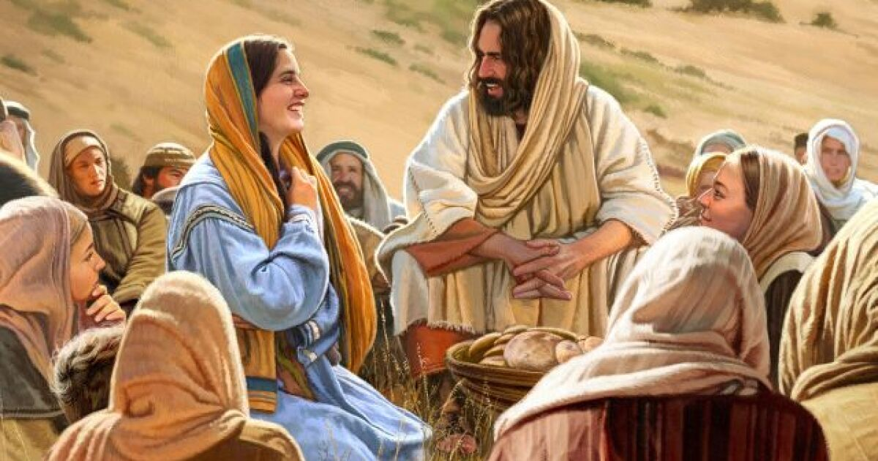
Luke 8: 1-3

Slide 31
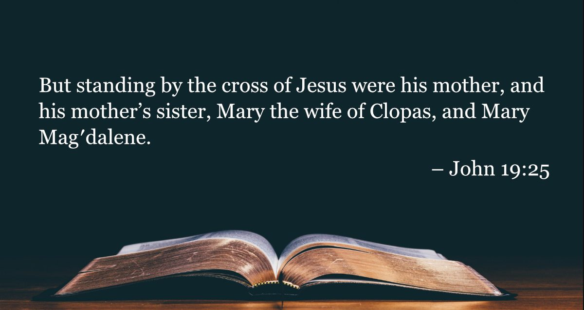
John 19:25

Slide 32
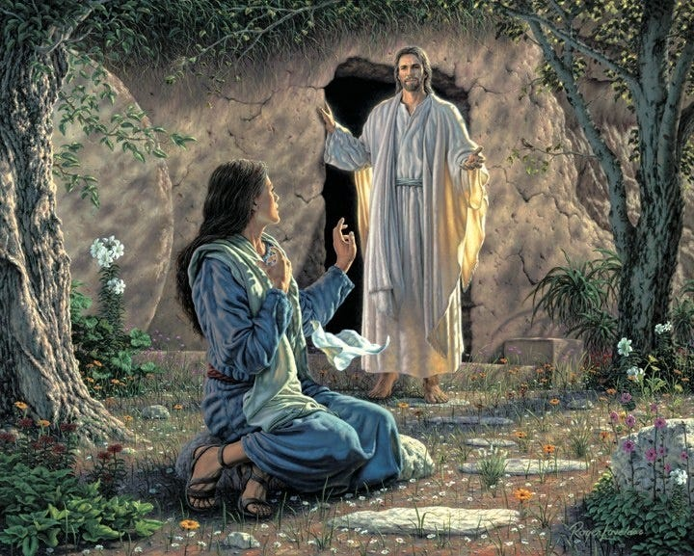
John 20: 1-2, 11-18

Slide 33
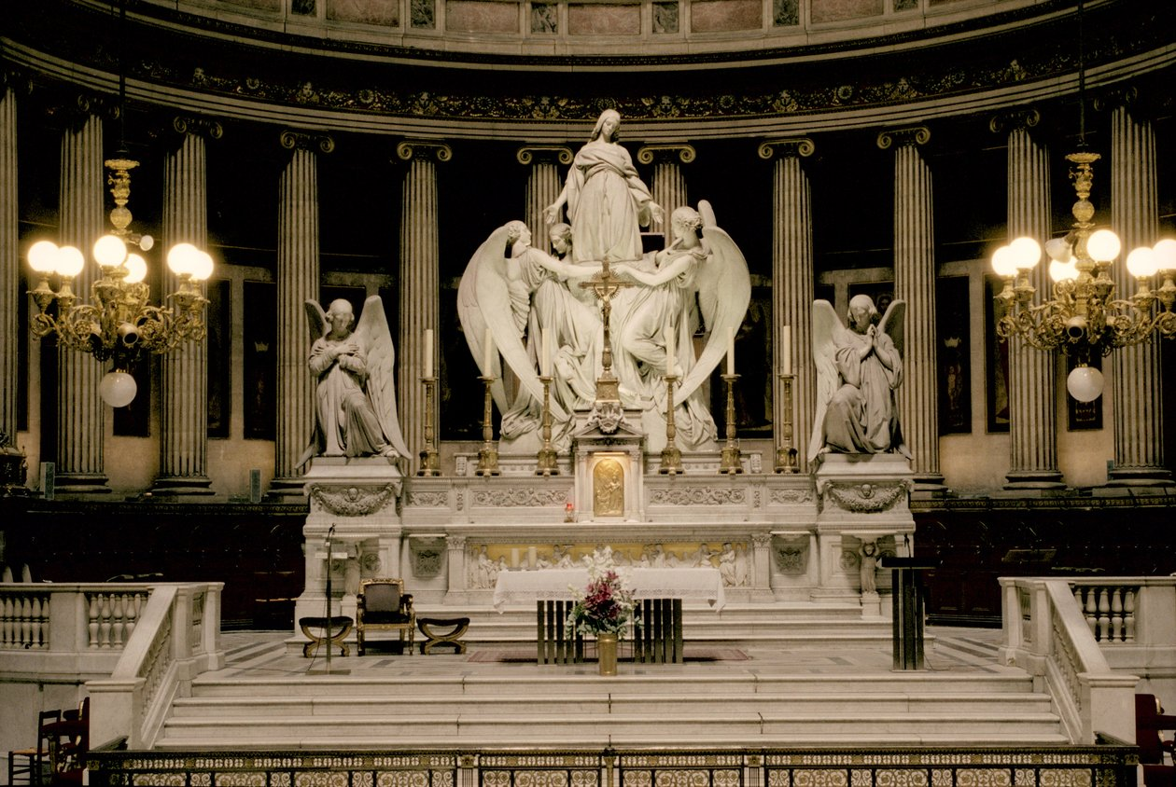
Mary, Mary…

Slide 34
Hymn: SOG #23
In the Garden
Words & Music Jonas Myrin and Matt Redman Reprinted under OneLicense A725110

Slide 35
I come to the garden alone,
While the dew is still on the roses;
And the voice I hear,
Falling on my ear;
The Son of God discloses

Slide 36
And He walks with me,
And He talks with me,
And He tells me I am His own,
And the joy we share
as we tarry there,
None other has ever known.

Slide 37
He speaks, and the sound of His voice
Is so sweet the birds hush their singing,
And the melody that he gave to me,
Within my heart is ringing

Slide 38
And He walks with me,
And He talks with me,
And He tells me I am His own,
And the joy we share
as we tarry there,
None other has ever known.

Slide 39
I’d stay in the garden with Him
Tho’ the night around me be falling,
But He bids me go;
Thro’ the voice of woe,
His voice to me is calling.

Slide 40
And He walks with me,
And He talks with me,
And He tells me I am His own,
And the joy we share
as we tarry there,
None other has ever known. *

Slide 41
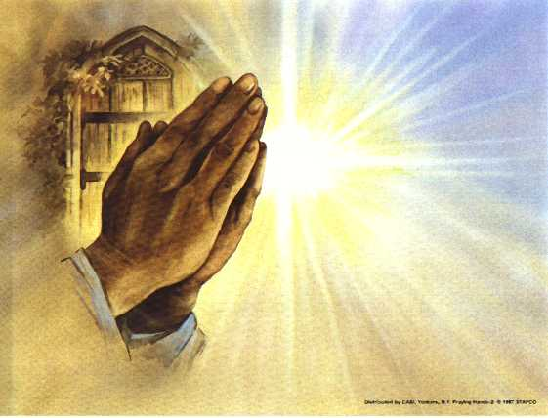
Prayers of
the People
One: God of every life,
All: Hear our prayer.

Slide 42
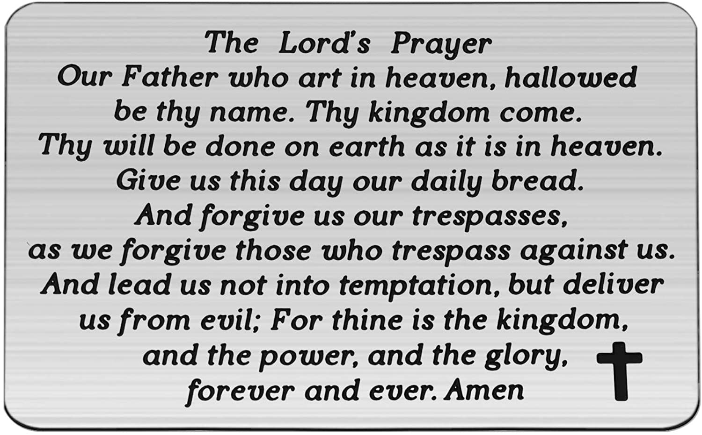

Slide 43
Support the ministry of St. Paul’s :
Through PAR – ask us how to join
via Canada Helps
search for St. Paul’s Sussex
via e-transfer to treasurerstpaulsucc1@gmail.com.
drop in collection plates located in the Narthex and near exit door
by mail to
4 Morrison Avenue, Sussex, N.B. E4E 1P5
during office hours
Notes:
Body text for hymns and prayers

Slide 44
Prayer of Dedication
Loving God, we offer these
offerings as a symbol of our hope
in you. May they be used to bring
hope to those who need it most.
Amen.

Slide 45
Hymn: SOG #25 Love Lifted Me
Words & Music Judith Snowdon ©2004 Used by permission Reprinted under OneLicense A725110

Slide 46
I was sinking deep in sin,
Far from the peaceful shore,
Very deeply stained within,
Sinking to rise no more;
But the Master of the sea
Heard my despairing cry,
From the waters lifted me,
Now safe am I.

Slide 47
Love lifted me! Love lifted me!
When nothing else could help,
Love lifted me.

Slide 48
All my heart to Him I give,
Ever to Him I’ll cling,
In His blessed presence live,
Ever His praises sing.
Love so mighty and so true
Merits my soul’s best songs;
Faithful, loving service too,
To Him belongs.

Slide 49
Love lifted me! Love lifted me!
When nothing else could help,
Love lifted me.

Slide 50
Souls in danger, look above,
Jesus completely saves;
He will lift you by His love
Out of the angry waves.
He’s the Master of the sea,
Billows His will obey;
He your Saviour wants to be
Be saved today.

Slide 51
Love lifted me! Love lifted me!
When nothing else could help,
Love lifted me.
Amen. *

Slide 52
Benediction
&
Commissioning

Slide 53
Sung Benediction:
TLUS# 104
May The Peace of Christ
Words & Music Izumi Shiota reprinted under OneLicense A-725110

Slide 54
May the peace of Christ be with you,
May the love of God dwell deep in your heart.
May the Spirit enlighten your way,
May you walk in the comfort of God’s care.

