Slide 1

St. Paul’s United Church
Sussex, NB
July 20th, 2025
Sixth Sunday
after
Pentecost

Slide 2
Welcome!
We’re so glad you could join us

Slide 3
A weekend with Linnea:
Linnea Good will be at Hampton United Church, August 9.
The weekend will begin on Saturday afternoon with Linnea hosting a novice ukulele session. Registration is required and can be completed by contacting office@hamptonunited.ca.

Slide 4
A weekend with Linnea:
From 5:00pm to 6:30pm, everyone is invited to join us for a good old fashion corn boil and cookout, followed by a concert starting at 7:00 PM. Donations to support the event, with proceeds benefiting Helping Hands for Displaced Ukrainians. Further info on boards.

Slide 5
Nursing home without walls:
The youth of St. Paul’s will be at Kiwanis nursing home on Monday from 1 to 3 to play a variety of games and activities.

Slide 6
Good News!

Slide 7

Prelude:
Eden Again
Paul Baloche CCLI

Slide 8

The Peace of Christ.
Sharing the Peace:
Response:
And also with you.
..
Notes:
Hymn Title Page

Slide 9
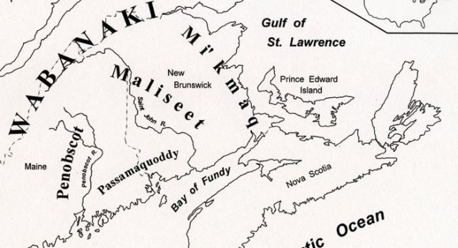
Acknowledging the Territories

Slide 10
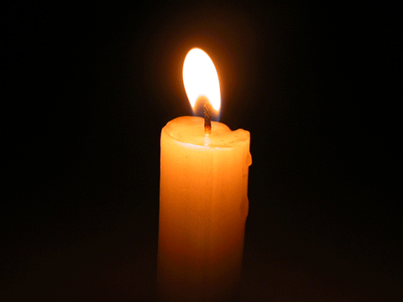
Lighting of the Christ Candle
.
“Your Faith has made you well,
Go Forward in Peace”

Slide 11
Call to Worship:
One: God is our light and our
salvation! Whom shall we fear?
All: God is our stronghold. Of
whom shall we be afraid?
One: Let us be strong and of good
courage as we wait upon God

Slide 12
All: God has called us together,
and we have come.
One: Let us thank God forever,
because of what God has done.
All: We will proclaim God’s holy
name, for God is good. Let us
worship God!

Slide 13
Hymn: MV #48
I Can Feel You Near Me God
Bruce Harding. reprinted under OneLicense A-725110

Slide 14
I can feel you near me God,
I can feel you near
Yes I know you’re with me God,
I feel you here
I can feel you near me God,
I can feel you near
Yes I know you’re with me God
Heaven is here.

Slide 15
And I’ll jump for joy
I’m singing Al-le-lu-ia
Jump for joy for you
I will jump for joy
I’m singing Al-le-lu-ia
Jump for joy for you.

Slide 16
I can feel you loving me,
Yes I know you care God
I know you’re loving me
Always everywhere
I can feel you loving me,
Yes I know you care God
I know you’re loving me
I know you’re there.

Slide 17
And I’ll jump for joy
I’m singing Al-le-lu-ia
Jump for joy for you
I will jump for joy
I’m singing Al-le-lu-ia
Jump for joy for you. *

Slide 18
Gathering Prayer
God of majesty and mystery, your
love and purpose embraces the
whole world. You set us in a
world of beauty and bounty and
invite us to meet you in the midst
of its wonders. You call us to love each other in the example of Jesus

Slide 19
to make your world a place of
justice and compassion. In this
hour of worship, send us your
Spirit of wisdom and grace so
that we can live out the praise on
our lips in our day-to-day living,
which we offer to you, our one
and only God.

Slide 20
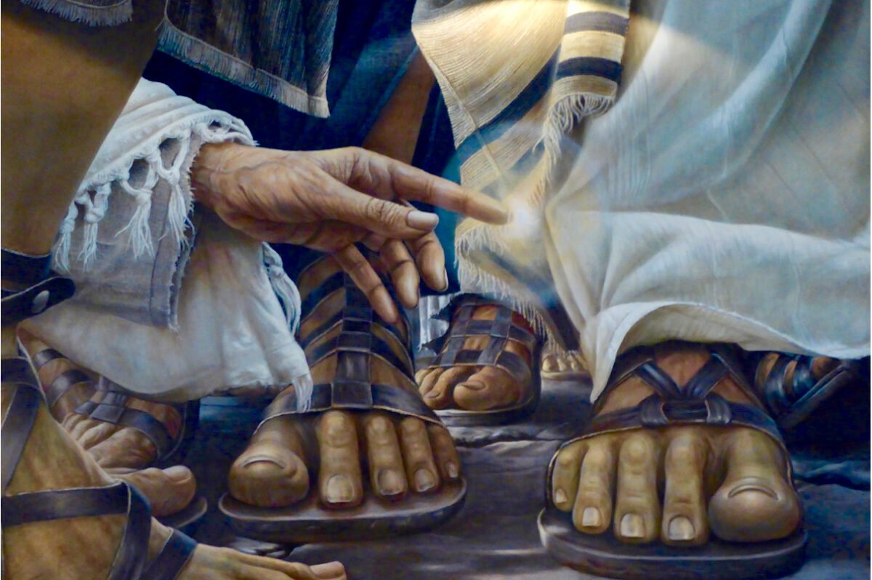
Jesus Heals

Slide 21
Hymn: VU #356 Seek Ye First
Words Karen Lafferty 1972 reprinted under OneLicense A-725110

Slide 22
Seek ye first the kingdom of God
And God's righteousness,
And all these things
shall be added unto you.
Hallelu, hallelujah.

Slide 23
Ask and it shall
be given unto you;
Seek and you shall find;
Knock and the door
shall be opened unto you.
Hallelu, hallelujah.

Slide 24
We do not live by bread alone,
But by every word
That proceeds from
the mouth of God.
Hallelu, hallelujah. *

Slide 25

Prayer for Illumination

Slide 26

Psalm 52

Slide 27
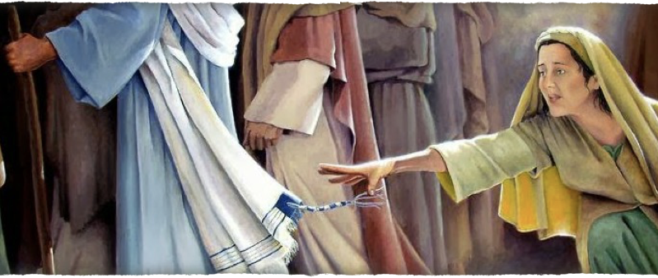
Mark 5:25-34

Slide 28
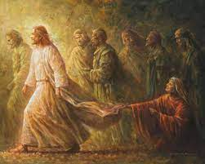
A Woman of Great Faith

Slide 29
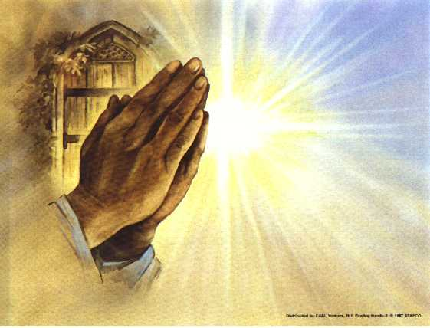
Prayers of
the People
One: God with an open heart,
All: Open our hearts to you.

Slide 30
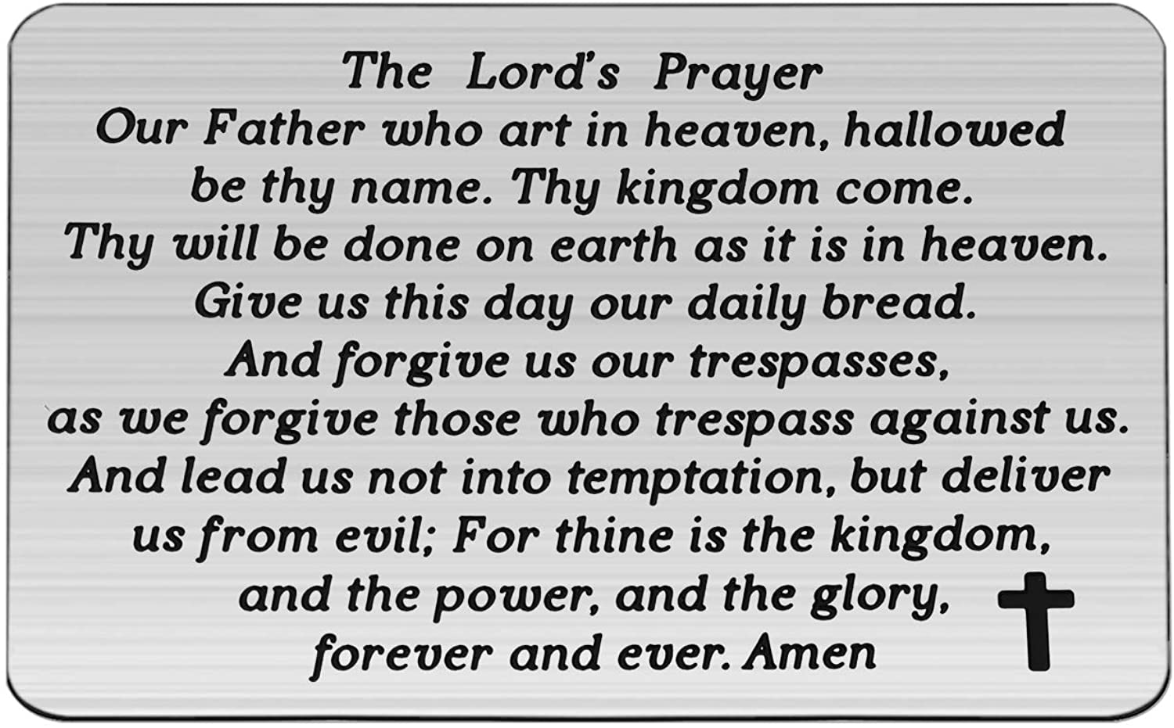

Slide 31
Support the ministry of St. Paul’s :
Through PAR – ask us how to join
via Canada Helps
search for St. Paul’s Sussex
via e-transfer to treasurerstpaulsucc1@gmail.com.
drop in collection plates located in the Narthex and near exit door
by mail to
4 Morrison Avenue, Sussex, N.B. E4E 1P5
during office hours
Notes:
Body text for hymns and prayers

Slide 32
Prayer of Dedication
We lift these gifts of our hands
and hearts to the glory that is in
you, O God. We offer our gifts of
talents and time that each of us
brings to this community of faith.

Slide 33
Receive all our gifts today, given
freely for the greater good of the
world. Amen.

Slide 34
Hymn: MV #161
I Have Called You By Your Name
Words & Music: Daniel Damon reprinted under OneLicense A725110

Slide 35
I have called you by your name,
you are mine;
I have gifted you and ask you
now to shine.
I will not abandon you;
all my promises are true.
You are gifted, called, and chosen
you are mine.

Slide 36
I will help you learn my name
as you go;
Read it written in my people,
help them grow.
Pour the water in my name,
speak the word your soul can claim,
Offer Jesus’ body given long ago.

Slide 37
I know you will need my touch
as you go;
Feel it pulsing in creation’s
ebb and flow.
Like the woman reaching out,
choosing faith in spite of doubt,
Hold the hem of Jesus’ robe,
then let it go.

Slide 38
I have given you a name,
it is mine;
I have given you my Spirit
as a sign.
With my wonder in your soul,
Make my wounded children whole,
Go and tell my precious people
they are mine. *

Slide 39
Benediction
&
Commissioning

Slide 40
Sung Benediction:
MV #221
I Am Walking a Path of Peace
Words & Music Janet Bauman Tissandier reprinted under OneLicense A-725110

Slide 41
I am walking a path of peace,
I am walking a path of peace,
I am walking a path of peace,
Lead me home, Lead me home.

Slide 42
I am walking a path of faith,
I am walking a path of faith,
I am walking a path of faith,
Lead me home, Lead me home. *

