Slide 1

St. Paul’s United Church
Sussex, NB
July 27th, 2025
Seventh Sunday
after
Pentecost

Slide 2
Welcome!
We’re so glad you could join us

Slide 3
A weekend with Linnea:
Linnea Good will be at Hampton United Church, August 9.
The weekend will begin on Saturday afternoon with Linnea hosting a novice ukulele session. Registration is required and can be completed by contacting office@hamptonunited.ca.

Slide 4
A weekend with Linnea:
From 5:00pm to 6:30pm, everyone is invited to join us for a good old fashion corn boil and cookout, followed by a concert starting at 7:00 PM. Donations to support the event, with proceeds benefiting Helping Hands for Displaced Ukrainians. Further info on boards.

Slide 5
Remembering the children of Palestine and israel:
With ongoing conflict in the Middle East, children are caught up in the midst of war with an alarming increase in casualties. Until Sept. 2024, approximately 11,500 children have perished.

Slide 6
Remembering the children of Palestine and israel:
In remembrance, St. Paul’s is sharing a list of names and ages of some of them. There are 43 such lists being shared among churches around the world. Copies are available in the Narthex.

Slide 7
Good News!

Slide 8
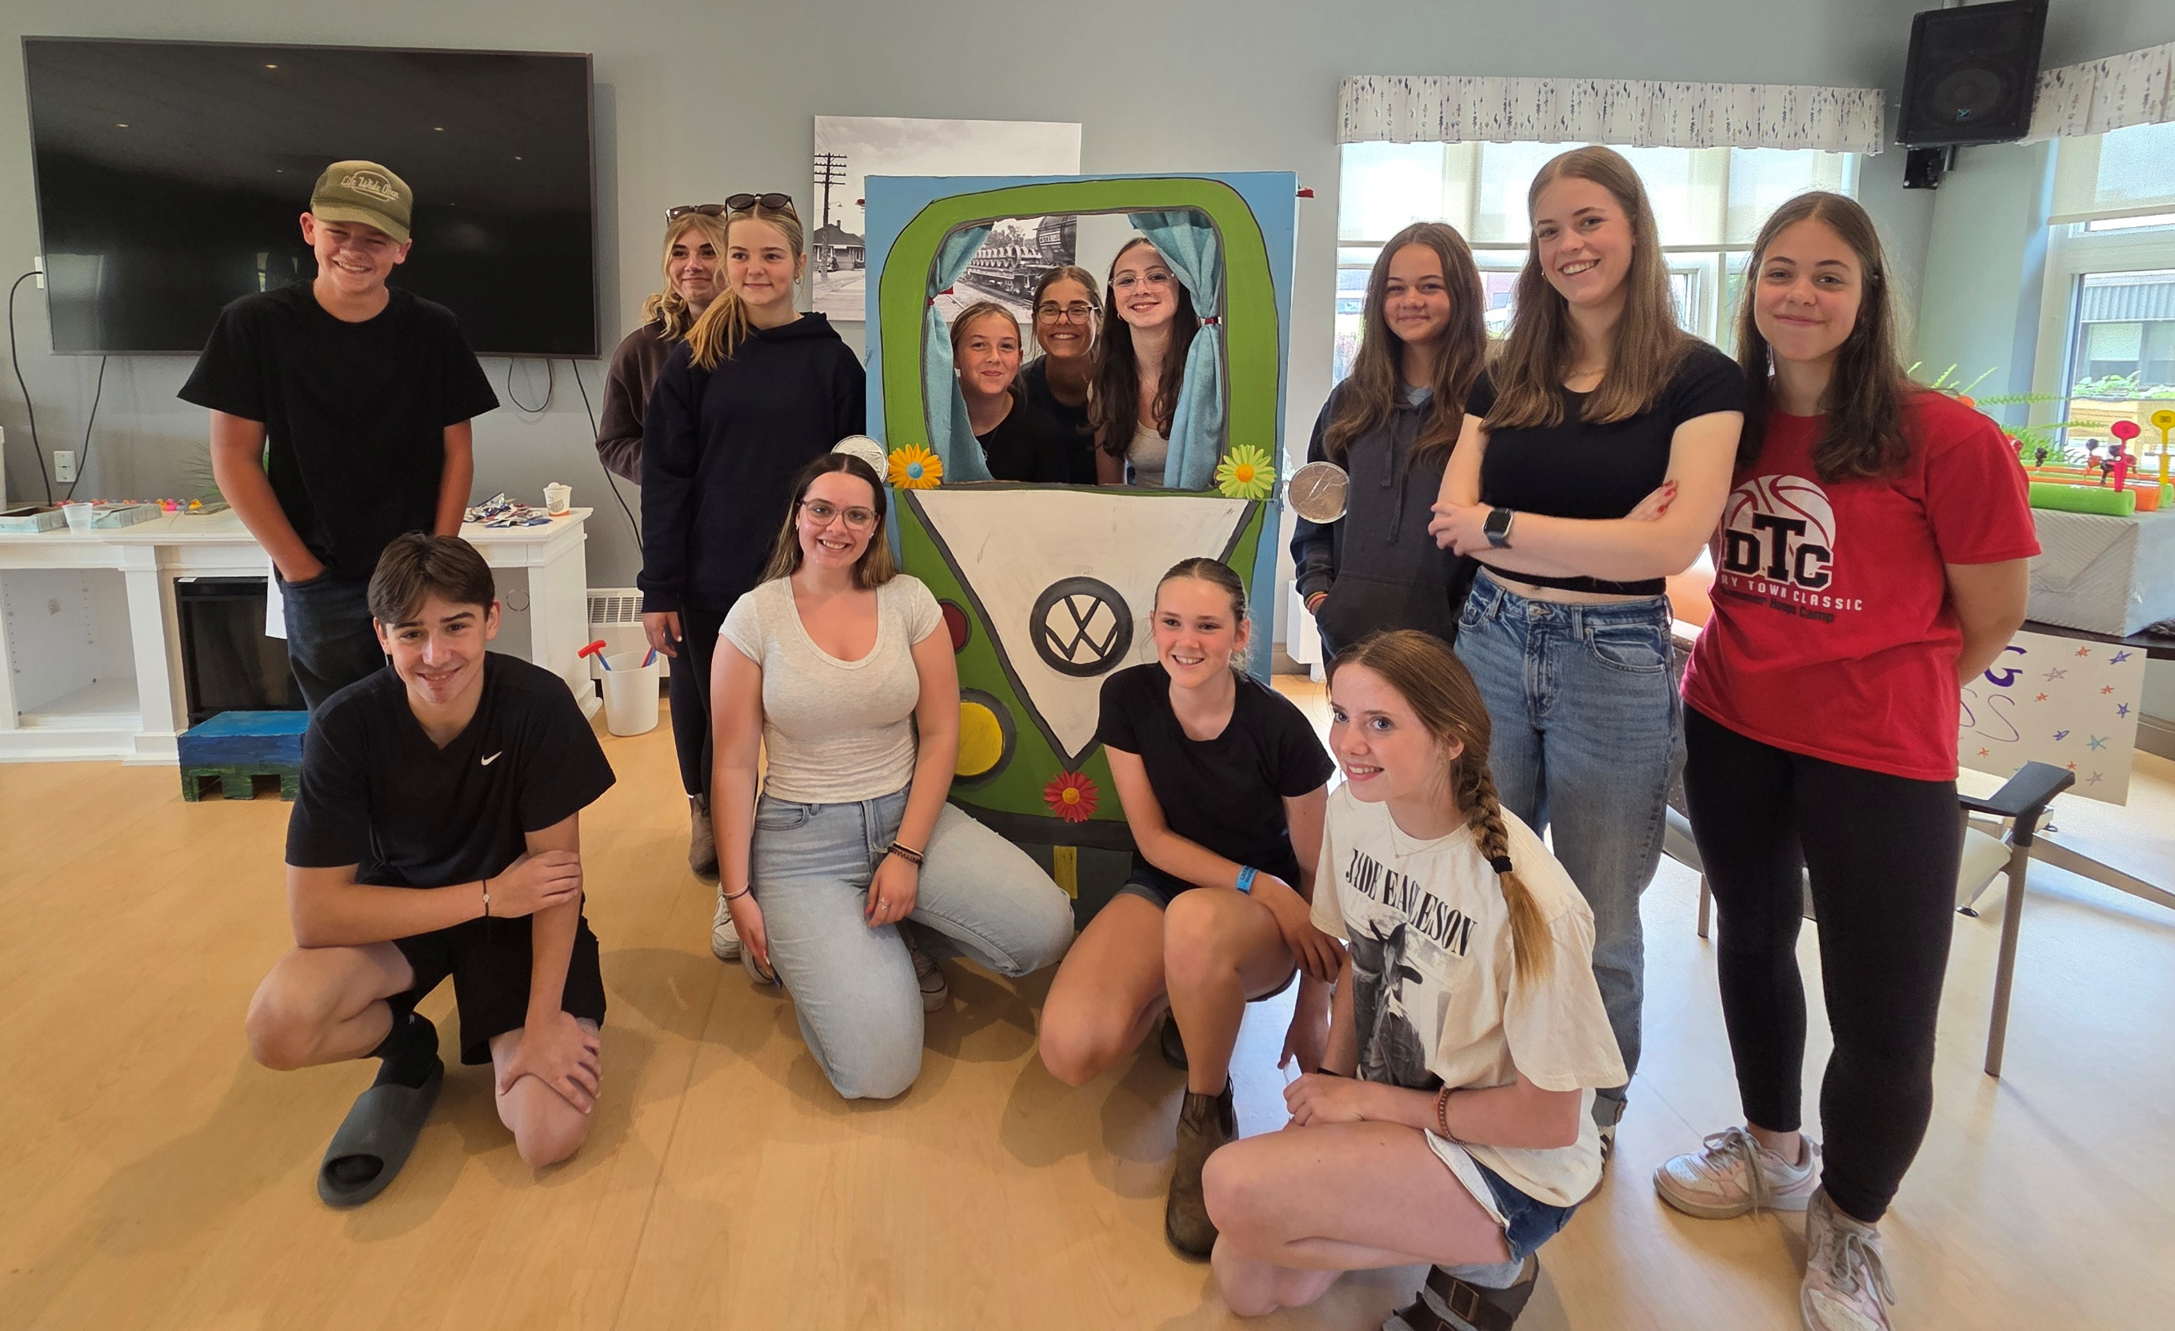
Nursing Home without Walls
The youth of St. Paul’s

Slide 9
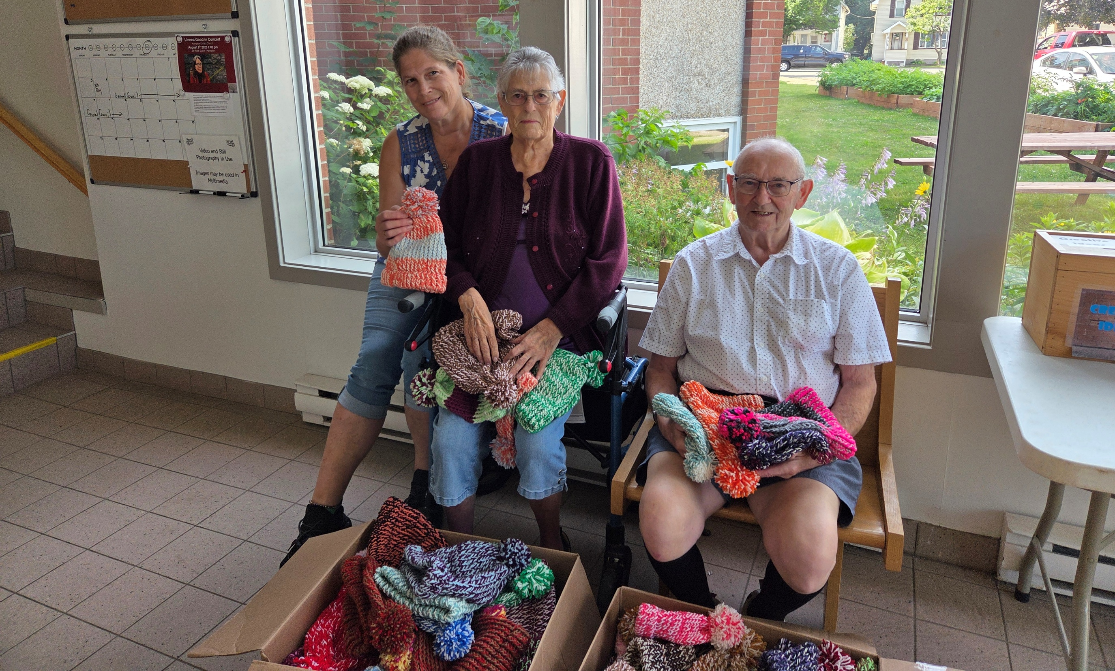
Ruel and the 100 Hats…

Slide 10
Happy 14th Birthday
Abbie Corcoran.

Slide 11
Any other Good News?

Slide 12

Prelude:
Song of Hannah
Paul Baloche CCLI

Slide 13

The Peace of Christ.
Sharing the Peace:
One: May the peace of Christ be with you.
Response: and also with you.
Response:
And also with you.
..
Notes:
Hymn Title Page

Slide 14
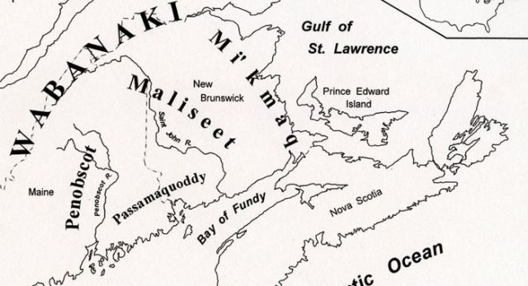
Acknowledging the Territories

Slide 15
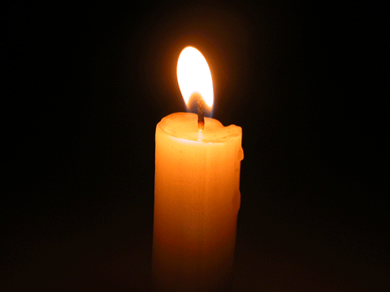
Lighting of the Christ Candle
.
“There is no Holy One like the Lord, no one besides you; there is no Rock like our God.”
Hannah, 1 Samuel 2:2

Slide 16
Call to Worship:
One: Our God is strong, like a rock.
All: We come to worship the God
of justice and joy.
One: Our God cares for the ones the
world forgets.
All: We come to worship the God
of justice and joy.

Slide 17
One: Our God is the one who gives
life, and who guards the future.
All: We come to worship the God
of justice and joy.
One: Come, let us worship God.

Slide 18
Hymn: MV #62 There is Room for All Bruce Harding. reprinted under OneLicense A-725110

Slide 19
There is room for all
in the shadow of God’s wing;
There is room for all,
sheltered in God’s love.

Slide 20
And I rejoice and sing,
“My refuge and my rock,
in whom I trust.”
There is room for all,
There is room for all!

Slide 21
There is room for all
in the shadow of God’s wing;
There is room for all,
sheltered in God’s love.

Slide 22
And I rejoice and sing,
“My refuge and my rock,
in whom I trust.”
There is room for all,
There is room for all! *

Slide 23
Gathering Prayer
(inspired by 1 Samuel 2: 1-10 NRSV)
God, above all, You cause our
hearts to rejoice and our strength
to increase. For You, are a God of
knowledge, who judges our
actions, who breaks the power of
the mighty,

Slide 24
and clothes the feeble with
strength, who makes rich and
makes poor, brings low and lifts
up. Raising up the poor from the
dust and the needy from the ash
heap; Giving them seats of
honour and guarding the feet of
those who are faithful.

Slide 25
We worship and praise You, O
God - judge of all the earth.
Amen.

Slide 26

Let us pray

Slide 27
Hymn:
O Great Earth
Words and Music: Linnea Good reprinted under OneLicense A-725110

Slide 28
O Great Earth so green and blue,
This is the promise that I’ll make to you:
To care for your _____
For _____ can hear
The rhythm of your heartbeat. *

Slide 29

Prayer for Illumination

Slide 30
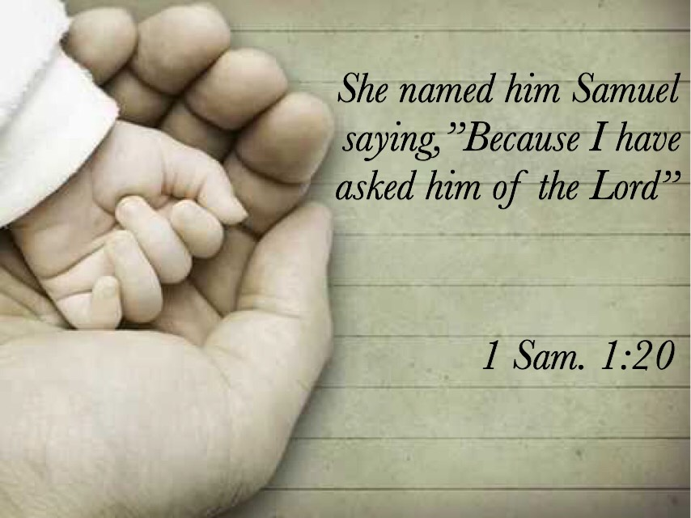
1 Samuel 1: 1- 1b, 4-18, 20, 24-28

Slide 31
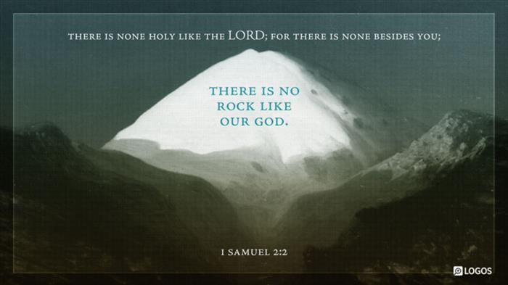
1 Samuel 2: 1-11

Slide 32
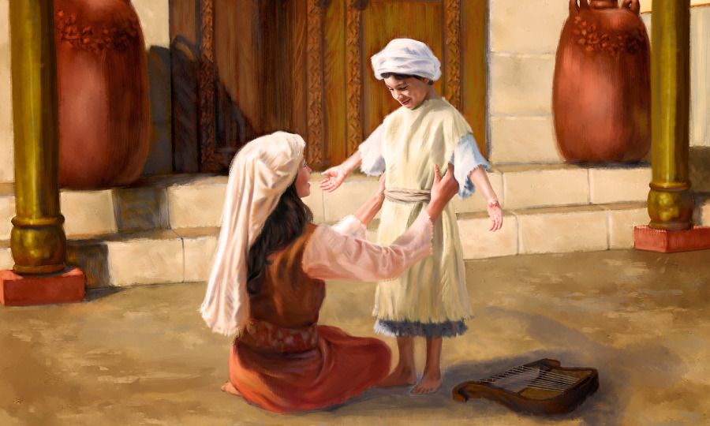
1 Samuel 2: 18-21

Slide 33

Hannah…a mother’s love

Slide 34
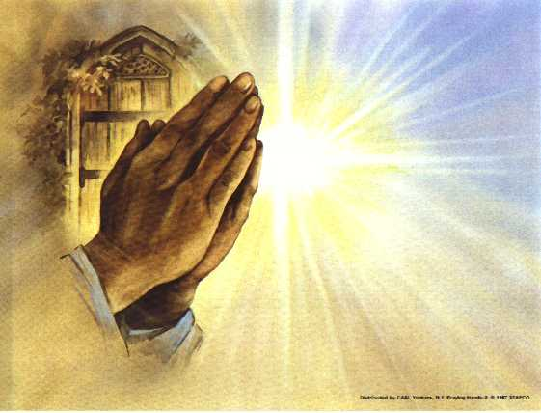
Prayers of
the People

Slide 35
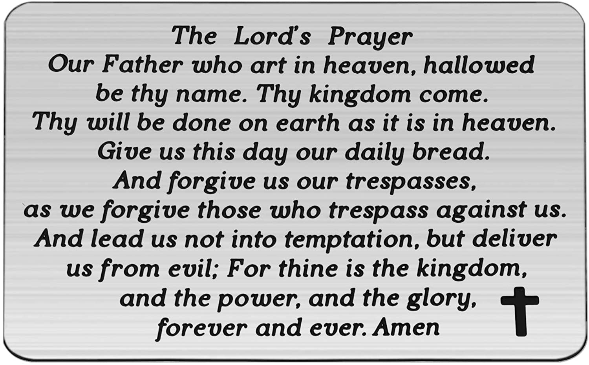

Slide 36
Support the ministry of St. Paul’s :
Through PAR – ask us how to join
via Canada Helps
search for St. Paul’s Sussex
via e-transfer to treasurerstpaulsucc1@gmail.com.
drop in collection plates located in the Narthex and near exit door
by mail to
4 Morrison Avenue, Sussex, N.B. E4E 1P5
during office hours
Notes:
Body text for hymns and prayers

Slide 37
Prayer of Dedication
Holy Love, may these gifts and
offerings make a difference in
this life of the community we
love, serve, and reflect. May these
gifts and offerings extend beyond
the borders and boundaries of the
stones that encase us

Slide 38
to the world that needs us. May
these gifts and offerings be a
balm to a world in need of
comfort and a fire to a world in
need of refining. May it begin
within us and flourish beyond us.
In Christ’s name, we pray. Amen.

Slide 39
Hymn: VU #878 Song of Hannah
Words: Emily R. Brink Music: William Wright reprinted under OneLicense A725110

Slide 40
My soul is filled with joy in my Redeemer
For God has lifted me and set me high.
There is no Holy One, no Rock like our God,
Who answered my request, who heard my cry.

Slide 41
All those who talk with pride now see who God is,
Who weighs our deeds and knows our every move.
Proud ones are humbled, but the poor are lifted;
All might and power are yours,
O God of love.

Slide 42
The strong have fallen, but the weak are strengthened,
Those who were hungry have enough to spare.
She who was barren sees her children’s children;
All things are ever in your loving care.

Slide 43
O God, you set the earth on sure foundations;
Help for your saints is found in you alone.
Those who oppose your truth will fall in judgement,
But you will strengthen your anointed one. *

Slide 44
Benediction
&
Commissioning

Slide 45
Sung Benediction: VU #267 Like a Might River Flowing vs 1,4
Words: Michael A. Perry reprinted under OneLicense A-725110

Slide 46
Like a mighty river flowing,
Like a flower in beauty growing,
Far beyond all human knowing
Is the perfect peace of God.

Slide 47
Like the morning sun ascended,
Like the scents of evening blended,
Like a friendship never ended
Is the perfect peace of God. *

