Slide 1

St. Paul’s United Church Sussex, NB
July 6th, 2025
Fourth Sunday
after
Pentecost

Slide 2
Welcome!
We’re so glad you could join us

Slide 3
Strawberry Festival:
At Salisbury United Church. July 16th from 6:00-8:00PM. Take out only. Choose from the following: strawberries, strawberry shortcake, strawberries and cake, cake. Gluten free options available.
$8.00

Slide 4
Strawberry Supper:
Takeout only. July 12th at the Belleisle Creek Hall. Potato Salad, ham, rolls, coleslaw, homemade beans, strawberry shortcake.
$15

Slide 5
See lisa run
Run lisa, run:
Lisa will be running a 5K while at General Council in Calgary in support of the Alvin Dixon Memorial Bursary Fund. Lisa is looking for folks to donate $1 per km. Thank you!

Slide 6
Be prepared!!!
It’s Coming!!!!
Rev. Jenn will be on vacation July 14 to 21.

Slide 7
Good News!

Slide 8

Prelude:
This Sunday all music except “Shoes” will be from the new hymn book called “Then Let Us Sing”! (TLUS)
Paul Baloche CCLI

Slide 9
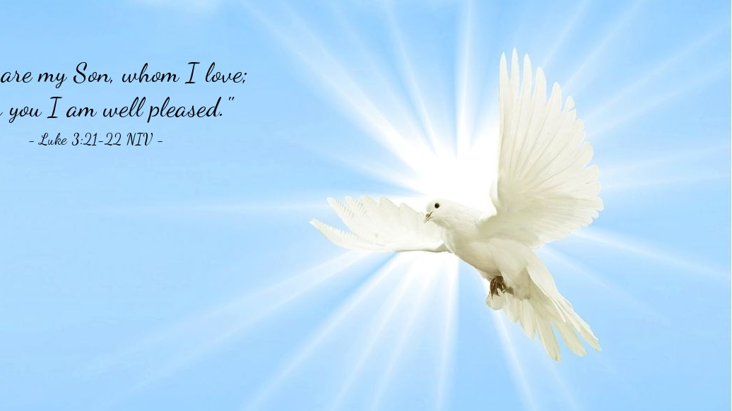
The Peace of Christ.
Sharing the Peace:
Response:
And also with you.
..
Notes:
Hymn Title Page

Slide 10
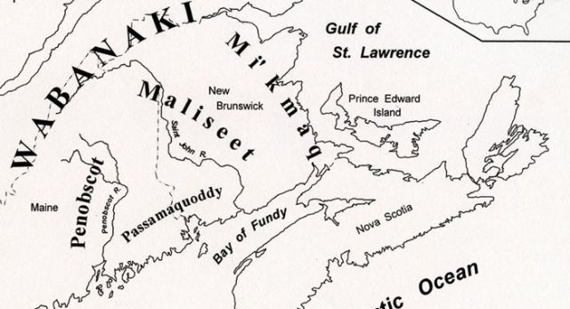
Acknowledging the Territories

Slide 11
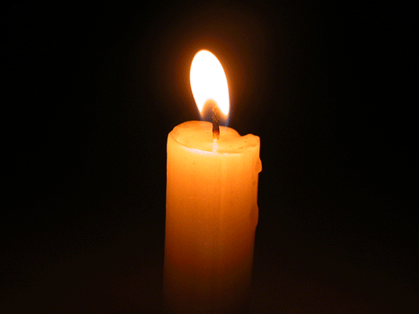
Lighting of the Christ Candle
“Do not press me to leave you, to turn back from following you! Where you go, I will go; where you lodge, I will lodge; your people shall be my people and your God my God. Where you die, I will die, and there will I be buried. May the Lord do thus to me, and more as well, if even death parts me from you!” - Ruth 1: 16-17

Slide 12
Call to Worship:
One: Make a joyful noise to God, all the earth;
All: We will sing to the glory of God with resounding praise.
One: Say to God, "How awesome are your deeds!”

Slide 13
All: God has turned our mourning
into dancing and clothed us with
joy.
One: Let all the earth worship God
and sing praises to God’s holy name.
All: O Lord, our God, we will give
thanks to you forever.
One: Come, let us worship God.

Slide 14
Hymn: TLUS #30 We’re the Light of all the World vs 1 & 4
Words and Music: David Kai 2017 Reprinted under OneLicense A-725110

Slide 15
We’re the light of all the world, we are a city on the hill,
We’re a candle on a stand proclaiming light.
We will not hide our lamp beneath a bushel anymore
We will shine a ray of hope that’s burning bright.

Slide 16
We are a rainbow,
sign of covenant and peace
For the flood of tears will fin’lly cease to be.
Come shine your rainbow, splash your hues across the sky,
Paint the world in colours proud and bold and free.

Slide 17
When we face the storms of life, we will never be alone
For our God will be with us on the way.
Here we are, side by side, we won’t be frightened anymore,
As the mourning night of tears breaks into day.

Slide 18
We are a rainbow,
sign of covenant and peace
For the flood of tears will fin’lly cease to be.
Come shine your rainbow, splash your hues across the sky,
Paint the world in colours proud and bold and free. *

Slide 19
Gathering Prayer
God of mourning and of dancing,
we come into your presence to
find new inspiration within our
scriptures. Give us eyes to see
strangers as friends. Give us ears
to hear new voices. Give us minds
open to fresh perspectives.

Slide 20
Give us courage to let go of old
prejudices and judgments. Give
us understanding to be open to
new stories. Give us hearts made
whole by the power of your Spirit.
Amen.

Slide 21
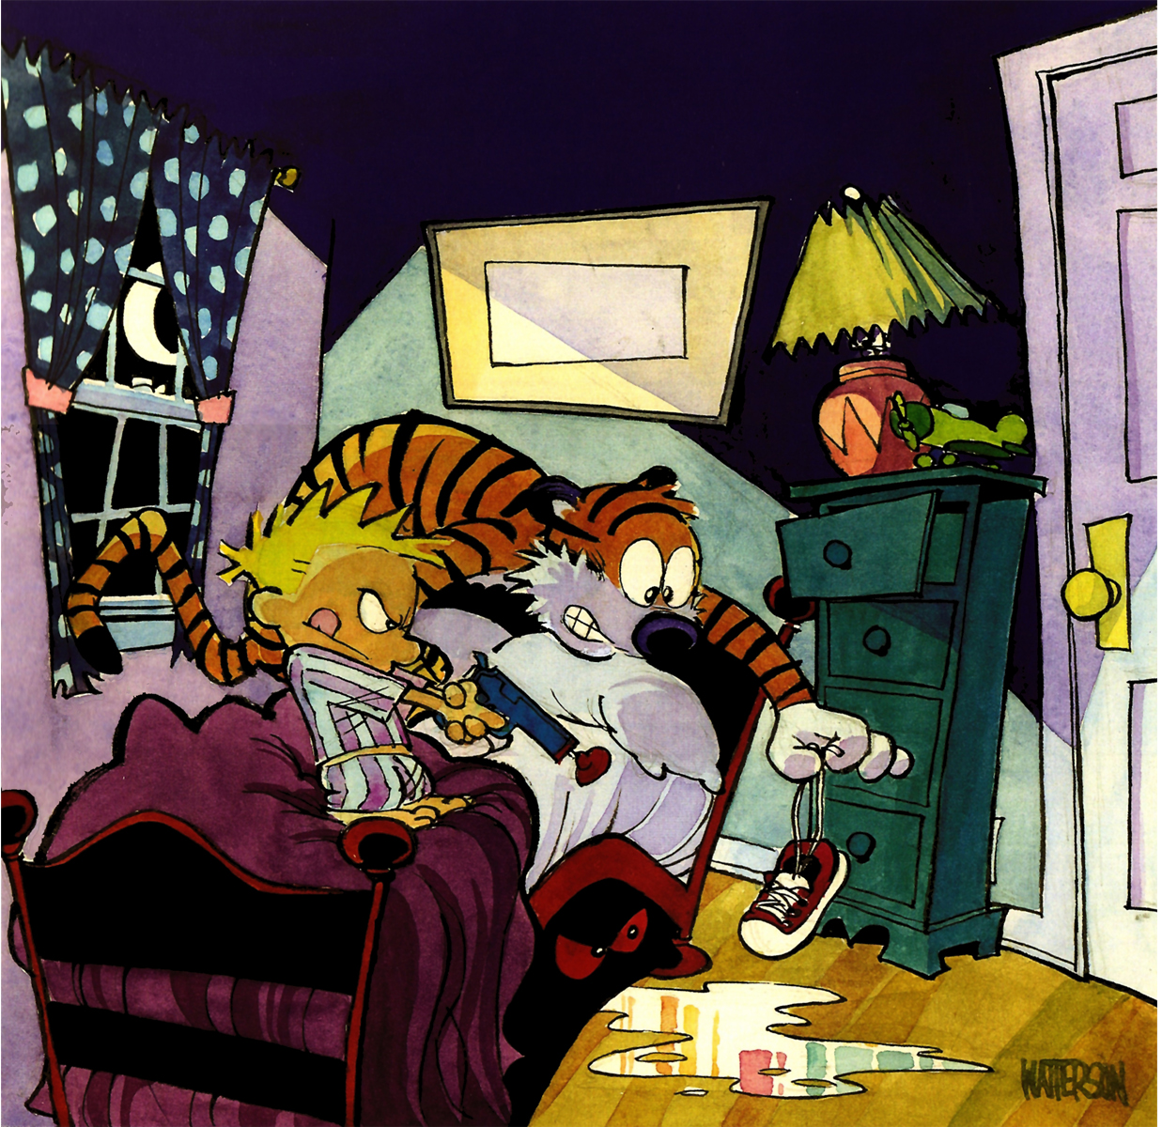
Monsters under the bed!

Slide 22
Ministry of Music:
TLUS #6
God Lights a Lamp

Slide 23

Prayer for Illumination

Slide 24
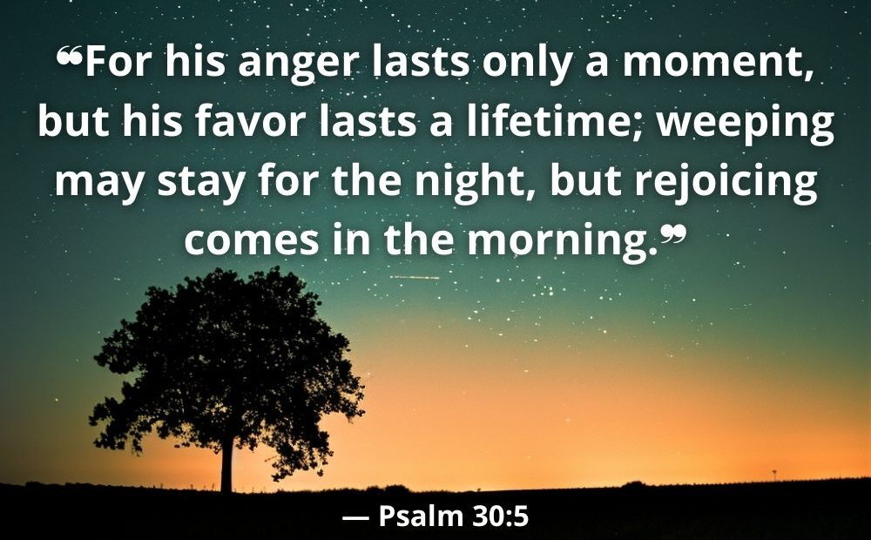
Psalm 30

Slide 25
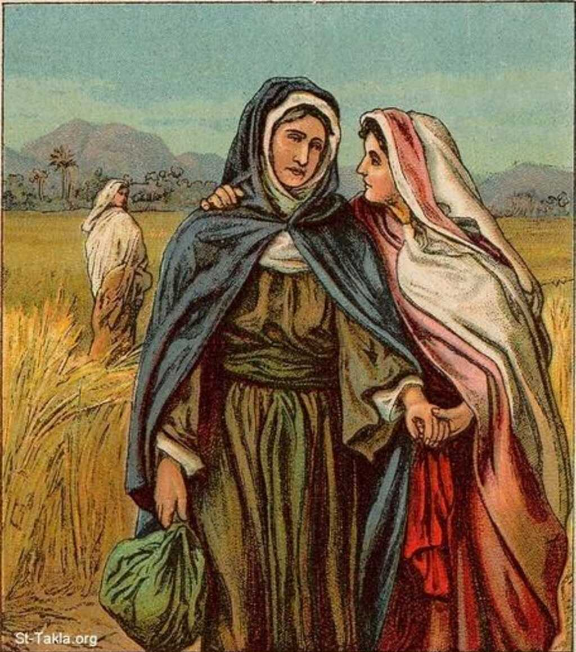
Ruth 1: 2b-18

Slide 26
Ministry of Music:
Shoes!

Slide 27
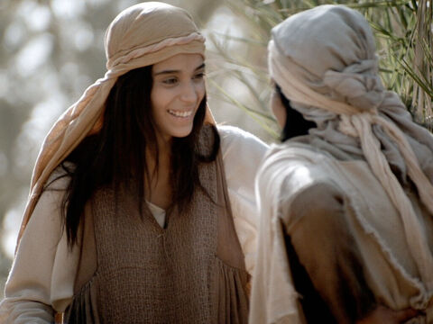
Which way you going
Naomi? Can I go too?

Slide 28
Hymn: TLUS #35 Bless The Lord, O My Soul
Words & Music Jonas Myrin and Matt Redman Reprinted under OneLicense A725110

Slide 29
Bless the Lord, O my soul, O my soul,
Worship your holy name.
Sing like never before, O my soul.
I'll worship your holy name.

Slide 30
The sun comes up,
it's a new day dawning;
It's time to sing your song again.
Whatever may pass, and whatever lies before me,
Let me be singing when the evening comes.

Slide 31
You're rich in love and you're slow to anger.
Your name is great and your heart is kind.
For all your goodness I will keep on singing;
Ten thousand reasons for my heart to find.

Slide 32
Bless the Lord, O my soul, O my soul,
Worship your holy name.
Sing like never before, O my soul.
I'll worship your holy name.

Slide 33
And on that day when my strength is failing,
The end draws near, and my time has come.
Still my soul will sing your praise unending
Ten thousand years and then forevermore!

Slide 34
Bless the Lord, O my soul, O my soul,
Worship your holy name.
Sing like never before, O my soul.
I'll worship your holy name.
Worship your holy name,
Worship your holy name.

Slide 35
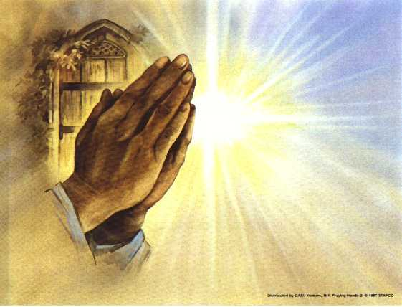
Prayers of
the People
One: God of all the earth,
All: Teach us to
live in love.

Slide 36
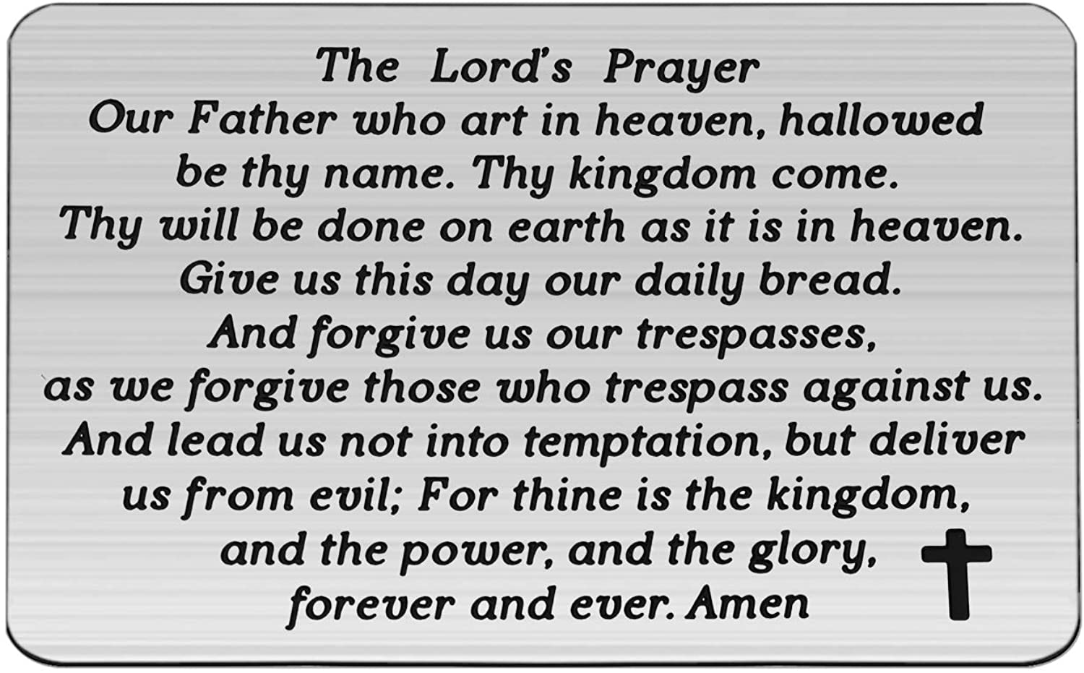

Slide 37

Dedication for Then Let Us Sing Hymnbooks:
Prayer:
Presentation of the
gifts:

Slide 38
Words of Dedication:
One: In the name of the holy and triune God: Creator, Christ, and Spirit,
All: We dedicate these
hymnbooks to the glory of God.
One: With gratitude and reverence,
All: We dedicate these
hymnbooks to the glory of God.

Slide 39
One: For the worship and singing out God’s glory,
All: We dedicate these
hymnbooks to the glory of God.
One: In remembrance of Frank and
Bev Folkins,
All: We dedicate these
hymnbooks to the glory of God.

Slide 40
One: Let us pray…
All: God you are the Singer and
the Song; you call us to enter
your gates with thanksgiving, to
make a joyful noise in praise of
you. Bless the use of these hymn
books we dedicate today.

Slide 41
May we sing psalms and hymns
with heart and soul and voice all
our lives, and in the life of perfect
praise yet to come.
Amen.

Slide 42
Support the ministry of St. Paul’s :
Through PAR – ask us how to join
via Canada Helps
search for St. Paul’s Sussex
via e-transfer to treasurerstpaulsucc1@gmail.com.
drop in collection plates located in the Narthex and near exit door
by mail to
4 Morrison Avenue, Sussex, N.B. E4E 1P5
during office hours
Notes:
Body text for hymns and prayers

Slide 43
Prayer of Dedication
Generous God, you have blessed
our lives with gifts, both visible
and invisible. We offer our gifts in
gratitude, to build up your love in
the world around us. Bless all that
we give to make a difference in
the lives of others. Amen.

Slide 44
Hymn: TLUS #54
I Know That Ev’ry Time I Pray 3x
(refrain only)
Words & Music Judith Snowdon ©2004 Used by permission Reprinted under OneLicense A725110

Slide 45
I know that ev’ry time I pray,
It shines a light along the way.
It makes the night as bright as day,
And ev’ry where I go is home.

Slide 46
And ev’ry time I call the Name,
It brings me joy, where there was pain.
I know my life’s not lived in vain;
I’m not alone.

Slide 47
I know that ev’ry time I pray,
It shines a light along the way.
It makes the night as bright as day,
And ev’ry where I go is home.

Slide 48
And ev’ry time I call the Name,
It brings me joy, where there was pain.
I know my life’s not lived in vain;
I’m not alone.

Slide 49
I know that ev’ry time I pray,
It shines a light along the way.
It makes the night as bright as day,
And ev’ry where I go is home.

Slide 50
And ev’ry time I call the Name,
It brings me joy, where there was pain.
I know my life’s not lived in vain;
I’m not alone. *

Slide 51
Benediction
&
Commissioning

Slide 52
Sung Benediction:
TLUS# 104
May The Peace of Christ
Words & Music Izumi Shiota reprinted under OneLicense A-725110

Slide 53
May the peace of Christ be with you,
May the love of God dwell deep in your heart.
May the Spirit enlighten your way,
May your walk in the comfort of God’s care.

