Slide 1

Easter Sunday
St. Paul’s United Church Sussex, NB
June 1st, 2025
Seventh Sunday of Easter
Welcome

Slide 2
Welcome!
We’re so glad you could join us

Slide 3
Forced to flee
Thursday June 5, 7-8pm in the board room. Learn about the experience of people forced to leave their home. Hosted by Canadian Foodgrains Bank: contact Wendy Anderson or Al.

Slide 4
Creative ideas
There is a box in the entryway where, if you have a creative suggestion, you can put it in the box for review.

Slide 5
It’s a party!!!
Tuesday at 10am.
Communion set cleaning and Anniversary Service Prep Party!! All welcome.
Are you excited!!? Wooo?

Slide 6
It’s a party!!! Part 2a
The 100th Anniversary of the United Church of Canada is being celebrated on June 8th. We will be joined by multiple congregations so join us after the service for a social time.

Slide 7
It’s a party!!! Part 2b
If you can bring sweets or sandwiches to the affair next Sunday, please indicate so on the sheet in the narthex.

Slide 8
Meetings
The board meets at 6:30 on Tuesday, June 3

Slide 9
Meetings
Notwithstanding the premature invitation last week, The Circle of Friendship will meet at St. Paul's Thursday at 11:15 and carpool to The Ridge this week.

Slide 10
Grad Sunday
June 15. Please let us know if you have a family member graduating from high school, college or university. Let Lisa or the office know.

Slide 11


Slide 12
UCC 100th anniversary is next week!!
Now the final Fun Fact(s)

Slide 13
Good News!

Slide 14

Prelude:
Paul Baloche CCLI

Slide 15
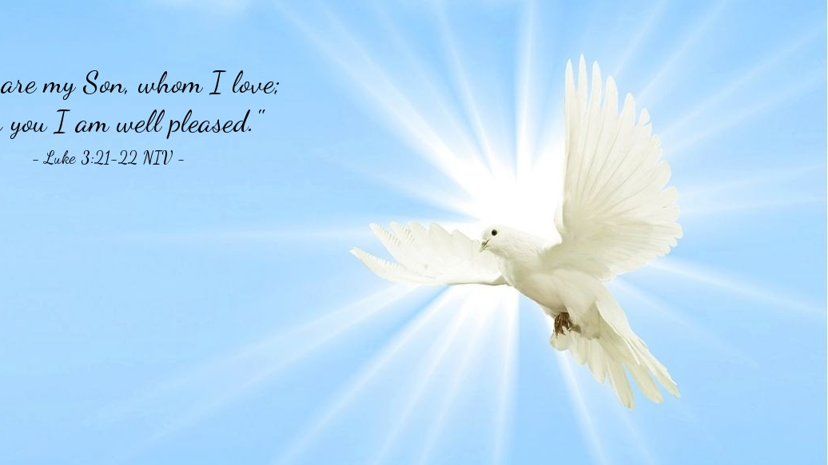
The Peace of Christ.
Sharing the Peace:
Response:
And also with you.
..
Notes:
Hymn Title Page

Slide 16
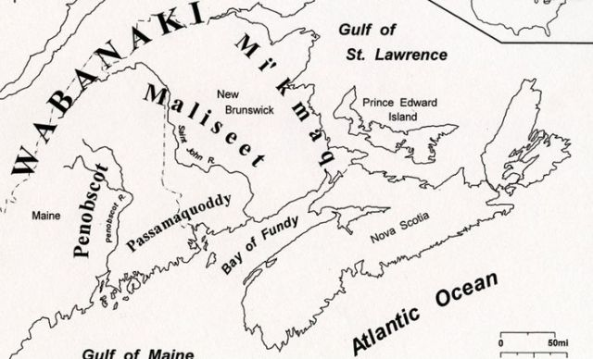
Acknowledging the Territories

Slide 17
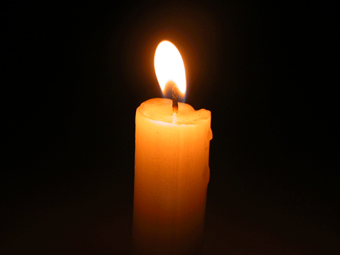
Lighting of the Christ Candle
“Never be afraid to trust an unknown future to a known God.” - Corrie Ten Boon

Slide 18
Call to Worship
One: We gather today from many different places.
All: But God we are one in you.
One: We gather from many different ways of living.
All: But God we are one in you.

Slide 19
One: We have many different hopes and beliefs.
All: But God we are one in you.
One: We have many different gifts and talents.
All: But God we are one in you.

Slide 20
One: We sometimes question an unknown future.
All: But we believe in the Known God.

Slide 21
Hymn Sing: MV #28 God of the Bible
vs 1,2,4,5
Words: Shirley Murray Music: Tony Alonso Reprinted under OneLicense A-725110

Slide 22
God of the Bible,
God in the Gospel,
Hope seen in Jesus,
hope yet to come,
You are our centre,
daylight or darkness,
Freedom or prison,
you are our home.
1

Slide 23
Fresh as the morning,
sure as the sunrise,
God always faithful,
you do not change.
Fresh as the morning,
sure as the sunrise,
God always faithful,
you do not change.

Slide 24
God in our struggles,
God in our hunger,
Suffering with us,
taking our part,
Still you empow’r us,
mothering Spirit,
Feeding, sustaining,
from your own heart.

Slide 25
Fresh as the morning,
sure as the sunrise,
God always faithful,
you do not change.
Fresh as the morning,
sure as the sunrise,
God always faithful,
you do not change.

Slide 26
Not by your finger,
not by your anger
Will our world order,
change in a day,
But by your people,
fearless and faithful,
Small paper lanterns,
lighting the way.

Slide 27
Fresh as the morning,
sure as the sunrise,
God always faithful,
you do not change.
Fresh as the morning,
sure as the sunrise,
God always faithful,
you do not change.

Slide 28
Hope we must carry,
shining and certain
Through all our turmoil,
terror and loss,
Bonding us gladly
one to the other,
Till our world changes
facing the Cross.

Slide 29
Fresh as the morning,
sure as the sunrise,
God always faithful,
you do not change.
Fresh as the morning,
sure as the sunrise,
God always faithful,
you do not change. *

Slide 30
Gathering Prayer
Loving God, we gather today with
hearts filled with concern for the
world around us. We pray for
peace amidst conflict, for healing
in the face of suffering, and for
justice in the face of injustice.

Slide 31
We ask for your guidance as we
strive to make a positive impact
in our communities and beyond.
May your love and wisdom
illuminate our paths and
empower us to Change the World.
Amen.

Slide 32

Try a Little Kindness

Slide 33
Hymn:
Try A Little Kindness
Words and Music Steve Bell reprinted under OneLicense A-725110

Slide 34
If you see your brother
standing by the road
With a heavy load,
from the seeds he’s sowed.
And if you see your sister
falling by the way
Just stop and say,
you’re goin’ the wrong way.

Slide 35
You’ve got to try a little kindness,
Show a little kindness.
Just shine your light
for everyone to see.
And if you try a little kindness
Then you’ll overlook the blindness
Of narrow minded people
on their narrow minded streets.

Slide 36
Don’t walk around
the down and out
Lend a helping hand
Instead of doubt.
And the kindness that you show ev’ry day
Will help someone
along their way.

Slide 37
You’ve got to try a little kindness,
Show a little kindness.
Just shine your light
for everyone to see.
And if you try a little kindness
Then you’ll overlook the blindness
Of narrow minded people
on their narrow minded streets.

Slide 38
You’ve got to try a little kindness,
Show a little kindness.
Just shine your light
for everyone to see.
And if you try a little kindness
Then you’ll overlook the blindness
Of narrow minded people
on their narrow minded streets. *

Slide 39

Prayer for Illumination

Slide 40
Proverbs 16: 21-24:
The wise of heart is called perceptive,
and pleasant speech increases
persuasiveness. Wisdom is a fountain
of life to one who has it, but folly is
the punishment of fools. The mind of
the wise makes their speech judicious
and adds persuasiveness to their lips.

Slide 41
Pleasant words are like a honeycomb,
sweetness to the soul and health to
the body.

Slide 42
1 Corinthians 9: 6 -15
Or is it only Barnabas and I who have
no right to refrain from working for a
living? Who at any time pays the
expenses for doing military service?
Who plants a vineyard and does not
eat any of its fruit? Or who tends a
flock and does not get any of its milk?

Slide 43
Do I say this on human authority?
Does not the law also say the same?
For it is written in the law of Moses,
“You shall not muzzle an ox while it is
treading out the grain.” Is it for oxen
that God is concerned? Or does he not
speak entirely for our sake?

Slide 44
It was indeed written for our sake, for
whoever plows should plow in hope
and whoever threshes should thresh in
hope of a share in the crop. If we
have sown spiritual things among you,
is it too much if we harvest material
things? If others share this rightful
claim on you, do not we still more?

Slide 45
Nevertheless, we have not made use
of this right, but we endure anything
rather than put an obstacle in the way
of the gospel of Christ. Do you not
know that those who work in the
temple service get their food from the
temple

Slide 46
and those who serve at the altar share
in what is sacrificed on the altar? In
the same way, the Lord commanded
that those who proclaim the gospel
should get their living by the gospel.
But I have made no use of any of
these rights, nor am I writing this so
that they may be applied in my case.

Slide 47
Indeed, I would rather die than that
no one will deprive me of my ground
for boasting!

Slide 48
John 9: 1-7, 32, 34
As he walked along, he saw a man
blind from birth. His disciples asked
him, “Rabbi, who sinned, this man or
his parents, that he was born blind?”
Jesus answered, “Neither this man nor
his parents sinned;

Slide 49
he was born blind so that God’s works
might be revealed in him. We must
work the works of him who sent me
while it is day; night is coming, when
no one can work. As long as I am in
the world, I am the light of the world.”

Slide 50
When he had said this, he spat on the
ground and made mud with the saliva
and spread the mud on the man’s
eyes, saying to him, “Go, wash in the
pool of Siloam” (which means Sent).
Then he went and washed and came
back able to see.

Slide 51
Never since the world began has it
been heard that anyone opened the
eyes of a person born blind. They
answered him, “You were born entirely
in sins, and are you trying to teach
us?” And they drove him out.

Slide 52
Ministry of Music:
Hallelujah
(Leonard Cohen)

Slide 53

Let’s Save the World

Slide 54
Hymn: MV #46 Bless The Lord
Words & music: Dan Brennan reprinted under OneLicense A725110

Slide 55
Bless the Lord, O my soul
Bless God’s holy name.
Bless the Lord, O my soul
Bless God’s holy name.

Slide 56
Remember
the kindness of our God,
Who showers us
with blessing all our days.

Slide 57
Bless the Lord, O my soul
Bless God’s holy name.
Bless the Lord, O my soul
Bless God’s holy name.

Slide 58
Remember
the justice of our God,
Who stands with those
forgotten and confused.

Slide 59
Bless the Lord, O my soul
Bless God’s holy name.
Bless the Lord, O my soul
Bless God’s holy name.

Slide 60
Remember
the healing love of God,
Who calls us to be
whole and to be free.

Slide 61
Bless the Lord, O my soul
Bless God’s holy name.
Bless the Lord, O my soul
Bless God’s holy name. *

Slide 62
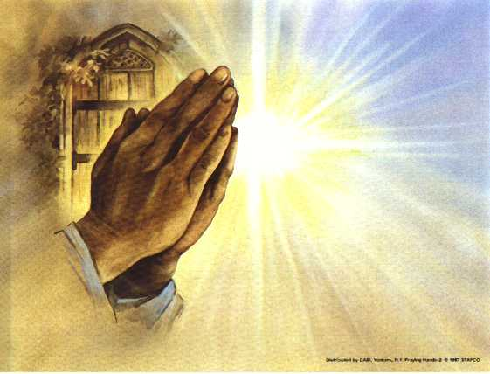
Prayers of the People

Slide 63
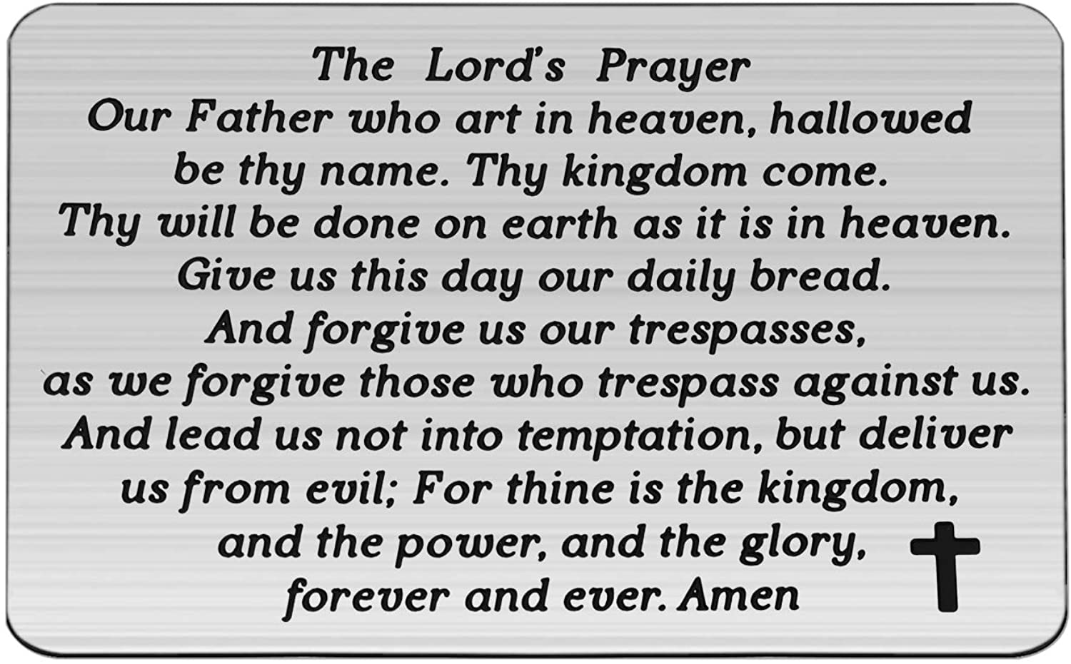

Slide 64
Support the ministry of St. Paul’s :
Through PAR – ask us how to join
via Canada Helps
search for St. Paul’s Sussex
via e-transfer to treasurerstpaulsucc1@gmail.com.
drop in collection plates located in the Narthex and near exit door
by mail to
4 Morrison Avenue, Sussex, N.B. E4E 1P5
during office hours
Notes:
Body text for hymns and prayers

Slide 65
Prayer of Dedication
Heavenly Father, you have given
us riches beyond measure. We
appreciate everything that you
have provided; but we ask, Lord,

Slide 66
that you will bless our offerings of
today and tomorrows and
encourage us to pass on our gifts
to others. Amen.

Slide 67
Hymn: MV #145
Draw the Circle Wide
Words & Music: Gordon Light reprinted under OneLicense 725110

Slide 68
Draw the circle wide.
Draw it wider still.
Let this be our song,
No one stands alone,
Standing side by side,
Draw the circle wide.

Slide 69
God the still point of the circle.
'Round whom all creation turns;
Nothing lost, but held forever,
In God's gracious arms.

Slide 70
Draw the circle wide.
Draw it wider still.
Let this be our song,
No one stands alone,
Standing side by side,
Draw the circle wide.

Slide 71
Let our hearts touch far horizons,
So encompass great and small;
Let our loving know no borders,
Faithful to God's call.

Slide 72
Draw the circle wide.
Draw it wider still.
Let this be our song,
No one stands alone,
Standing side by side,
Draw the circle wide.

Slide 73
Let the dreams we dream be larger
Than we've ever dreamed before;
Let the dream of Christ be in us,
Open every door.

Slide 74
Draw the circle wide.
Draw it wider still.
Let this be our song,
No one stands alone,
Standing side by side,
Draw the circle wide. *

Slide 75
Benediction
&
Commission

Slide 76
Sung Benediction:
MV #32 Hallelujah 2x
Words: Trad. Music: Julian Pattison 2003 reprinted under OneLicense 725110

Slide 77
Halle, hallelujah,
halle, hallelu,
Halle, hallelujah,
Ha-le-lu-jah!

Slide 78
Halle, hallelujah,
halle, hallelu,
Halle, hallelujah,
Ha-le-lu-jah! *

