Slide 1

St. Paul’s United Church
Sussex, NB
June 15th, 2025
Trinity Sunday
Grad Sunday
Father’s Day

Slide 2
Welcome!
We’re so glad you could join us

Slide 3
Social time
There will be cupcakes and lemonade after the service on the lawn as we congratulate our grads for 2025.

Slide 4
Meeting
M&P will meet at noon on Wednesday, June 18 at noon

Slide 5
Come help us celebrate the
of the
Kings Kirk United Church
June 22, 2025 at 10:00 am
Music with Kings Khoral, some history,
lunch to follow with Ice Cream Sundaes

Slide 6
VBS Road trip!
Vacation Bible School
June 23-26 Nine to noon.
35 spaces, registration forms on the table in the entry or from the office.

Slide 7
Baby Bottles
If you took a baby bottle to put change in for the Sussex Pregnancy and New Parents Center, they are due back. Please return to the office by Thursday morning. Thanks.

Slide 8
It’s Survey Sunday
Please answer a simple survey. Do you want the scripture to be printed on the screen while read? Yes or No. Please answer on the white board in the narthex.

Slide 9
Next Sunday
June 22 service: Confirmation and joining the church with cake afterwards!
Because Cake!!!

Slide 10
The summer of women begins june 29th
The stories of women in the bible will start on June 29th. The first one is Samantha.

Slide 11
Good News!

Slide 12

Prelude:
Holy Holy Holy
Paul Baloche CCLI

Slide 13
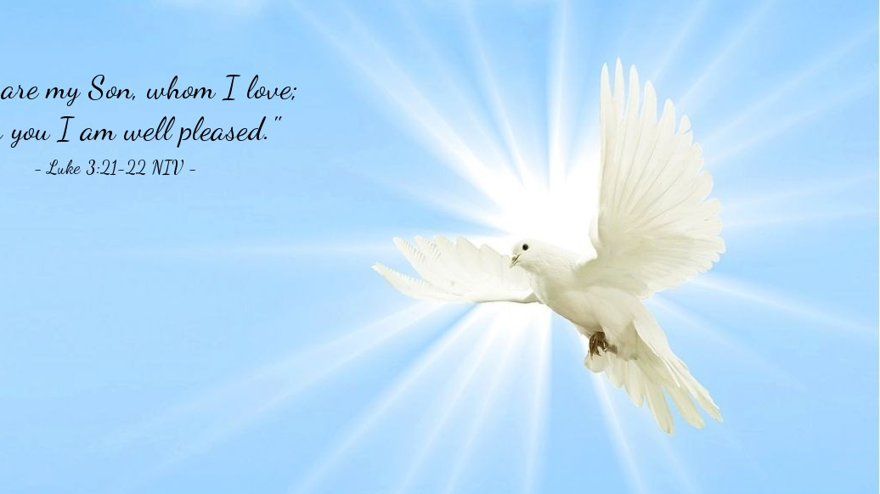
The Peace of Christ.
Sharing the Peace:
Response:
And also with you.
..
Notes:
Hymn Title Page

Slide 14
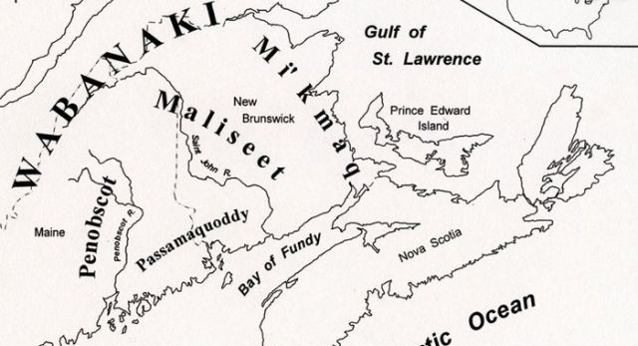
Acknowledging the Territories

Slide 15
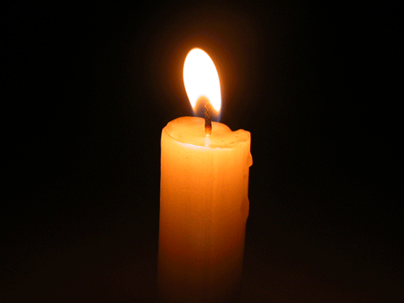
Lighting of the Christ Candle
“When I despair, I remember that all through history the way of truth and love have always won. There have been tyrants and murderers, and for a time, they can seem invincible, but in the end, they always fall. Think of it–always.” ― Mahatma Gandhi

Slide 16
Call to Worship:
One: Trinity of love, Creator,
Redeemer and Sustainer, Holy God,
Three Yet One,
All: We worship you in spirit and in truth.
One: God our maker, Jesus our
redeemer, Spirit our comforter,

Slide 17
All: We worship you in spirit and in truth.
One: Way of all being, truth of all
knowing, life of all things
All: We worship you in spirit and in truth.

Slide 18
Hymn: VU #401 Worship the Lord
vs 1,2&5
Words: Fred Kaan, Music: Ron Klusmeier ©1977 reprinted under OneLicense A725110

Slide 19
Worship the Lord
(worship the Lord)
Worship the Father,
the Spirit, the Son,
Raising our hands
(raising our hands)
In devotion to God who is one!

Slide 20
Raising our hands
as a sign of rejoicing,
And with our lips our
togetherness voicing,
Giving ourselves to a life of creativeness,
Worship and work must be one!

Slide 21
Worship the Lord
(worship the Lord)
Worship the Father,
the Spirit, the Son,
Raising our hands
(raising our hands)
In devotion to God who is one!

Slide 22
Praying and training that we be a blessing,
And by our handiwork daily confessing:
We are committed to serving humanity,
Worship and work must be one!

Slide 23
Worship the Lord
(worship the Lord)
Worship the Father,
the Spirit, the Son,
Raising our hands
(raising our hands)
In devotion to God who is one!

Slide 24
Now in response
to the life you are giving,
Help us, O Father,
to offer our living,
Seeking a just and a healing society,
Worship and work must be one!

Slide 25
Worship the Lord
(worship the Lord)
Worship the Father,
the Spirit, the Son,
Raising our hands
(raising our hands)
In devotion to God who is one! *

Slide 26
Gathering Prayer

Slide 27

Graduation Advice

Slide 28
Introduction of the Graduates and Presentations:

Slide 29
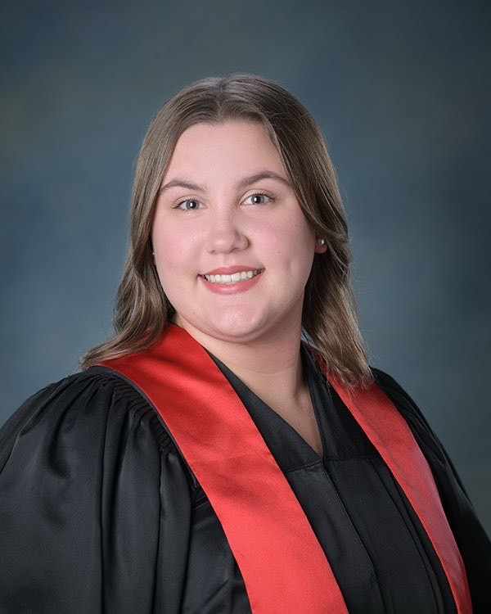
Abbie Alexander

Slide 30
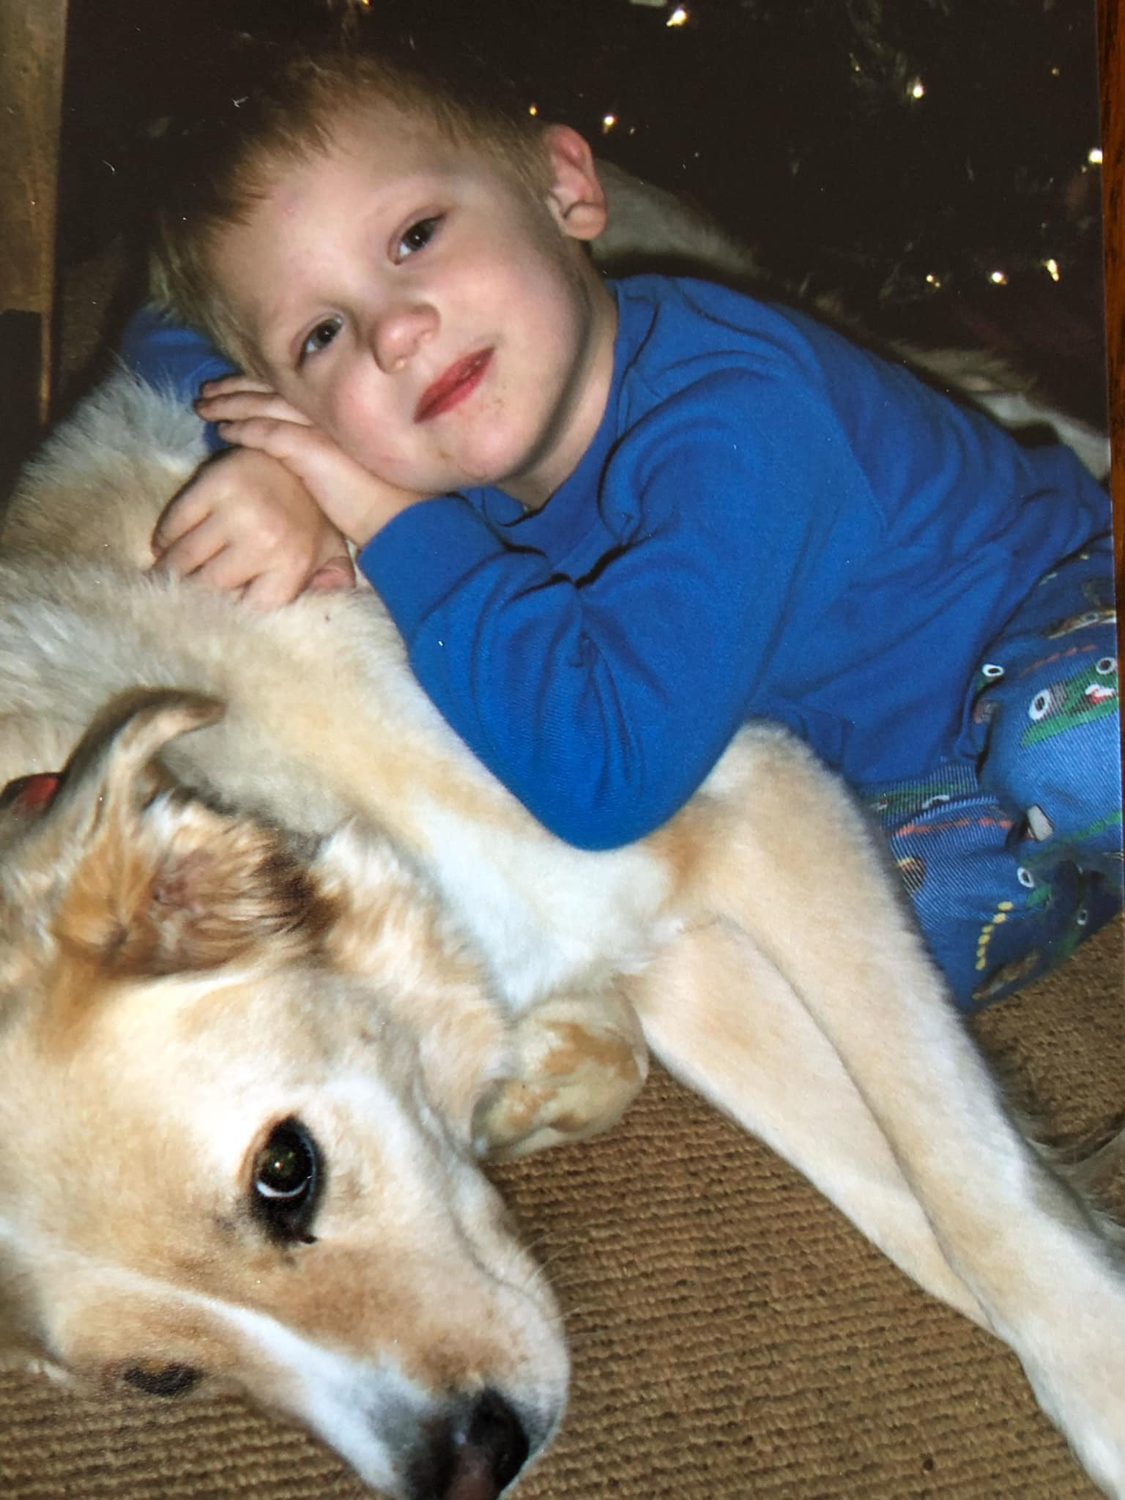
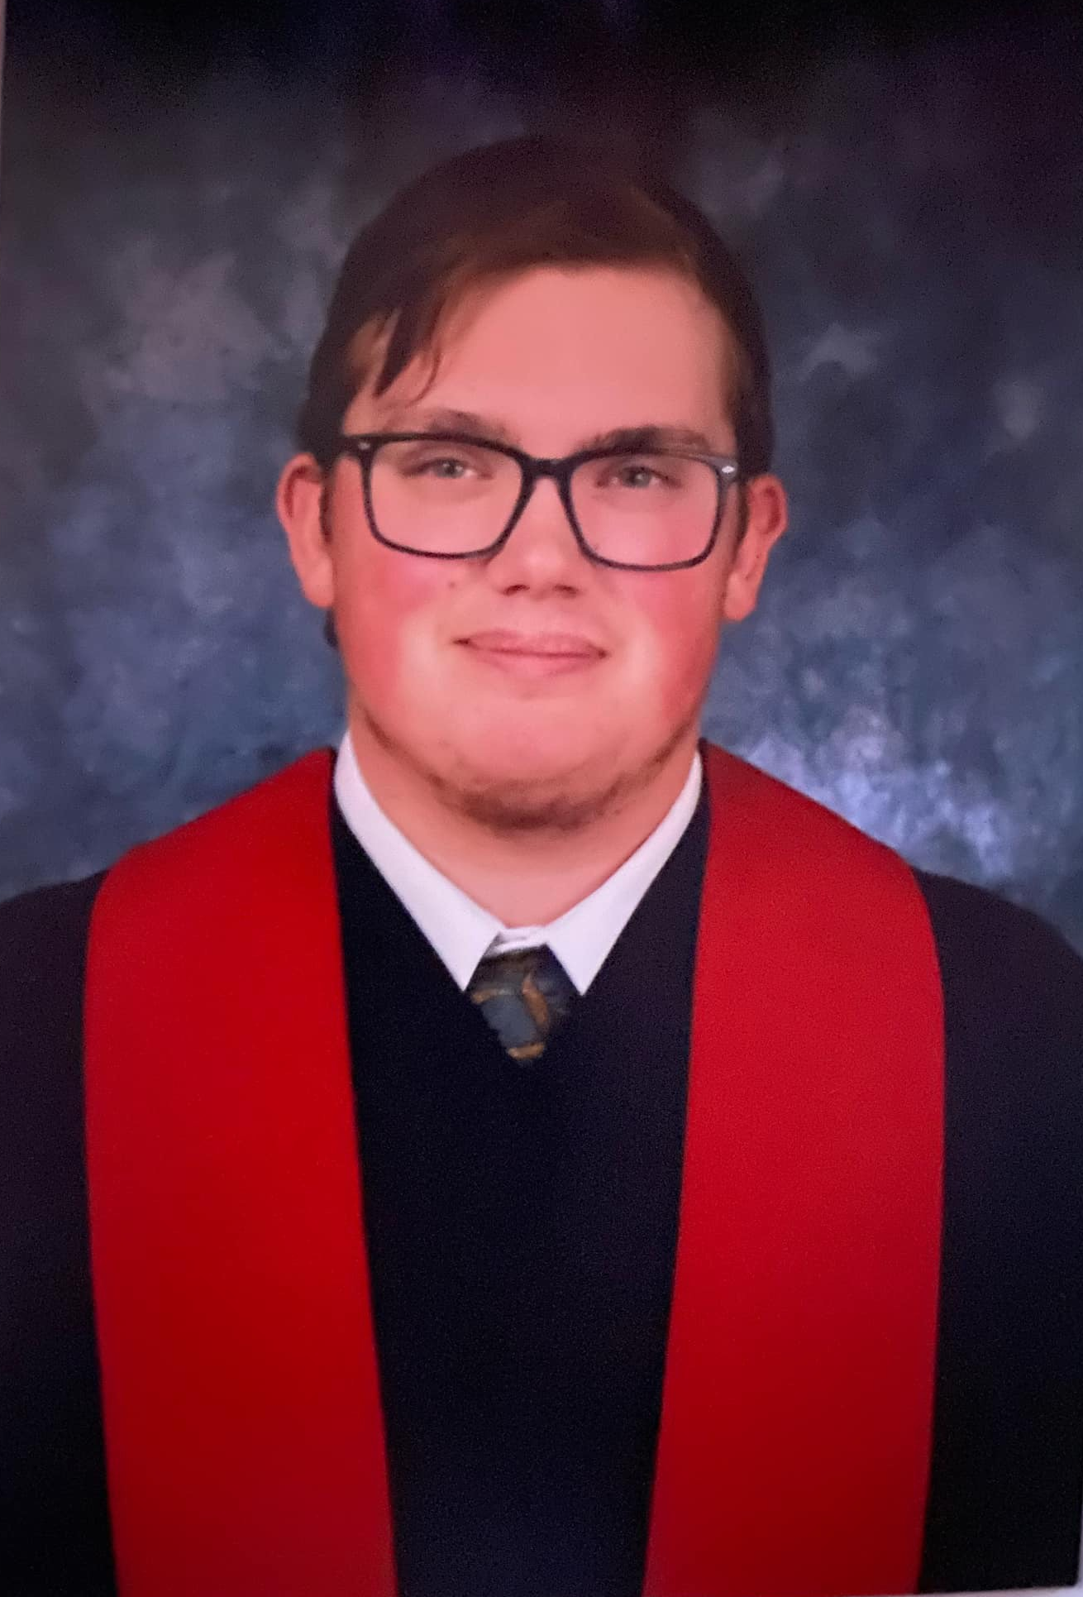
James Magee

Slide 31
Parker McLaughlin

Slide 32
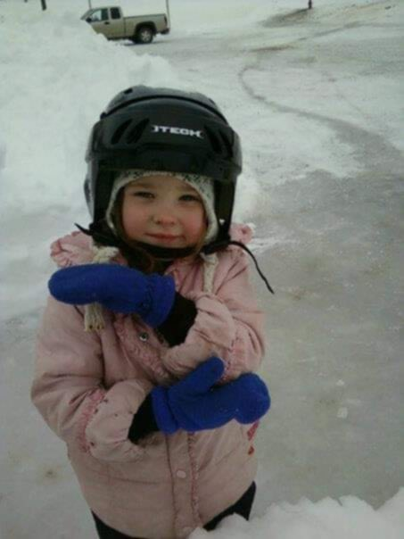
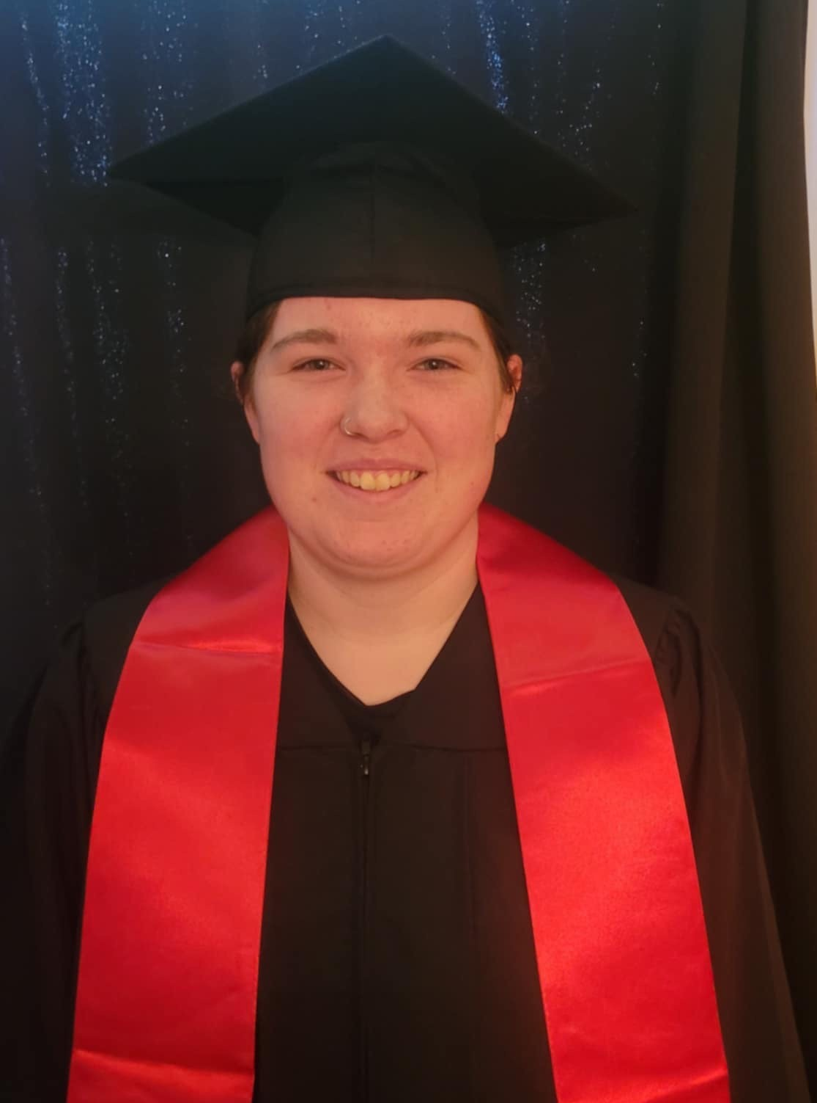
Rian McCullum

Slide 33
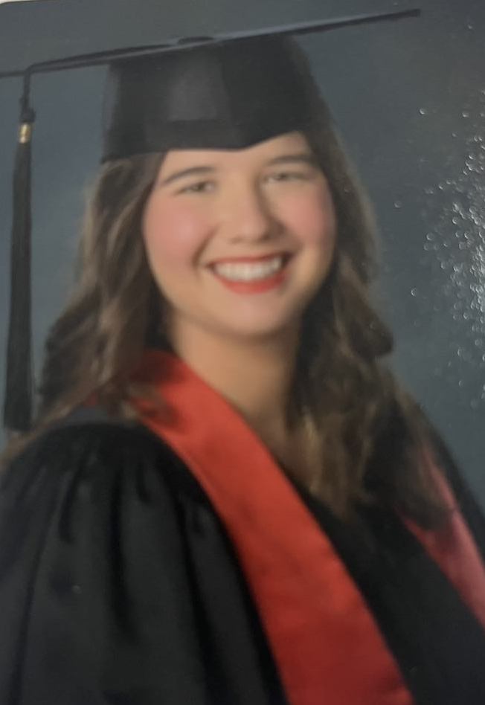
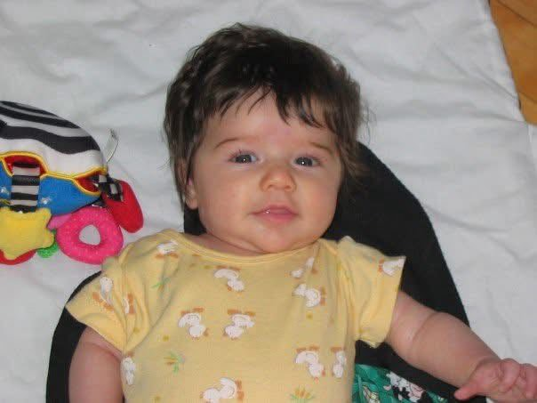
Katelyn
Sharp

Slide 34
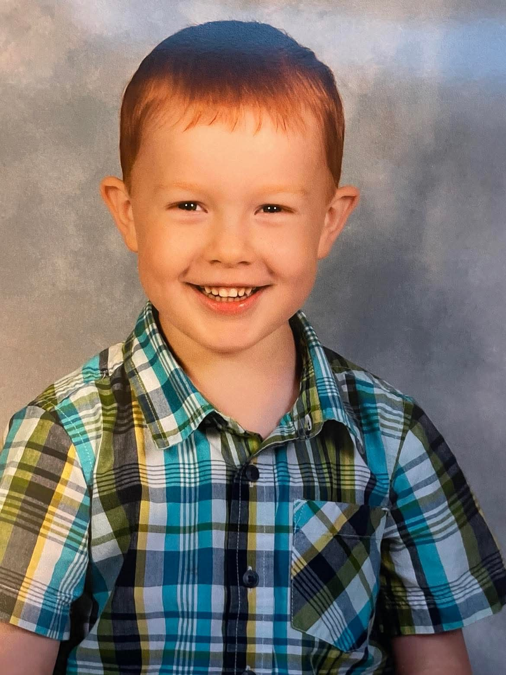
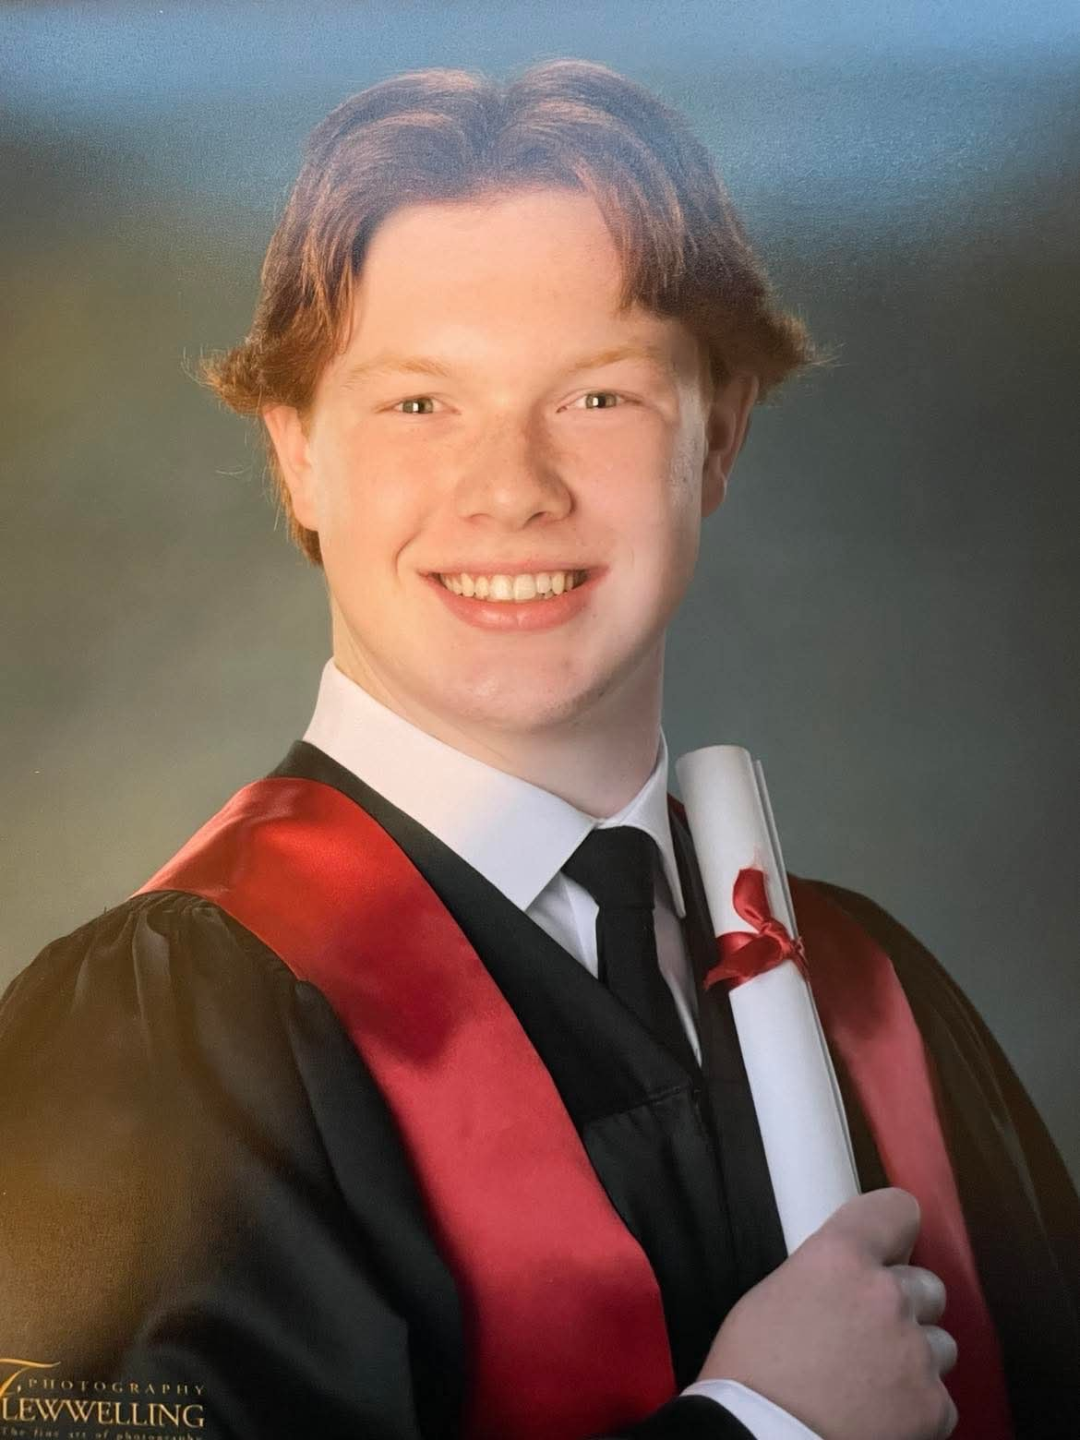
Nate Turner

Slide 35
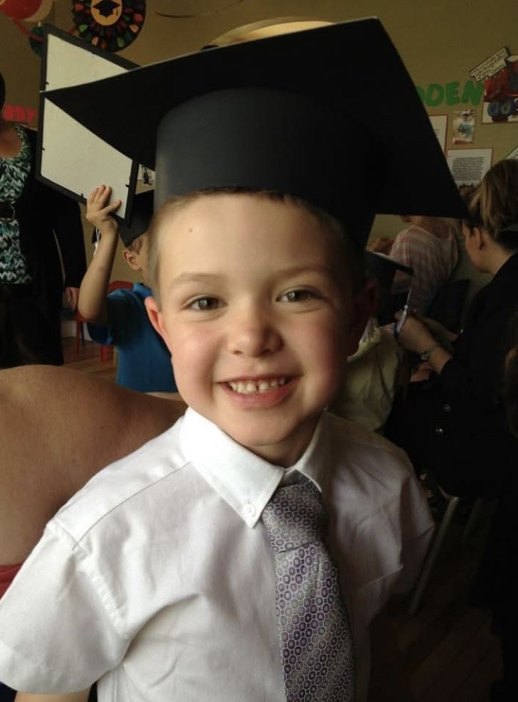
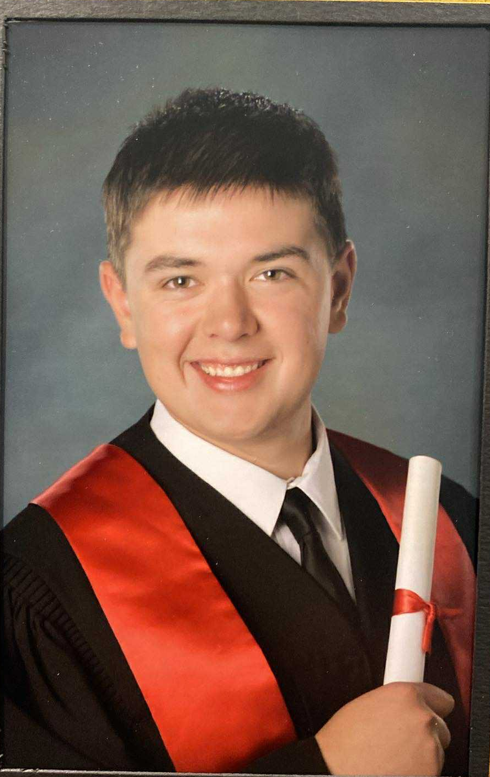
Bennett Warner

Slide 36
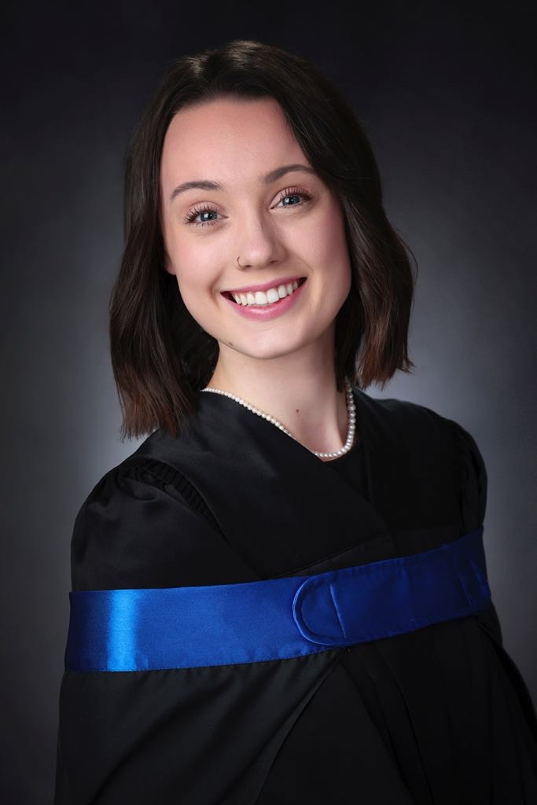
Lily Alexander

Slide 37
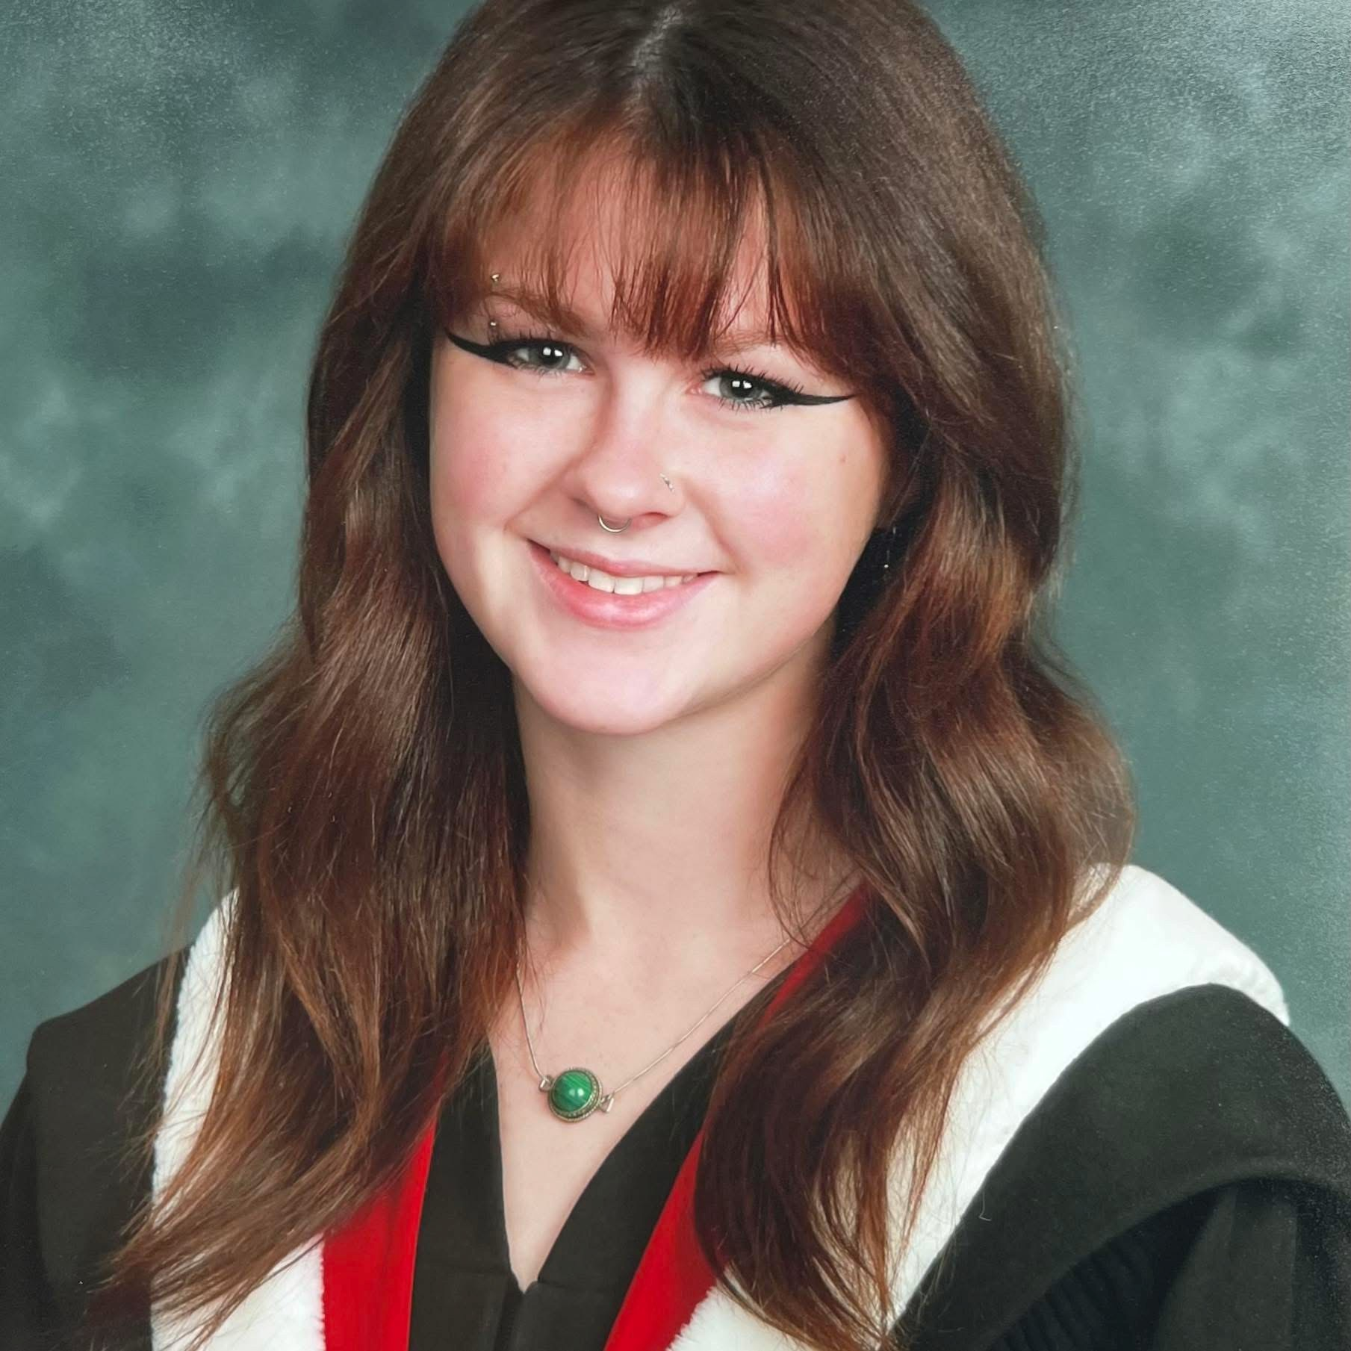
Maddison Mullin

Slide 38
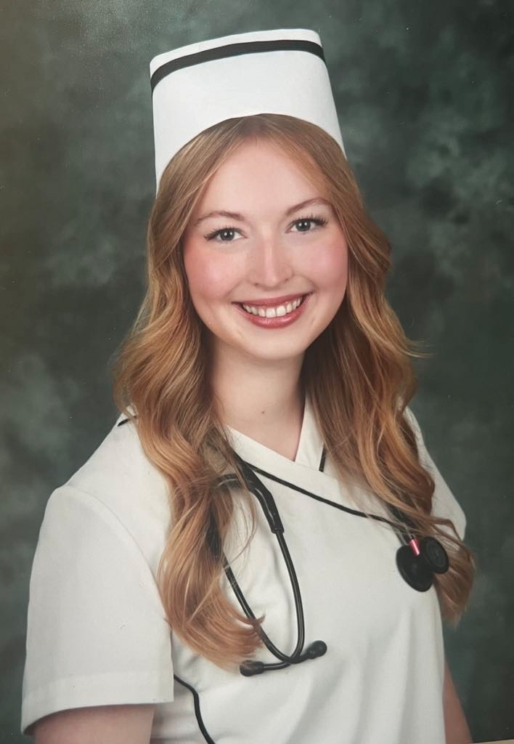
Kathleen Vail

Slide 39
Graduate Blessing

Slide 40
Hymn: MV #131
You Creator God, Have Searched Me
Words & Music George Mulrain Arr 2007 reprinted under OneLicense A-725110

Slide 41
You, Creator God,
have searched me
and you know my ways
You perfectly understand me;
it’s my cause of praise.

Slide 42
I cannot escape your presence
in air, land or sea.
Your arms of love and protection
are always with me.

Slide 43
You know me, O God,
you have made me,
I am proud I’m the work of your hand.
In my waking and sleeping moments,
With my being I will praise your name.

Slide 44
You created light and darkness
and you love them both.
You blessed the womb of my mother,
you brought me to birth.

Slide 45
In your image and your likeness,
wonderfully made.
I will lift my voice to praise you,
you are God indeed.

Slide 46
You know me, O God,
you have made me,
I am proud I’m the work of your hand.
In my waking and sleeping moments,
With my being I will praise your name. *

Slide 47

Prayer for Illumination

Slide 48
Proverbs 8:1-4, 22-31:
Does not wisdom call and understanding
raise her voice? On the heights, beside the
way, at the crossroads she takes her stand;
beside the gates in front of the town, at the
entrance of the portals she cries out: “To
you, O people, I call, and my cry is to all who live.

Slide 49
“The LORD created me at the beginning of
his work, the first of his acts of long ago.
Ages ago I was set up, at the first, before
the beginning of the earth. When there
were no depths I was brought forth, when
there were no springs abounding with
water. Before the mountains had been
shaped, before the hills, I was brought
forth,

Slide 50
when he had not yet made earth and fields
or the world’s first bits of soil. When he
established the heavens, I was there; when
he drew a circle on the face of the deep,
when he made firm the skies above, when
he established the fountains of the deep,
when he assigned to the sea its limit, so
that the waters might not transgress his
command,

Slide 51
when he marked out the foundations of the
earth, then I was beside him, like a master
worker, and I was daily his delight, playing
before him always, playing in his inhabited
world and delighting in the human race.

Slide 52
John 16:12-15 :
“I still have many things to say to you, but
you cannot bear them now. When the Spirit
of truth comes, he will guide you into all
the truth, for he will not speak on his own
but will speak whatever he hears, and he
will declare to you the things that are to
come.

Slide 53
He will glorify me because he will take what
is mine and declare it to you. All that the
Father has is mine. For this reason I said
that he will take what is mine and declare it
to you.

Slide 54
Ministry of Music:
The Play of The Godhead

Slide 55
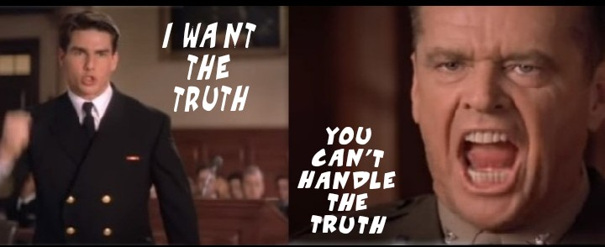
What is Truth?

Slide 56
Hymn: God is the One Whom We Seek Together
Words & Music George Mulrain Arr 2007 reprinted under OneLicense A-725110

Slide 57
God is the One
Whom we seek together,
God is the Life
Which is part of us all.
God is the Truth
And the mark of mystery,
God is the Love and the Joy
That makes us whole.

Slide 58
Freedom is the pathway
For each and all to see;
You are my companions
Who walk the Way with me.

Slide 59
God is the One
Whom we seek together,
God is the Life
Which is part of us all.
God is the Truth
And the mark of mystery,
God is the Love and the Joy
That makes us whole.

Slide 60
God is the One
Whom we seek together,
God is the Life
Which is part of us all.
God is the Truth
And the mark of mystery,
God is the Love and the Joy
That makes us whole. *

Slide 61
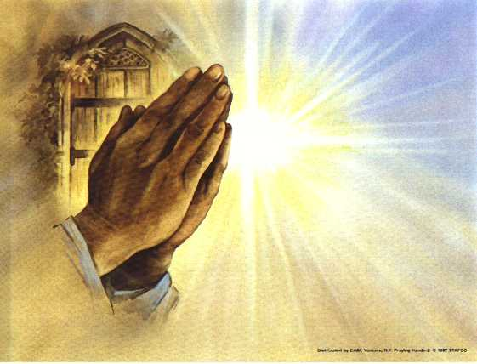
Prayers of
the People
One: God in Your grace and mercy,
All: hear our prayers for all Your children –

Slide 62
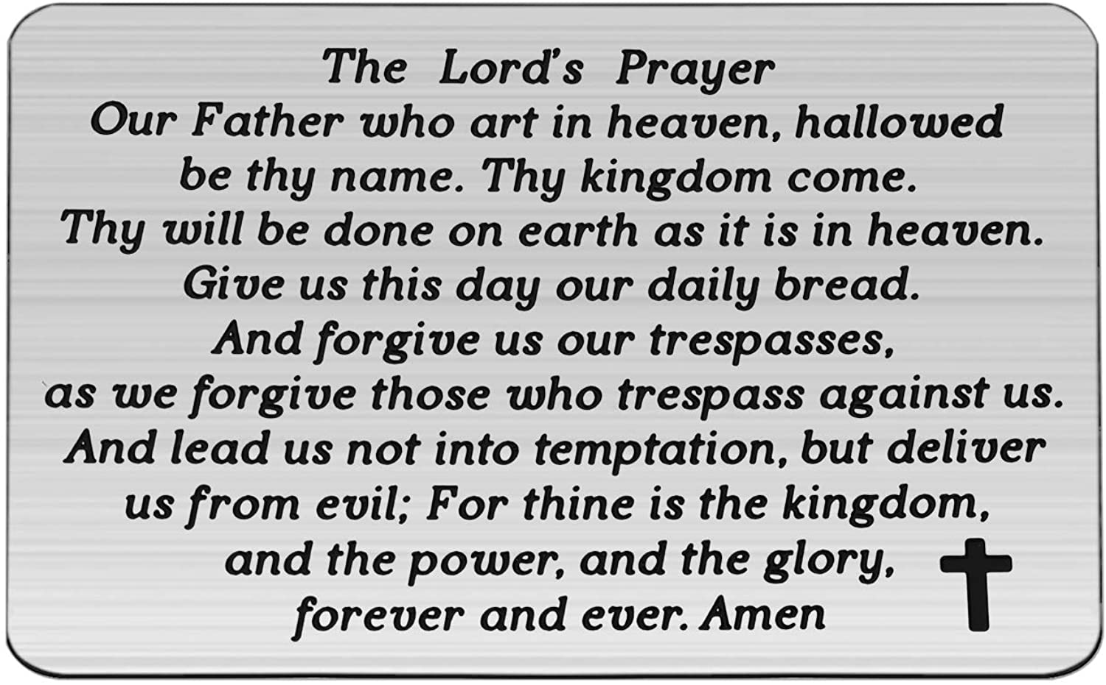

Slide 63
Support the ministry of St. Paul’s :
Through PAR – ask us how to join
via Canada Helps
search for St. Paul’s Sussex
via e-transfer to treasurerstpaulsucc1@gmail.com.
drop in collection plates located in the Narthex and near exit door
by mail to
4 Morrison Avenue, Sussex, N.B. E4E 1P5
during office hours
Notes:
Body text for hymns and prayers

Slide 64
Prayer of Dedication
Generous God, thank you for all
your gifts which bring us hope
and joy. Bless the gifts we bring
and work with them to establish
your reign in the world you love.
In the name of your greatest gift,
Jesus Christ, we pray. Amen.

Slide 65
Hymn: TLS #100
My Lighthouse Chris Tomlin CCLI #4348399

Slide 66
In my wrestling
and in my doubts,
In my failures,
you won’t walk out.
Your great love will lead me through,

Slide 67
You are the peace in my troubled sea,
You are the peace in my troubled sea.

Slide 68
In the silence you won’t let go,
In the questions,
your truth will hold
Your great love will lead me through

Slide 69
You are the peace in my troubled sea,
You are the peace in my troubled sea.

Slide 70
My lighthouse, my lighthouse,
Shining in the darkness,
I will follow you. Oh
My lighthouse, my lighthouse,
I will trust the promise,

Slide 71
You will carry me safe to shore.....
Safe to shore.....
Safe to shore...
Safe to shore.

Slide 72
I won’t fear what tomorrow brings,
With each morning I’ll rise and sing
My God’s love will lead me through,

Slide 73
You are the peace in my troubled sea,
You are the peace in my troubled sea.

Slide 74
My lighthouse, my lighthouse,
Shining in the darkness,
I will follow you. Oh
My lighthouse, my lighthouse,
I will trust the promise,

Slide 75
You will carry me safe to shore.....
Safe to shore.....
Safe to shore...
Safe to shore.

Slide 76
Fire before us,
you’re the brightest
You will lead us
through the storms.
Fire before us,
you’re the brightest
You will lead us
through the storms. 1

Slide 77
Fire before us,
you’re the brightest
You will lead us
through the storms.
Fire before us,
you’re the brightest
You will lead us
through the storms. 2

Slide 78
My lighthouse, my lighthouse,
Shining in the darkness,
I will follow you. Oh
My lighthouse, my lighthouse,
I will trust the promise,

Slide 79
You will carry me safe to shore.....
Safe to shore.....
Safe to shore...
Safe to shore. *

Slide 80
Benediction
&
Commissioning

Slide 81
Sung Benediction:
MV #32 Hallelujah 2x
Words: Trad. Music: Julian Pattison 2003 reprinted under OneLicense 725110

Slide 82
Halle, hallelujah,
halle, hallelu,
Halle, hallelujah,
Ha-le-lu-jah!

Slide 83
Halle, hallelujah,
halle, hallelu,
Halle, hallelujah,
Ha-le-lu-jah! *

