Slide 1

St. Paul’s United Church Sussex, NB
June 22nd, 2025
Confirmation
Sunday.

Slide 2
Welcome!
We’re so glad you could join us

Slide 3
Social time
There will be cake and lemonade after the service on the lawn as we welcome our newly confirmed and transferred members.

Slide 4
VBS Road trip!
Vacation Bible School
June 23-26 Nine to noon.

Slide 5
Results from last Sunday’s survey.
In a close vote, it was the nays over the ayes. Thanks for your participation.

Slide 6
summer has begun
The office will be moving to summer hours starting July 1.
From July 1 to Sept. 6, the office will be open Wednesday and Thursday from 9:30 – 3:00

Slide 7
The summer of women begins next week.
The stories of women in the bible will start on June 29th. The first one is Samantha.

Slide 8
Good News!

Slide 9

Prelude:
Paul Baloche CCLI

Slide 10
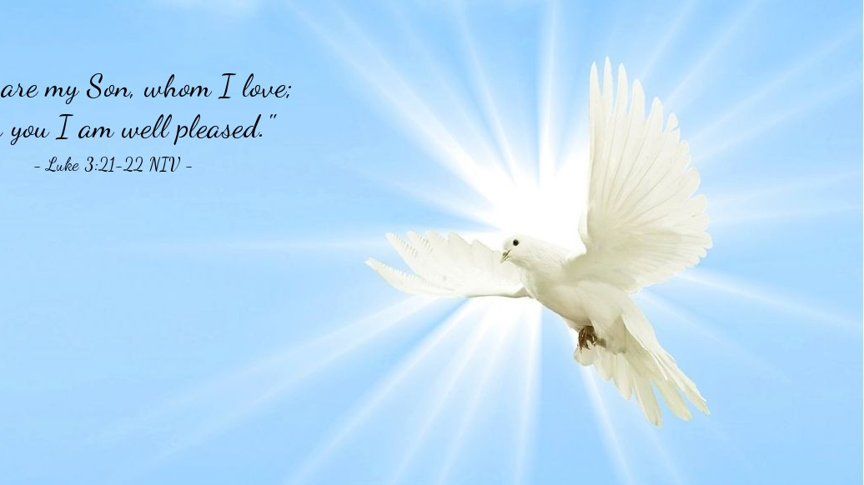
The Peace of Christ.
Sharing the Peace:
Response:
And also with you.
..
Notes:
Hymn Title Page

Slide 11
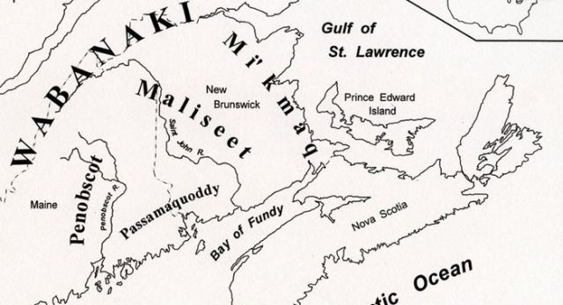
Acknowledging the Territories

Slide 12
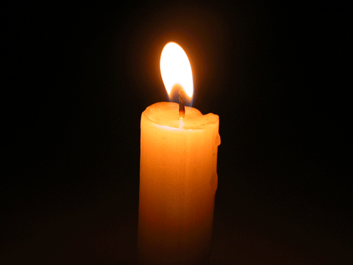
Lighting of the Christ Candle
“And the sign said, "The words of the prophets
Are written on the subway walls; And tenement halls; And whispered in the sounds of silence"” – Paul Simon

Slide 13
Call to Worship:
One: As a deer longs for flowing
streams, so we long for you, O God.
As the plants turn toward the sun, so
we turn to you, O God. As the tide
ebbs and flows, so we move with you,
O God.

Slide 14
All: Hope in God! Again, we
worship the Holy One, our help
and our God.
One: When tears are our constant
companion, when our souls become
weary, when we feel forgotten or
alone, we may ask the question,
“Where is God?”

Slide 15
All: Trust in God! Again, we honor
the Present One, our strength and
our God.
One: Deep calls to deep. The steadfast
love of God surrounds us. The Spirit of
Truth leads us to everlasting joy.

Slide 16
All: Rejoice in God. Again, we
praise the Living One, our source
and our God.

Slide 17
Hymn: VU#766
As The Deer Pants For the Water
Public Domain

Slide 18
As the deer pants for the water,
So my soul longs after you;
You alone are my heart’s desire
And I long to worship you.

Slide 19
You alone are my strength, my shield,
To you alone may my spirit yield;
You alone are my heart’s desire,
And I long to worship you!

Slide 20
I want you more than gold or silver,
Only you can satisfy;
You alone are the real joy-giver
And the apple of my eye.

Slide 21
You alone are my strength, my shield,
To you alone may my spirit yield;
You alone are my heart’s desire,
And I long to worship you!

Slide 22
You’re my friend and you are my brother,
Even though you are a king;
I love you more than any other
So much more than anything!

Slide 23
You alone are my strength, my shield,
To you alone may my spirit yield;
You alone are my heart’s desire,
And I long to worship you! *

Slide 24
Gathering Prayer
God in whom we take refuge, we
seek you as the calm in the storm,
the path in the wilderness, and
the order in the chaos. Renew our
strength with a vision of your
kin(g)dom made real and
expanding before us.

Slide 25
Encourage us with a word of
possibility and an encounter with
your presence. Enliven us as we
pray, sing, laugh, cry, witness,
listen, ponder, and imagine in
your midst and in our own way.

Slide 26
We come to you with our full
selves knowing you offer us the
fullness of your being. May we
find hope and challenge, joy and
rest, peace and power as we
immerse ourselves in you and
glorify your name. Amen.

Slide 27
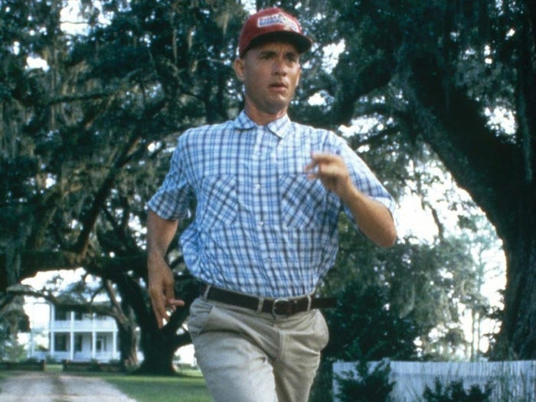
You can run…

Slide 28
Hymn: VU #412 This Is The Day
Words R. Gerald Hobbs 1987 Music Trad. Fijian Reprinted under OneLicense. A-725110

Slide 29
This is the day, this is the day
That our God has made,
that our God has made;
We will rejoice,
we will rejoice,
And be glad in it,
and be glad in it.
This is the day that our God has made,
we will rejoice and be glad in it.
This is the day, this is the day
That our God has made.

Slide 30
This is the day
that our God has made,
we will rejoice and be glad in it.
This is the day, this is the day
That our God has made.

Slide 31
Open to us, open to us
your gates O God,
your gates, O God;
We will go in, we will go in,
To your holy place,
to your holy place.

Slide 32
Open to us your gates O God,
We will go in to your holy place,
Open to us, open to us
your gates, O God.

Slide 33
You are our God, you are our God
We will praise your name,
We will praise your name;
We will give thanks,
We will give thanks,
For your faithfulness,
For your faithfulness.

Slide 34
You are our God,
we will praise your name,
We will give thanks
for your faithfulness.
You are our God, You are our God,
We will praise your name.

Slide 35
You are our God,
we will praise your name,
We will give thanks
for your faithfulness.
You are our God, You are our God,
We will praise your name.

Slide 36
This is the day, this is the day
That our God has made,
that our God has made;
We will rejoice,
we will rejoice,
And be glad in it,
and be glad in it.
This is the day that our God has made,
we will rejoice and be glad in it.
This is the day, this is the day
That our God has made.

Slide 37
This is the day
that our God has made,
we will rejoice and be glad in it.
This is the day, this is the day
That our God has made. *

Slide 38

Prayer for Illumination

Slide 39
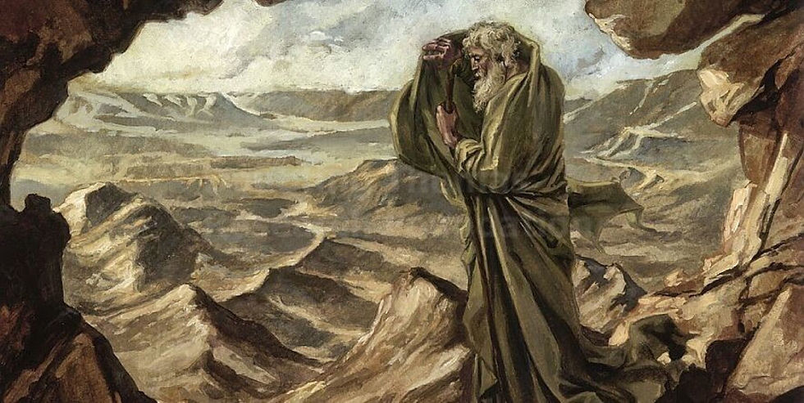
1 Kings 19:1-15a

Slide 40
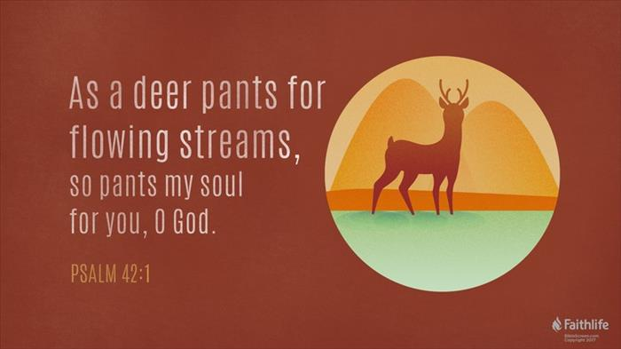
Psalm 42 and 43

Slide 41
Ministry of Music with the Congregation:
The Blessing

Slide 42
The Lord bless you, and keep you,
Make his face shine upon you
And be gracious to you.
The Lord turn his face toward you
And give you peace.
1

Slide 43
The Lord bless you, and keep you,
Make his face shine upon you
And be gracious to you.
The Lord turn his face toward you
And give you peace.
2

Slide 44
A--men, a --men, a---men.
A--men, a --men, a---men.

Slide 45
The Lord bless you, and keep you,
Make his face shine upon you
And be gracious to you.
The Lord turn his face toward you
And give you peace.
1

Slide 46
The Lord bless you, and keep you,
Make his face shine upon you
And be gracious to you.
The Lord turn his face toward you
And give you peace.
2

Slide 47
A--men, a --men, a---men.
A--men, a --men, a---men.

Slide 48
“May his favour be upon you
and a thousand generations
and your family and your children
and their children
and their children”.
1

Slide 49
“May his favour be upon you
and a thousand generations
and your family and your children
and their children
and their children”.
2

Slide 50
“May his presence go
before you and behind you
And beside you, all around you
and within you.
He is with you, he is with you”.
1

Slide 51
“May his presence go
before you and behind you
And beside you, all around you
and within you.
He is with you, he is with you”.
2

Slide 52
“In the morning , in the evening,
In your coming and your going,
In your weeping and rejoicing.
He is for you, he is for you.”
1

Slide 53
“In the morning , in the evening,
In your coming and your going,
In your weeping and rejoicing.
He is for you, he is for you.”
2

Slide 54
He is for you………
A--men, a --men, a---men.
A--men, a --men, a---men. *

Slide 55
Confirmation:

Slide 56
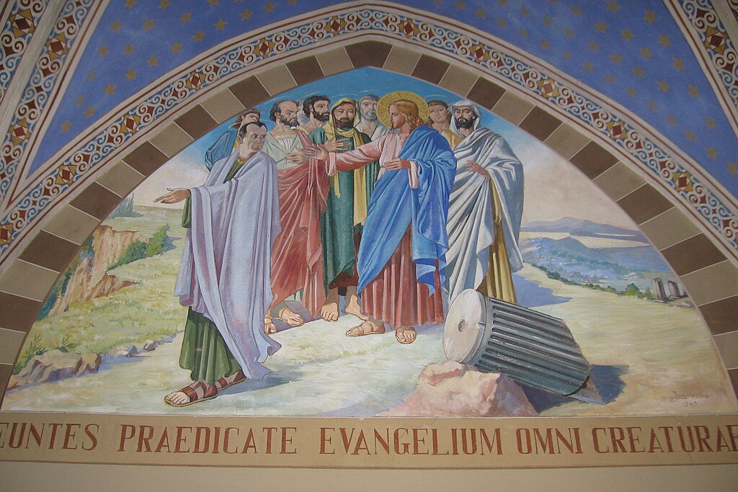
Matthew 28: 16-20

Slide 57
Statement of Purpose

Slide 58
Presentation of Candidates for Renewal of Faith by Confirmation
Abbie Corcoran
Daniel Carmicheal
Wanda Jewer-Northrup

Slide 59
Profession of Faith and Promises by the Candidates

Slide 60
Profession of Faith and Promise by the Congregation:
We will continue to support you,
walk with you, and grow with you
on this journey of faith. With
God’s help, we will live out our
baptism as a loving community in
Jesus Christ:

Slide 61
nurturing one another in faith,
upholding one another in prayer,
and encouraging one another in
God’s work.

Slide 62
The United Church Creed #VU 918
We are not alone,
we live in God’s world.
We believe in God:
who has created and is creating,

Slide 63
who has come in Jesus,
the Word made flesh,
to reconcile and make new,
who works in us and others
by the Spirit
We trust in God.
We are called to be the Church:

Slide 64
to celebrate God’s presence,
to live with respect in Creation,
to love and serve others,
to seek justice and resist evil,
to proclaim Jesus,
crucified and risen,
our judge and our hope.

Slide 65
In life, in death,
in life beyond death,
God is with us.
We are not alone.
Thanks be to God.

Slide 66
Transfer of Membership:
Presentation of Certificate:
Gordon Phippen
Karen Phippen
Janice Hoyt
Kevin Darbyson
Janet McKinley

Slide 67
Hymn: MV #161
I Have Called You by Your Name
Words & Music: Daniel Damon reprinted under OneLicense A-725110

Slide 68
I have called you by your name,
you are mine;
I have gifted you and ask you
now to shine.
I will not abandon you;
all my promises are true.
You are gifted, called, and chosen;
you are mine.

Slide 69
I will help you learn my name
as you go;
Read it written in my people,
help them grow.
Pour the water in my name,
speak the word your soul can claim,
Offer Jesus’ body given long ago.

Slide 70
I know you will need my touch
as you go;
Feel it pulsing in creation’s
ebb and flow.
Like the woman reaching out,
choosing faith in spite of doubt,
Hold the hem of Jesus’ robe,
then let it go.

Slide 71
I have given you a name, it is mine;
I have given you my Spirit as a sign.
With my wonder in your soul,
Make my wounded children whole,
Go and tell my precious people
they are mine.

Slide 72
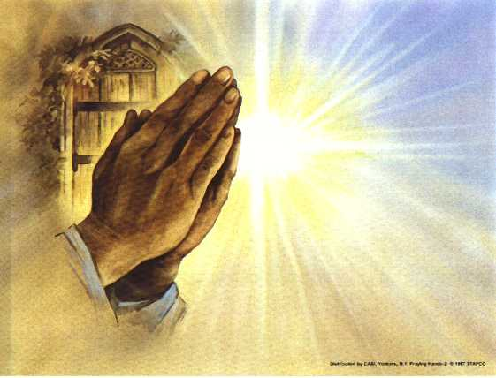
Prayers of
the People
One: God of the earth and all its peoples,
All: Let your light shine!

Slide 73
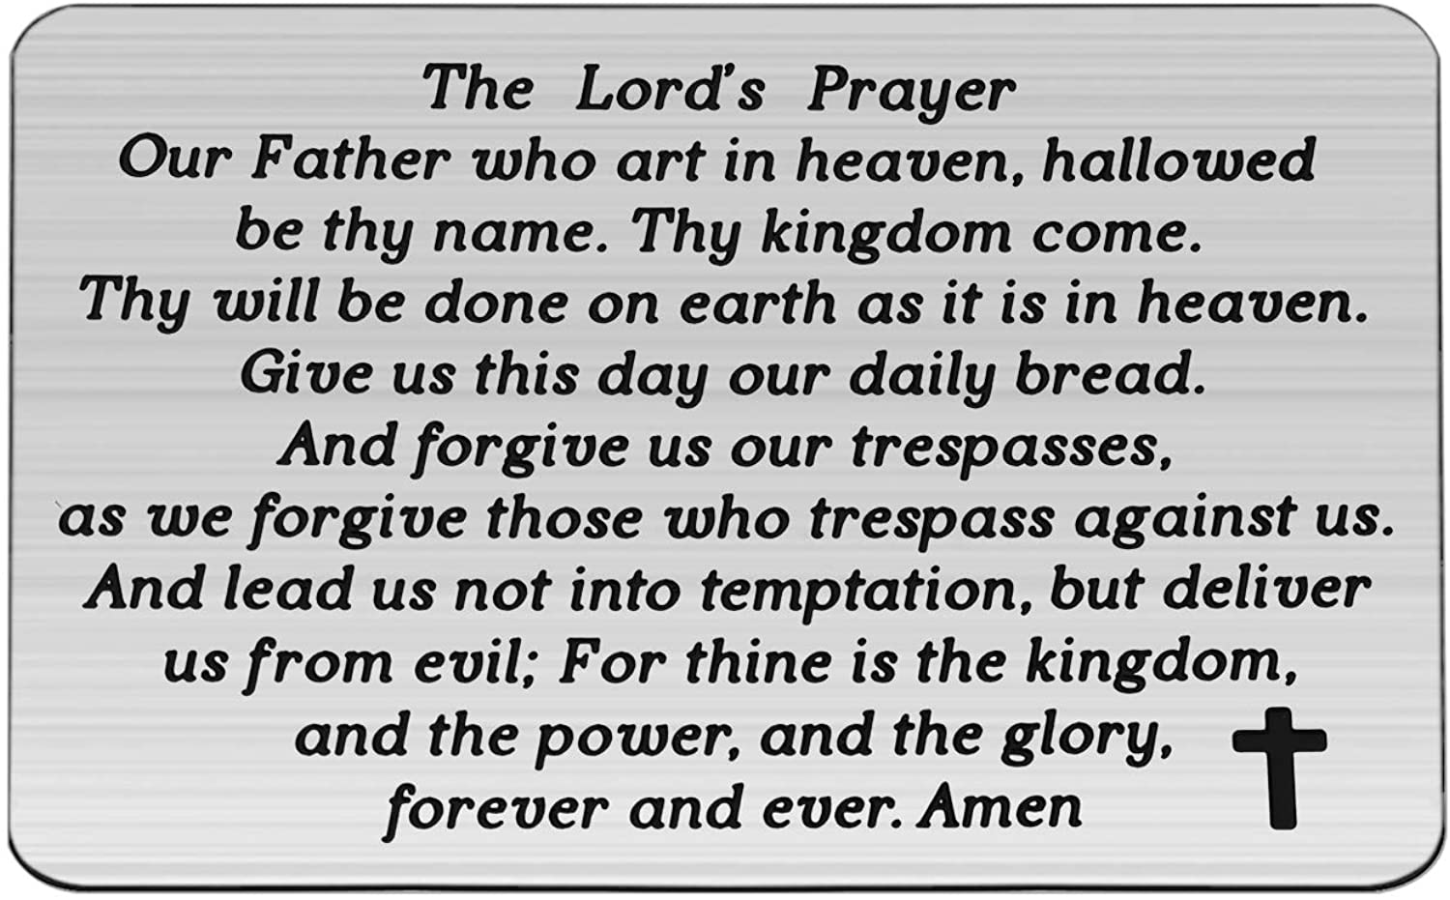

Slide 74
Support the ministry of St. Paul’s :
Through PAR – ask us how to join
via Canada Helps
search for St. Paul’s Sussex
via e-transfer to treasurerstpaulsucc1@gmail.com.
drop in collection plates located in the Narthex and near exit door
by mail to
4 Morrison Avenue, Sussex, N.B. E4E 1P5
during office hours
Notes:
Body text for hymns and prayers

Slide 75
Prayer of Dedication
Generous God, through these
offerings may ministry be
nurtured, love shared, people
encouraged, and glory be given to
your name. Amen.

Slide 76
Hymn: VU #575 I’m Gonna Live So God Can Use Me
African American Spiritual Arr Wendell Whalum 1987 Reprinted under OneLicense A-725110

Slide 77
I'm gonna live
so God can use me
anywhere, Lord, anytime!
I'm gonna live
so God can use me
anywhere, Lord, anytime!

Slide 78
I'm gonna work
so God can use me
anywhere, Lord, anytime!
I'm gonna work
so God can use me
anywhere, Lord, anytime!

Slide 79
I'm gonna pray
so God can use me
anywhere, Lord, anytime!
I'm gonna pray
so God can use me
anywhere, Lord, anytime!

Slide 80
I'm gonna sing
so God can use me
anywhere, Lord, anytime!
I'm gonna sing
so God can use me
anywhere, Lord, anytime! *

Slide 81
Benediction
&
Commissioning

Slide 82
Sung Benediction:
MV #214
May God’s Sheltering Wings
Words & Music Judith Snowdon 2004 reprinted under OneLicense A-725110

Slide 83
May God’s sheltering wings,
Her gathering wings protect you.
May God’s nurturing arms
Her cradling arms sustain you,
And hold you in her love,
And hold you in her love. *

