Slide 1

St. Paul’s United Church
Sussex, NB
June 29th, 2025
Third Sunday
after
Pentecost

Slide 2
Welcome!
We’re so glad you could join us

Slide 3
VBS Road trip!
A big thank you to all the volunteers that helped make the 2025 VBS such a success.

Slide 4
summer has begun
The office will be moving to summer hours starting July 1.
From July 1 to Sept. 6, the office will be open Wednesday and Thursday from 9:30 – 3:00

Slide 5
Good News!

Slide 6

Prelude:
Paul Baloche CCLI

Slide 7

The Peace of Christ.
Sharing the Peace:
Response:
And also with you.
..
Notes:
Hymn Title Page

Slide 8
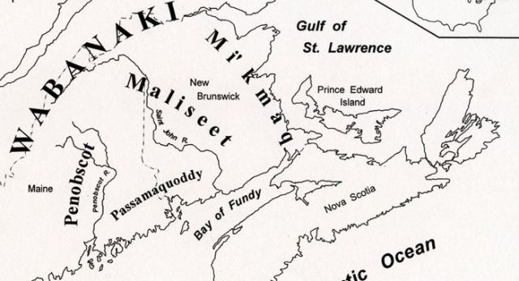
Acknowledging the Territories

Slide 9
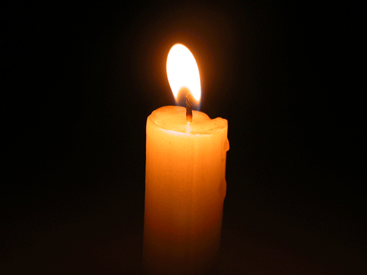
Lighting of the Christ Candle
“For we walk by faith, not by sight.”
2 Corinthians 5:7

Slide 10
Call to Worship:
One: It is good to give thanks to God;
All: Let us sing praises to God’s
holy name!
One: We will declare God’s steadfast
love in the morning,
All: And God’s faithfulness night
after night.

Slide 11
One: Let us make a joyful noise in our
worship!
All: For God is good and we know
God’s blessings.
One: Let us worship God with grateful
hearts;
All: We will give God thanks in
our prayers and praise.

Slide 12
Hymn: VU #606
In Christ There Is
No East or West
Public Domain

Slide 13
In Christ there is no east or west,
in him no south or north,
but one great family of love
throughout the whole wide earth.

Slide 14
In him shall true hearts everywhere
their high communion find;
his service is the golden cord
close binding humankind.

Slide 15
Join hands, then, people of the faith,
whate'er your race may be;
all children of the living God
are surely kin to me.

Slide 16
In Christ now meet both east and west,
in him meet south and north;
all Christ-like souls are one in him
throughout the whole wide earth.
*

Slide 17
Gathering Prayer

Slide 18

Monsters under the bed!

Slide 19
Hymn: MV #1
Let Us Build A House vs 1,2,4,5
Words & Music: Marty Haugen 1994. Reprinted under OneLicense A-725110

Slide 20
Let us build a house
where love can dwell
And all can safely live,
A place where saints and children tell
How hearts learn to forgive.

Slide 21
Built of hopes and dreams and visions,
Rock of faith and vault of grace;
Here the love of Christ shall end divisions:
All are welcome,
All are welcome,
All are welcome in this place.

Slide 22
Let us build a house
where prophets speak,
and words are strong and true,
Where all God’s children dare to seek
To dream God’s reign anew.

Slide 23
Here the cross shall stand as witness
And as symbol of God’s grace;
Here as one we claim the faith of Jesus:
All are welcome,
All are welcome,
All are welcome in this place.

Slide 24
Let us build a house
where hands will reach
Beyond the wood and stone
To heal and strengthen, serve and teach,
And live the Word they’ve known.

Slide 25
Here the outcast and the stranger
Bear the image of God’s face;
Let us bring an end to fear and danger:
All are welcome,
All are welcome,
All are welcome in this place.

Slide 26
Let us build a house
where all are named,
Their songs and visions heard
And loved and treasured,
taught and claimed
As words within the Word.

Slide 27
Built of tears and cries and laughter,
Prayers of faith and songs of grace;
Let this house proclaim from floor to rafter:

Slide 28
All are welcome,
All are welcome,
All are welcome in this place. *

Slide 29

Prayer for Illumination

Slide 30

Galatians 5:1, 13-25

Slide 31

Galatians 3:23 - 4:11

Slide 32
Why we
should never
ignore
Samantha…

Slide 33
We Walk in the Company of…
A litany to honor Our women of summer
One: We walk in the company of the
women who have gone before,
Mothers and sisters of the faith, both
named and unnamed, Testifying with
ferocity and faith to the Spirit of
Wisdom and Healing.

Slide 34
All: They are the judges, the
prophets, the martyrs, the
warriors, poets, lovers and saints
who are near to us in the shadow
of awareness, in the crevices of
memory, in the landscape of our
dreams.

Slide 35
One: We walk in the company of the
woman whose names have been lost
and silenced, who kept and cradled
the wisdom of the ages.
All: We walk in the company of
Hannah, who had great faith in
God to work within her life.

Slide 36
One: We walk in the company of
Abigail, who used her wisdom to
become a peacemaker.
All: We walk in company of the
woman with the flow of blood,
who audaciously sought her
healing and release.

Slide 37
One: We walk in the company of
Esther, who used her position as
Queen to ensure the welfare of her
people.
All: We walk in the company of
Rahab, who risked her life to
protect those deemed
unwelcome.

Slide 38
One: We walk in the company of
Lydia, who used her wealth and
resources to support the ongoing
ministry of the early church.
All: We walk in the company of
Deborah, who judged the
Israelites with authority and
strength.

Slide 39
One: We walk in the company of Jael,
who used her cunning and strength to
turn the tide of war.
All: We walk in the company of
Miriam who sang and danced
leading the people in worship and
praise of God.

Slide 40
One: We walk in the company of all
Mothers and Sisters of the faith, who
teach us to resist evil with boldness, to
lead with wisdom and strength, and to
heal with compassion and love.
All: We walk in the company of
one another. In Jesus’s name we
pray. Amen.

Slide 41
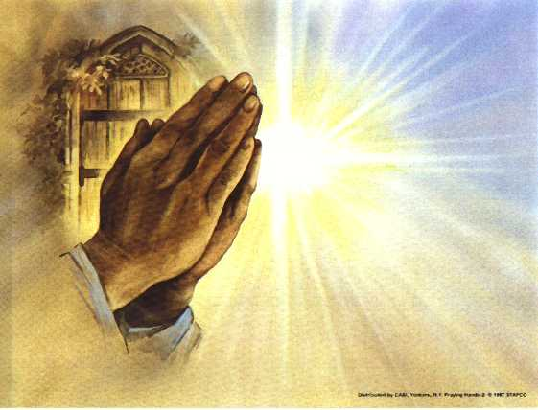
Prayers of
the People
One: God of purpose and promise,
All: Receive our prayers.

Slide 42
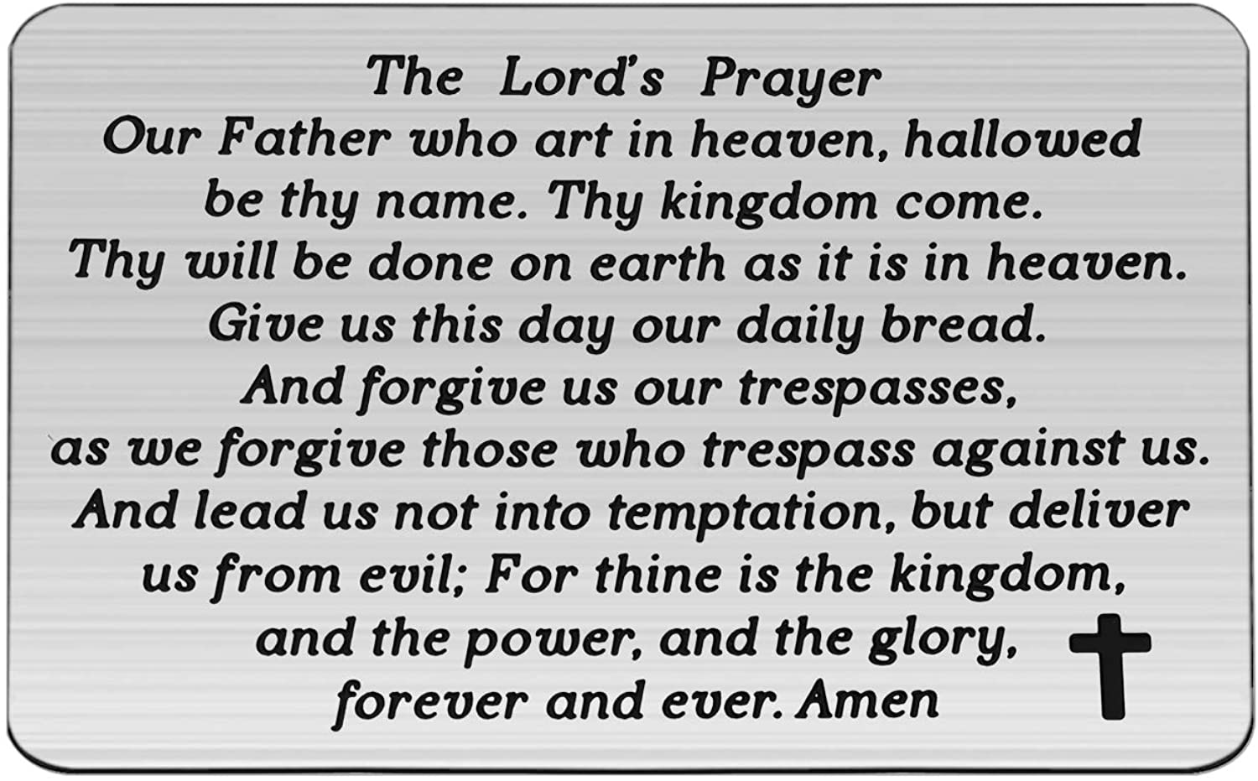

Slide 43
Support the ministry of St. Paul’s :
Through PAR – ask us how to join
via Canada Helps
search for St. Paul’s Sussex
via e-transfer to treasurerstpaulsucc1@gmail.com.
drop in collection plates located in the Narthex and near exit door
by mail to
4 Morrison Avenue, Sussex, N.B. E4E 1P5
during office hours
Notes:
Body text for hymns and prayers

Slide 44
Prayer of Dedication
O God, we know you to be kind
and generous, so we bring our
gifts in gratitude and joy.

Slide 45
Pour out your Spirit on these gifts
and on our lives, so that we may
bear the fruit of your Spirit in
every situation and relationship,
through Christ, our Living Lord.
Amen.

Slide 46
Hymn: MV #179 Sisters Let Us Walk Together
Words & Music Judith Snowdon ©2004 Used by permission Reprinted under OneLicense A725110

Slide 47
Sisters let us walk together,
Sharing sadness, loss and grief,
We will move through pain to wholeness,
Brokenness transformed to peace.

Slide 48
Brothers let us work together,
Seeking justice, healing shame
Filled with hope, embued with courage,
Ev’ry violence we will name.

Slide 49
People let us love together,
Joining spirits, linking hands,
We are God’s unique creation,
Clothed with dignity we’ll stand.*

Slide 50
Benediction
&
Commissioning

Slide 51
Sung Benediction:
MV #214
May God’s Sheltering Wings
Words & Music Judith Snowdon 2004 reprinted under OneLicense A-725110

Slide 52
May God’s sheltering wings,
Her gathering wings protect you.
May God’s nurturing arms
Her cradling arms sustain you,
And hold you in her love,
And hold you in her love. *

