Slide 1
St. Paul’s United Church
Sussex, NB
June 8th, 2025
Pentecost Sunday
Anniversary Sunday

Slide 2


Slide 3
Welcome!
We’re so glad you could join us

Slide 4
Social time
There will be a time for fellowship and fun after the service in the fellowship hall.
There will be cake!

Slide 5
Meetings
St. Paul’s Ladies will meet at
All Season’s Inn on June 12 at
noon. All ladies are welcome.

Slide 6
100th Annivesary
Saint John edition
June 15th at 10:30. If you wish to do this again, only different, park at TD Station to bus to Saint John High.

Slide 7
Grad Sunday
June 15th is Grad Sunday.
Come and help celebrate our graduates. There will be cupcakes and lemonade on the lawn after the service.

Slide 8
VBS Road trip!
Vacation Bible School
June 23-26 Nine to noon.
35 spaces, registration forms on the table in the entry or from the office.

Slide 9
Good News!

Slide 10

Prelude:
Featuring Megan Brenan
Paul Baloche CCLI

Slide 11
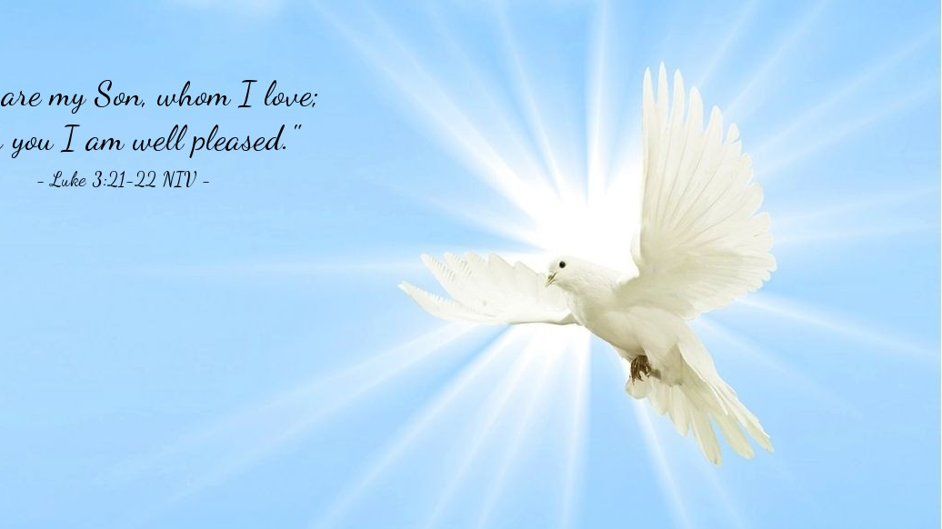
The Peace of Christ.
Sharing the Peace:
Response:
And also with you.
..
Notes:
Hymn Title Page

Slide 12
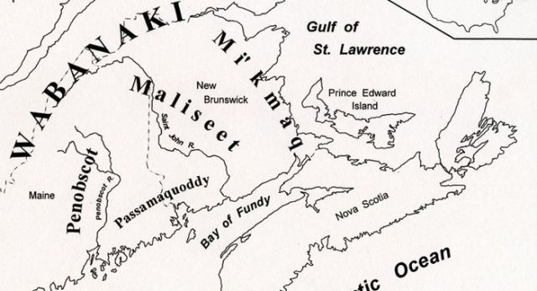
Acknowledging the Territories
Erin, Kit, Sybil and Joni Johnson

Slide 13
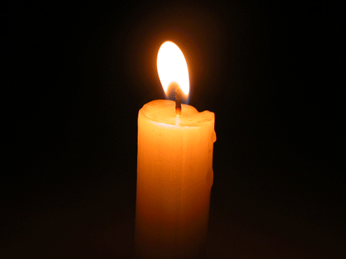
Lighting of the Christ Candle
“Enter these gates with Thanksgiving”

Slide 14
Call to the Church
Noah Gibbons-Salib
paraphrasing Acts 2:14-18

Slide 15
Call to Worship: Leslie Anthony
One: When the day of Pentecost
came, they were all together in one
place… Today, we gather in many
places and ways, yet we are one in
heart! Touched by the Spirit, the first
disciples were enlivened.

Slide 16
All: By the Spirit, we live and
thrive!
One: On the day of Pentecost, the
Church was born.
All: Today, we celebrate 100
years of being the United Church!

Slide 17
One: In their gathering that day,
people were changed by the Spirit.
All: In our gathering today, we
seek the Spirit’s direction for
tomorrow.

Slide 18
One: With open hearts, let us worship
God and pray for the Spirit’s presence
amongst us.
All: Come, Holy Spirit, Come!

Slide 19
Opening Prayer: Leslie Anthony
Awesome God, on Pentecost, you
gave the gift of the Holy Spirit to
an expectant and united church.
And by your Spirit, you bring us to
this time and place to lift our
hearts, minds, and bodies to
worship you.

Slide 20
Grant us the hope of the same
Spirit in our life and worship. Help
us to expect great things from
you, and attempt great things for
you! We are diverse in many
ways, but our hearts are one in
you.

Slide 21
May we show the world the love
we experience in Jesus, and the
power we find in the Spirit as we
seek to honour your dream. To
your glory be our worship and
witness. Amen.

Slide 22
Hymn: VU #380
She Comes Sailing On the Wind
Words and music: Gordon Light 1985 reprinted under OneLicense A725110

Slide 23
She comes sailing on the wind,
Her wings flashing in the sun,
On a journey just begun,
She flies on.

Slide 24
And in the passage of her flight,
Her song rings out through the night,
Full of laughter, full of light,
She flies on.
1

Slide 25
Silent waters rocking
on the morning of our birth,
Like an empty cradle
waiting to be filled,
And from the heart of God
the Spirit moved upon the earth,
Like a mother breathing
life into her child.

Slide 26
Many were the dreamers
whose eyes were given sight
When the Spirit filled their
dreams with life and form.
Deserts turned to gardens,
broken hearts found new delight,
And then down the age
still she flew on.

Slide 27
She comes sailing on the wind,
Her wings flashing in the sun,
On a journey just begun,
She flies on.

Slide 28
And in the passage of her flight,
Her song rings out through the night,
Full of laughter, full of light,
She flies on.
1

Slide 29
To a gentle girl in Galilee,
a gentle breeze she came,
A whisper softly calling
in the dark,
The promise of a child of peace
whose reign would never end,
Mary sang the Spirit song
within her heart.

Slide 30
Flying to the river,
she waited circling high
Above the child now grown
so full of grace.
As he rose up from the water,
she swept down from the sky,
And she carried him
away in her embrace.

Slide 31
She comes sailing on the wind,
Her wings flashing in the sun,
On a journey just begun,
She flies on.

Slide 32
And in the passage of her flight,
Her song rings out through the night,
Full of laughter, full of light,
She flies on.
1

Slide 33
Long after the deep darkness
that fell upon the world,
After dawn returned
in flame of rising sun,
The Spirit touched the earth
again, again her wings unfurled,
Bringing life in the wind and fire
as she flew on.

Slide 34
And in the passage of her flight,
Her song rings out through the night,
Full of laughter, full of light,
She flies on.
1

Slide 35
She comes sailing on the wind,
Her wings flashing in the sun,
On a journey just begun,
She flies on. *

Slide 36
Words of Welcome
Jennifer Brown

Slide 37
Prayer for Reflection
and Celebration:
Lorraine Pollock

Slide 38
Hymn: VU#238
How Great Thou Art
Copyright: Manna Music 1981 Reprinted under OneLicense A-725110

Slide 39
O Lord my God,
when I in awesome wonder
Consider all
the works thy hand hath made,
I see the stars,
I hear the mighty thunder,
Thy power throughout
the universe displayed.

Slide 40
Then sings my soul,
my Saviour God, to thee,
How great thou art!
How great thou art!
Then sings my soul,
my Saviour God, to thee,
How great thou art!
How great thou art!

Slide 41
When through the woods
and forest glades I wander,
I hear the birds
sing sweetly in the trees;
When I look down
from lofty mountain grandeur
And hear the brook
and feel the gentle breeze.

Slide 42
Then sings my soul,
my Saviour God, to thee,
How great thou art!
How great thou art!
Then sings my soul,
my Saviour God, to thee,
How great thou art!
How great thou art!

Slide 43
But when I think that God,
his son not sparing,
Sent him to die,
I scarce can take it in,
That on the cross,
my burden gladly bearing,
He bled and died
to take away my sin.

Slide 44
Then sings my soul,
my Saviour God, to thee,
How great thou art!
How great thou art!
Then sings my soul,
my Saviour God, to thee,
How great thou art!
How great thou art!

Slide 45
When Christ shall come
with shout of acclamation
And take me home,
what joy shall fill my heart!
Then I shall bow
in humble adoration
And there proclaim,
'My God, how great thou art!'

Slide 46
Then sings my soul,
my Saviour God, to thee,
How great thou art!
How great thou art!
Then sings my soul,
my Saviour God, to thee,
How great thou art!
How great thou art! *

Slide 47

Happy Birthday UCC

Slide 48
Ministry of Music:
Mungu ni Mwema (God Is So Good)
Claire Turner and
Megan Brenan

Slide 49

Prayer for Illumination
Gordon Phippen

Slide 50
Scripture:
Ephesians 1:15–19, 3:16-21 Bruce Mercer and Chris Ayers

Slide 51
Choir Anthem:
“Back to the Church in the Wildwood”
(sing along, stay seated)
Words and Music Steve Bell reprinted under OneLicense A-725110

Slide 52
Take me back to the
church in the wildwood,
where the folks make me
feel so at home.
How I love going back to my childhood
Where we’d sing all the old, old songs.

Slide 53
It was there where I first met Jesus.
It was there where I knew I belonged.
How I love going back to the old, old church
Where we’d sing all the old, old songs.

Slide 54
What a fellowship,
what a joy divine
Leaning on the everlasting arms.
What a blessedness,
what a peace is mine,
Leaning on the everlasting arms.

Slide 55
In the sweet by and by,
We shall meet on that beautiful shore.
In the sweet by and by
We shall meet on that beautiful shore.

Slide 56
Shall we gather at the river,
Where bright angel feet have trod.
With it’s crystal tide forever
Flowing by the throne of God-Yes,
We’ll gather at the river,
The beautiful, beautiful river.
Gather with the Saints at the river
That flows by the throne of God.

Slide 57
There’s a church in the valley by the wildwood,
No lov-lier spot in the dale;
No place is so dear to my childhood
As the little brown church in the vale.

Slide 58
O come, come, come, come,
Come to the church in the wildwood,
O come to the church in the dale.
No place is so dear to my childhood
As the little brown church in the vale.

Slide 59
It was there where I first met
Jesus.
It was there where I knew I belonged.

Slide 60
How I love going back to the old, old church,
Where we’d sing all the old, old songs,
Where we’d sing all the old, old, songs.
(sing the old, old songs) *

Slide 61

Why the United Church?
Tom Barn, Steve Harding,
Samantha Corcoran

Slide 62
Invitation to Offering:
Jennifer Brown

Slide 63
The United Church Creed VU 918
We are not alone,
we live in God’s world.
We believe in God:
who has created and is creating,

Slide 64
who has come in Jesus,
the Word made flesh,
to reconcile and make new,
who works in us and others
by the Spirit
We trust in God.

Slide 65
We are called to be the Church:
to celebrate God’s presence,
to live with respect in Creation,
to love and serve others,
to seek justice and resist evil,

Slide 66
to proclaim Jesus,
crucified and risen,
our judge and our hope.
In life, in death,
in life beyond death,
God is with us.
We are not alone.
Thanks be to God.

Slide 67
Prayer of Dedication
Jennifer Brown
Empowering God, we believe your
Spirit is with us this day, leading
us into a new future. We offer our
time, talents, finances, and
hopes, trusting you to do more
than we can dream possible.

Slide 68
Bless us and these offerings with
your Spirit. May we be bold
disciples, deeply connected to
you, who dare to act for justice.
This we pray, in Jesus’ name.
Amen.

Slide 69
Communion Hymn: MV#198 When We gather at the Table Words: Walter Farquharson, Music: Ron Klusmeier reprinted under OneLicense A-725110

Slide 70
When we gather at the table
Wine is poured and bread is broken.
Then love claims us, offering healing
We hear welcome, gently spoken.

Slide 71
Jesus offers our thanksgiving
Blessing God for life we’re given.
From the earth comes grain to feed us
Watered by the rains of heaven.

Slide 72
Word of promise claims attention
Earth renewed by God’s designing.
All the creatures join in praises
God’s intended wholeness finding.

Slide 73
Come, invited, now draw nearer,
Join this holy celebration.
Here be strengthened, called to justice,
Living now God’s new creation.

Slide 74
Christ, your coming and your hosting
Gives us place at widening table
Now embracing world and neighbor
Spirit strong, by love enabled. *

Slide 75
Sacrament of Communion: Invitation:
One: God is with us.
All: We are not alone.
One: Christ is present here.
All: The Spirit is among us!
One: Let us give thanks to God
All: in memory and in hope.

Slide 76
Great Thanksgiving:
One: Blessed are you, Gracious God,…
They proclaimed your goodness in
every language, saying:
All: Holy, holy, holy Lord, God of
power and might, Heaven and
earth are full of your glory,
Hosanna in the highest!

Slide 77
Blessed is the One who comes in
the name of the Lord. Hosanna in
the highest!

Slide 78
One: Living in the Spirit’s ways …
proclaim the mystery of our faith:
All: Christ has died. Christ is risen.
Christ will come again!
One: Pour out your Spirit … On this
Pentecost day, we pray: Come, Holy
Spirit!
All: Come, Holy Spirit! Amen!

Slide 79
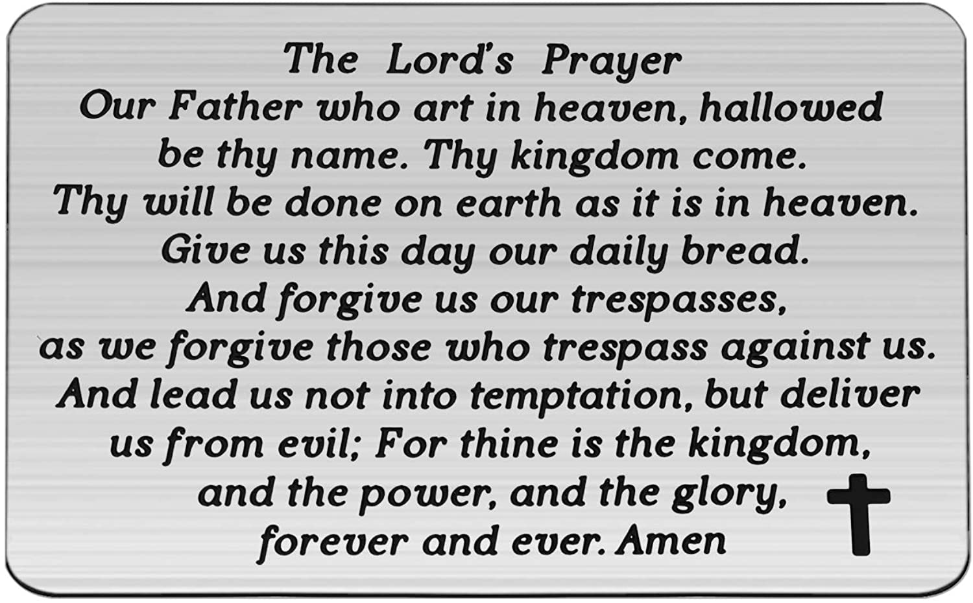

Slide 80
Distribution of the Elements:

Slide 81
Hymn: VU #467
One Bread One Body
Words & Music: John B Foley, S.J. 1978 reprinted under OneLicense 725110

Slide 82
One bread, one body,
one Lord of all,
one cup of blessing
which we bless;
and we, though many,
throughout the earth,
we are one body in this one Lord.

Slide 83
Gentile or Jew,
servant or free,
woman or man, no more.

Slide 84
One bread, one body,
one Lord of all,
one cup of blessing
which we bless;
and we, though many,
throughout the earth,
we are one body in this one Lord.

Slide 85
Many the gifts,
many the works,
one in the Lord of all.

Slide 86
One bread, one body,
one Lord of all,
one cup of blessing
which we bless;
and we, though many,
throughout the earth,
we are one body in this one Lord.

Slide 87
Grain for the fields,
scattered and grown,
gathered to one, for all.

Slide 88
One bread, one body,
one Lord of all,
one cup of blessing
which we bless;
and we, though many,
throughout the earth,
we are one body in this one Lord.
*

Slide 89
Hymn: VU #466
Eat This Bread, Drink This Cup
Words: Robert J. Batastini and the Taize Community Music: Jacques Berthier 1982 reprinted under OneLicense 725110

Slide 90
Eat this bread, drink this cup;
Come to me and never be hungry.
Eat this bread, drink this cup;
Trust in me and you will not thirst. *

Slide 91
Prayer after Communion:
In your grace and by your Spirit
we have been fed at this table,
brought into communion with you
and each other.

Slide 92
May this banquet so inspire us to
love as we have been loved, feed
as we have been fed, and to
welcome all as Christ has
welcomed us. In this way, we will
witness your reign on earth, as it
is in heaven. Amen.

Slide 93
Prayer for the Church
Shirley Keith, Steve Harding,
Tracey Reynolds

Slide 94
Hymn:
How Great is Our God
Chris Tomlin CCLI #4348399

Slide 95
The splendour of the King,
clothed in majesty,
Let all the earth rejoice,
all the earth rejoice.
He wraps himself in light,
and darkness tries to hide,
And trembles at his voice,
trembles at his voice.

Slide 96
How great is our God,
Sing with me,
How great is our God,
and all will see
How great, how great, is our God.

Slide 97
And age to age He stands,
and time is in his hands,
Beginning and the end,
beginning and the end.
The God head, three in one,
Father, Spirit , Son,
The lion and the lamb,
the lion and the lamb.

Slide 98
How great is our God,
Sing with me,
How great is our God,
and all will see
How great, how great, is our God.

Slide 99
Name above all names,
worthy of all praise,
My heart will sing,
How great is our God.
Name above all names,
worthy of all praise,
My heart will sing,
How great is our God.

Slide 100
How great is our God,
Sing with me,
How great is our God,
and all will see
How great, how great, is our God.
1

Slide 101
How great is our God,
Sing with me,
How great is our God,
and all will see
How great, how great, is our God.
2

Slide 102
How great is our God,
Sing with me,
How great is our God,
and all will see
How great, how great, is our God.
*
3

Slide 103
Benediction
One: Beloved, … in Christ’s name,
through whom all things are possible.
All: Praise be to God, whose
power working in us can do
infinitely more than we can ask or
imagine!

Slide 104
Glory be to God, in the Church,
and in Christ Jesus, from
generation to generation.
Amen!

Slide 105
Sung Benediction:
My Peace
Words: Trad. Music: Julian Pattison 2003 reprinted under OneLicense 725110

Slide 106
My peace I give unto you.
It’s a peace that the world cannot give.
It’s a peace that the world cannot understand.
Peace to know, Peace to live.

Slide 107
My peace I give unto you.
My love I give unto you.
It’s a love that the world cannot give.
It’s a love that the world cannot understand.

Slide 108
Love to know, Love to live.
My love I give unto you. *

Slide 109
Postlude:
Paul Baloche CCLI

