Slide 1
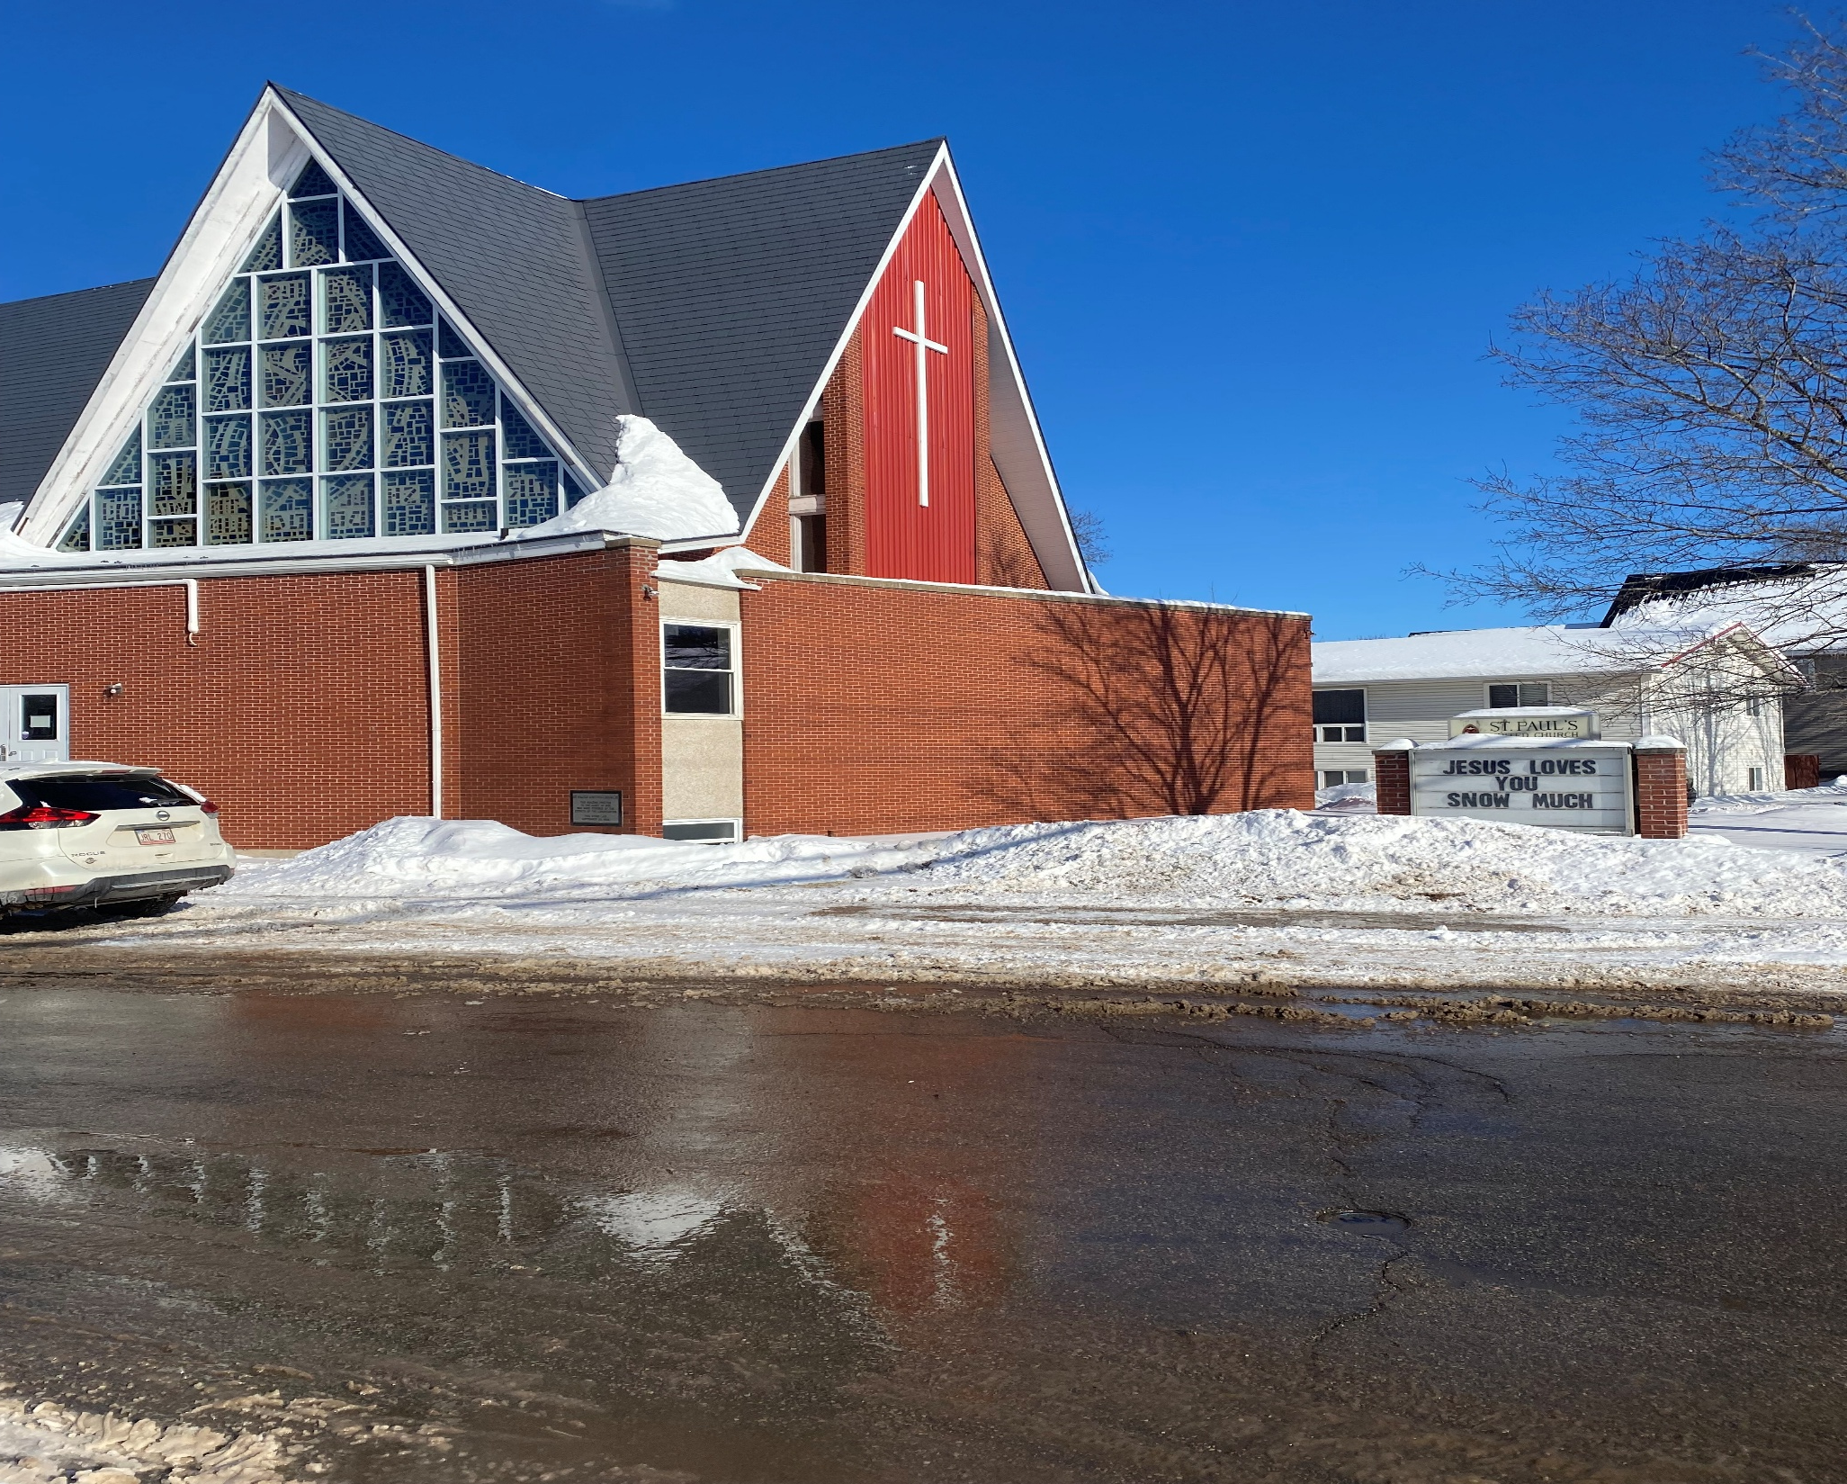
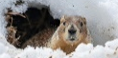
2nd Sunday of Lent
St. Paul’s United Church
Sussex, NB
March 16, 2025
Welcome

Slide 2

Prelude:
El Shaddai
(God Almighty)

Slide 3
Welcome!
We’re so glad you could join us

Slide 4
Bookmarks
Lenten Bookmarks are available.
A new one each week of Lent and Easter Sunday.

Slide 5
The agm
The 2024 Annual General Meeting of St. Paul’s United Church will be held on Sunday, March 23rd after the service. It will be café style.
Annual reports are now available.

Slide 6
The agm part deux
There are 3 positions on the board to be filled, one vacant and two from members’ terms ending.
Nominations will be taken from the floor.

Slide 7
The agm Redux
We have many seats at the table at the regional conference level. Will you take a seat at the table? We are looking for 2 people to be regional representatives. Nominations will be taken from the floor or talk to Lisa or Nelson Ball about joining.

Slide 8
Good News!

Slide 9
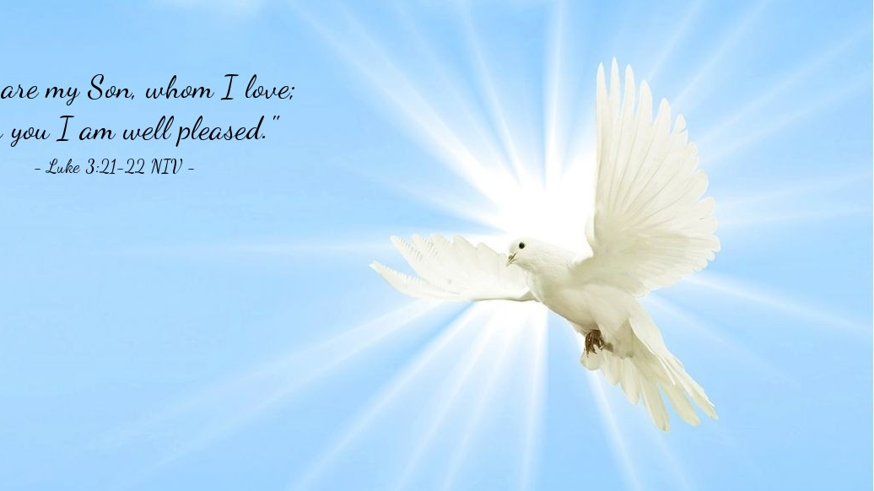
The Peace of Christ.
Sharing the Peace:
One: May the Peace of Christ be with you
All: And also with you
Response:
And also with you.
..
Notes:
Hymn Title Page

Slide 10
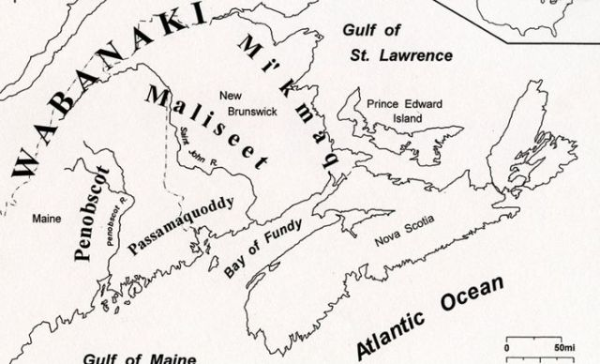
Acknowledging the Territories

Slide 11
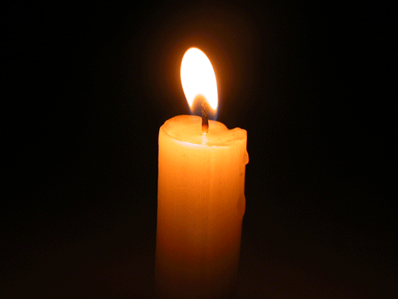
Lighting of the Christ Candle
Our spiritual hunger pangs are but our response to the aroma of the fresh bread of life that Christ has provided for us.

Slide 12
Call to Worship
One: Calling all who are hungry for
the goodness of life!
All: The bread of life satisfies our
hunger and thirst.
One: Come with empty pockets and
open hands!

Slide 13
All: The bread of life loves us and
knows our needs.
One: Let us gather from all walks of
life, celebrating in unity our common
needs and singular purpose.
All: The bread of life has come to
sustain us. Believing this promise,
let us worship together!

Slide 14
Hymn: VU #460
All Who Hunger
Words and music: Michael Joncas 1979 reprinted under OneLicense A725110

Slide 15
All who hunger, gather gladly;
holy manna is our bread.
Come from wilderness and wandering.
Here, in truth, we will be fed.

Slide 16
You that yearn for days of
fullness,
all around us is our food.
Taste and see the grace eternal.
Taste and see that God is good.

Slide 17
All who hunger, never strangers;
seeker, be a welcome guest.
Come from restlessness and roaming.
Here, in joy, we keep the feast.

Slide 18
We that once were lost and scattered
in communion's love have stood.
Taste and see the grace eternal.
Taste and see that God is good.

Slide 19
All who hunger, sing together;
Jesus Christ is living bread.
Come from loneliness and longing.
Here, in peace, we have been led.

Slide 20
Blest are those who from this table
live their lives in gratitude.
Taste and see the grace eternal.
Taste and see that God is good. *

Slide 21
Gathering Prayer
God, our mother hen, we gather
beneath your ever-expanding
wings to see how you will meet
us today. Though we grow and
mature, we cannot outgrow your
love.

Slide 22
Though our belief grows more
complex, your mysteries always
outpace our imaginations. Help us
grow and mature today as we
worship, delighting in new
understanding and greater depth
of meditation.

Slide 23
Cause our hearts, empowered by
your Spirit, to expand like dough
becoming bread. Amen.

Slide 24
Lenten Prayer of Confession:
One: Often… commit ourselves to
God’s ever-expanding purposes.
All: God Most High, who knows
the highest heights and deepest
valleys of this universe,

Slide 25
we confess we have limited your
work because of our small
thinking. While you long for the
bread of life to expand and
nourish all creation, our fears and
worries keep us contained.

Slide 26
While you long to create
kin(g)doms of peace and
reconciliation, we draw lines
between us. While you make
space for everyone, we worry
about sharing too much or being
too vulnerable.

Slide 27
While you search tirelessly for
lost lambs, we focus our concern
inward on our own issues. Forgive
us for our small perspective, and
open our minds to the big ideas
you have for our future.

Slide 28

The offering of

Slide 29

God’s Love is Always Growing

Slide 30
Hymn: MV #201
I am the Bread of Life x2
Words & Music: Tom Kacemarek 2005 reprinted under OneLicense A-725110

Slide 31
I am the bread of life
Broken for the world,
I am the cup poured out for all.
Those who believe in me
Will never die.
I am the life of the world.

Slide 32
I am the bread of life
Broken for the world,
I am the cup poured out for all.
Those who believe in me
Will never die.
I am the life of the world. *

Slide 33

Prayer for Illumination

Slide 34
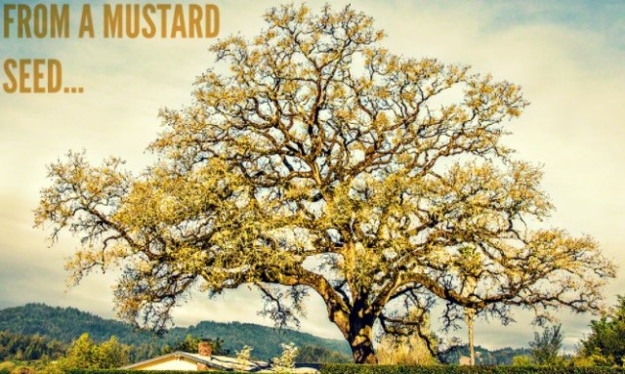
Luke 13: 18-21, 31-35

Slide 35
Ministry of Music:
Blessed Be Your Name

Slide 36
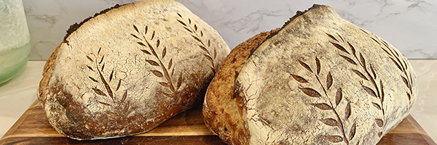
Bread for growth

Slide 37
Hymn: MV #194
Bread of Life, Feed my Soul
Words & Music: Stephen Spencer reprinted under OneLicense A-725110

Slide 38
Bread of life, feed my soul,
as the presence of the
Spirit makes me whole.
Bread of life, fill my heart
with the grace and mercy you impart.

Slide 39
I have heard your voice calling,
“Come, my friend, and share
in the feast that is laid out for you
to show how much I care.”

Slide 40
Bread of life, help me live
a life as pure and true as Jesus did.
Bread of life, help me see
the boundless love of Christ
for you and me.

Slide 41
I have heard your voice calling,
“Come my friend, and share
in the feast that is laid out for
you to show how much I care.”

Slide 42
Bread of life, feed my soul,
as the presence of the
Spirit makes me whole.
Bread of life, fill my heart
with the grace and mercy you impart. *

Slide 43
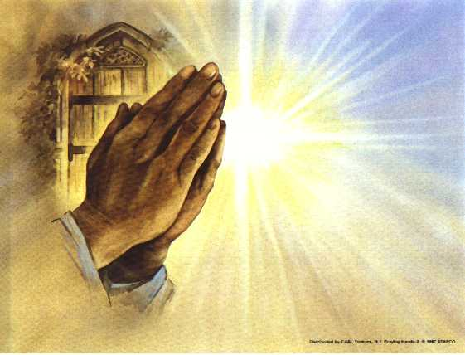
Prayers of
The People
One: With your guidance and grace
All: may your kin(g)dom grow.

Slide 44
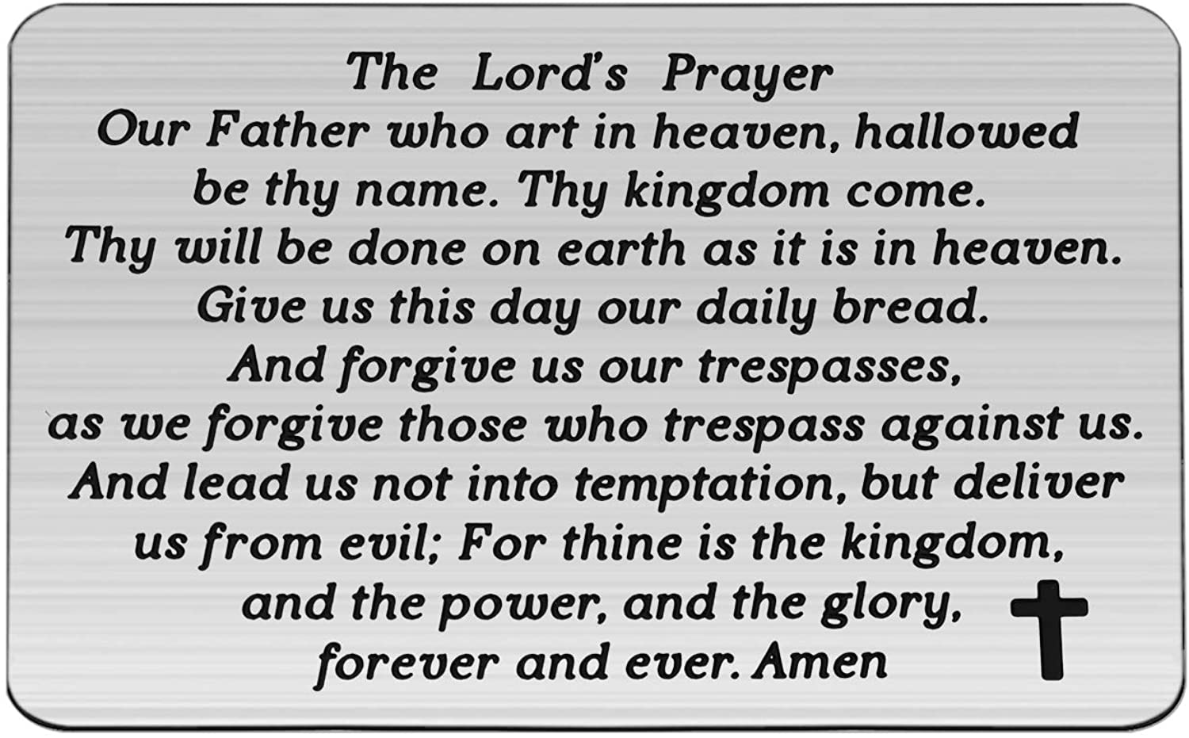

Slide 45
Support the ministry of St. Paul’s :
Through PAR – ask us how to join
via Canada Helps
search for St. Paul’s Sussex
via e-transfer to treasurerstpaulsucc1@gmail.com.
drop in collection plates located in the Narthex and near exit door
by mail to
4 Morrison Avenue, Sussex, N.B. E4E 1P5
during office hours
Notes:
Body text for hymns and prayers

Slide 46
Prayer of Dedication
Generous God, we give because
you have satisfied our needs
with the bread of life. Use these
fruits of our labor and inheritance
to bless our community with love.
Amen

Slide 47
Hymn: VU #424
May the God of Hope
Words Alvin Schutmaat Music: Argentine folk melody reprinted under OneLicense A-725110

Slide 48
May the God of hope
go with us every day,
Filling all our lives
with love and joy and peace.
May the God of justice
speed us on our way,
Bringing light and hope
to every land and race.

Slide 49
Praying, let us work for peace,
singing, share our joy with all,
working for a world that’s new,
faithful when we hear Christ’s call.

Slide 50
May the God of healing free the
earth from fear,
freeing us for peace, both treasured and pursued.
May the God of love keep our commitment clear,
to a world restored, to human life renewed.

Slide 51
Praying, let us work for peace,
singing, share our joy with all,
working for a world that’s new,
faithful when we hear Christ’s call. *

Slide 52
Affirmation of Faith
We believe the kin(g)dom of God
is like baker’s yeast, thorough
and unstoppable, spreading and
rising over time. We believe the
bread of life is enough for all
creation, enough for the hungry,
the weak, and the poor.

Slide 53
We believe Jesus is the bread of
life, broken and shared with all
who will receive it. We believe
the bread of life cannot be limited
to our finite imaginations. The
bread of life is making all things
new. Thanks be to God! Amen

Slide 54
Benediction
&
Commission

Slide 55
Sung Benediction:
Irish Blessing
Words and music: Pedro Rubalcava 2002 reprinted under OneLicense A-725110

Slide 56
May the road rise up to meet you.
May the wind be
always at your back.
May the sun shine warm
upon your face.
And the rain fall soft
upon your fields.

Slide 57
And until we meet again,
And until we meet again,
May the good Lord hold you
In the palm of his hand.

Slide 58
And until we meet again,
And until we meet again,
May the good Lord hold you
In the palm of his hand. *

