Slide 1
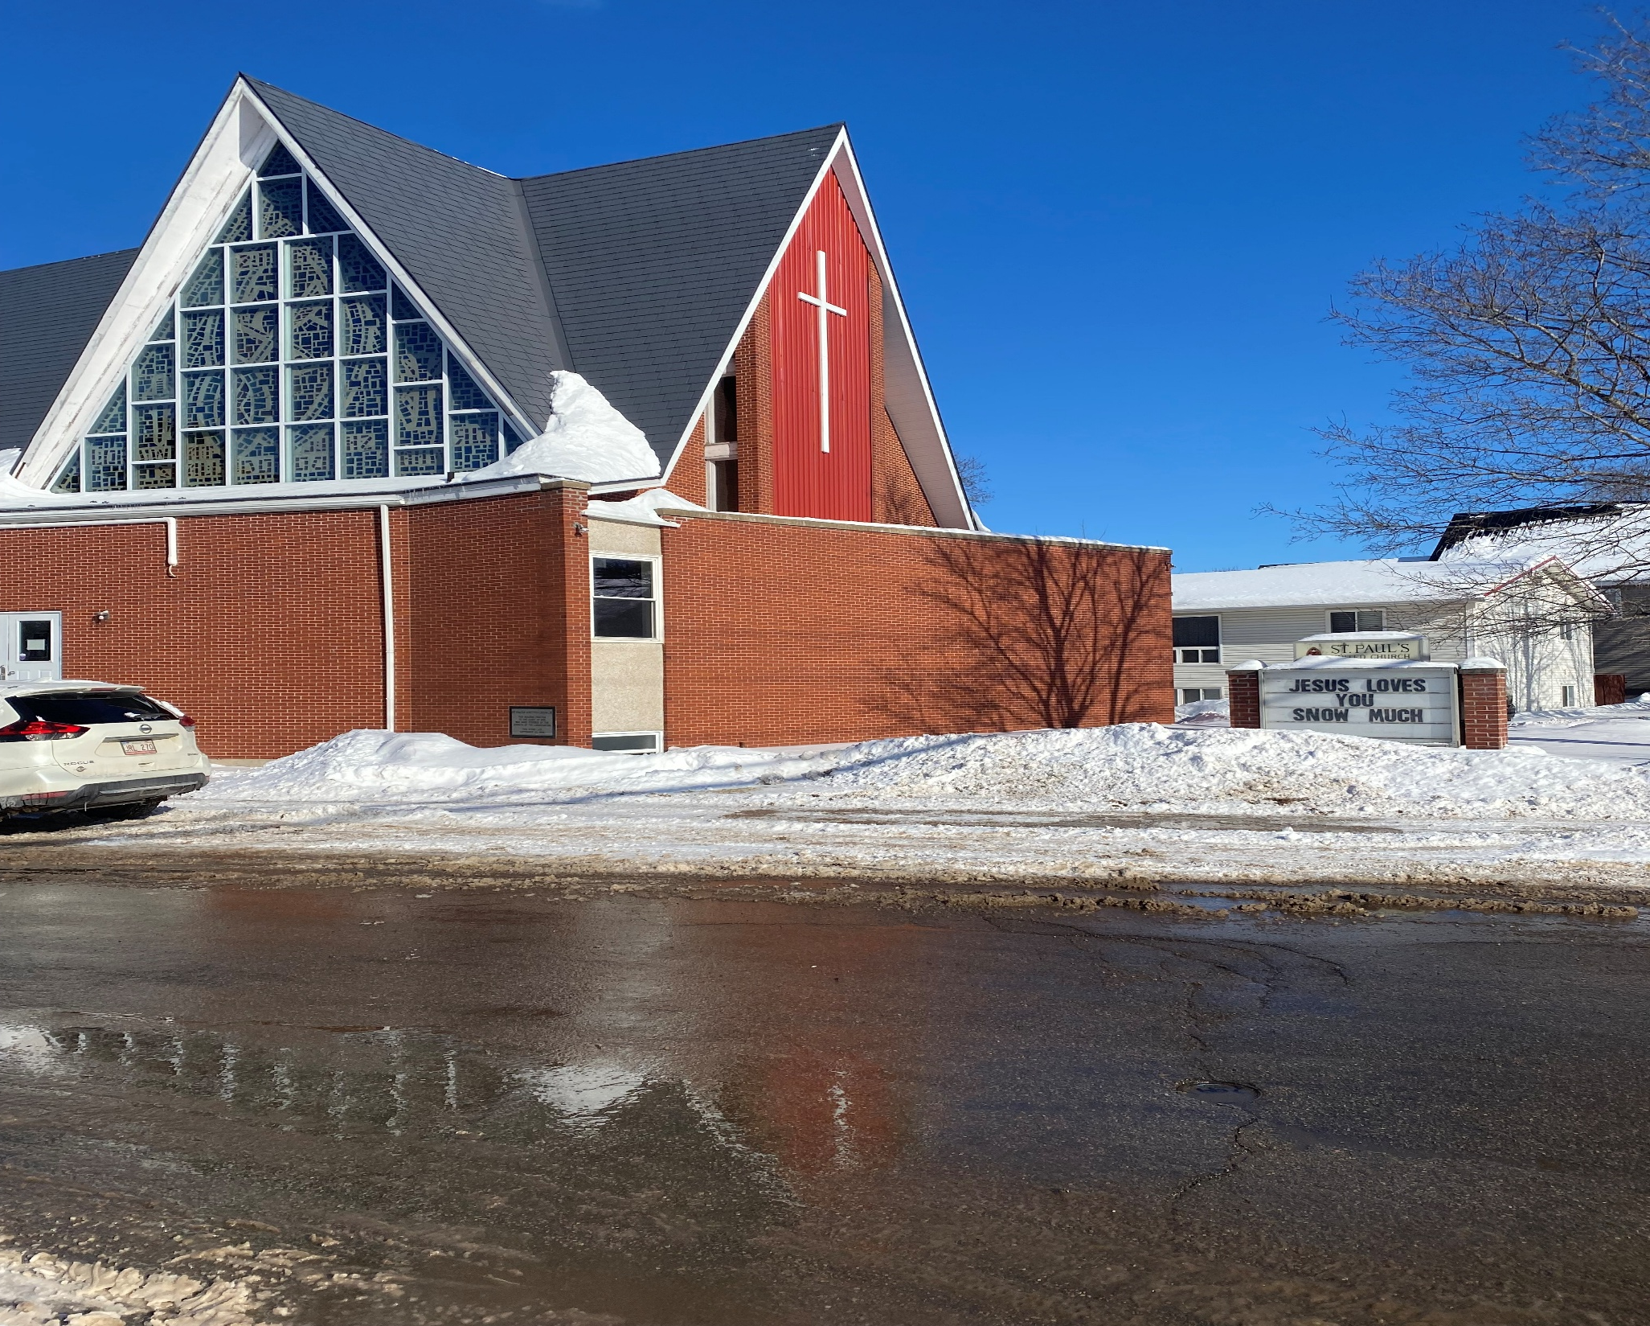
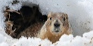
Transfiguration Sunday
St. Paul’s United Church Sussex, NB
March 2, 2025
Welcome

Slide 2
In sanctuary passing of the peace.

Slide 3

New Hymn
MV #180 vs 1
Sing, Sing Out

Slide 4
Sing, sing out! Sing a new song.
Sing oh people as one voice!
Sing, sing out! Sing a new song.
Sing of God, Each heart rejoice!
Sing! Hallelujah!
Hallelujah, as one voice! Sing!
Hallelujah! Hallelujah, all rejoice!

Slide 5
Welcome!
We’re so glad you could join us

Slide 6
Youth group
The youth group will be going to Kiwanis Nursing Home to lead a rousing game of Bingo with the seniors on Monday at 1.

Slide 7
Lent Begins:
Ash Wednesday is this Wednesday, March 5th.
There will be a service offered here in the sanctuary at 6:30pm

Slide 8
Meetings
Council meets Wednesday in the board room at 7:10
Circle of Friendship meets Thursday in the parlour at 2pm.

Slide 9
Game night
Join us for Game Night in the fellowship hall.
Thursday March 6th
starting at 6:30.

Slide 10
World day of prayer
The World Day of Prayer is March 7
This year the service will take place at the Salvation Army Church at the end of Main Street.
Start time is 2pm and all are welcome.

Slide 11
Good News!

Slide 12
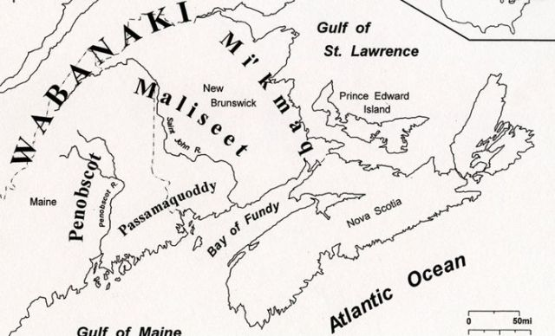
Acknowledging the Territories

Slide 13
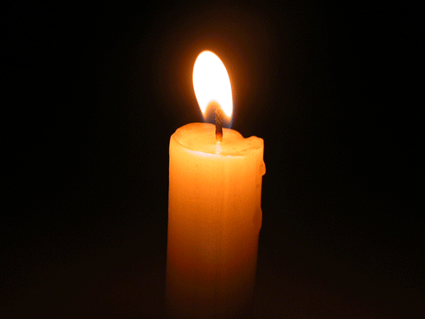
Lighting of the Christ Candle
“God places us in the world as his fellow workers-agents of transfiguration. We work with God so that injustice is transfigured into justice, so there will be more compassion and caring, that there will be more laughter and joy, that there will be more togetherness in God’s world.” — Desmond Tutu

Slide 14

Leader: May the Peace of Christ be with you.
Response:
And also with you.
..
Notes:
Hymn Title Page

Slide 15
Call to Worship
One: The call of the Holy One has
brought us together.
All: We have been called to pray
and to praise.
One: We are called to worship and to
holy wonder.

Slide 16
All: May the light of Love burn
brightly in us.
One: May it transfigure and transform
our hearts and minds.
All: May it become a beacon of
hope for others.

Slide 17
Hymn: VU #104
We Have Come at Christ’s Own Bidding
Words Carl P. Daw jr. music: Cyril Vincent Taylor reprinted under OneLicense A725110

Slide 18
We have come at Christ’s own bidding
To this high and holy place,
Where we wait with hope and longing
For some token of God’s grace.

Slide 19
Here we pray for new assurance
That our faith is not in vain,
Searching like those first disciples
For a sign both clear and complete.

Slide 20
Light breaks in upon our darkness;
Splendour bathes the flesh-joined Word;
Moses and Elijah marvel
As the heavenly voice is heard.

Slide 21
Eyes and hearts behold with wonder
How the Law and Prophets meet:
Christ, with garments drenched in brightness,
Stands transfigured and complete.

Slide 22
Strengthened by this glimpse of glory,
Fearful lest our faith decline,
We like Peter find it tempting
To remain and build a shrine.

Slide 23
But true worship gives us courage
To proclaim what we profess,
That our daily lives may prove us
People of the God we bless. *

Slide 24
Gathering Prayer
God of mountaintops and valleys
and everywhere in between, we
thank you for meeting us where
we are. We thank you also for
leading us to this place of prayer
and renewal.

Slide 25
Enlighten our minds, radiate our
hearts, and ready us for Your
Word of Love. Let it shine in and
through us, lighting a path of
grace, hope, and joy. May the
same transfiguring power, shown
in Jesus Christ, also shine in us
for the good of the world. Amen.

Slide 26

SHINE!!!!!!

Slide 27
Hymn: MV #180
Sing, Sing Out!
Words & Music: Jim Hannah 2003 reprinted under OneLicense A-725110

Slide 28
Sing, sing out! Sing a new song.
Sing oh people as one voice!
Sing, sing out! Sing a new song.
Sing of God, Each heart rejoice!
Sing! Hallelujah!
Hallelujah, as one voice! Sing!
Hallelujah! Hallelujah, all rejoice!

Slide 29
Sing, sing out! Sing a new song.
Sing oh people for rebirth!
Sing, sing out! Sing a new song.
Sing of God in all the earth!
Sing! Hallelujah!
Hallelujah for rebirth! Sing!
Hallelujah! Hallelujah, all rejoice!
*

Slide 30

Prayer for Illumination

Slide 31
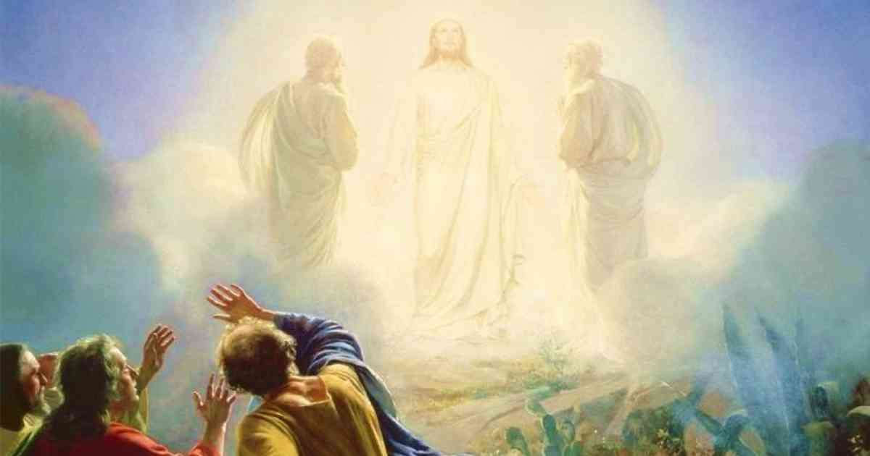
Exodus 34:29-35
Psalm 99
Luke 9:28-36

Slide 32
Ministry of Music:
Shout To The Lord

Slide 33

on top of the mountain

Slide 34
Hymn: MV #82
Bathe Me in Your Light
Words John Oldham, Music Ron Klusmeier 2002 reprinted under OneLicense A-725110

Slide 35
Bathe me in your light,
O God of All, Creator;
Let it shine upon my soul
with healing and with grace.

Slide 36
Be to me a beacon bright through shadows of life’s wounding,
Showing me the way to live in faith,
in your embrace.

Slide 37
Bathe me in your love,
O Source of Awe and Wonder;
Help me walk the sacred path
of harmony and peace.
May I be attentive to
the musings of your presence,
Drinking from the well of hope
that brings the heart release.

Slide 38
Bathe me in your grace,
O One of Spirit’s longing;
Teach me of your gentle ways
that fill the soul with strength.
Guide me on the pilgrimage
that leads to truth and wholeness
Fill me with your promise
of a love that knows no length.*

Slide 39
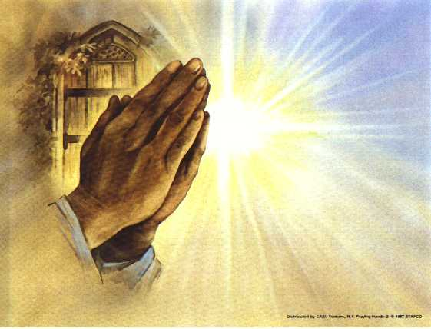
Prayers of
The People
One: God, in your mercy,
All: Hear our prayer.

Slide 40
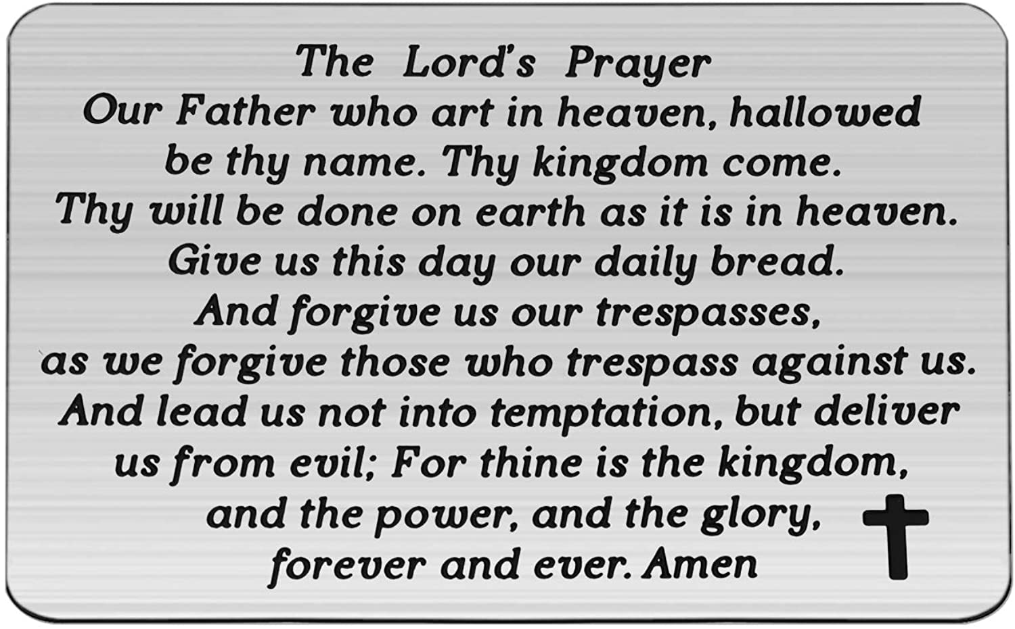

Slide 41
Support the ministry of St. Paul’s :
Through PAR – ask us how to join
via Canada Helps
search for St. Paul’s Sussex
via e-transfer to treasurerstpaulsucc1@gmail.com.
drop in collection plates located in the Narthex and near exit door
by mail to
4 Morrison Avenue, Sussex, N.B. E4E 1P5
during office hours
Notes:
Body text for hymns and prayers

Slide 42
Prayer of Dedication
O Spirit of Life, shine on us again
and again that we may become
the blessing you intend. Keep
awakening us to Your holy
mystery and sacred call.

Slide 43
Bless these gifts we bring so that
Your love may be shared with
others and offer the light of a
new beginning. By this, and more
than we can name, continue to
transfigure us and the world.
Amen.

Slide 44
Hymn: He Is Exalted
Words and music: Kurt Kaiser reprinted under OneLicense A725110

Slide 45
He is exalted,
the King is exalted on high
We will praise him.
He is exalted
forever exalted
And I will praise his name.

Slide 46
He is the Lord
forever his truth shall reign
Heaven and earth
rejoice in his holy name.
He is exalted
the King is exalted on high.
He is exalted
the King is exalted on high. *

Slide 47
Benediction
&
Commission

Slide 48
Sung Benediction:
Shine Jesus Shine
Words and music: Pedro Rubalcava 2002 reprinted under OneLicense A-725110

Slide 49
Shine Jesus Shine,
fill this land with the Father’s glory
Blaze Spirit blaze,
set our hearts on fire.

Slide 50
Flow river flow,
flood the nations with grace and mercy
Send forth your word,
Lord and let there be light. *

