Slide 1

3rd Sunday of Lent
St. Paul’s United Church Sussex, NB
March 23, 2025
Welcome

Slide 2
Welcome!
We’re so glad you could join us

Slide 3
Bookmarks
Lenten Bookmarks are available.
A new one each week of Lent and Easter Sunday.

Slide 4
The agm
The 2024 Annual General Meeting of St. Paul’s United Church will be held after the service so head up to the fellowship hall after.
It will be café style.
Annual reports are now available.

Slide 5
The agm part deux
There are 3 positions on the board to be filled, one vacant and two from members’ terms ending.
Nominations will be taken from the floor.

Slide 6
The agm Redux
We have many seats at the table at the regional conference level. Will you take a seat at the table? We are looking for 2 people to be regional representatives. Nominations will be taken from the floor or talk to Lisa or Nelson Ball about joining.

Slide 7
VBS is coming
There will be a meeting about this year’s VBS program:
Road Trip!
The meeting will be Tuesday at 5:30

Slide 8
Good News!

Slide 9
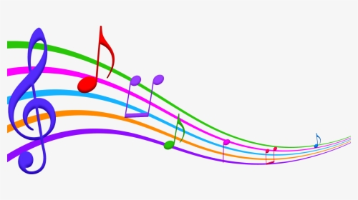
Prelude:
El Shaddai
(God Almighty)

Slide 10
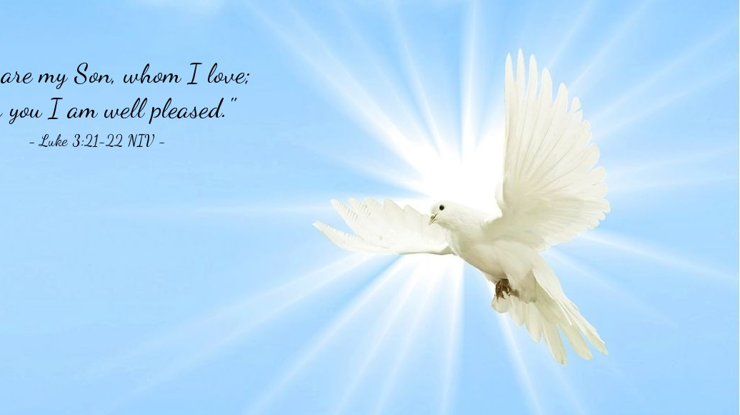
The Peace of Christ.
Sharing the Peace:
Response:
And also with you.
..
Notes:
Hymn Title Page

Slide 11
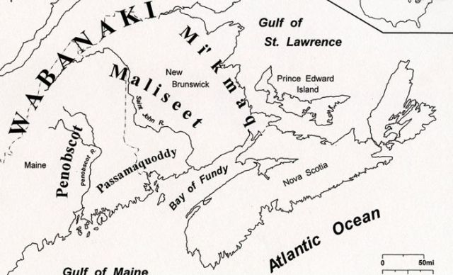
Acknowledging the Territories

Slide 12
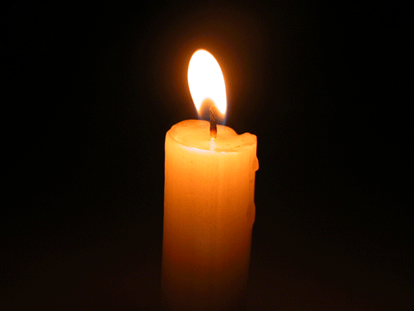
Lighting of the Christ Candle

Slide 13
Call to Worship
One: Listen, siblings of faith. Today,
you will receive the good news of
Jesus.
All: The bread of life satisfies our
hunger and thirst.
One: Today, God will speak to us,
filling our hearts and healing our souls

Slide 14
All: The bread of life loves us and
knows our needs.
One: Today, there will be enough
bread for all, enough to mend every
broken place.
All: The bread of life has come to
sustain us. Believing this promise,
let us worship together!

Slide 15
Hymn: VU #401
Worship the Lord 1,4,5
Words: Fred Kaan, Music: Ron Klusmeier ©1977 reprinted under OneLicense A725110

Slide 16
Worship the Lord
(worship the Lord)
Worship the Father, the Spirit, the Son,
Raising our hands
(raising our hands)
In devotion to God who is one!

Slide 17
Raising our hands as a sign of
rejoicing,
And with our lips our togetherness voicing,
Giving ourselves to a life of creativeness,
Worship and work must be one!

Slide 18
Worship the Lord
(worship the Lord)
Worship the Father, the Spirit, the Son,
Raising our hands
(raising our hands)
In devotion to God who is one!

Slide 19
Bringing the bread and the wine to the table,
Asking that we may be led and enabled,
Truly united to build new communities,
Worship and work must be one!

Slide 20
Worship the Lord
(worship the Lord)
Worship the Father, the Spirit, the Son,
Raising our hands
(raising our hands)
In devotion to God who is one!

Slide 21
Now in response to the life you are giving,
Help us, O Father, to offer our living,
Seeking a just and a healing society,
Worship and work must be one!

Slide 22
Worship the Lord
(worship the Lord)
Worship the Father, the Spirit, the Son,
Raising our hands
(raising our hands)
In devotion to God who is one! *

Slide 23
Gathering Prayer
God our daily provider, you call us
into community, banish our
emptiness, and meet us in
ordinary things like our daily
bread. As we gather in worship,
open our hearts to your voice and
our hands to your provision.

Slide 24
Teach us to trust in your
abundance, to share what we
have, and to pray boldly: “Give us
this day our daily bread.” May this
time of worship nourish us with
your truth and prepare us to
share your love in the world. In
Christ’s name, we pray. Amen

Slide 25
Lenten Prayer of Confession:
One: Often, we overlook… sins of
ingratitude and greed together.
All: God of abundance, we confess
we overlook your daily provision.
We take your gifts for granted,
longing for what we do not have
instead of treasuring what we do.

Slide 26
Our hearts are often filled with
envy, and our desires pull us
away from gratitude. Forgive us,
O God. Open our eyes to your
faithfulness and teach us to live
with contentment and
thanksgiving. We trust that you
provide all we truly need.

Slide 27

The offering of

Slide 28
Jesus told us to pray

Slide 29
Hymn: MV #201
I am the Bread of Life x2
Words & Music: Tom Kacemarek 2005 reprinted under OneLicense A-725110

Slide 30
I am the bread of life
Broken for the world,
I am the cup poured out for all.
Those who believe in me
Will never die.
I am the life of the world.

Slide 31
I am the bread of life
Broken for the world,
I am the cup poured out for all.
Those who believe in me
Will never die.
I am the life of the world. *

Slide 32

Prayer for Illumination

Slide 33
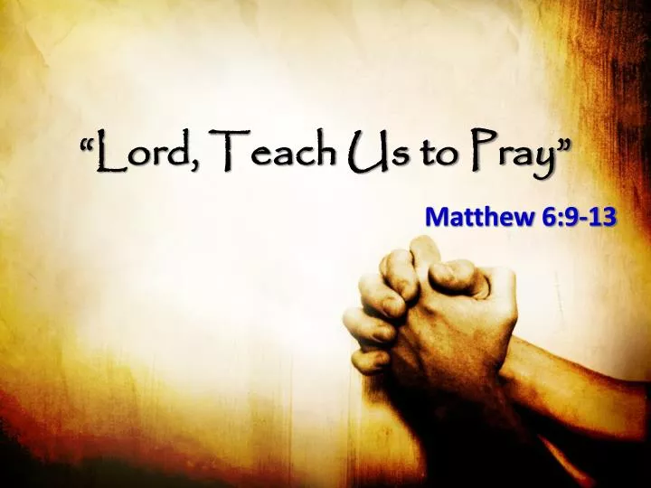
Matthew 6: 9-13

Slide 34
Ministry of Music:
The Face of Jesus

Slide 35
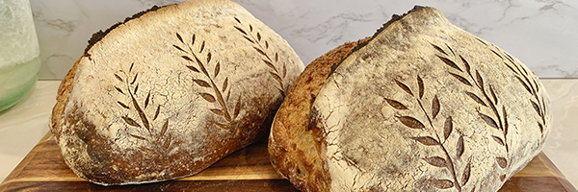
Bread for each day

Slide 36
Hymn: VU #959
The Lord’s Prayer
Words & Music: Stephen Spencer reprinted under OneLicense A-725110

Slide 37
Our Father in heaven,
Hallowed be your name,
Your kingdom come,
Your will be done
on earth as in heaven.
Give us today
our daily bread.

Slide 38
Forgive us our sins as
We forgive those
who sin against us.
Save us from the time of trial
And deliver us from evil
for the kingdom, the power and the glory are yours,
now and forever. *

Slide 39
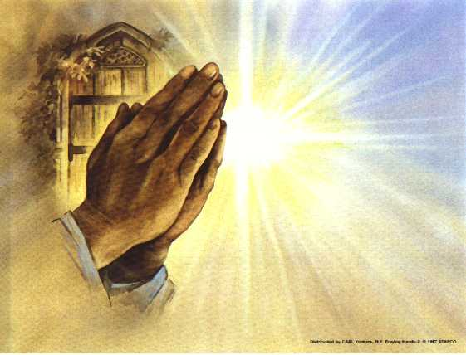
Prayers of
The People
One: Thy will be done on Earth
All: Give us this day our daily bread.

Slide 40
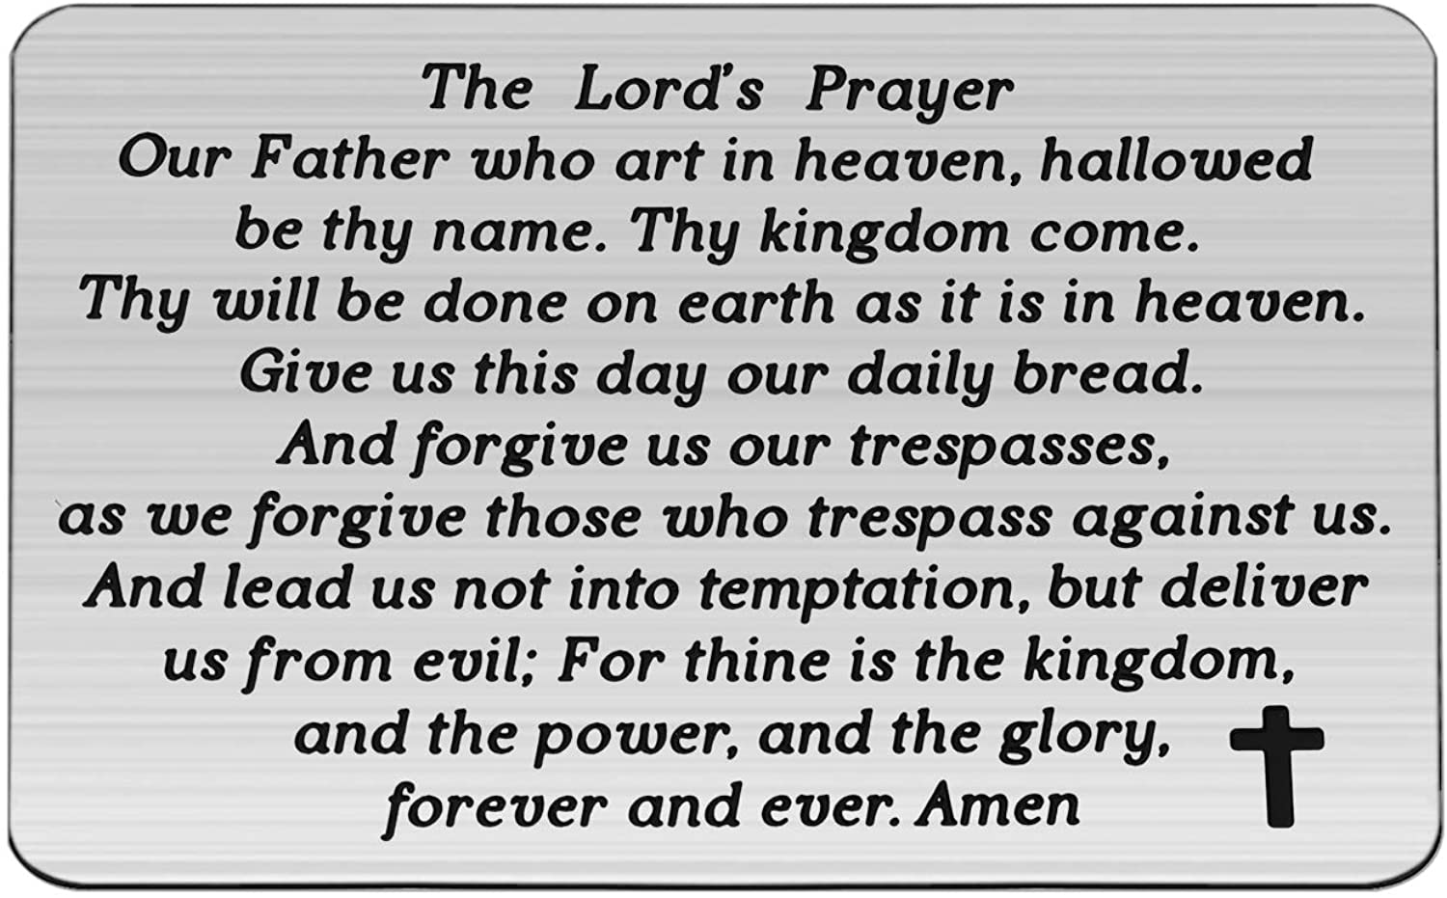

Slide 41
Support the ministry of St. Paul’s :
Through PAR – ask us how to join
via Canada Helps
search for St. Paul’s Sussex
via e-transfer to treasurerstpaulsucc1@gmail.com.
drop in collection plates located in the Narthex and near exit door
by mail to
4 Morrison Avenue, Sussex, N.B. E4E 1P5
during office hours
Notes:
Body text for hymns and prayers

Slide 42
Prayer of Dedication
Holy God, receive these humble
gifts and bless those who give
with steady daily provision. Help
us steward these gifts wisely and
multiply our resources to do good
work in faith.
Amen.

Slide 43
Hymn: VU #468
Let Us Talents and Tongues Employ
Words: Fred Kaan Jamaican Folk Tune © 1975 reprinted under OneLicense A-725110

Slide 44
Let us talents and tongues employ,
Reaching out with a shout of joy:
Bread is broken, the wine is poured,
Christ is spoken and seen and heard.

Slide 45
Jesus lives again,
earth can breathe again,
Pass the Word around:
loaves abound!
Jesus lives again,
earth can breathe again,
Pass the Word around:
loaves abound!

Slide 46
Christ is able to make us one,
At the table he sets the tone,
Teaching people to live to bless,
Love in word and in deed express.

Slide 47
Jesus lives again,
earth can breathe again,
Pass the Word around:
loaves abound!
Jesus lives again,
earth can breathe again,
Pass the Word around:
loaves abound!

Slide 48
Jesus calls us in, sends us out,
Bearing fruit in a world of doubt,
Gives us love to tell, bread to share:
God (Immanuel) everywhere!

Slide 49
Jesus lives again,
earth can breathe again,
Pass the Word around:
loaves abound!
Jesus lives again,
earth can breathe again,
Pass the Word around:
loaves abound! *

Slide 50
Affirmation of Faith
We believe the kin(g)dom of God
is like baker’s yeast, thorough
and unstoppable, spreading and
rising over time. We believe the
bread of life is enough for all
creation, enough for the hungry,
the weak, and the poor.

Slide 51
We believe Jesus is the bread of
life, broken and shared with all
who will receive it. We believe
the bread of life cannot be limited
to our finite imaginations. The
bread of life is making all things
new. Thanks be to God! Amen

Slide 52
Benediction
&
Commission

Slide 53
Sung Benediction:
The Lord Bless You
Words and music: Pedro Rubalcava 2002 reprinted under OneLicense A-725110

Slide 54
The Lord bless you
The Lord keep you
May his love ever,
Always surround you,
Protect you and guide you,
In all that you do.
Our prayer for you. Amen. *

