Slide 1

4th Sunday of Lent
St. Paul’s United Church Sussex, NB
March 30, 2025
Welcome

Slide 2
Welcome!
We’re so glad you could join us

Slide 3
Bookmarks
Lenten Bookmarks are available.
A new one each week of Lent and Easter Sunday.

Slide 4
Meeting
The Board will meet Tuesday at 6:30
Circle of Friendship will meet in the parlour on Thursday at 2pm.
All ladies are welcome.

Slide 5
Join US!!
Literally; join us.
If you are considering or wanting to transfer your membership from another church to ours, or to be confirmed as a member of St. Paul’s see our delightful minister to discuss the possibilities!

Slide 6
The agm revisted
There is an addendum to the Annual report available in the narthex and at the office.

Slide 7
Good News!

Slide 8

Prelude:
Hymn of Promise

Slide 9
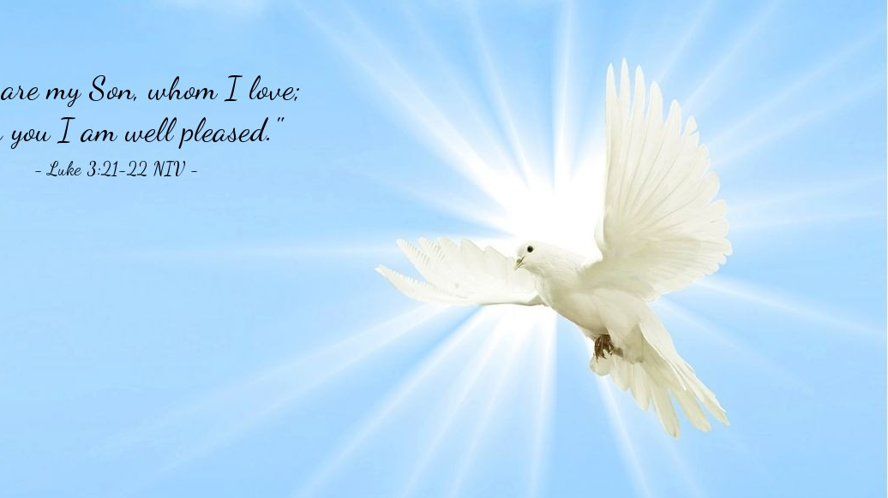
The Peace of Christ.
Sharing the Peace:
Response:
And also with you.
..
Notes:
Hymn Title Page

Slide 10
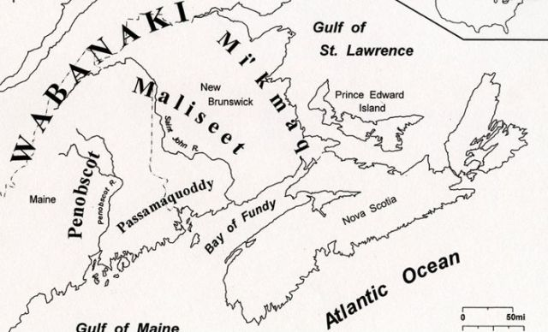
Acknowledging the Territories

Slide 11
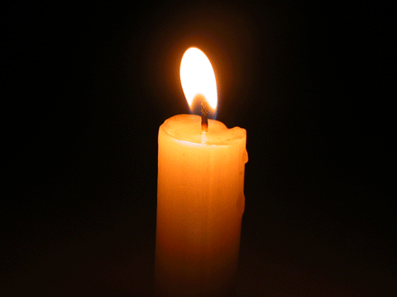
Lighting of the Christ Candle

Slide 12
Call to Worship
One: You are invited to the feast of
plenty. Let every willing soul join in
the circle!
All: The bread of life satisfies our
hunger and thirst.
One: Wear whatever you have. You
are welcome as you are!

Slide 13
All: The bread of life loves us and
knows our needs.
One: At this celebration, no one is
turned away. There is a place for you!
All: The bread of life has come to
sustain us. Believing this promise,
let us worship together!

Slide 14
Hymn: VU #402
We Are One vs 1,2,3 Words: Fred Kaan, Music: Ron Klusmeier ©1977 reprinted under OneLicense A725110

Slide 15
We are one as we come,
as we come, joyful to be here,
In the praise on our lips
there's a sense that God is near.

Slide 16
We are one as we sing,
as we seek, we are found;
And we come needful of God's grace
as we meet, together in this place.

Slide 17
We are one as we share,
as we share brokenness and fear,
In the touch of a hand
there's a sense that God is here.

Slide 18
We are one as we care,
as we heal, we are healed;
And we share warmth in God's embrace
as we pray together in this place.

Slide 19
We are one as we feast,
As we feast, peace becomes the sign;
In the bread and the wine
There’s a sense of love divine.

Slide 20
We are one as we come,
As we feed, we are fed;
And we feel God’s refreshing grace
As we meet at table in this place. *

Slide 21
Gathering Prayer
God of fellowship, laughter, and
friendship, you invite everyone to
join in joyful worship. We are
here not because we are better
than anyone else but because we
are all your beloved children.

Slide 22
You welcome us into worship
with extravagant love. May our
hearts and minds be awakened.
Be glorified in our worship today
and in the fellowship we share.
Amen.

Slide 23
Lenten Prayer of Confession:
One: Often, we choose…confess our
sins of exclusion together.
All: God of extravagant feasts and
open invitations, we confess our
tables are often small and
exclusive. When we should
stretch our welcome to others,

Slide 24
we limit seats to those we find
useful, acceptable, or
entertaining. We make plans
without accommodating
everyone’s needs. We choose to
leave people out rather than
express boundaries that might
feel uncomfortable.

Slide 25
We choose a shallow sense of
peace rather than the deep peace
that comes after hard, healing
conversations. While you do not
require us to include people who
cause us to feel unsafe or at risk,

Slide 26
you do call us to welcome people
we find different, difficult, or
annoying. Give us good
discernment to include those who
challenge us and expand our
capacity for compassion so we
might love our neighbors as you
love us.

Slide 27

The offering of

Slide 28
Jesus told us to pray

Slide 29
Hymn: MV #201
I am the Bread of Life x2
Words & Music: Tom Kacemarek 2005 reprinted under OneLicense A-725110

Slide 30
I am the bread of life
Broken for the world,
I am the cup poured out for all.
Those who believe in me
Will never die.
I am the life of the world.

Slide 31
I am the bread of life
Broken for the world,
I am the cup poured out for all.
Those who believe in me
Will never die.
I am the life of the world. *

Slide 32

Prayer for Illumination

Slide 33
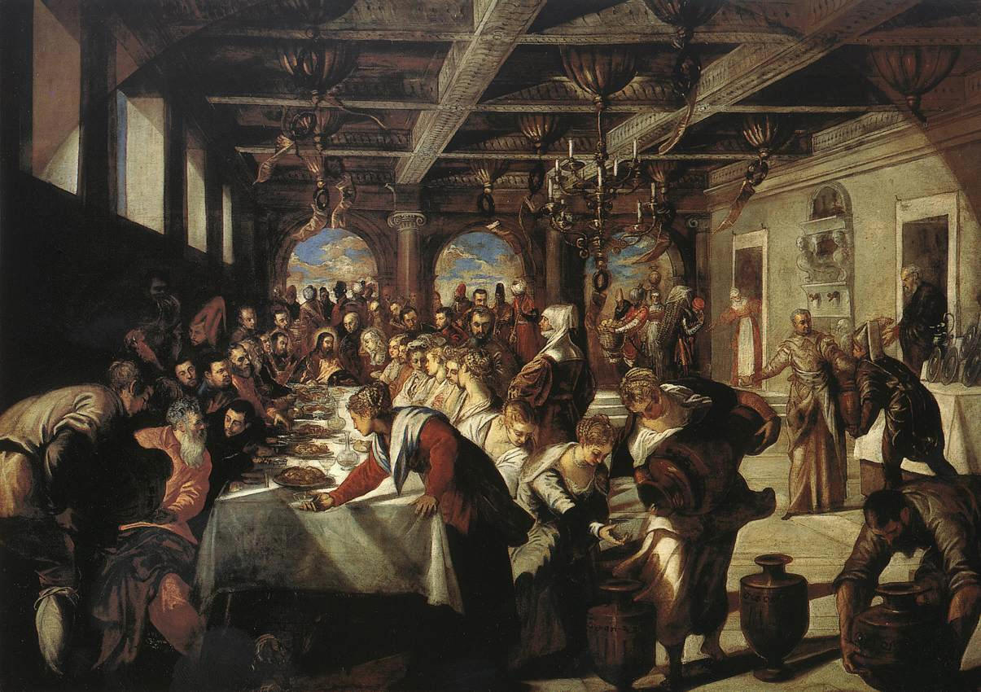
Luke 14: 7-14

Slide 34
Ministry of Music:
O Lord, Have Mercy
solo part by Emily O’Donnell

Slide 35
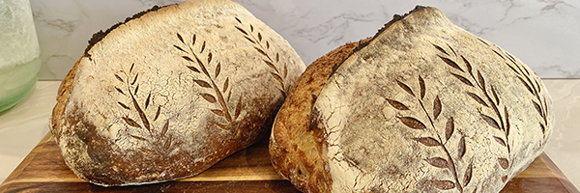
Bread for Sharing

Slide 36
Hymn: VU #469 Come Share the Lord
Words & Music: Stephen Spencer reprinted under OneLicense A-725110

Slide 37
We gather here in Jesus’ name,
His love is burning in our hearts
like living flame;
For through the loving son
God fashions us as one:

Slide 38
Come take the bread,
Come drink the wine,
Come share the Lord.

Slide 39
No one is a stranger here,
Every one belongs;
Finding our forgiveness here,
We in turn forgive all wrongs.

Slide 40
He joins us here, he breaks the bread,
The One who pours the cup
is risen from the dead;
the One we love the most
is now our gracious host:

Slide 41
Come take the bread,
Come drink the wine,
Come share the Lord.

Slide 42
We are now a family
Of which Christ is the head;
Though unseen he meets us here
In the breaking of the bread.

Slide 43
We’ll gather soon where angels sing;
We’ll see the glory of
Our Lord and coming King;
Now we anticipate
The feast for which we wait;

Slide 44
Come take the bread,
Come drink the wine,
Come share the Lord. *

Slide 45
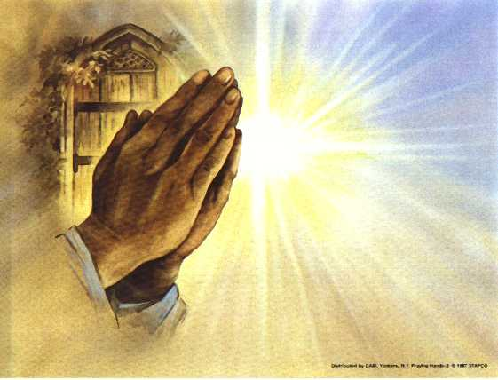
Prayers of
The People
One: Bread of life,
All: may we freely give to others.

Slide 46
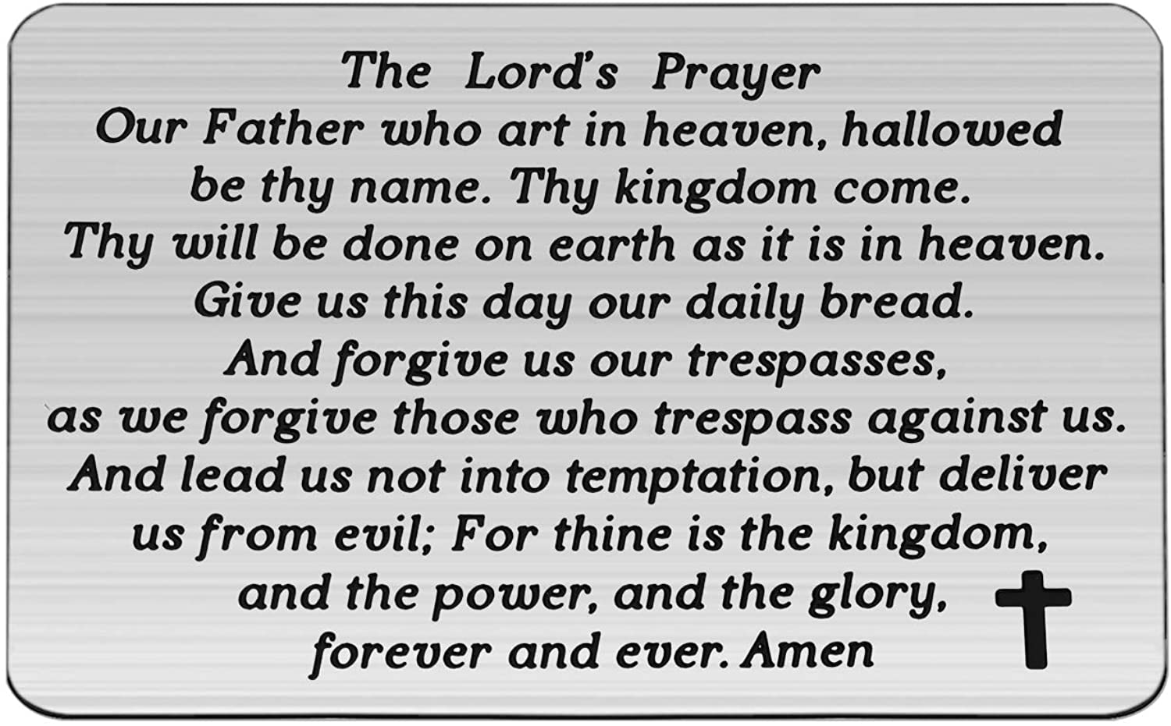

Slide 47
Support the ministry of St. Paul’s :
Through PAR – ask us how to join
via Canada Helps
search for St. Paul’s Sussex
via e-transfer to treasurerstpaulsucc1@gmail.com.
drop in collection plates located in the Narthex and near exit door
by mail to
4 Morrison Avenue, Sussex, N.B. E4E 1P5
during office hours
Notes:
Body text for hymns and prayers

Slide 48
Prayer of Dedication
Bread of life and source of all
good things, receive these gifts
and offerings in your generous
hands.

Slide 49
May they serve your
church and our community,
expanding the message of your
love and grace to all who hunger
and thirst.
Amen

Slide 50
Hymn: VU #481
Sent Forth by
God’s Blessing
Words: Fred Kaan Jamaican Folk Tune © 1975 reprinted under OneLicense A-725110

Slide 51
Sent forth by God's blessing,
our true faith confessing,
the people of God from
this dwelling take leave.
The supper is ended, O now be extended
the fruits of this service in all who believe.

Slide 52
The seed of Christ's teaching,
receptive souls reaching,
shall blossom in action for God and for all.
God's grace did invite us,
God's love shall unite us
to work for the kingdom
and answer its call.

Slide 53
With praise and thanksgiving
to God ever living,
the tasks of our everyday life we will face.
Our faith ever sharing, in love ever caring,
embracing God's children
of each tribe and race.

Slide 54
With your feast you feed us,
with your light now lead us;
unite us as one in this life that we share.
Then may all the living
with praise and thanksgiving
give honour to Christ and
the name that we bear. *

Slide 55
Affirmation of Faith
We believe in God, who created
all people in the divine image and
calls each person beloved. We
believe in Jesus Christ, who
welcomed and ate with outsiders
and proclaimed good news to the
poor.

Slide 56
We believe in the Holy Spirit, who
breaks down dividing walls and
gathers us into one body where
all belong. We believe God calls
us to practice radical hospitality,
inviting those who are excluded
to the table.

Slide 57
We believe the church is called to
be a refuge of safety and healing
where healthy boundaries nurture
trust and protect the vulnerable.
We believe inclusion means
valuing each person’s dignity,
welcoming their story, and
celebrating their gifts.

Slide 58
We believe humility guides our
interactions, teaching us to honor
and serve others. We believe
God’s kin(g)dom is a great
banquet with room for all, and
love is the host.

Slide 59
We believe our work of inclusion
is ongoing and empowered by the
Spirit, who makes all things new.
Amen.

Slide 60
Benediction
&
Commission

Slide 61
Sung Benediction:
The Lord Bless You
Words and music: Pedro Rubalcava 2002 reprinted under OneLicense A-725110

Slide 62
The Lord bless you
The Lord keep you
May his love ever,
Always surround you,
Protect you and guide you,
In all that you do.
Our prayer for you. Amen. *

