Slide 1
WELCOME
PLEASE PLACE YOUR BACKPACKS, LUNCHBAG, WORK BAG, WHATEVER YOU BROUGHT FOR BLESSING AROUND THE COMMUNION TABLE BEFORE THE START OF THE SERVICE.
THANK YOU.

Slide 2

St. Paul’s United Church
Sussex, NB
September 14th, 2025
1st Sunday
of Creation Time
In Pentecost

Slide 3
Welcome!
We’re so glad you could join us

Slide 4
What are they doing?
Minutes of the board meetings are posted on the bulletin board by the sanctuary doors
or see a board member for a copy.

Slide 5
What are they doing?
Paving!!!
The parking lot will be paved this week so look forward to a proper parking space next Sunday.

Slide 6
What are they doing?
Boiling Corn!
Don’t forget, the corn boil today after the service along with sweets, tea, coffee, etc.

Slide 7
Speaking of Coffee and tea…
Coffee time is after the service on the 2nd and 4th Sunday of each month. If you’d like to help, contact the office.

Slide 8
Sing sing sing!
Choir rehearsals are every Wednesday at 6pm.
We will be happy to welcome new members.

Slide 9
Sunday September 28
Orange Shirt Day! Wear an orange shirt.
Blessing of the Animals in the parking lot at 1pm.

Slide 10
Sign up now for fun in the future!
Church Buddies returns!!
Sign up on the white board.

Slide 11
Bible study
Bible study sessions will begin on September 24th and continue the last Wednesday of each month. 6:30 drop in.

Slide 12
Good News!

Slide 13

Prelude:
Congregational
Sing-a-long:
Happy in Your Faith
Paul Baloche CCLI

Slide 14
If you’re happy and you know it clap your hands XX
If you’re happy and you know it clap your hands XX
If you’re happy and you know it,
then your faith will surely show it
If you’re happy and you know it clap your hands. XX

Slide 15
If you’re happy and you know it, stomp your feet XX
If you’re happy and you know it, stomp your feet XX

Slide 16
If you’re happy and you know it,
then your faith will surely show it
If you’re happy and you know it,
stomp your feet XX,
and clap your hands! XX

Slide 17
If you’re happy and you know it, praise the Lord (A-men!)
If you’re happy and you know it, praise the Lord (A-men!)

Slide 18
If you’re happy and you know it,
then your faith will surely show it
If you’re happy and you know it, praise the Lord (A-men!)
And stomp your feet XX,
and clap your hands! XX *

Slide 19
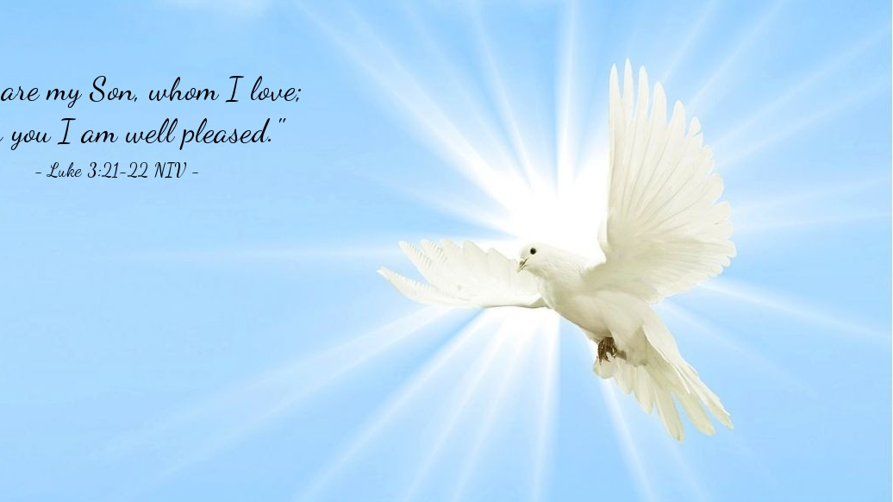
The Peace of Christ.
Sharing the Peace:
One: May the peace of Christ be with you.
Response: and also with you.
Response:
And also with you.
..
Notes:
Hymn Title Page

Slide 20
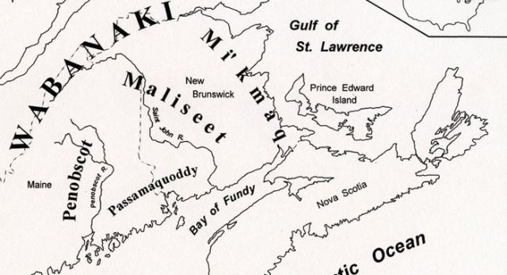
Acknowledging the Territories

Slide 21
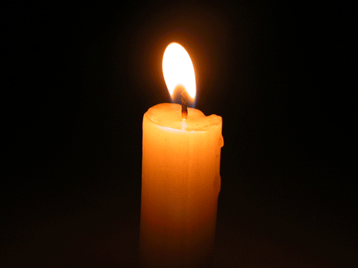
Lighting of the Christ Candle
.
“In the same way, I tell you, there is rejoicing in the presence of the angels of God over one sinner who repents.” - Jesus from Luke 15

Slide 22
Call to Worship:
One: Today we gather to worship our God!
All: Let us worship our Creator,
One: The God who connects us all:
different peoples, different lives,
different histories. Let us worship God.

Slide 23
All: We give you thanks for your
diverse creation, and the love and
respect evident in this church.
One: We will give thanks to the Lord
with our whole heart; we will tell of all
God’s wonderful deeds.

Slide 24
All: We will be glad and exult in
you; we will sing praise to your
name, O Most High.
One: Let us praise God.
All: Amen.

Slide 25
Hymn: MV #122
This Is the Day
Words & Music: Bruce Harding 2003 reprinted under OneLicense A-725110

Slide 26
This is the day that God has made;
We will rejoice and be glad!
This is the day that God has made;
We will rejoice and be glad!

Slide 27
Singing hallelu, singing hallelu
Singing hallelu,
We will rejoice and be glad!
Singing hallelu, singing hallelu
Singing hallelu,
We will rejoice and be glad! *

Slide 28
Gathering Prayer
Storytelling God, we have
gathered in this space to
celebrate your love in our lives.
We come to find ways to have our
faith stories to merge with the
stories of your people over the
centuries.

Slide 29
You are the source of wisdom we
seek, your mercy eases the
troubles that stir our hearts, and
we come to praise you for your
stories have the power to
challenge us and change us. Draw
near to us as we draw near to you
this day.

Slide 30
Tell us the stories that will
change our lives, through the
grace of Jesus Christ and the
power of the Holy Spirit.

Slide 31
A FRIENDLY WELCOME

Slide 32
Hymn:
MV #183 Shout Out Your Love
Words and Music: Bruce Harding reprinted under OneLicense A-725110

Slide 33
I’m gonna shout, shout,
Shout out my love for Jesus,
for Jesus!
I’m gonna shout, shout,
Shout out my love
for God’s most holy child!

Slide 34
For whatever I might do today,
At home, at school,
at work, at play,
I’ve Jesus’ love deep down inside of me!

Slide 35
I’m gonna raise, raise,
Raise up my hands for Jesus,
for Jesus!
I’m gonna raise, raise,
Raise up my hands
for God’s most holy child!

Slide 36
For whatever I might do today,
At home, at school,
at work, at play,
I’ve Jesus’ love deep down inside of me!

Slide 37
I’m gonna dance, dance,
dance all around for Jesus,
for Jesus!
I’m gonna dance, dance,
dance all around for God’s most holy child!

Slide 38
For whatever I might do today,
At home, at school,
at work, at play,
I’ve Jesus’ love deep down inside of me! *

Slide 39

Prayer for Illumination

Slide 40
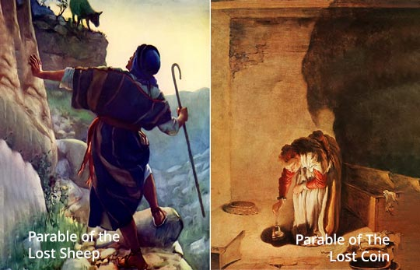
Luke 15: 1-10

Slide 41
Ministry of Music:
God of Wonders

Slide 42
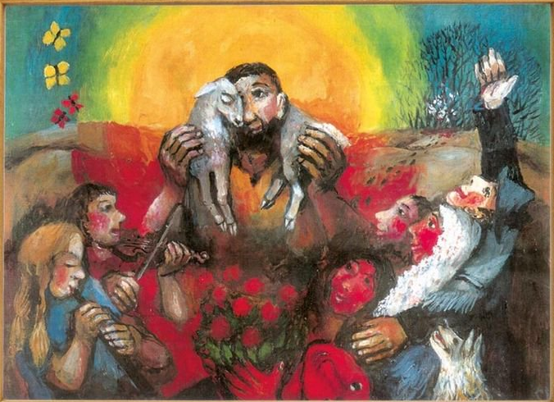
Lost sheep and found blessings

Slide 43
Blessing of the Backpacks
One: Today, we have before us…
Whose backpacks are these? (Everyone who brought a bag call out their name)
One: Will you fill the backpacks and
work bags of these people with your
love, prayers, and support?
All: We will.

Slide 44
Litany of Blessing:
One: When I am ready to go,
All: I know you are with me, God.
One: When I am not sure about anything,
All: I know you are with me, God.
One: When I am scared,
All: I know you are with me, God.

Slide 45
One: When I am embarrassed,
All: I know you are with me, God.
One: When I am delighted,
All: I know you are with me, God.
One: When I am trying something new,
All: I know you are with me, God.

Slide 46
One: Allow my work to be a gift to you,
All: God, I trust in you.
One: Allow me to find my rest in you,
All: God, I trust in you.
One: Allow me to know that you will
always hear me,
All: God, I trust in you.

Slide 47
One: Allow me to feel your love in all my moments,
All: God, I trust in you.
One: Allow me to know that my life is a gift,
All: God, I trust in you.
One: Let us pray. O God,… Let the people say “Amen!”

Slide 48
Hymn: TLUS #6 God Lights A Lamp 2x
Words: Katie Grabe 2024 Music: Anneli Loepp Thiessen 2020. reprinted under OneLicense A-725110

Slide 49
God lights a lamp
and she searches everywhere
For the hidden, lonely heart.
God lights a lamp
and she searches everywhere
When she finds you, oh she sings;

Slide 50
“I have found my treasure,
my precious silver coin.
I have found my love!”
Even an-gels will hear the news:
What once was lost is found.

Slide 51
God lights a lamp
and she searches everywhere
For the hidden, lonely heart.
God lights a lamp
and she searches everywhere
When she finds you, oh she sings;

Slide 52
“I have found my treasure,
my precious silver coin.
I have found my love!”
Even an-gels will hear the news:
What once was lost is found. *

Slide 53
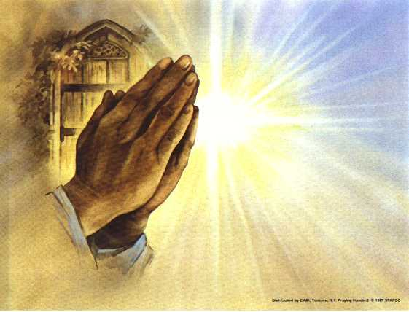
Prayers of
the People
One: God of mercy,
All: Draw near to all who need you.

Slide 54
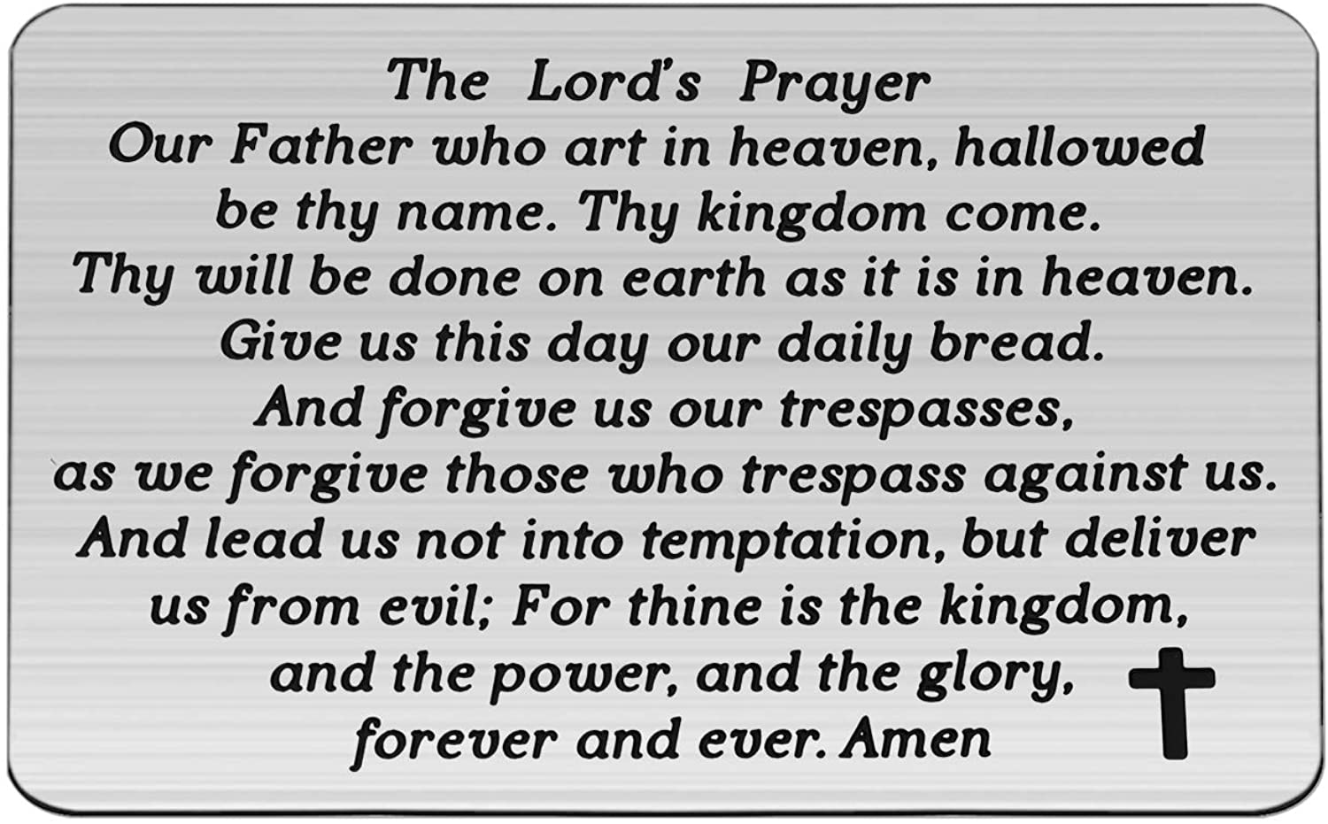

Slide 55
Support the ministry of St. Paul’s :
Through PAR – ask us how to join
via Canada Helps
search for St. Paul’s Sussex
via e-transfer to treasurerstpaulsucc1@gmail.com.
drop in collection plates located in the Narthex and near exit door
by mail to
4 Morrison Avenue, Sussex, N.B. E4E 1P5
during office hours
Notes:
Body text for hymns and prayers

Slide 56
Prayer of Dedication
Lord God, receive our gifts
offered in a spirit of generosity
and humility. Bless and use them
for the work that you long to do
in the world, in Jesus’ name.
Amen.

Slide 57
Hymn: MV #191 What Can I Do? 2x
Words and Music: Paul Rumbolt and Michele McCarthy 2005 Reprinted under OneLicense A-725110

Slide 58
What can I do? What can I bring?
What can I say? What can I sing?
I’ll sing with joy. I’ll say a prayer.
I’ll bring my love.
I’ll do my share.

Slide 59
What can I do? What can I bring?
What can I say? What can I sing?
I’ll sing with joy. I’ll say a prayer.
I’ll bring my love.
I’ll do my share. *

Slide 60
Benediction
&
Commissioning

Slide 61
Sung Benediction:
TLUS #4 Glory to The Creator
Words and Music: Christopher Grundy 2002 reprinted under OneLicense A-725110

Slide 62
Glory to the Creator,
And the Christ
and the Spirit so near,
As it was from the start
So it shall be forever one God,
Always here.

Slide 63
Glory to the Creator,
And the Christ
and the Spirit so near,
As it was from the start
So it shall be forever one God,
Always here. *

