Slide 1

St. Paul’s United Church
Sussex, NB
September 14th, 2025
2nd Sunday
of Creation Time
In Pentecost

Slide 2
Welcome!
We’re so glad you could join us

Slide 3
It’s so nice!!!
A big THANK YOU to the trustees as they were able to divest our unused lot for cash and that superb new
parking lot.

Slide 4
Bible study
Bible study sessions will begin on September 24th and continue the last Wednesday of each month. 6:30 drop in.

Slide 5
Sunday September 28
The service will be led by the intrepid venturers who went to General Council.

Slide 6
Sunday September 28
Orange Shirt Day! Wear an orange shirt.
Blessing of the Animals in the parking lot at 1pm.

Slide 7
Wednesday October 1 5pm, Millstream UCW are hosting a themed supper “Dining With The Stars” details on the calendar board in the entryway.

Slide 8
Good News!

Slide 9

Prelude:
All The Earth
Paul Baloche CCLI

Slide 10
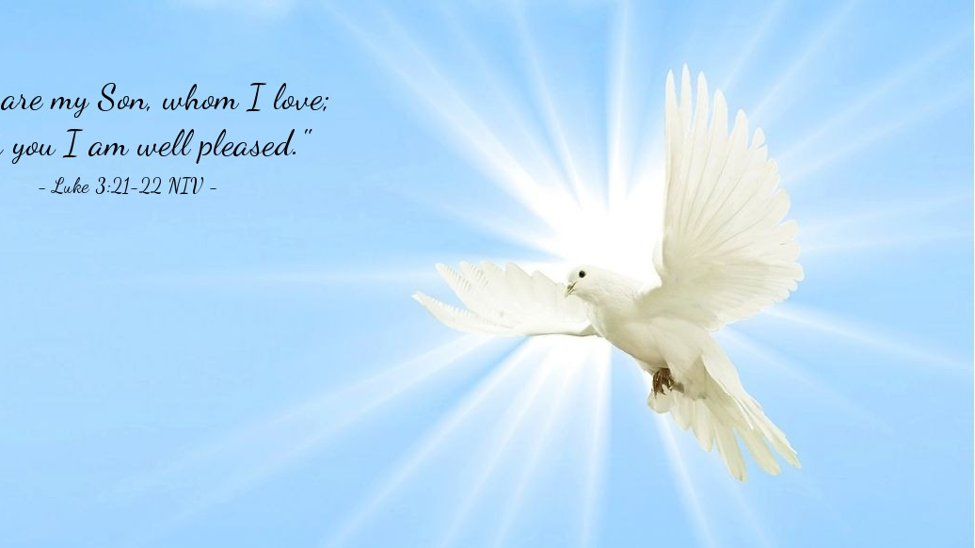
The Peace of Christ.
Sharing the Peace:
One: May the peace of Christ be with you.
Response: and also with you.
Response:
And also with you.
..
Notes:
Hymn Title Page

Slide 11
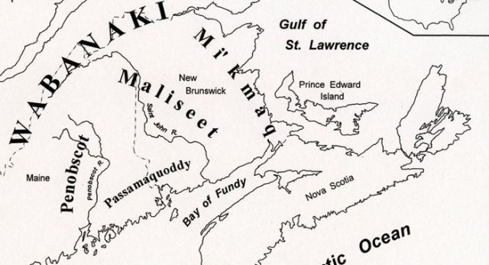
Acknowledging the Territories

Slide 12
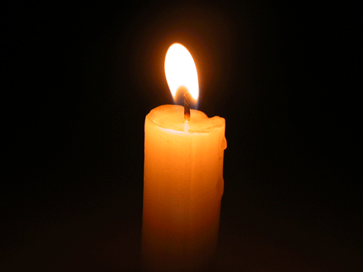
Lighting of the Christ Candle
.
“A person is whole only when they take into account their shadow.” – Djuna Barnes

Slide 13
Call to Worship:
One: Praise the Lord! From the rising
of the sun until its setting, for the
name of God deserves our praise!
All: Who is like our God…
One: Praise God, who sees all things
and remembers the poor and those
in need.

Slide 14
All: For God raises the lowly and
levels the exalted.
One: Praise God, who is just and
mighty, who repairs and redeems.
All: For God pours out love and
justice, compassion and
conviction, hope and salvation.
Praise the Holy One!

Slide 15
Hymn: MV #27 Creator God You Gave Us Life
Words & Music: Judith Snowdon 2003 reprinted under OneLicense A-725110

Slide 16
Creator God you gave us life,
Your image formed within our souls,
Yet through the mist of time and
space
We search for that which makes
us whole.

Slide 17
Through hands that paint majestic skies
And voices chanting melody,
With words that reach beyond the page
We comprehend your mystery.

Slide 18
In ev’ry flow’r and ev’ry tree
We see your great diversity,
Yet greater still we see your love,
Expressed in our humanity.

Slide 19
Through hands that paint majestic skies
And voices chanting melody,
With words that reach beyond the page
We comprehend your mystery.

Slide 20
When with our hearts, our hands our minds,
We share our gifts with all the world,
Our spirits soar beyond the veil,
To touch the very face of God.

Slide 21
Through hands that paint majestic skies
And voices chanting melody,
With words that reach beyond the page
We comprehend your mystery. *

Slide 22
Gathering Prayer
God, you are our source, guide
and goal: for you have made us in
your image and set us in a world
full of beauty; although you dwell
in heavenly light, you have come
to be among us, full of grace and
truth;

Slide 23
and coming in wind and flame to
work your wonders in our midst.
Gracious God, awaken us from
sleep that we may worship you in
spirit and in truth: through Jesus
Christ our Lord. Amen.

Slide 24
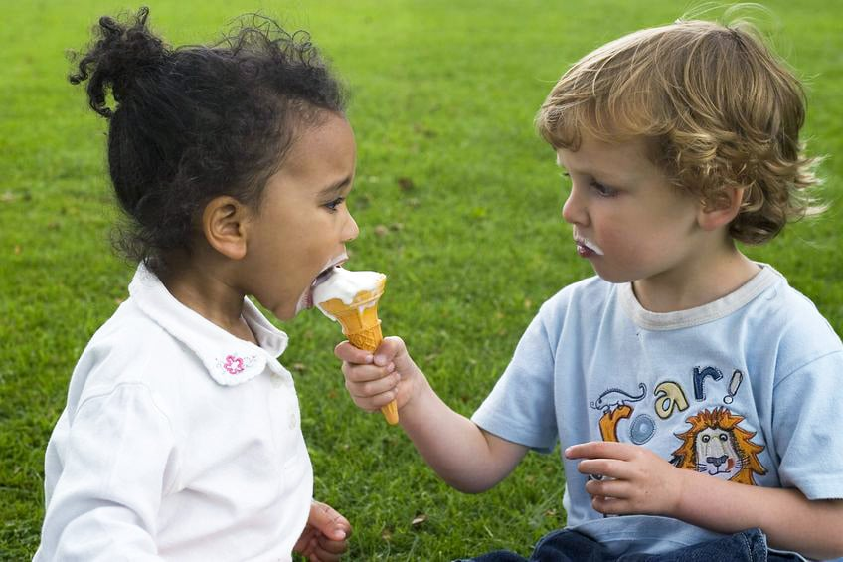
Sharing is Best

Slide 25
Hymn:
Dare to Dance 2x
Words and Music: Bruce Harding reprinted under OneLicense A-725110

Slide 26
Dare to dance with dreamers,
sing their song.
Dare to dance their stories,
sing out strong.
Dare to dance with freedom
your whole life long.
Dare to dance again.

Slide 27
Dare to dance with dreamers,
sing their song.
Dare to dance their stories,
sing out strong.
Dare to dance with freedom
your whole life long.
Dare to dance again. *

Slide 28

Prayer for Illumination

Slide 29
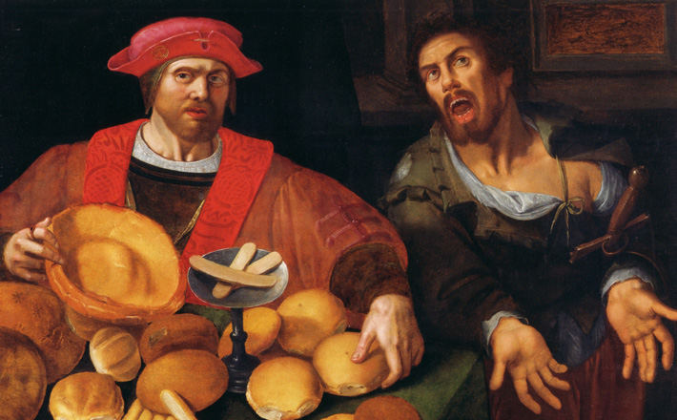
Luke 16:1–13

Slide 30
Ministry of Music:
Way Maker
(from TLUS)

Slide 31

Hmmm…

Slide 32
Hymn: MV #65 When We Are Tested vs 1,3,4
Words: Ruth Duck 1996 Music: Ruth Watson Henderson 2006. reprinted under OneLicense A-725110

Slide 33
When we are tested
and wrestle alone,
Famished for bread when the world offers stone,
Nourish us, God, by your word and your way,
Food that sustains us by night and by day.

Slide 34
When we are tempted to barter our souls,
Trading the truth for the pow’r to control,
Teach us to worship and praise only you,
Seeking your will in the work that we do.

Slide 35
When we have struggled and searched through the night,
Sorting and sifting the wrong from the right,
Saviour, surround us with circles of care,
Angels of healing, of hope, and of prayer. *

Slide 36
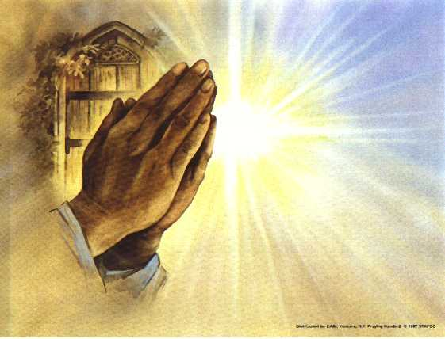
Prayers of
the People
One: God, speak to us a word of ***
All: Embrace us with your love.

Slide 37
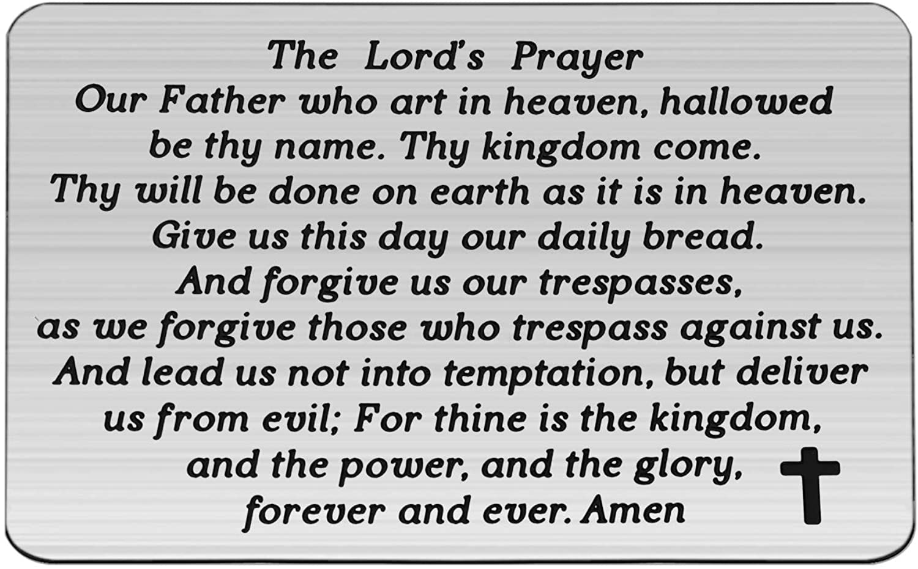

Slide 38
Support the ministry of St. Paul’s :
Through PAR – ask us how to join
via Canada Helps
search for St. Paul’s Sussex
via e-transfer to treasurerstpaulsucc1@gmail.com.
drop in collection plates located in the Narthex and near exit door
by mail to
4 Morrison Avenue, Sussex, N.B. E4E 1P5
during office hours
Notes:
Body text for hymns and prayers

Slide 39
Prayer of Dedication
We bring our gifts to you, O God,
in gratitude for all you give us.
Bless them and make them a
source of healing for a world in
need, for the sake of Jesus Christ,
who sends us out in love. Amen.

Slide 40
Hymn: VU #701 What Does the Lord Require of You
Words and music Jim Strathdee 1986 reprinted under OneLicense A-725110

Slide 41
What does the Lord
require of you?
What does the Lord
require of you?
What does the Lord
require of you?
What does the Lord
require of you?

Slide 42
Justice, kindness,
walk humbly with your God.
Justice, kindness,
walk humbly with your God.

Slide 43
To seek justice, and love kindness,
And walk humbly with your God.
To seek justice, and love kindness,
And walk humbly with your God.

Slide 44
What does the Lord
require of you?
What does the Lord
require of you?
What does the Lord
require of you?
What does the Lord
require of you? *

Slide 45
Benediction
&
Commissioning

Slide 46
Sung Benediction:
TLUS #4 Glory to The Creator
Words and Music: Christopher Grundy 2002 reprinted under OneLicense A-725110

Slide 47
Glory to the Creator,
And the Christ
and the Spirit so near,
As it was from the start
So it shall be forever one God,
Always here.

Slide 48
Glory to the Creator,
And the Christ
and the Spirit so near,
As it was from the start
So it shall be forever one God,
Always here. *

