Slide 1

St. Paul’s United Church
Sussex, NB
September 28th, 2025
3rd Sunday
of Creation Time
In Pentecost

Slide 2
Welcome!
We’re so glad you could join us

Slide 3
After the service
Coffee and conversation after the service today.

Slide 4
This afternoon!
Blessing of the Animals in the parking lot at 1pm.

Slide 5
This is Your Last chance!
Don’t leave someone alone.
be a hero. be a buddy.
Today is the last day to sign up for church buddies.

Slide 6
meeting
Circle of Friendship will meet on Thursday at 2pm.

Slide 7
Wednesday October 1 5pm, Millstream UCW are hosting a themed supper “Dining With The Stars” details on the calendar board in the entryway.

Slide 8
Hey Jo-Ann. You selling apples?
The fall take out luncheon is October 24th. You can order by calling the office
Oct. 7,8,9,14,15,16. Cost $10

Slide 9
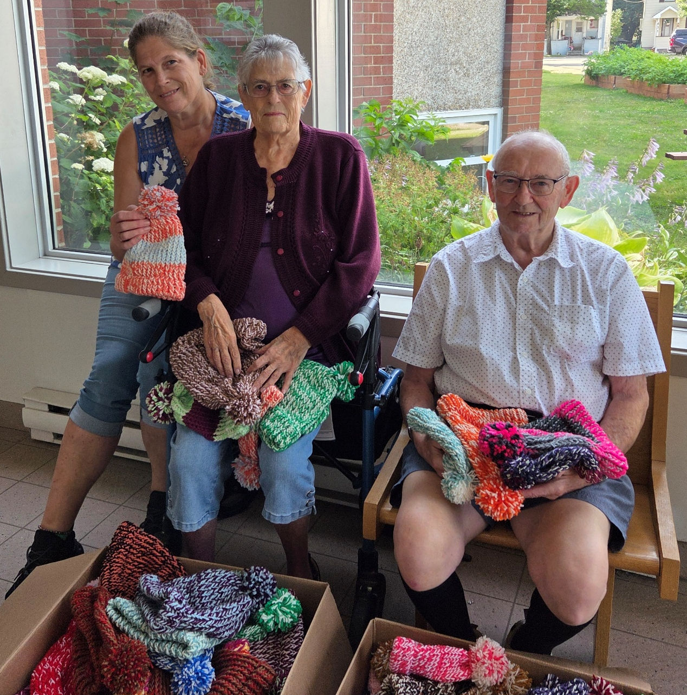
Ruel and Marion Hall need
yarn. If you have
any yarn that you
can donate,
please bring it in
to the office.

Slide 10
Forced to Flee:
Oct 16 7pm
Contact Wendy
Anderson or the
Office for more
Information on this free event.

Slide 11
Choral Fest is coming! October 26th, 2pm.
Over 75 members will perform Vivaldi’s Four Seasons in this national premiere. Tickets now on sale for $20 at the office.

Slide 12
Good News!

Slide 13

Prelude:
Learn the New Hymn “Let’s Go Together”
vs 1

Slide 14
Let’s go together for a while and ask where we begin-
to build a world where love can grow and hope can enter in.
To be the hands of healing
and to plant the seed of peace,

Slide 15
Singing welcome,
welcome to this place.
You’re invited to come and know God’s grace.
All are welcome, the love of God to share---
‘cause all of us are welcome here;
All are welcome in this place.

Slide 16
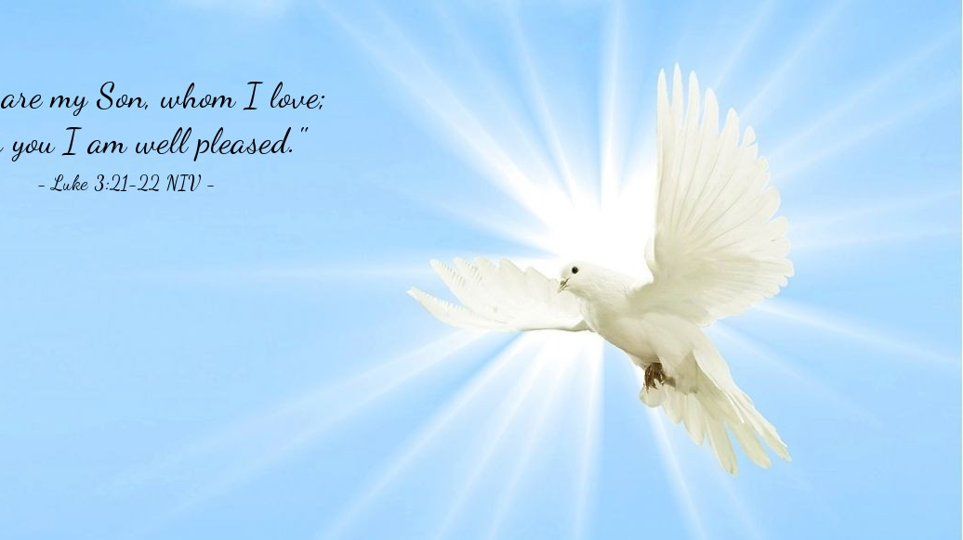
The Peace of Christ.
Sharing the Peace:
One: May the peace of Christ be with you.
Response: and also with you.
Response:
And also with you.
..
Notes:
Hymn Title Page

Slide 17

Acknowledging the Territories

Slide 18
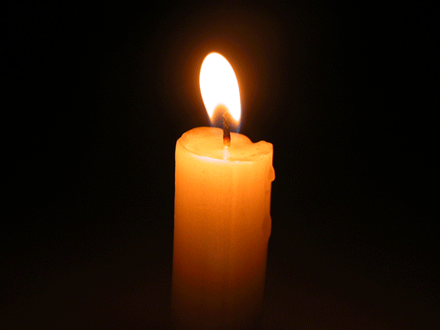
Lighting of the Christ Candle
.
“Then afterward I will pour out my spirit on all flesh; your children shall prophesy, your old men shall dream dreams, and your elders shall see visions."
— Joel 2:28

Slide 19
Call to Worship:
One: As sunlight dazzles on lakes and
sunsets blaze through the sky,
All: Let the brilliance of our
Creator God’s love guide us to
discover God’s way for us.

Slide 20
One: With the cry of a loon rising up
into the dusk or the shouts of children
playing in a field,
All: Let the melody of God’s love
sung through Jesus help us to
receive God’s word for us.

Slide 21
One: Like granite running jagged
through the hills or creeks flowing
from source to sea,
All: Let the presence of God’s
Spirit ground us so we may know
God’s strength within us.

Slide 22
Hymn: TLUS#138 Let’s Go Together Words: Laura Zelman Music: Mark A. Miller 2007 reprinted under OneLicense A-725110

Slide 23
Let’s go together for a while and ask where we begin-
to build a world where love can grow and hope can enter in.
To be the hands of healing
and to plant the seed of peace,

Slide 24
Singing welcome,
welcome to this place.
You’re invited to come and know God’s grace.
All are welcome, the love of God to share---
‘cause all of us are welcome here;
All are welcome in this place.

Slide 25
Let’s talk together of a time
When we will share a feast,
Where pride and power kneel to serve
The lonely and the least,
And joy will set the table
As we join our hands to pray,

Slide 26
Singing welcome,
welcome to this place.
You’re invited to come and know God’s grace.
All are welcome, the love of God to share---
‘cause all of us are welcome here;
All are welcome in this place.

Slide 27
Let’s dream together of the day
When earth and heav’n are one,
A city built of love and light,
The new Jerusalem,
Where mourning turns to dancing,
Ev’ry creature lifts its voice,

Slide 28
Singing welcome,
welcome to this place.
You’re invited to come and know God’s grace.
All are welcome, the love of God to share---
‘cause all of us are welcome here;
All are welcome in this place. *

Slide 29
Gathering Prayer
O God, who at Pentecost gave us
the gift of the Holy Spirit, and
who has brought us here now to
worship, grant us the help of the
same Spirit in all our lives and in
worship today that we may
expect great things from you and

Slide 30
attempt great things for you. Help
us to have visions and dreams for
the future of our church.
Amen.

Slide 31


Slide 32
Hymn: MV #156 Dance With The Spirit Vs 1,2,3
Words and Music Jim Strathdee © 1995 reprinted under OneLicense A-725110

Slide 33
Dance with the Spirit
early in the mornin’,
Walk with the Spirit
throughout the long day.
Work and hope
for the new life a-bornin’,
Listen to the Spirit
to show you the way.

Slide 34
Dance with the Spirit
early in the mornin’,
Move with the Spirit
throughout the long day.
Work and hope
for the new life a-bornin’,
Listen to the Spirit
to show you the way.

Slide 35
Dance with the Spirit
early in the mornin’,
Sing with the Spirit
throughout the long day.
Work and hope
for the new life a-bornin’,
Listen to the Spirit
to show you the way. *

Slide 36

Prayer for Illumination

Slide 37

Esther 4:10-17

Slide 38
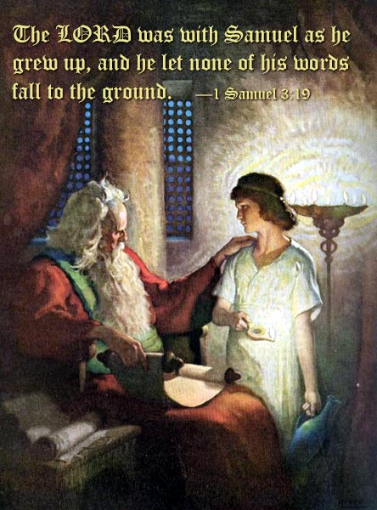
1 Samuel 3:1-19

Slide 39

Acts 2:14-17

Slide 40
Ministry of Music:
Dare to Dance (for Congregation and Choir)

Slide 41
Dare to dance with dreamers,
sing their song.
Dare to dance their stories,
sing out strong.
Dare to dance with freedom your whole life long.
Dare to dance again.
1

Slide 42
Dare to dance with dreamers,
sing their song.
Dare to dance their stories,
sing out strong.
Dare to dance with freedom your whole life long.
Dare to dance again.
2

Slide 43
(choir)
Free the captives, heal the blind.
Leave the fear of oppression
behind.
Walk on boldly , take a stand.
Let’s walk on New Jerusalem.

Slide 44
Dare to dance with dreamers,
sing their song.
Dare to dance their stories,
sing out strong.
Dare to dance with freedom your whole life long.
Dare to dance again.

Slide 45
(choir)
Break the silence, spread the word.
Let the voice of liberation be heard.
Walk on boldly, take a stand.
Let’s walk on New Jerusalem.

Slide 46
Dare to dance with dreamers,
sing their song.
Dare to dance their stories,
sing out strong.
Dare to dance with freedom your whole life long.
Dare to dance again. *

Slide 47
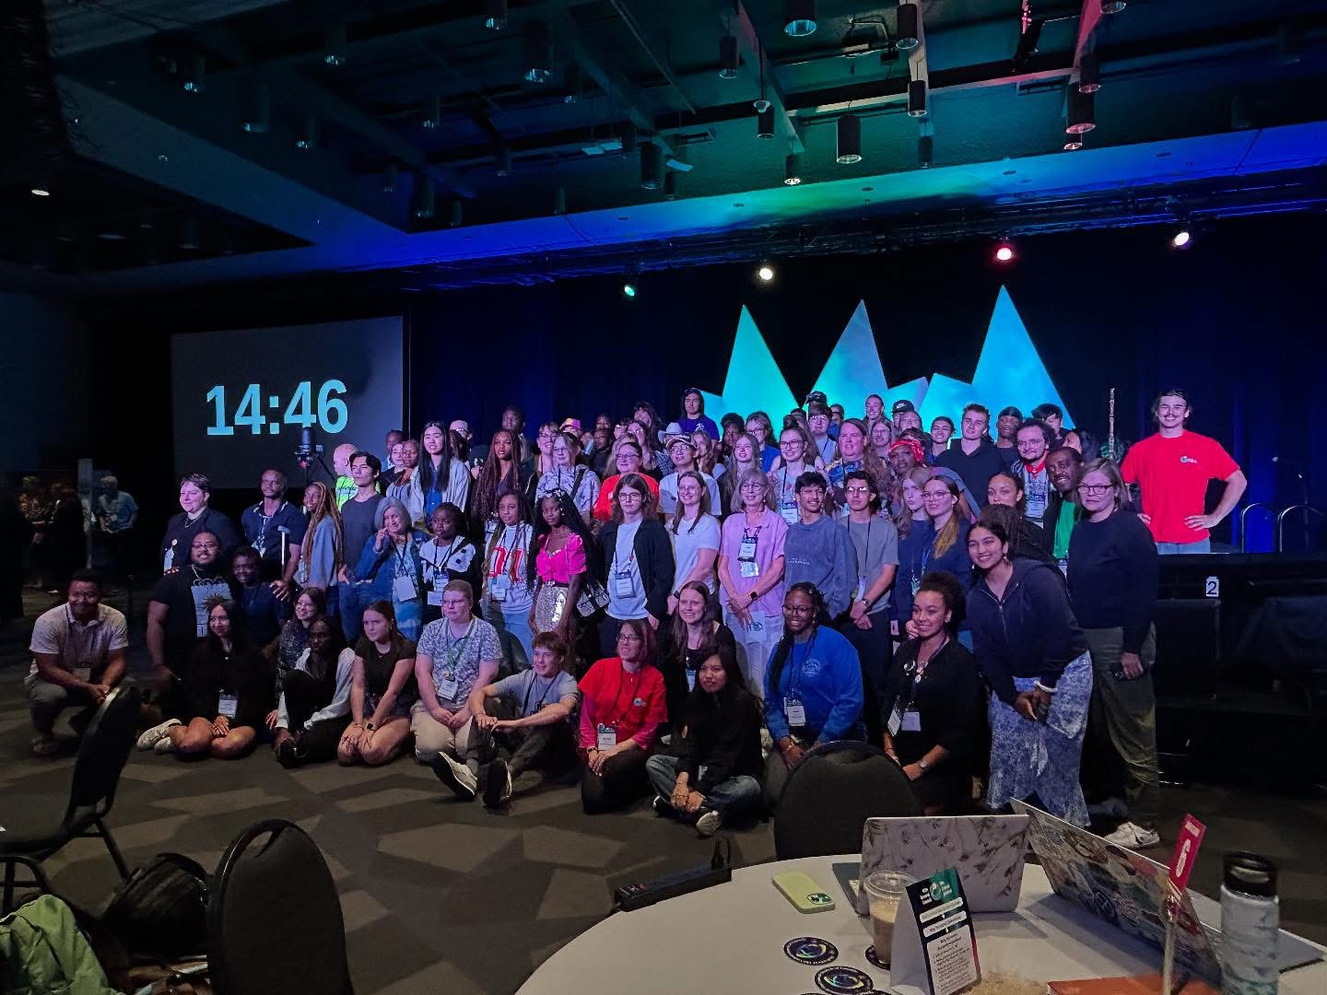
GC45 –
Samantha Corcoran

Slide 48
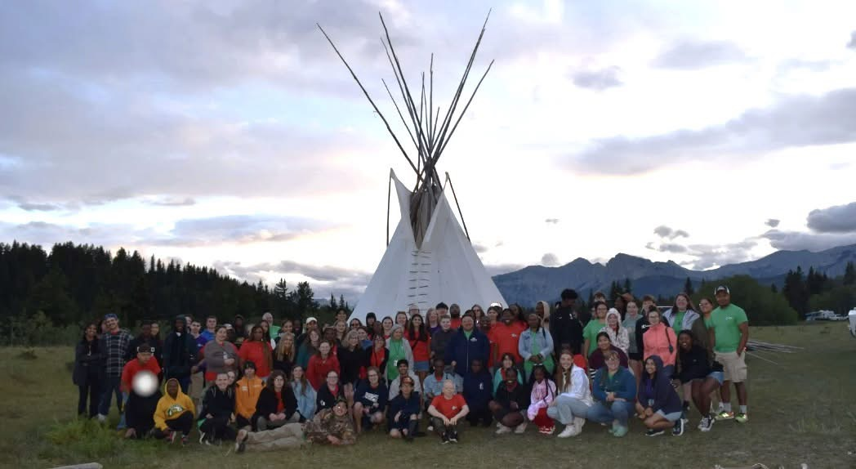
GC45 –
Daniel Carmichael

Slide 49
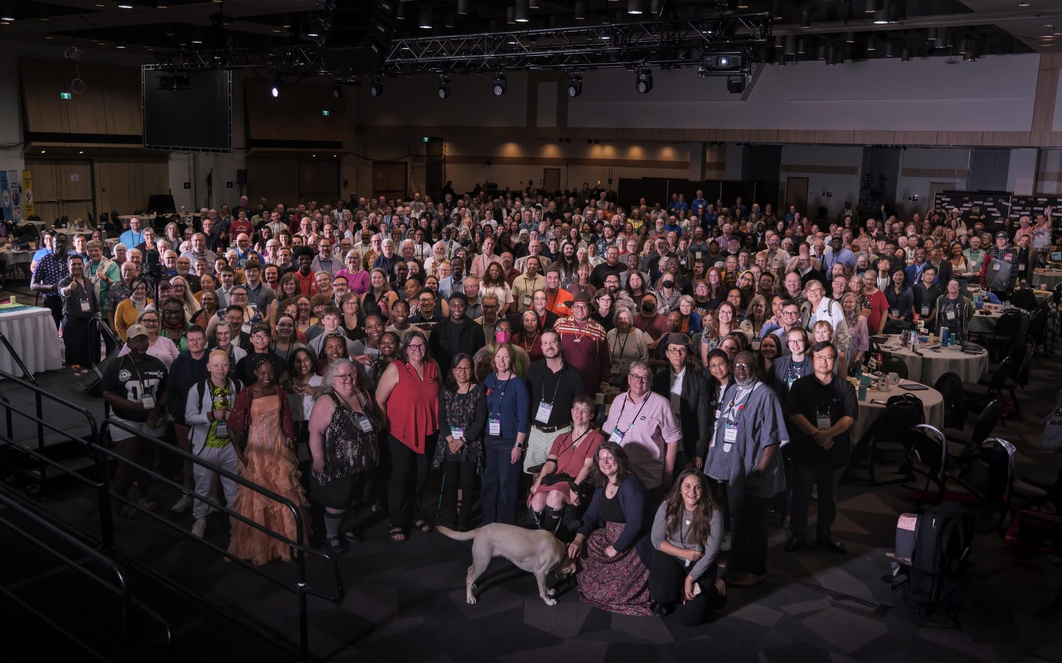
GC45 –
Lisa Folkins

Slide 50
Hymn: MV #145 Draw The Circle Wide
Words & Music Gordon Light 1994. reprinted under OneLicense A-725110

Slide 51
Draw the circle wide,
Draw it wider still,
Let this be our song,
no-one stands alone
Standing side by side,
Draw the circle wide.

Slide 52
God the still point of the circle
‘round whom all creation turns;
Nothing lost, but held forever
In God’s gracious arms.

Slide 53
Draw the circle wide,
Draw it wider still,
Let this be our song,
no-one stands alone
Standing side by side,
Draw the circle wide.

Slide 54
Let our hearts touch far horizons,
So encompass great and small,
Let our loving know no borders,
Faithful to God’s call.

Slide 55
Draw the circle wide,
Draw it wider still,
Let this be our song,
no-one stands alone
Standing side by side,
Draw the circle wide.

Slide 56
Let the dreams we dream be larger
Than we’ve ever dreamed before,
Let the dream of Christ be in us,
Open every door.

Slide 57
Draw the circle wide,
Draw it wider still,
Let this be our song,
no-one stands alone
Standing side by side,
Draw the circle wide. *

Slide 58
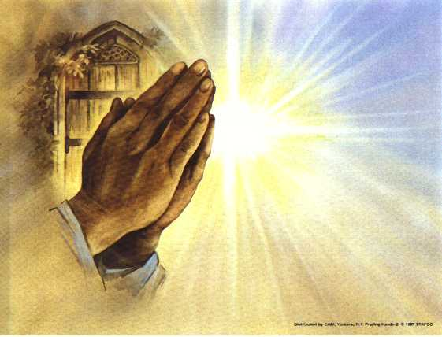
Prayers of
the People

Slide 59
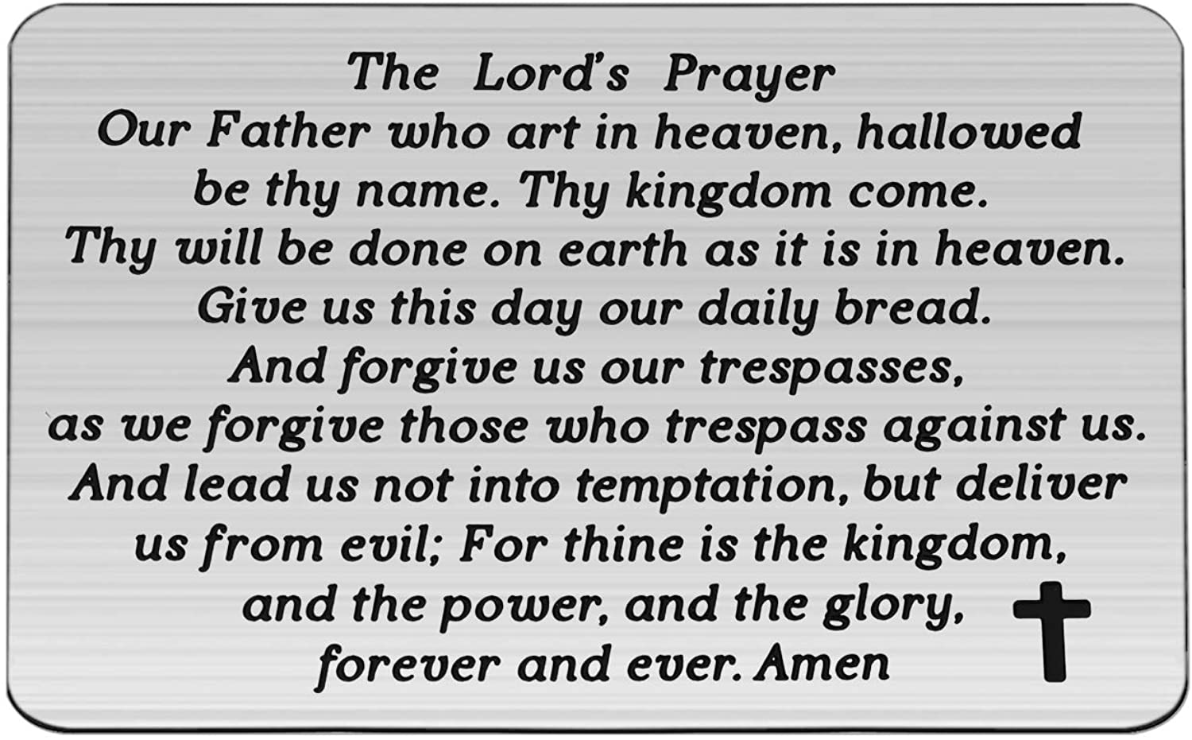

Slide 60
Support the ministry of St. Paul’s :
Through PAR – ask us how to join
via Canada Helps
search for St. Paul’s Sussex
via e-transfer to treasurerstpaulsucc1@gmail.com.
drop in collection plates located in the Narthex and near exit door
by mail to
4 Morrison Avenue, Sussex, N.B. E4E 1P5
during office hours
Notes:
Body text for hymns and prayers

Slide 61
Prayer of Dedication
All-embracing God, we praise you
for the blessings of love and care
that we have received. You do a
new thing in each of us. Your
Spirit enables us to do more than
we can possibly imagine.

Slide 62
So as we offer our gifts, we ask
that you bless them in Jesus’
name, that others may
understand and believe.
Amen.

Slide 63
Hymn: TLUS#100 In My Wrestling and In My Doubts (My Lighthouse)
Words and music: Gareth Gilkeson and Chris Llewellyn reprinted under OneLicense A-725110

Slide 64
In my wrestling
and in my doubts,
In my failures,
you won’t walk out.
Your great love
will lead me through,

Slide 65
You are the peace
in my troubled sea, woah oh,
You are the peace
in my troubled sea.

Slide 66
In the silence you won’t let go,
In the questions,
your truth will hold
Your great love will lead me through,

Slide 67
You are the peace
in my troubled sea, woah oh,
You are the peace
in my troubled sea.

Slide 68
My lighthouse, my lighthouse,
Shining in the darkness,
I will follow you. Oh
My lighthouse, my lighthouse,
I will trust the promise,
You will carry me safe to shore.....
Safe to shore.....
Safe to shore... Safe to shore.

Slide 69
I won’t fear
what tomorrow brings,
With each morning
I’ll rise and sing
My God’s love
will lead me through,

Slide 70
You are the peace
in my troubled sea, woah oh,
You are the peace
in my troubled sea.

Slide 71
My lighthouse, my lighthouse,
Shining in the darkness,
I will follow you. Oh
My lighthouse, my lighthouse,
I will trust the promise,
You will carry me safe to shore.....
Safe to shore.....
Safe to shore... Safe to shore.

Slide 72
Fire before us,
you’re the brightest
You will lead us
through the storms.
Fire before us,
you’re the brightest
You will lead us
through the storms . Hey!

Slide 73
Fire before us,
you’re the brightest
You will lead us
through the storms .
Fire before us,
you’re the brightest
You will lead us
through the storms . *

Slide 74
My lighthouse, my lighthouse,
Shining in the darkness,
I will follow you. Oh
My lighthouse, my lighthouse,
I will trust the promise,
You will carry me safe to shore.....
Safe to shore.....
Safe to shore... Safe to shore.

Slide 75
Benediction
&
Commissioning

Slide 76
Sung Benediction:
TLUS #4 Glory to The Creator
Words and Music: Christopher Grundy 2002 reprinted under OneLicense A-725110

Slide 77
Glory to the Creator,
And the Christ
and the Spirit so near,
As it was from the start
So it shall be forever one God,
Always here.

Slide 78
Glory to the Creator,
And the Christ
and the Spirit so near,
As it was from the start
So it shall be forever one God,
Always here. *

