Slide 1

St. Paul’s United Church Sussex, NB
September 7th, 2025
Thirteenth Sunday
after
Pentecost

Slide 2
Welcome!
We’re so glad you could join us

Slide 3
Meeting:
The Board will meet 6:30 Monday Sept. 8th

Slide 4
Sing sing sing!
Choir rehearsals will start Sept. 10 at 7pm
We will be happy to welcome new members.

Slide 5
Meeting:
St. Paul's Ladies meet in the Parlor at 1:30 Thursday, Sept. 11, for fellowship and tea. All welcome.

Slide 6
Meeting:
Youth Group starts this Friday, Sept 12.
6:30 – 8:00

Slide 7
Kick off Sunday:
September 14.
Blessing of the backpacks.
Bring a school or work related item to get a blessing.

Slide 8
Kick off Sunday:
September 14.
Service will be followed with a corn boil.

Slide 9
Looking for volunteers:
Sunday morning children and youth helpers. Sign up on the white board.

Slide 10
Sunday September 28
Orange Shirt Day! Wear an orange shirt.
Blessing of the Animals in the parking lot at 1pm.

Slide 11
Sign up now for fun in the future!
Church Buddies returns!!
Sign up on the white board.

Slide 12
Bible study
Bible study sessions will begin on September 24th and continue the last Wednesday of each month. 6:30 drop in.

Slide 13
Good News!

Slide 14

Prelude: As the Deer
Paul Baloche CCLI

Slide 15

The Peace of Christ.
Sharing the Peace:
One: May the peace of Christ be with you.
Response: and also with you.
Response:
And also with you.
..
Notes:
Hymn Title Page

Slide 16
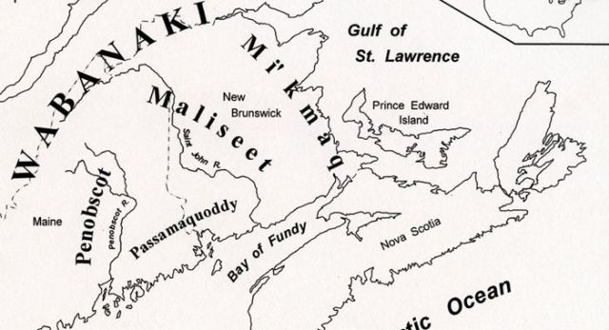
Acknowledging the Territories

Slide 17
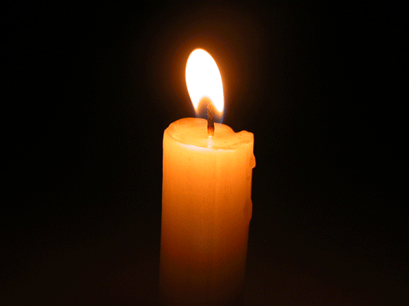
Lighting of the Christ Candle
.
Sing to the Lord, for he has triumphed gloriously.
- Excerpt from Miriam’s song found in
Exodus 15: v, 21

Slide 18
Call to Worship:
One: Joy comes to those who follow
God’s ways.
All: We will follow the Lord with
joyful hearts!
One: Those who follow the Lord are
like trees planted by the river,
bearing fruit each season.

Slide 19
All: May our lives be fruitful and
blessed by God!
One: Worship the Lord who leads us
to joy and abundance.
All: Let us worship God now and
throughout all our days.

Slide 20
Hymn: VU #820 Make a Joyful Noise
Words & Music: Linnea Good © 1991 reprinted under OneLicense A-725110

Slide 21
Make a joyful noise all the earth!
Worship your God with gladness.
Make a joyful noise all the earth.
Come to this place with a song!

Slide 22
Know that your God has made you.
Know it’s to God we belong.
And come to this place
with joyfulness and praise.
Worship your God with a song!

Slide 23
Make a joyful noise all the earth!
Worship your God with gladness.
Make a joyful noise all the earth.
Come to this place with a song!

Slide 24
Enter these gates, thanks giving.
Enter these courts with praise.
Sing thanks to your God
And bless the holy Name.
Worship your God with a song.

Slide 25
Make a joyful noise all the earth!
Worship your God with gladness.
Make a joyful noise all the earth.
Come to this place with a song!

Slide 26
Ages through endless ages,
Seasons of endless years,
The love of our Maker
Ever shall endure.
Worship your God with a song.

Slide 27
Make a joyful noise all the earth!
Worship your God with gladness.
Make a joyful noise all the earth.
Come to this place with a song! *

Slide 28
Gathering Prayer
God of all creation, you have
formed the world in beauty and
filled it with creatures of your
love and purpose. Each one
declares your praise – the
mountain states your majesty;
the ripened field, your generosity.

Slide 29
Birds flying aloft sing of your
freedom; the tiny ant works with
your persistence. And what do we
declare about you in our lives?
We pray that our work will
honour your justice and mercy;
may our relationships speak of
your love and compassion.

Slide 30
So may we praise you, O God, not
just in this hour of worship, but in
all our waking and our working.
Challenge us today to live out the
praise we offer you through the
grace of Jesus Christ and the
guidance of the Holy Spirit.

Slide 31

Caring for One Another

Slide 32
Hymn:
TLUS #72
Oh Let Us Breathe vs 1,2,3
Words and Music: Lori L. Earhardt reprinted under OneLicense A-725110

Slide 33
Oh, let us breathe,
Breathe and be together,
Breathe and be together,
Together now.
Oh, let us breathe,
Breathe and be together,
Breathe and be together,
As if we knew how.

Slide 34
Oh let us sing,
Sing by heart together,
Sing by heart together,
Together now.
Oh let us sing,
Sing by heart together,
Sing by heart together,
As if we knew how.

Slide 35
Oh let us arise,
Arise and shine together,
Arise and shine together,
Together now.
Oh let us arise,
Arise and shine together,
Arise and shine together,
As if we knew how. *

Slide 36

Prayer for Illumination

Slide 37
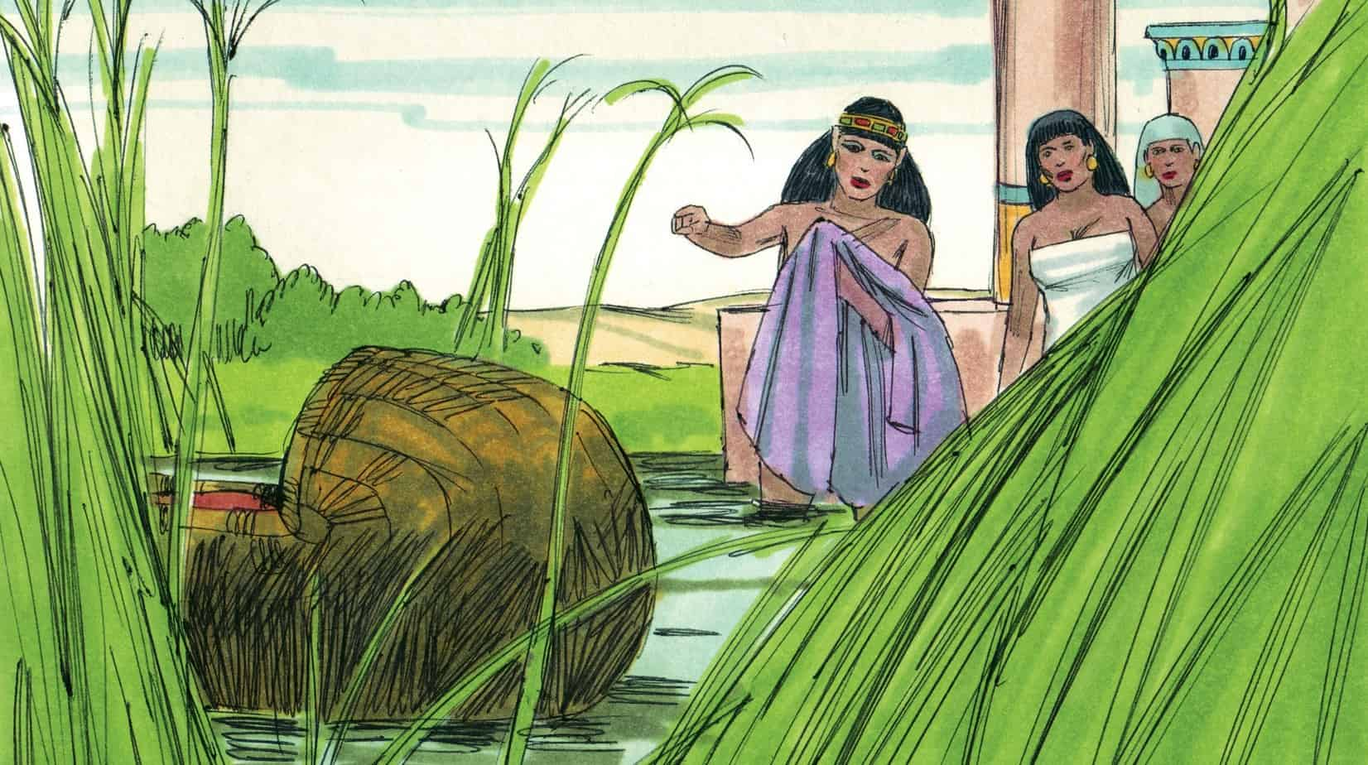
Exodus 2: 1-9

Slide 38
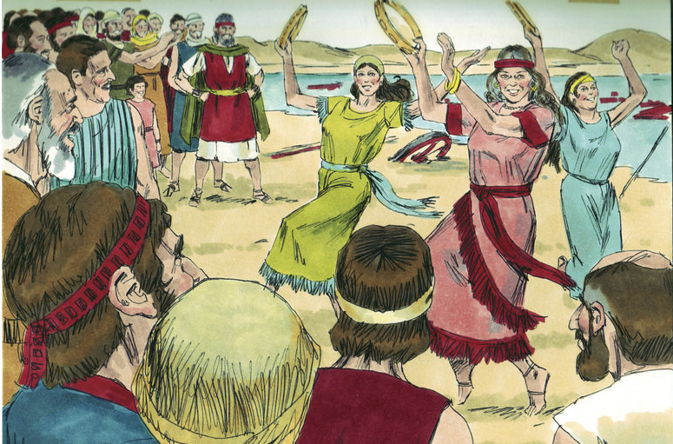
Exodus 15: 19-21

Slide 39
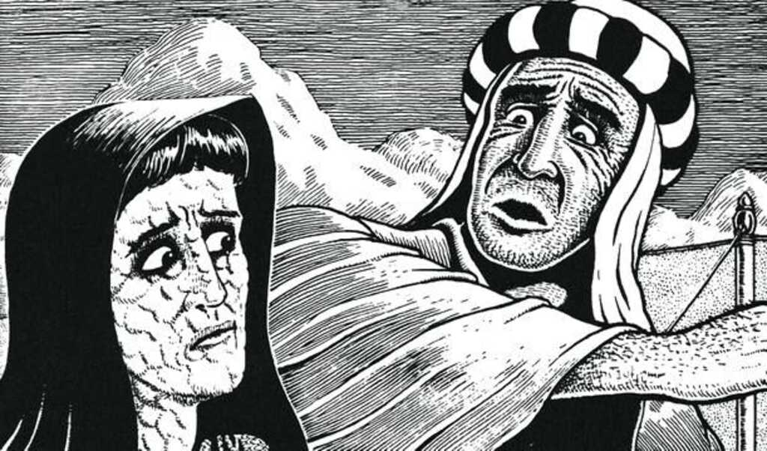
Numbers 12: 1,2,4, 10, 13, 15

Slide 40
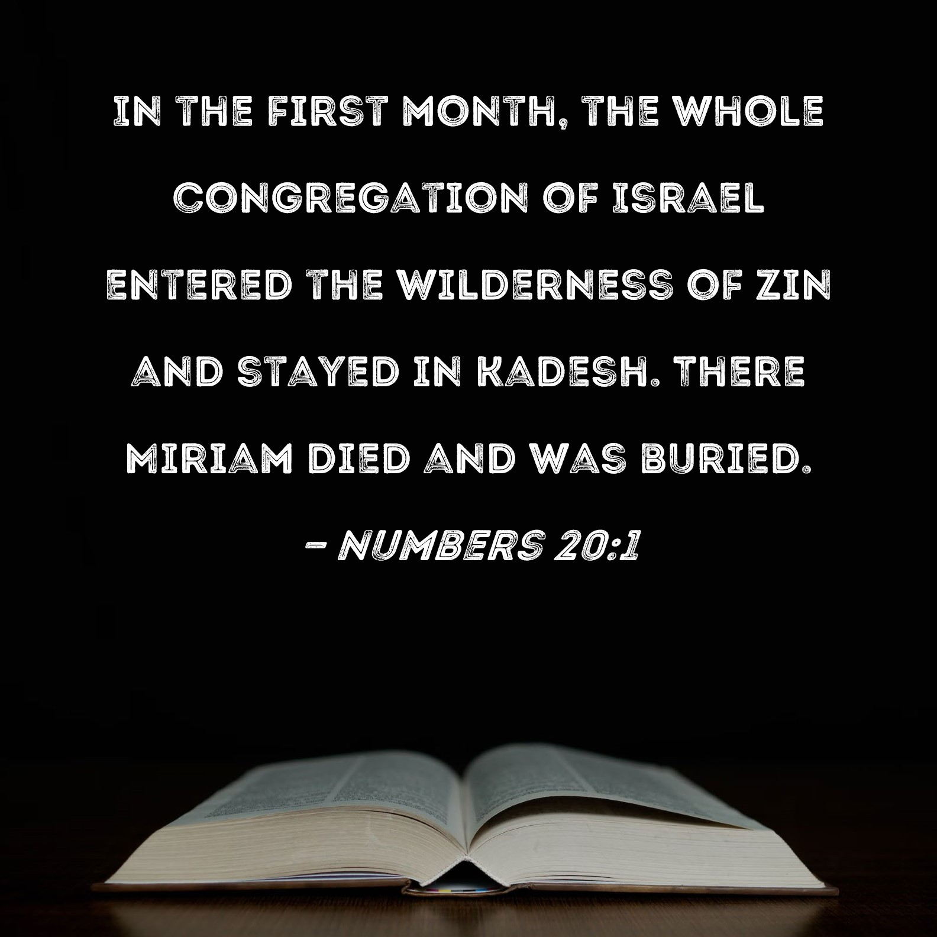
Numbers 20: 1

Slide 41
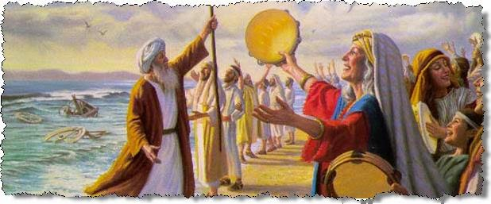
And Last but not Least

Slide 42
Hymn: MV #48
I Can Feel You Near Me God
Bruce Harding. reprinted under OneLicense A-725110

Slide 43
I can feel you near me God,
I can feel you near
Yes I know you’re with me God,
I feel you here
I can feel you near me God,
I can feel you near
Yes I know you’re with me God
Heaven is here.

Slide 44
And I’ll jump for joy
I’m singing Al-le-lu-ia
Jump for joy for you
I will jump for joy
I’m singing Al-le-lu-ia
Jump for joy for you.

Slide 45
I can feel you loving me,
Yes I know you care God
I know you’re loving me
Always everywhere
I can feel you loving me,
Yes I know you care God
I know you’re loving me
I know you’re there.

Slide 46
And I’ll jump for joy
I’m singing Al-le-lu-ia
Jump for joy for you
I will jump for joy
I’m singing Al-le-lu-ia
Jump for joy for you. *

Slide 47
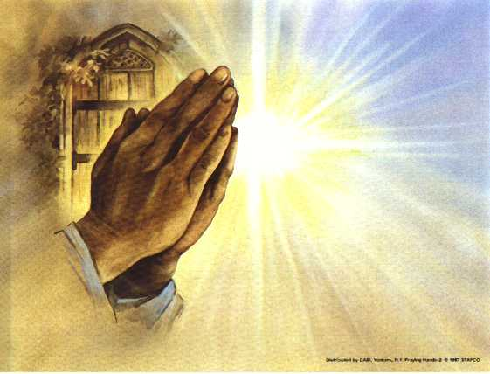
Prayers of
the People
One: fill our lives with what matters, O God.
All: Fill our lives with you.

Slide 48
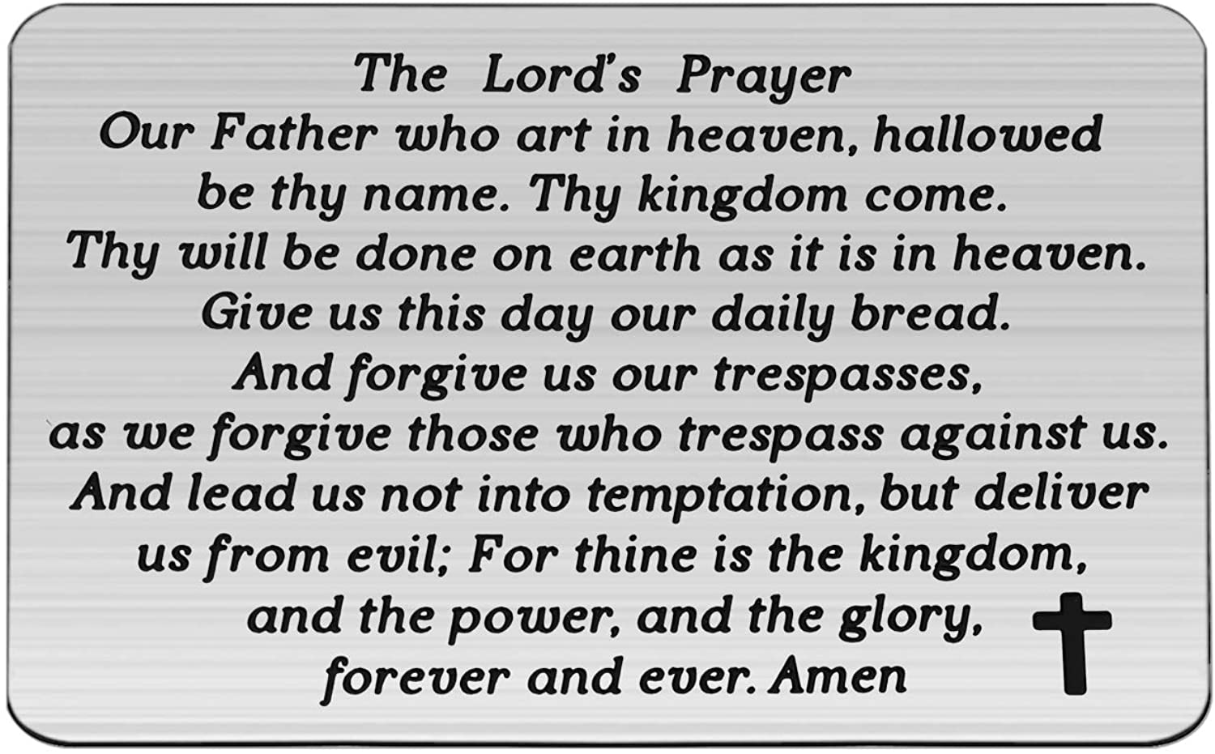

Slide 49
Support the ministry of St. Paul’s :
Through PAR – ask us how to join
via Canada Helps
search for St. Paul’s Sussex
via e-transfer to treasurerstpaulsucc1@gmail.com.
drop in collection plates located in the Narthex and near exit door
by mail to
4 Morrison Avenue, Sussex, N.B. E4E 1P5
during office hours
Notes:
Body text for hymns and prayers

Slide 50
Prayer of Dedication
O God, we offer these gifts to you.
Bless them and use them to heal
and reshape the world you love
with compassion and justice.
Amen.

Slide 51
Hymn: VU #884 You Shall Go Out With Joy 2x
Words Steffi G Rubin reprinted under OneLicense A-725110

Slide 52
You shall go out with joy
And be led forth with peace;
The mountains and the hills
Will break forth before you;
There'll be shouts of joy,
And all the trees of the field
Will clap, will clap their hands!

Slide 53
And all the trees of the field
will clap their hands, (clap, clap)
The trees of the field
will clap their hands, (clap, clap)
The trees of the field
will clap their hands (clap, clap)
While you go out with joy.

Slide 54
You shall go out with joy
And be led forth with peace;
The mountains and the hills
Will break forth before you;
There'll be shouts of joy,
And all the trees of the field
Will clap, will clap their hands!

Slide 55
And all the trees of the field
will clap their hands, (clap, clap)
The trees of the field
will clap their hands, (clap, clap)
The trees of the field
will clap their hands (clap, clap)
While you go out with joy. *

Slide 56
Benediction
&
Commissioning

Slide 57
Sung Benediction:
TLUS #72 Oh Let Us Breathe vs 4,5
Words and Music: Lori L. Earhardt reprinted under OneLicense A-725110

Slide 58
Oh let us pray,
Pray for peace together,
Pray for peace together,
Together now.
Oh let us pray,
Pray for peace together,
Pray for peace together,
As if we knew how.

Slide 59
Oh let us live,
Live in love together,
Live in love together,
Together now.
Oh let us live,
Live in love together,
Live in love together,
As if we knew how. *

